Slide 1


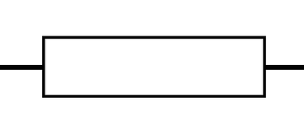


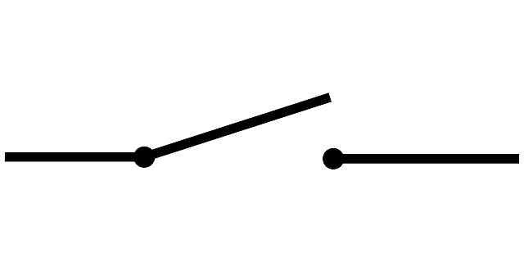
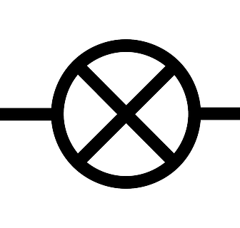

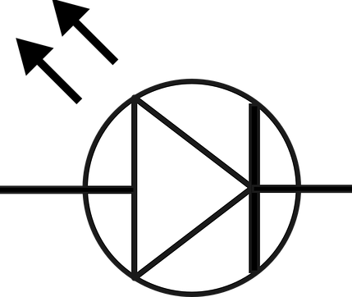
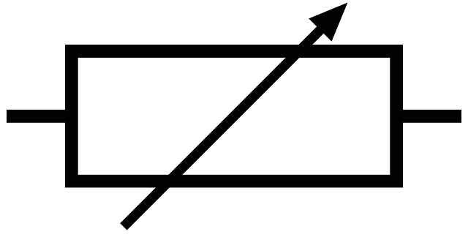
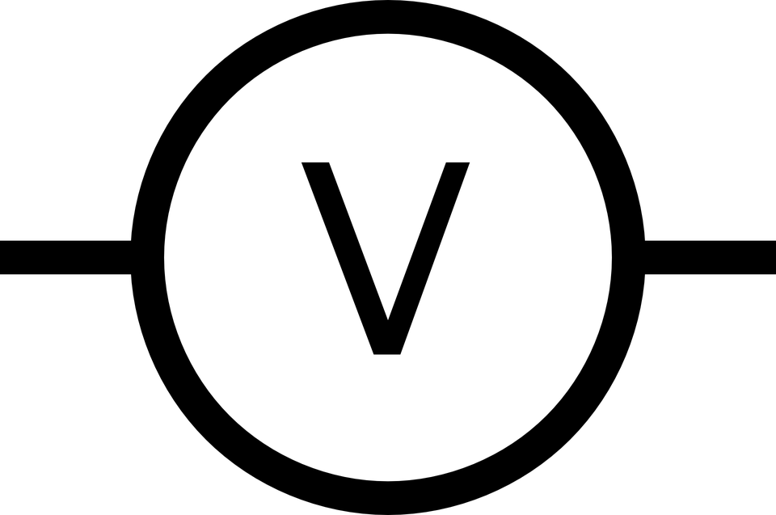

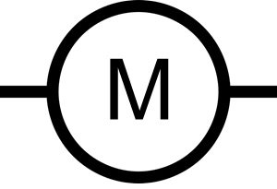

Mission Assignment: Describe an electric circuit and its parts
KS3-22-01
Circuit Symbols
Identify the following circuit symbols. You may use a name more than once.
Word bank
ammeter battery bulb buzzer cell lamp
LED motor resistor switch voltmeter
What three things do all circuits need to work?
______________________________________________________________________________________________________________________________________________________________________
A student connects a bulb and a cell together with one piece of wire in a line. Explain why the bulb does not light up.
_________________________________________________________________________________________________________________________________________________________________________________________________________________________________________________________
Look at the symbol for a switch above. Suggest why it has been drawn this way and what it shows.
_________________________________________________________________________________________________________________________________________________________________________________________________________________________________________________________
Developing Experts Copyright 2023 All Rights Reserved

Slide 2
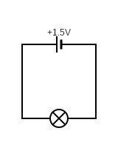
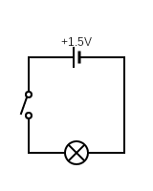
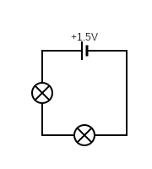
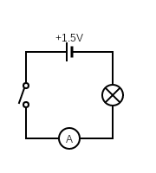
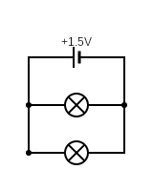
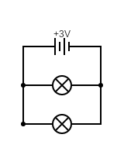
Mission Assignment: Describe an electric circuit and its parts
KS3-22-01
Circuit Symbols
Build the following circuits from the diagrams below.
a
b
c
d
e
f
Describe each circuit you have built. Include any observations that you make.
______________________________________________________________________________________________________________________________________________________________
______________________________________________________________________________________________________________________________________________________________
______________________________________________________________________________________________________________________________________________________________
______________________________________________________________________________________________________________________________________________________________
______________________________________________________________________________________________________________________________________________________________
______________________________________________________________________________________________________________________________________________________________
Developing Experts Copyright 2023 All Rights Reserved

Slide 3
Mission Assignment: Describe an electric circuit and its parts
KS3-22-01
Circuit Symbols
In the box below, design your own circuit.
Before you build your circuit, make a prediction of what will happen to each component.
____________________________________________________________________________________________________________________________________________________________________________________________________________________________________________________________________________________________________________________________________________
Was your prediction correct? Why?
____________________________________________________________________________________________________________________________________________________________________________________________________________________________________________________________________________________________________________________________________________
Developing Experts Copyright 2023 All Rights Reserved

Slide 4
Mission Assignment: Describe an electric circuit and its parts
ANSWERS
KS3-22-01
Circuit Symbols
Identify the following circuit symbols. You may use a name more than once.
  battery cell switch resistor
  bulb bulb LED variable resistor
  voltmeter ammeter motor buzzer
Word bank
ammeter battery bulb buzzer cell lamp
LED motor resistor switch voltmeter
What three things do all circuits need to work?
______________________________________________________________________________________________________________________________________________________________________
A student connects a bulb and a cell together with one piece of wire in a line. Explain why the bulb does not light up.
_________________________________________________________________________________________________________________________________________________________________________________________________________________________________________________________
Look at the symbol for a switch above. Suggest why it has been drawn this way and what it shows.
_________________________________________________________________________________________________________________________________________________________________________________________________________________________________________________________
  A power source, a component and conductors.
  The circuit must be connected in a continuous loop. Connecting components in a line is an incomplete circuit.
  The switch symbol is an open switch. It shows two wires that are not touching to show there is a break in the circuit and that it won’t turn on.
Developing Experts Copyright 2023 All Rights Reserved

