Slide 1

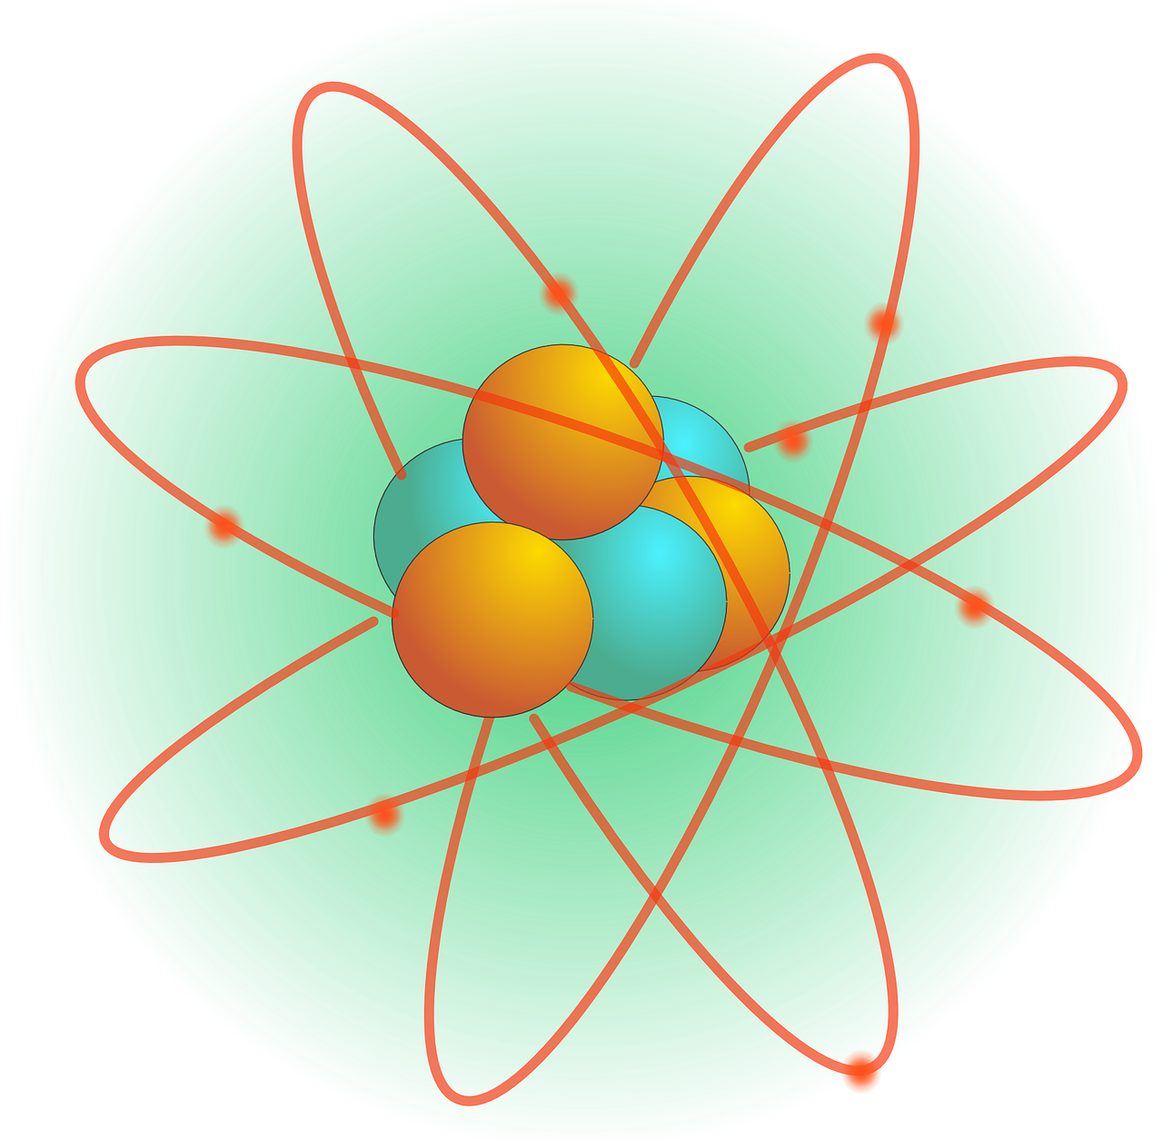
0001.01
Mission Assignment
Task | Make a periodic table to refer to as a revision guide. Ensure that you record the atomic number and the atomic mass on the table.
Developing skills | Practise calculating the number of neutrons each element contains by subtracting the atomic number from the atomic mass.
Think about… | How scientists proposed atomic and sub-atomic theories and hypotheses without visual evidence and proof.
KS4-21-01:
Explore inside atoms

