Slide 1




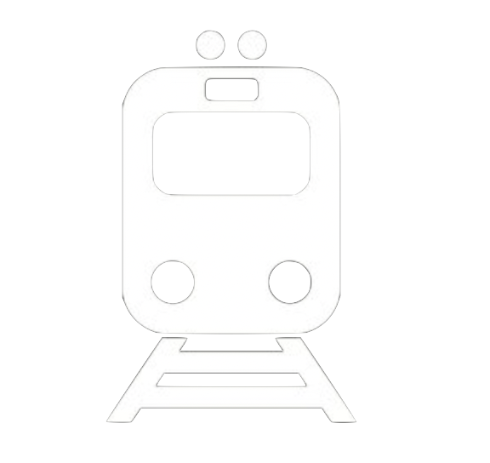


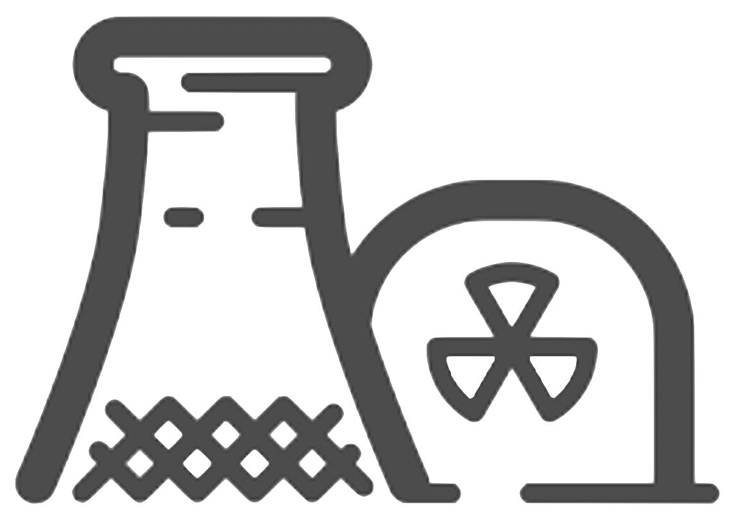

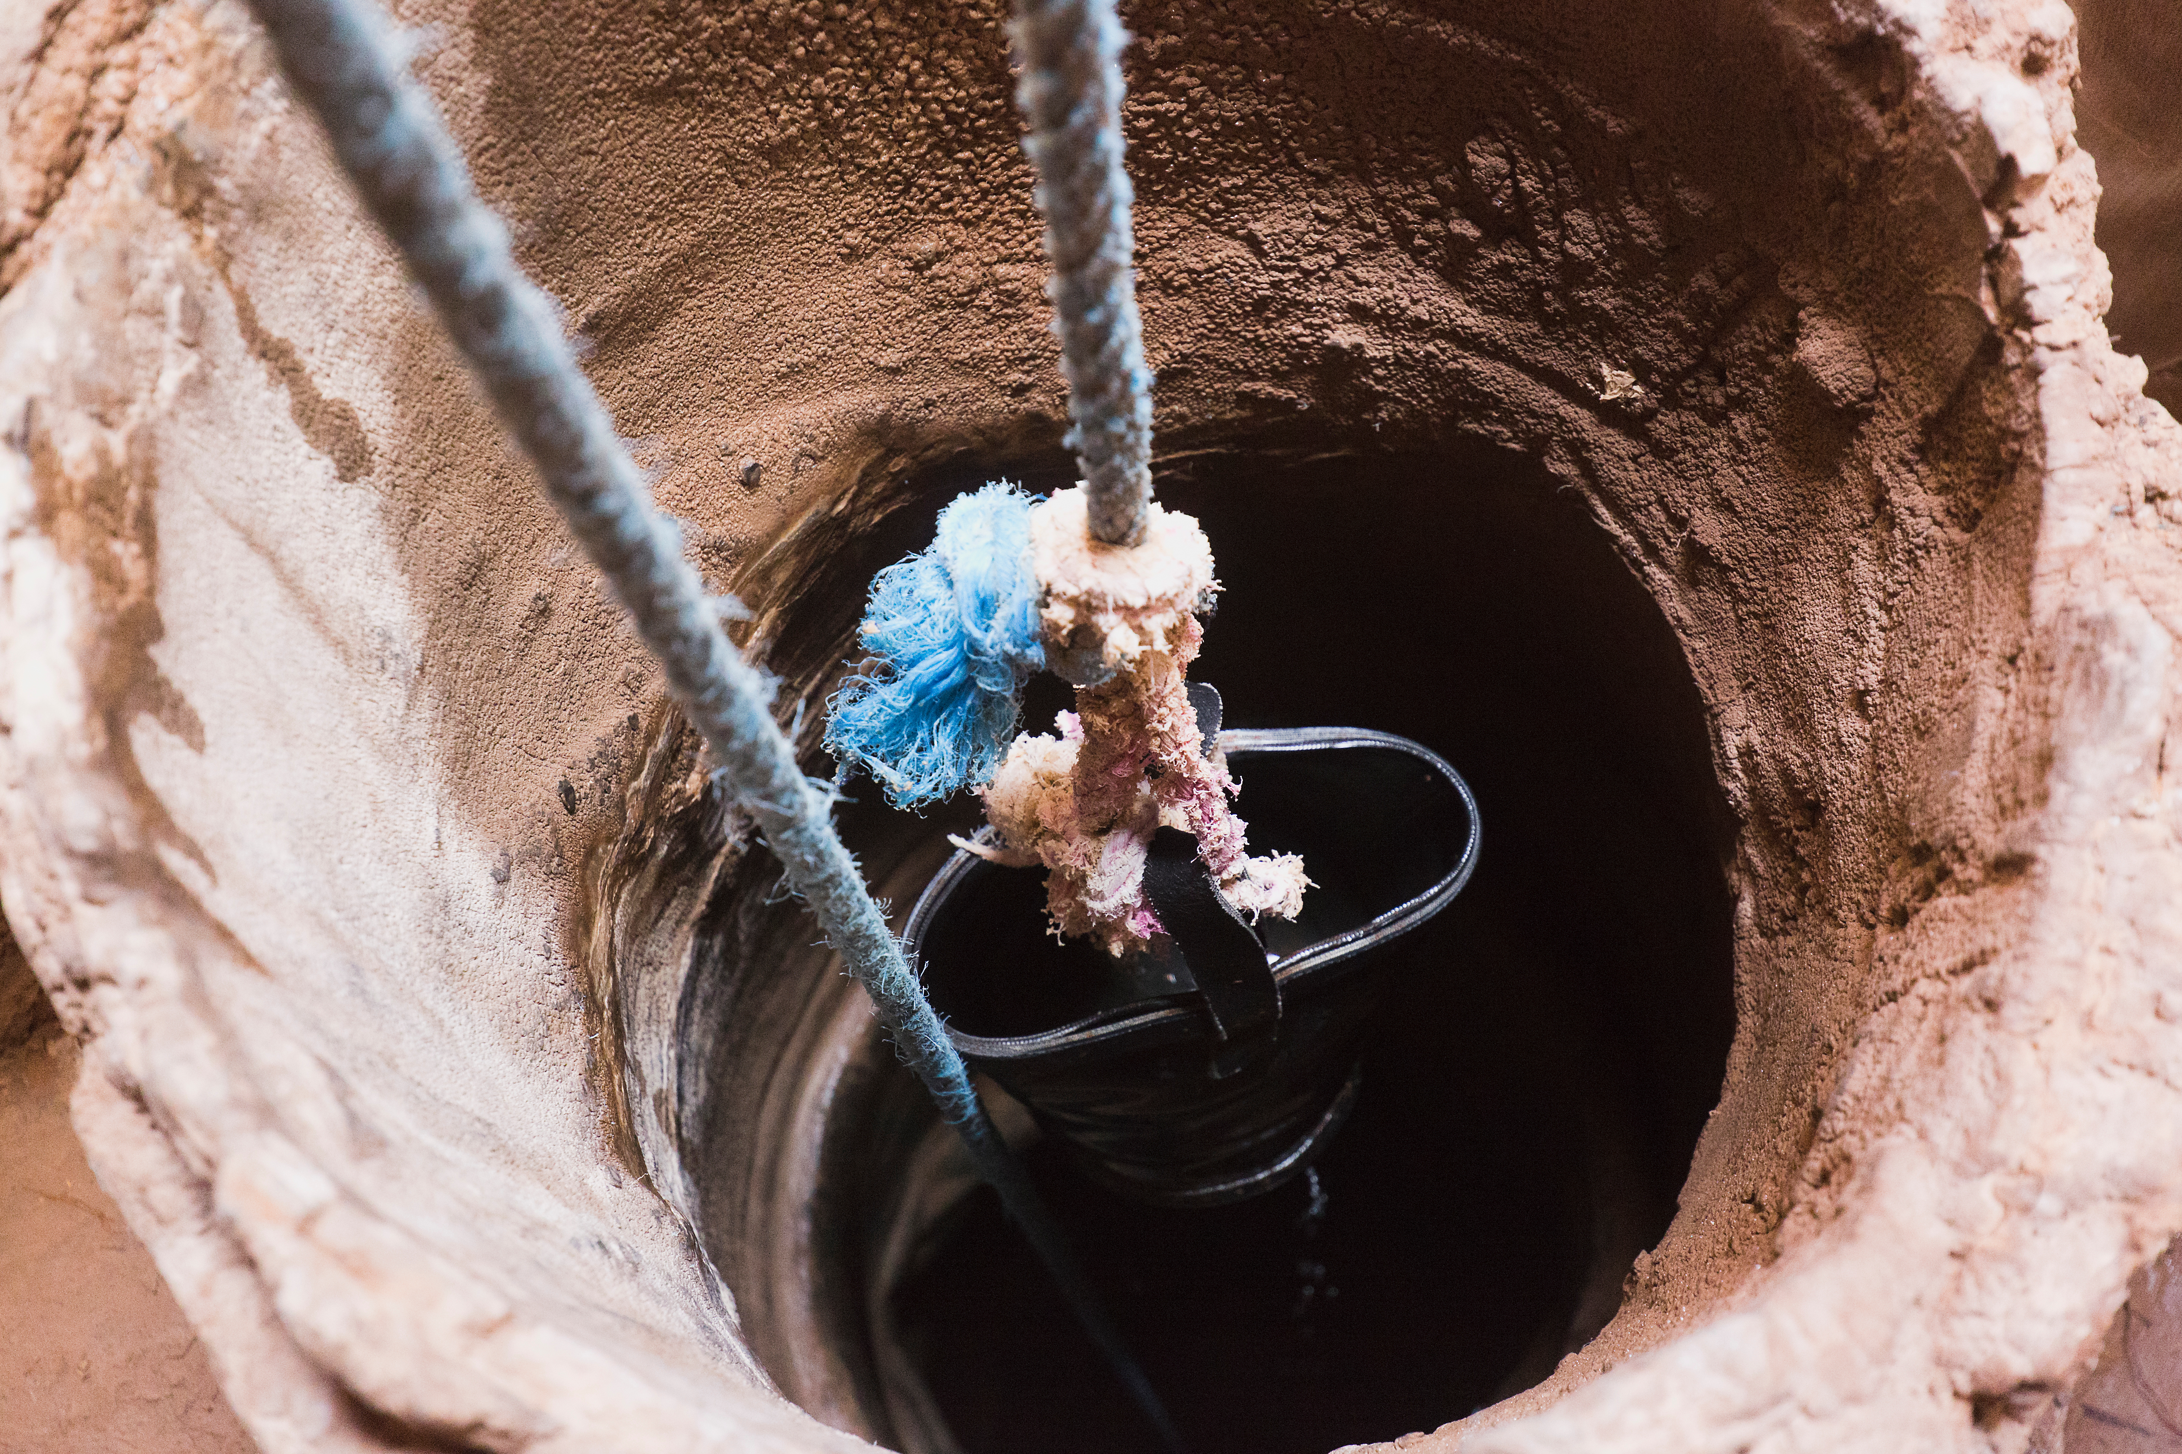
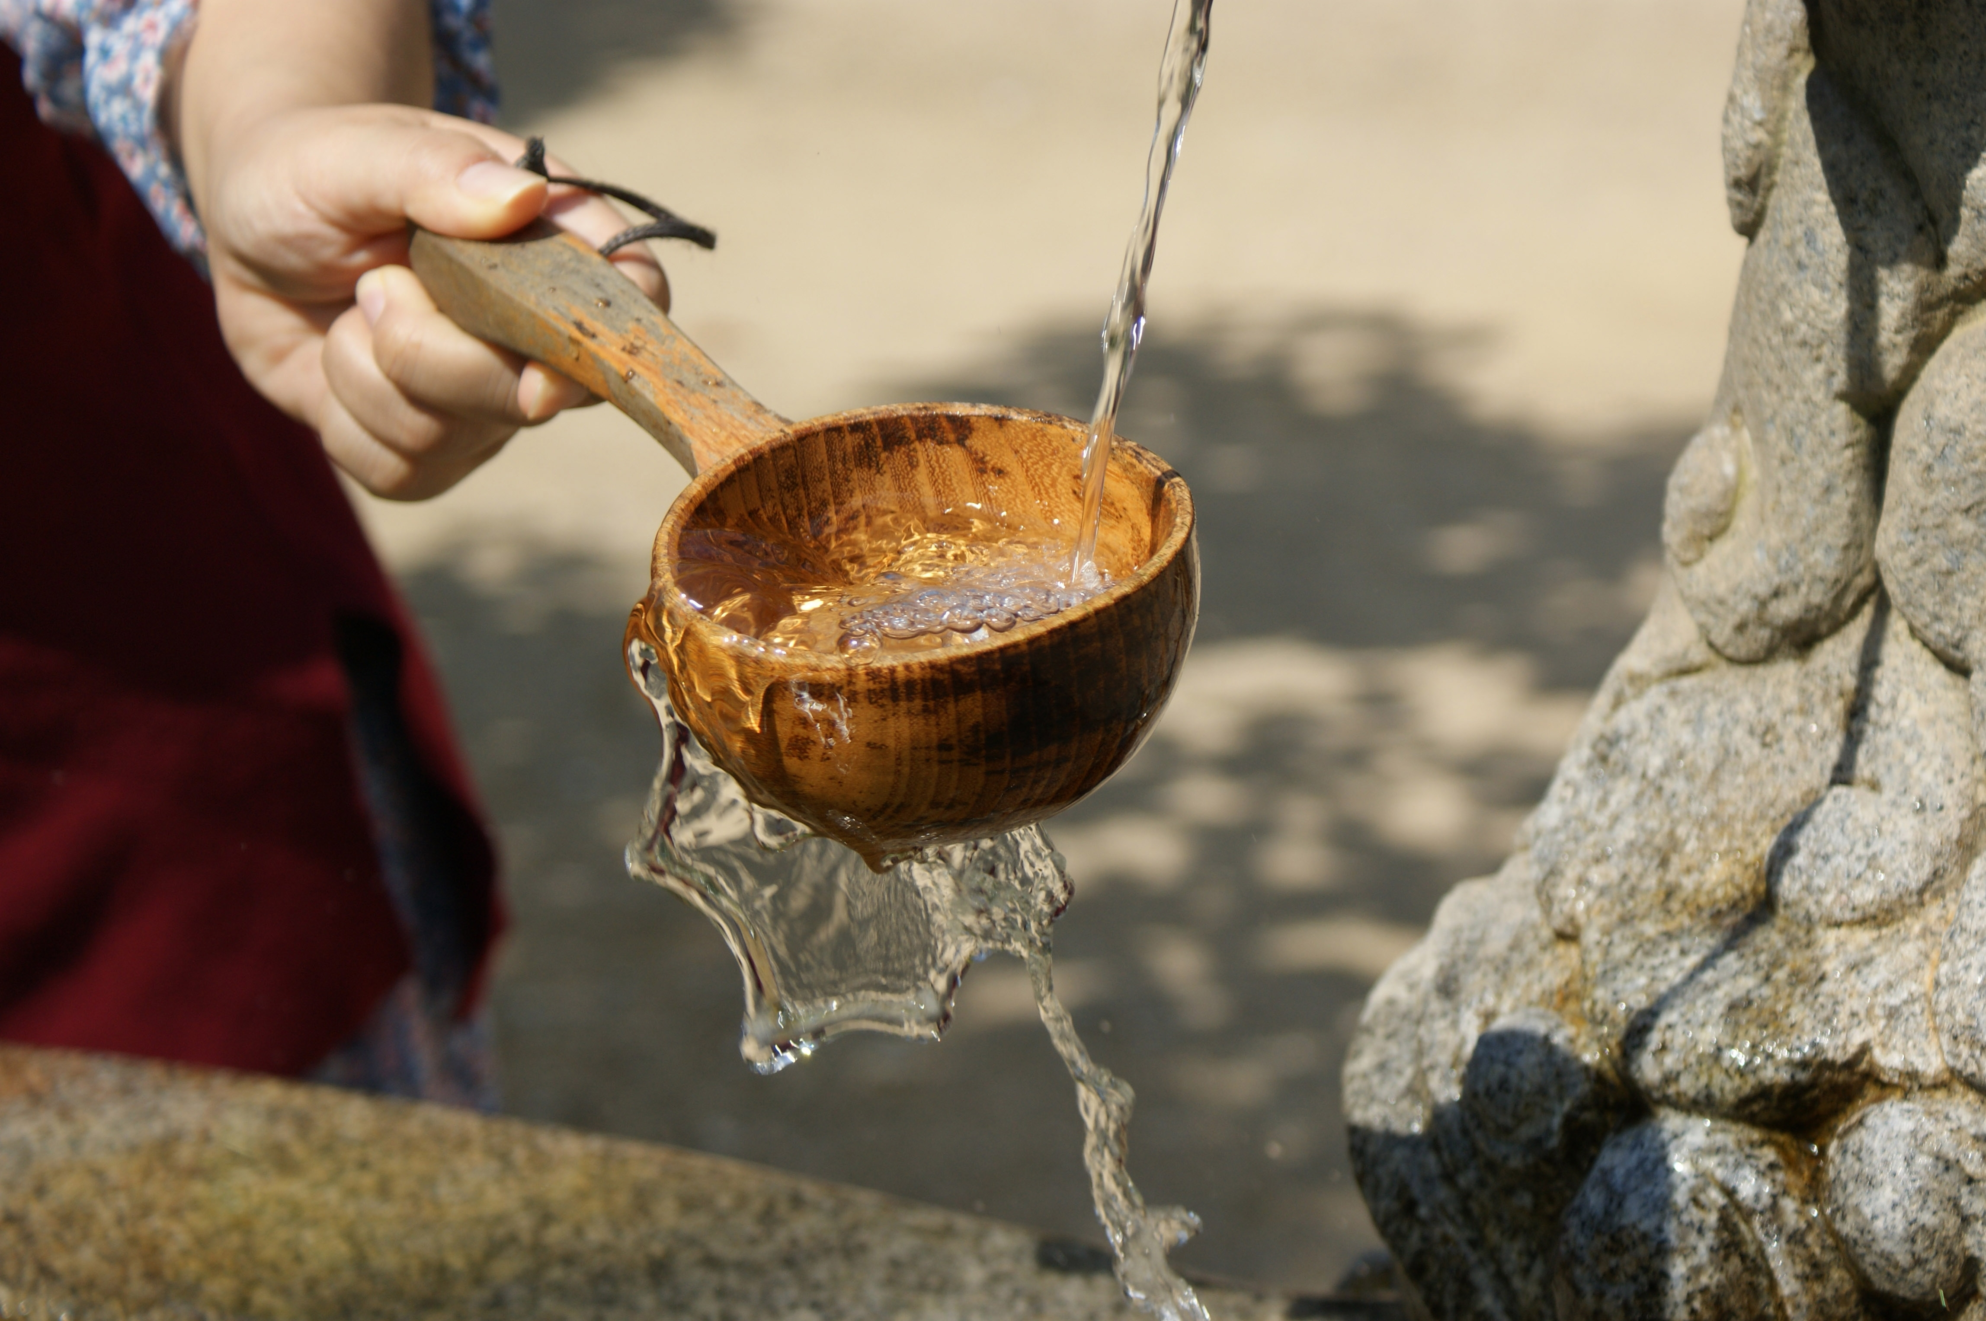
Mission Assignment: Explore Climate Change and Water
MA Code: N22.KS3.07
Try to collect enough water for your household before your ‘school day’ begins.
Step 1: Divide into 5 groups, each with a number. Each group will represent a different household from an African village. Then, distribute two 1 cup container to each group. These cups will represent your water buckets. Pour half a cup of vegetable oil on top of the water in the jar.
Step 2: Each household has about 5 people, so each group needs to gather at least 5 “buckets” of water for survival. However, they would need 10 buckets to maintain good health. Therefore, five buckets may jeopardize someone’s life. Since you only have 2 buckets per household, this will obviously take more than one trip. Each household has a cistern with your group number on it (the litre jugs, located in the classroom), where you can dump the water when you get back home.
Step 3: For sanitation reasons, the community has agreed that a ladle is the only thing that will touch the water. If the water source gets contaminated, everyone gets sick. Also, waiting in line for the well is part of the water-gathering process for many people.
Step 4: Before you begin carrying your water, know that your “school day” begins in 5 minutes.
Step 5: Go to your household’s “cistern” (gallon jug). Count down the time until the start of the school day.
Developing Experts Copyright 2022 All Right Reserved

