Slide 1
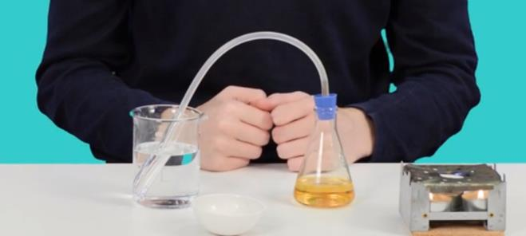
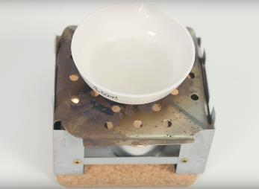
Mission Assignment: Show how mixtures can be separated using evaporation and distillation
KS3-06-05
You are going to evaporate and distil two mixtures to compare their similarities and differences.
Task 1: Distilling the essence of apple juice
Method
Pour 50 ml of apple juice into a conical flask.
Place a bung in the top with a delivery tube leading out of it.
Fill a beaker with cold water and place a test tube in it, making sure no water goes into the tube.
Place the end of the delivery tube into the test tube.
Heat the apple juice in the conical flask. You can use a Bunsen burner (on a small blue flame, with the collar open and the gas down) to do this, or you could use some tealights on a tripod.
Task 2: Evaporating saltwater
Method
Make a solution of saltwater, make sure that it is a concentrated solution, but not saturated.
Pour your solution into an evaporating dish.
Heat the solution, using the Bunsen burner or tealights as you did in Task 1.
Leave the dish on the heat until all the water has evaporated.
Equipment
Distilling the essence of apple juice:
50 ml of apple juice
Conical flask
Delivery tube
Beaker
Water
Test tube
Evaporating saltwater:
Water
Salt
Evaporating dish
Both tasks:
Bunsen burner (or tealights)
Tripod
Safety goggles
Developing Experts Copyright 2023 All Rights Reserved

Slide 2
Mission Assignment: Show how mixtures can be separated using evaporation and distillation
KS3-06-05
Questions
What liquid was collected in the test tube? ___________________________________________________________
What happened to the colour of the liquid in the conical flask? Why do you think this happened? __________________________________________________________________________________________________________________________________________________________________
Why did you heat the evaporating dish with the solution in it? Would the saltwater solution have evaporated if it had not been heated? Explain your answer. ___________________________________________________________________________________________________________________________________________________________________________________________________________________________________________________
What was left behind in the evaporating dish? _________________________________________________________________________________
What process was being utilised in both the distillation and evaporation to separate the mixtures? _________________________________________________________________________________
What was the additional process called that was in the distillation which allowed the vapour to be captured? _________________________________________________________________________________
Fill out the table below, explaining the differences and similarities between evaporation and distillation.
Similarities | Differences
Developing Experts Copyright 2023 All Rights Reserved

Slide 3
Mission Assignment: Show how mixtures can be separated using evaporation and distillation ANSWERS
KS3-06-05
Questions
1. What liquid was collected in the test tube?
The essence of apple juice.
2. What happened to the colour of the liquid in the conical flask? Why do you think this happened?
It became darker, because the liquid being evaporated was clear. Therefore the remaining mixture became more concentrated, resulting in a darker colour.
3. Why did you heat the evaporating dish with the solution in it? Would the saltwater solution have evaporated if it had not been heated? Explain your answer.
The dish was heated to speed up the investigation. The water would have evaporated without any heat because the intermolecular forces between the water molecules do not need that much energy to be broken and for water to evaporate.
4. What was left behind in the evaporating dish?
Salt (crystals).
5. What process was being utilised in both the distillation and evaporation to separate the mixtures?
Evaporation.
6. What was the additional process called that was in the distillation which allowed the vapour to be captured?
Condensation.
7. Fill out the table below, explaining the differences and similarities between evaporation and distillation.
Similarities | Differences
They are both methods used to separate mixtures. In this mission assignment, both used heat to evaporate parts of a mixture. | The evaporated liquid is captured and condensed in distillation. In an evaporation, the vapour is lost. Evaporation happens naturally, where as distillation is a man-made process. When a mixture is being evaporated, it does not need to be heated, but a distillation always needs heat adding to it.
Developing Experts Copyright 2023 All Rights Reserved

