Slide 1

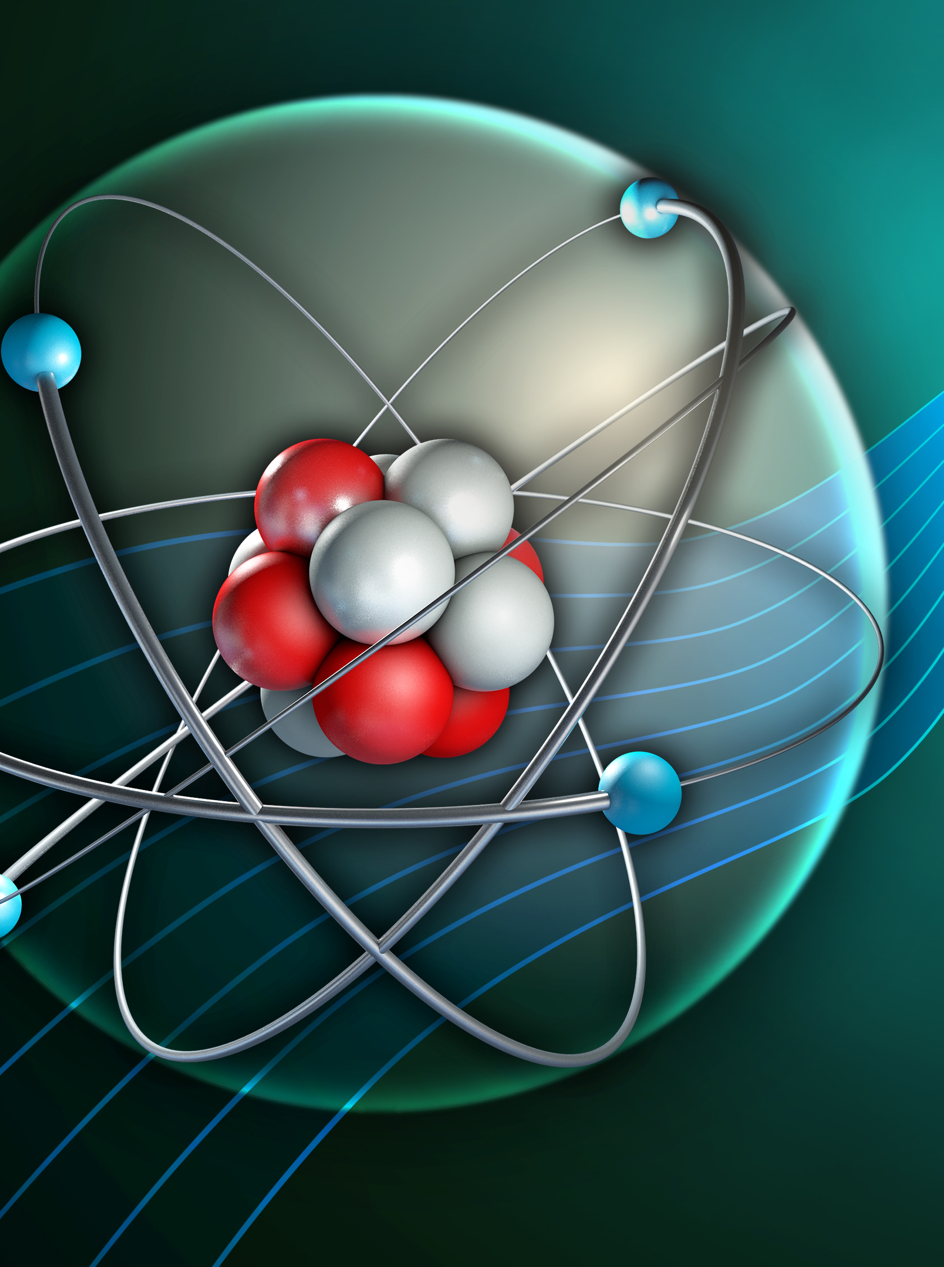
0001.01
Mission Assignment
Task | Go online and research the 38 radioactive elements and make a table of these against the periodic table of elements.
Developing skills | Practise nuclear equations. Learn the alpha and beta rule. Check your results against the periodic table.
Think about… | How elements transition to other elements because of radioactive decay.
KS4-21-07:
Explore Nuclear Equations

