Slide 1

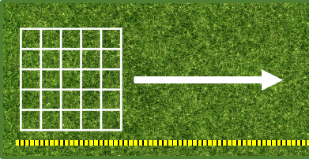
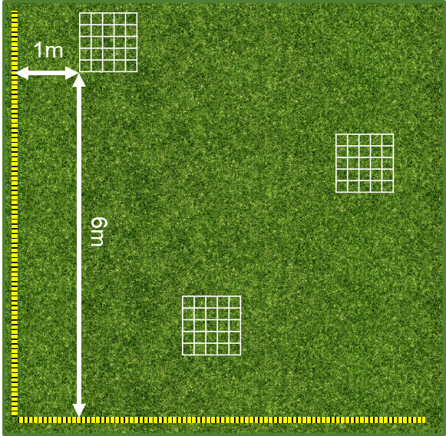
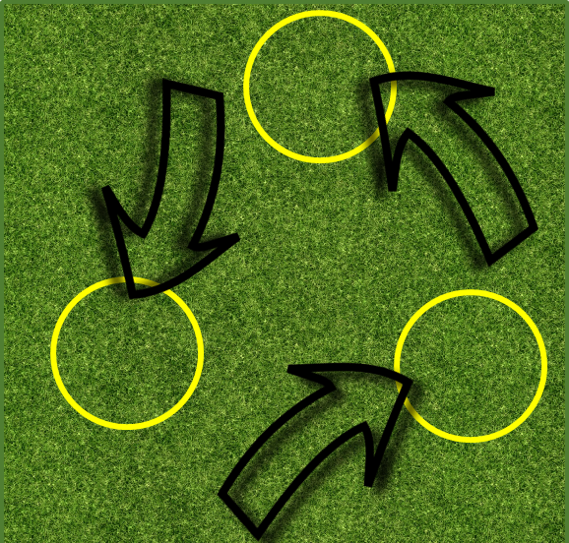
Mission Assignment: Explain the importance of maintaining biodiversity
KS3-20-06
Sampling biodiversity
You are going to try three different methods to measure biodiversity and then evaluate each method for how accurate and reliable it is.
Sampling
Sampling is the name given to counting the number of different species and the number of individuals within each species. When the methods ask you to sample, you must count the number of individuals in the 5 most dominant species i.e. approximately 22,500* grass blades, 24 daisies, 10 dandelions , 9 buttercups, 3 mosses.
*count the number in one small square and multiply by the number of squares
Quadrat and transect
A transect is a fixed line that you sample along.
Mark out a straight transect line using a
long measuring tape. The line should be
several metres long.
Place a quadrat at one end of the transect
line and sample the contents of the quadrat.
Then move the quadrat along the transect at
regular intervals, sampling each time.
B. Quadrat and coordinates
1. Mark out two straight transect lines using
long measuring tapes, from the same point,
so that they are perpendicular to each other.
The lines should be several metres long.
2. Using a random number generator,
generate some coordinates. Then, place the
bottom left hand corner of the quadrat at the
coordinates, i.e. a 1 and 6 would mean you place
the quadrat at the point of 1m and 6m.
3. Sample the contents of the quadrat, then
move it to the next set of randomly
generated coordinates.
C. Throwing the hula-hoop
1. Stand near the spot you want to sample. Check there is
no one in front of you, close your eyes and gently throw the
hula hoop.
2. Sample the contents of the hula hoop, then from that location
throw the hula hoop again, sampling at the next location.
Developing Experts Copyright 2023 All Rights Reserved

Slide 2
Mission Assignment: Explain the importance of maintaining biodiversity
KS3-20-06
Evaluating sampling
1. Which method do you think most accurately measures biodiversity?
Explain your idea.
____________________________________________________________________________________________________________________________________________________________________
2. Which method do you think least accurately measures biodiversity?
Explain your idea.
____________________________________________________________________________________________________________________________________________________________________
3. How does the quadrat being divided into smaller squares help with counting species?
____________________________________________________________________________________________________________________________________________________________________
4. The transect method is an example of systematic sampling, whereas the hula hoop is an example of random sampling. Give an advantage for both random and systematic sampling.
Random ______________________________________________________________________________________________________________________________________________________________
Systematic ______________________________________________________________________________________________________________________________________________________________
5. What safety considerations must you think about when sampling.
_____________________________________________________________________________________________________________________________________________________________________________________________________________________________________________
6. Explain why it would be challenging to use these methods to sample plant species in ponds or lakes.
______________________________________________________________________________________________________________________________________________________________________________________________________________________________________________________
7. Challenge question: Can you calculate the total number of each species you sampled in the area you sampled? Do you think this is representative of the actual number and why? ______________________________________________________________________________________________________________________________________________________________________________________________________________________________________________________
Developing Experts Copyright 2023 All Rights Reserved

Slide 3
Mission Assignment: Explain the importance of maintaining biodiversity
ANSWERS
KS3-20-06
Evaluating sampling
1. Which method do you think most accurately measures biodiversity?
Explain your idea.
____________________________________________________________________________________________________________________________________________________________________
2. Which method do you think least accurately measures biodiversity?
Explain your idea.
____________________________________________________________________________________________________________________________________________________________________
3. How does the quadrat being divided into smaller squares help with counting species?
____________________________________________________________________________________________________________________________________________________________________
4. The transect method is an example of systematic sampling, whereas the hula hoop is an example of random sampling. Give an advantage for both random and systematic sampling.
Random ______________________________________________________________________________________________________________________________________________________________
Systematic ______________________________________________________________________________________________________________________________________________________________
5. What safety considerations must you think about when sampling.
_____________________________________________________________________________________________________________________________________________________________________________________________________________________________________________
6. Explain why it would be challenging to use these methods to sample plant species in ponds or lakes.
______________________________________________________________________________________________________________________________________________________________________________________________________________________________________________________
7. Challenge question: Can you calculate the total number of each species you sampled in the area you sampled? Do you think this is representative of the actual number and why? ______________________________________________________________________________________________________________________________________________________________________________________________________________________________________________________
Method B is most accurate because it randomly samples across the whole area. You must repeat the quadrat enough times to get a representative sample.
Method C, the hula hoop because it is open to bias (you choose where to throw the quadrat- it is not random).
It means that you don’t need to count every single blade of grass (or other high population plant). Instead, you can just count the number in a small square and multiply by the number of small squares.
Not affected by bias, the whole area has the potential to be sampled, rare species might be missed.
Not affected by bias but only one strip of the area will be sampled, transect might not be representative of the whole area, good for looking at how things change across an area, e.g up a seashore.
Personal safety- is the area safe? Don’t throw the hula hoop at anyone. Don’t trip over the quadrat/ transect. Wash your hands after sampling.
Deep water prevents you from sampling lake beds. Plants need light to grow so you won’t find many if it’s deep. Different methods are used to sample these areas.
Credit valid student responses.
Developing Experts Copyright 2023 All Rights Reserved

