Slide 1


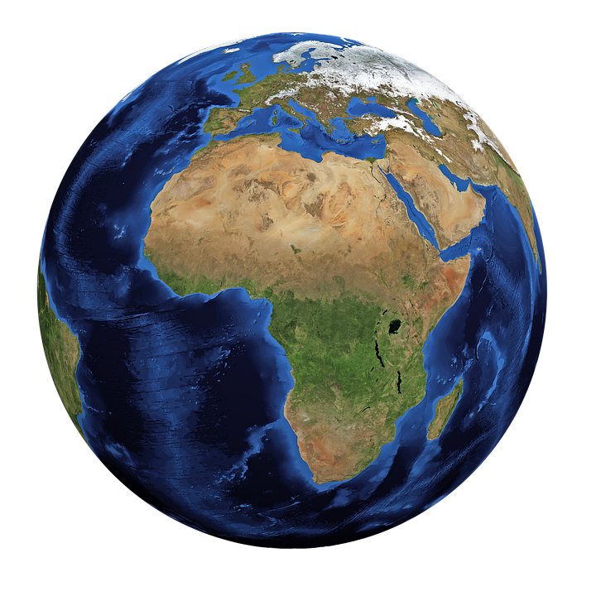
You are going to research one of the following issues and present a live news report to your class or write a newspaper column about it.
Disaster report
oil spills | climate change | deforestation
overfishing | Great Pacific Garbage Patch | Aral Sea drying up
Your report should include:
Overview – a description of the issue
Who – who is affected?
What – what caused the issue?
Where – where did it happen?
When – when did it begin?
Why – why is it important we deal with the issue?
Stretch:
Should your report be persuasive or informative? Explain your idea.
Challenge:
How do news reports help solve problems?

