Slide 1



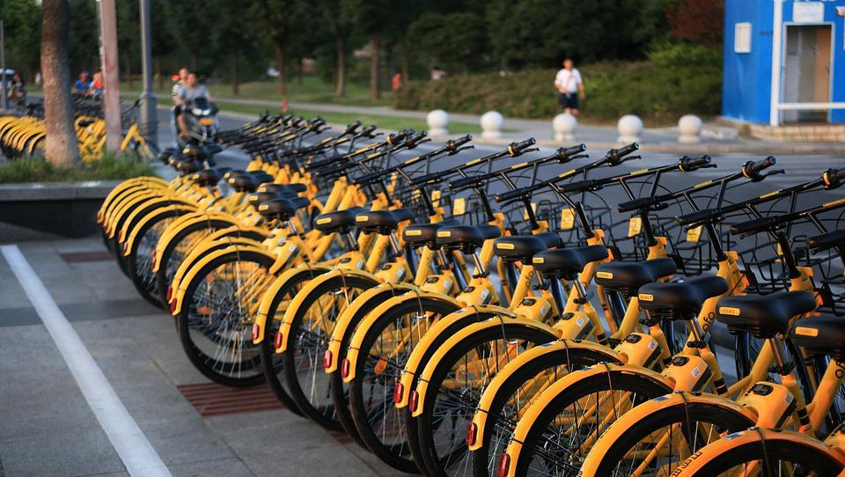

Mission Assignment: Explore how we can build resilient flood defences
Code: COP26_02_01
Brainstorm how your school can build the eco-friendly rules we have discussed into your classroom. Present your findings in the table below.
Using objects that can be powered by electric energy rather than non-renewable energy.
Make clear how much energy each household item (e.g. kettles, washing machines and dishwashers) uses.
Use less equipment as a better use of energy.
Share the items that we have, rather than everyone having their own.
Use energy-efficient systems like buses and electric cars to increase demand and lower costs.
Raise awareness of eco-conscious companies in order to make them more popular.
Make organisations work better to make them more eco-friendly.
2
Developing Experts Copyright 2022 All Rights Reserved

Slide 2
Mission Assignment: Explore how we can build resilient flood defences
Code: COP26_02_01
Challenge Task: Choose one eco-friendly rule that you have built into your classroom and create a classroom charter for everyone to follow that is based around that rule.
Create 5 rules starting with:
“We are an eco-friendly class, we…”
We are an eco-friendly class, we…
We are an eco-friendly class, we…
We are an eco-friendly class, we…
We are an eco-friendly class, we…
We are an eco-friendly class, we…
4
2
Developing Experts Copyright 2022 All Rights Reserved
Developing Experts Copyright 2022 All Rights Reserved

