Slide 1
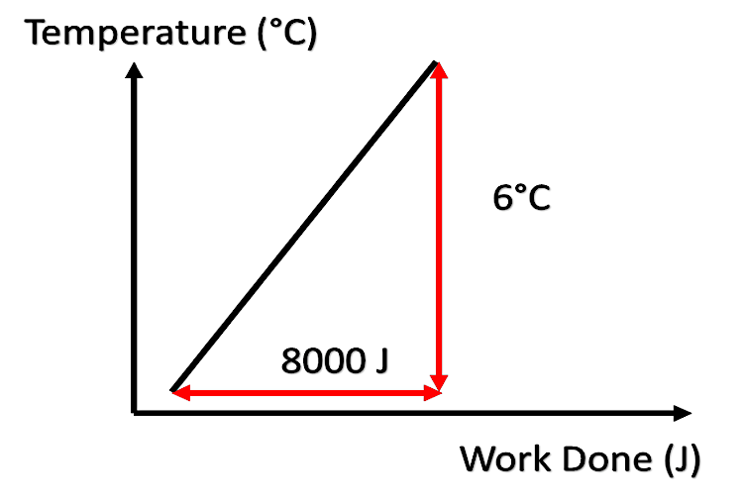
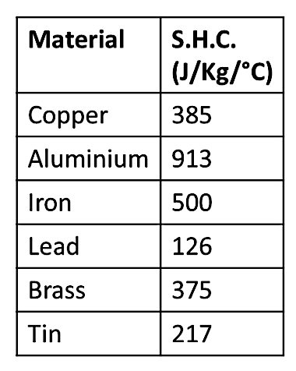
Joule & specific heat capacity
James Prescott Joule was born in Salford, England, as the son of a wealthy brewer. He studied science and mathematics. Whilst working as a brewer, he began to investigate heat. His studies led to the laws of the conservation of energy and laws of thermodynamics.
He worked alongside Lord Kelvin in his scientific endeavours. Joule is credited with his discoveries linking electricity, resistance and the dissipation of energy.
Joule proved through his experiments that every material when heated had a ‘specific heat capacity’. He proved that heat energy and mechanical energy are interchangeable. The SI unit for energy – joule – is named after him.
Specific heat capacity is the amount of energy needed to heat 1 kg of a substance by 1°c.
change in = mass X SHC X change in
energy temperature
𝛥E = M X C X 𝛥𝜽
kg J/kg°C °C
𝛥E
________
M X C X 𝛥𝜽
Example:
If the specific heat capacity of water is 4200J/kg°C, how many joules (J) of energy are needed to raise the temperature of a 7kg bucket of water by 4°C?
𝛥E = M X C X 𝛥𝜽
kg J/kg°C °C
M = 7kg
𝛥𝜽 = 4°C
C = 4200J/kg°C
E = 7 X 4200 X 4 E = 117,600J
Gravitational
field strength
10N/kg
Question:
If the specific heat capacity of water is 4200J/kg°C, how many joules (J) of energy are needed to raise the temperature of a 7kg bucket of water by 4°C?

Slide 2
Practice
Using the specific heat capacity of water (4200 J/kg°C), how much energy is needed to increase the temperature of 500 g of water by 80°C in a kettle? ____________________________________________________________________________________________________________________________
A 2 kg metal cylinder is supplied with 1600J of energy to heat it from 5°C to 13°C. What is the specific heat capacity of the metal? ________________________________________________________________________________________________________________________________________________________________
A length of lead with a specific heat capacity of 126J/kg°C is given 5000J of energy to heat it from 20°C to 250°C. What was the mass of the piece of lead? _____________________________________________________________________________________________
Calculate how much energy is needed to heat 2kg of cooking oil with a specific heat capacity of 2000J/kg°C from 20°C to 120°C? ________________________________________________________________________________________________________________________ _______________________________________

Slide 3
Key Vocabulary
Complete these statements:-
Specific heat capacity is the measure of the amount of ____________ _________ that is needed to raise 1kg of substance by 1_________.
A higher specific heat capacity will mean that a material requires more heat energy to raise the _______________. Also, a larger mass of the material means that the material requires more heat energy to _________________________ the temperature.
 | Exam-style questions
6 | What is the difference between heat and temperature?
7 | Why is water a good material to have in a central heating system? (Consider what a plumber does to help formulate your answer)
8 | Night storage heaters warm up at night when electricity is cheaper and then release their heat energy during the day. The value of c for bricks in a night storage heater is higher than water. Why is this an advantage?
9 | Radiators can either be filled with water or filled with oil. Water has a higher specific heat capacity. What are the advantages and disadvantages of each?
10 | An electrical circuit malfunctions and starts to overheat. The copper wire of the circuit has a mass of 3g and it increases in temperature from 20°C to 60°C. How much energy is transferred to the wire in joules? [Copper has a SHC of 390 J/kg°C]
11 | John has a shower and uses 20,000g of water with a specific heat capacity of 4200J/kg°C. When the water is supplied with 336,000J of energy, it heats up to 50°C. What was the starting temperature of the water?
12 | Explain why houses built of stone take a long time to warm up but once they are warm they stay warm for a very long time.

