Slide 1
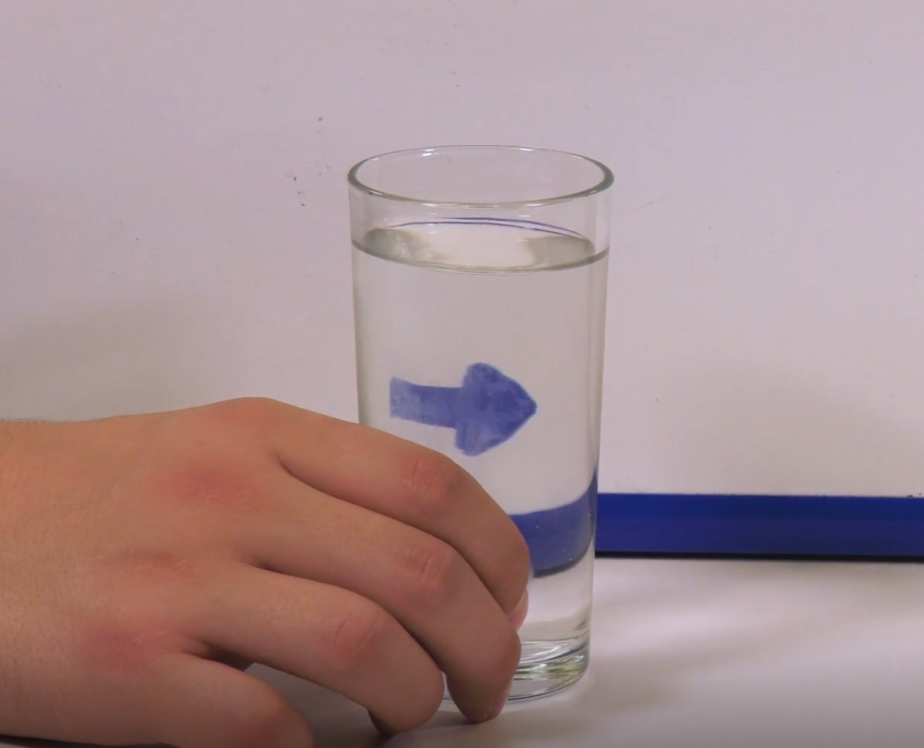
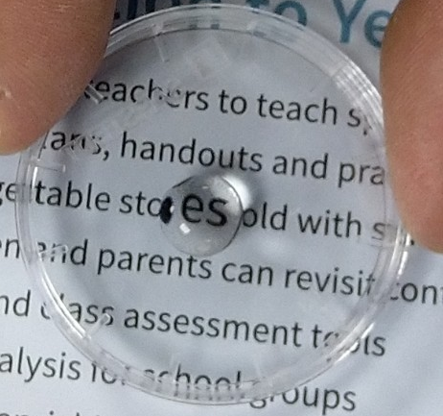
Glass of Water Lens
Method
Hold up an image of a left-facing arrow.
Slide a cylindrical glass of water in front the image.
Look through the glass and describe what you see.
Move the glass towards and away from the image and
describe what you see.
What happened to the arrow when the glass was slid in front of it?
______________________________________________________________________________________________________________
What happened to the arrow when the glass was moved towards it?
______________________________________________________________________________________________________________
What happened to the arrow when the glass was moved away from it?
______________________________________________________________________________________________________________
Droplet Magnifier
Method
Place a waterproof transparent material on top of a
page of newspaper. Near the middle of the film,
place a drop of water using a pipette or the tip of
your finger.
Next, carefully lift and hold the transparent material
about 2cm above the newspaper.
What happens as the water lens is lifted? _____________________________________________________________________________________________________________________________________________________________________
Stretch:
List 3 things that are different about the two lenses.
Challenge:
List 3 things the two lenses have in common.

