Slide 1

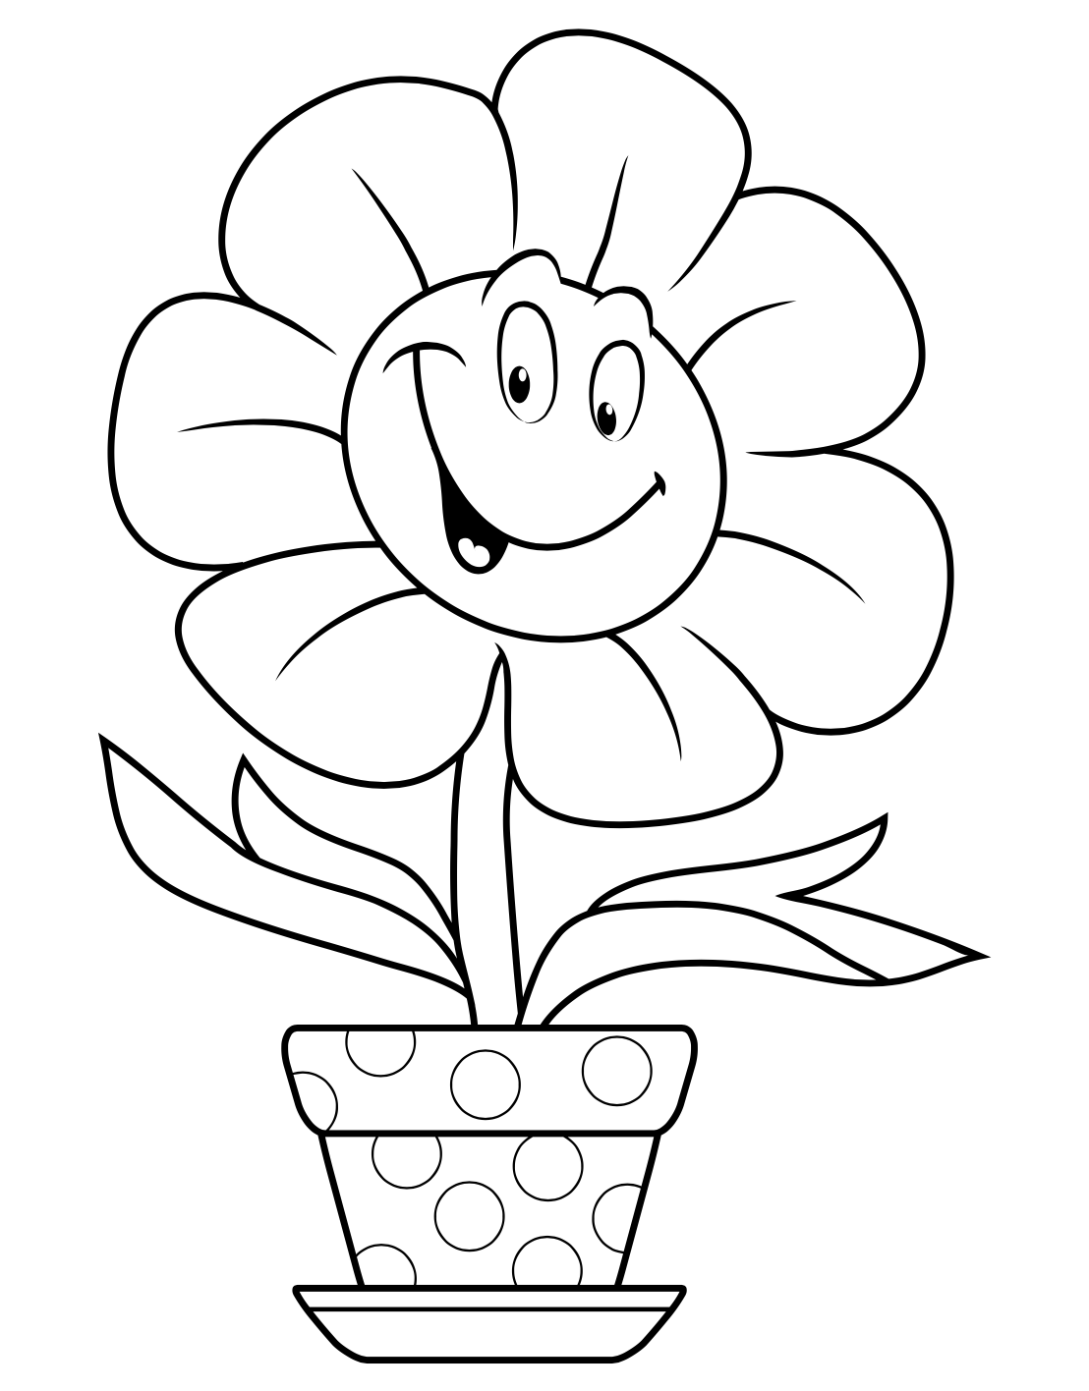
S01.07.11 Handout
How plants change over time.
Flower Power! Colour in the plant and then trace over the words and draw a line to where these are on the plant.
flower
stem
leaves
pot
Developing Experts Ltd. © 2022
.

