Slide 1
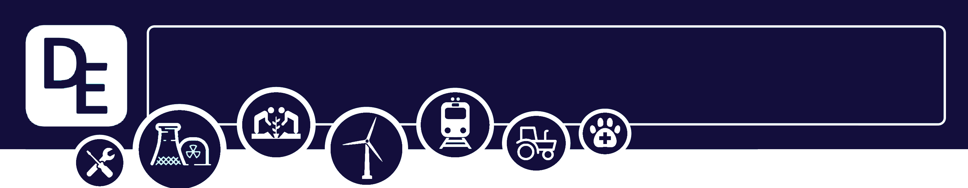

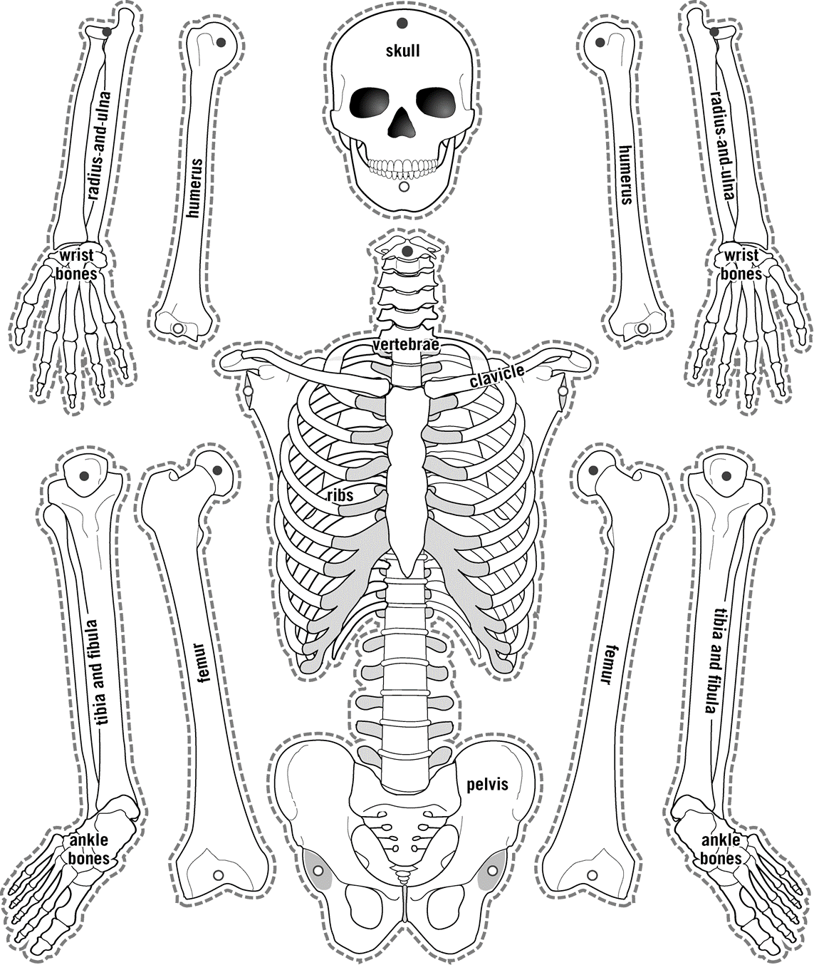
Mission Assignment: Explain why plants are important
Mission Assignment: Describe the structure and function of the skeleton
KS3-16-03
KS3-05-01
Developing Experts Copyright 2023 All Rights Reserved
Developing Experts Copyright 2023 All Rights Reserved

Slide 2
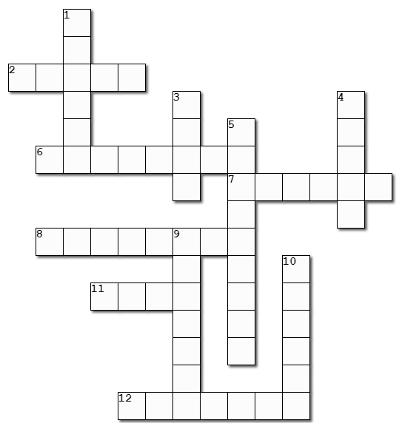
Mission Assignment: Explain why plants are important
Mission Assignment: Describe the structure and function of the skeleton
KS3-16-03
KS3-05-01
The skeleton
List the four functions of the skeleton.
1: ________________________
2: ________________________
3: ________________________
4: ________________________
Across |  | Down
2 | the shinbone (5) | 1 | A little lie found in this leg bone (6)
6 | the bone you chew with (8) | 3 | these bones protect the heart and lungs (4)
7 | this bone is the distance from the centre to the edge of a circle (6) | 4 | the longest bone (5)
8 | the bone on which you hang a tie (8) | 5 | these bones work together to bend the back (9)
11 | Luna rearranged gives a forearm bone (4) | 9 | a bone to protect your thoughts (7)
12 | the funny bone (7) | 10 | the hip bones contain the king of rock and roll (6)
Developing Experts Copyright 2023 All Rights Reserved
Developing Experts Copyright 2023 All Rights Reserved

Slide 3
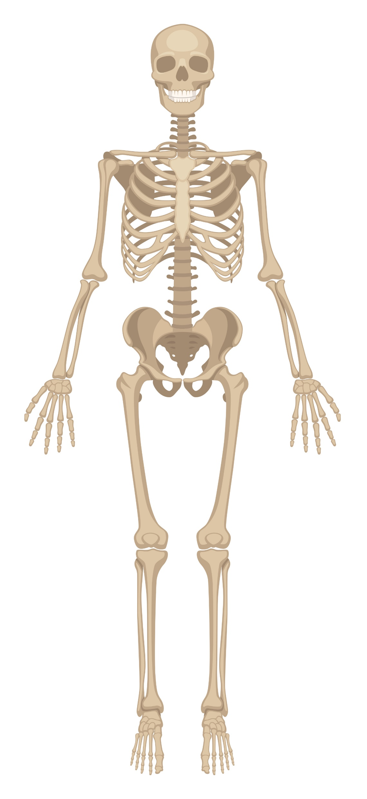
Mission Assignment: Explain why plants are important
Mission Assignment: Describe the structure and function of the skeleton
KS3-16-03
KS3-05-01
Label the skeleton
mandible
rib cage
vertebrae
pelvis
femur
patella
Word bank
cranium humerus tibia coccyx
metatarsals fibula radius carpals
Developing Experts Copyright 2023 All Rights Reserved
Developing Experts Copyright 2023 All Rights Reserved

Slide 4
Mission Assignment: Explain why plants are important
Mission Assignment: Describe the structure and function of the skeleton
KS3-16-03
KS3-05-01
The axial skeleton
1. Name 3 main parts of the axial skeleton. Which main organ or organs do you think these bones help protect?
Bone
Organs
2. Explain why you think these organs need protecting.
____________________________________________________________________________________________________________________________________________________________________________________________________________________________________________________________________________________________________________________________________________________________________________________________________________________________________________________________________________________________________________
3. The rib cage is made with flexible bones. The skull is made of more rigid bone.
Explain why these different types of bones are suited to the organs they protect.
________________________________________________________________________________________________________________________________________________________________________________________________________________________________________________________________________________________________________________________________________
____________________________________________________________________________________________________________________________________________________________________
4. Challenge: Some bones are made of softer tissues called cartilage. Explain why the skeleton needs some parts to made from cartilage. ____________________________________________________________________________________________________________________________________________________________________________________________________________________________________________________________________________________________________________________________________________________________________________________________________________________________________________________________________________________________________________
Developing Experts Copyright 2023 All Rights Reserved
Developing Experts Copyright 2023 All Rights Reserved

Slide 5
Mission Assignment: Explain why plants are important
Mission Assignment: Describe the structure and function of the skeleton
ANSWERS
KS3-16-03
KS3-05-01
The skeleton
Across |  | Down
2 | the shinbone (5) tibia | 1 | A little lie found in this leg bone (6) fibula
6 | the bone you chew with (8) mandible | 3 | these bones protect the heart and lungs (4) ribs
7 | this bone is the distance from the centre to the edge of a circle (6) radius | 4 | the longest bone (5) femur
8 | the bone on which you hang a tie (8) clavicle | 5 | these bones work together to bend the back (9) vertebrae
11 | Luna rearranged gives a forearm bone (4) ulna | 9 | a bone to protect your thoughts (7) cranium
12 | the funny bone (7) humerus | 10 | the hip bones contain the king of rock and roll (6) pelvis
List the four functions of the skeleton.
1: ________________________
2: ________________________
3: ________________________
4: ________________________
Protection
Support
Movement
Blood production
Developing Experts Copyright 2023 All Rights Reserved
Developing Experts Copyright 2023 All Rights Reserved

Slide 6
Mission Assignment: Explain why plants are important
Mission Assignment: Describe the structure and function of the skeleton
ANSWERS
KS3-16-03
KS3-05-01
The axial skeleton
1. Name 3 main parts of the axial skeleton. Which main organ or organs do you think these bones help protect?
Bone
Organs
Skull or cranium
Vertebrae or backbone
Rib cage
Brain
Spinal column
Heart, lungs, kidneys, spleen, stomach
2. Explain why you think these organs need protecting.
____________________________________________________________________________________________________________________________________________________________________________________________________________________________________________________________________________________________________________________________________________________________________________________________________________________________________________________________________________________________________________
3. The rib cage is made with flexible bones. The skull is made of more rigid bone.
Explain why these different types of bones are suited to the organs they protect.
________________________________________________________________________________________________________________________________________________________________________________________________________________________________________________________________________________________________________________________________________
____________________________________________________________________________________________________________________________________________________________________
4. Challenge: Some bones are made of softer tissues called cartilage. Explain why the skeleton needs some parts to made from cartilage. ____________________________________________________________________________________________________________________________________________________________________________________________________________________________________________________________________________________________________________________________________________________________________________________________________________________________________________________________________________________________________________
The brain, spinal column, heart, lungs, stomach and other organs need protection because they are vital for maintaining life-sustaining functions. Shielding them from external trauma ensures their proper functioning and reduces the risk of severe damage or dysfunction that could have potentially life-threatening consequences.
The rib cage's flexibility allows for the expansion and movement required for efficient breathing, while the skull's rigidity provides optimal protection for the brain against potential trauma and injury.
Cartilage is a softer and more flexible tissue compared to bone. It allows for smooth joint movement and acts as a cushion between bones, reducing friction and impact during movement. This flexibility is especially crucial in areas such as the joints, where it allows for a wide range of motion and helps absorb shocks, protecting the bones from damage.
Developing Experts Copyright 2023 All Rights Reserved
Developing Experts Copyright 2023 All Rights Reserved

