Slide 1
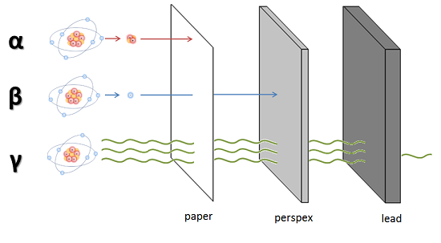
Developing Experts All rights reserved © 2021

Slide 2
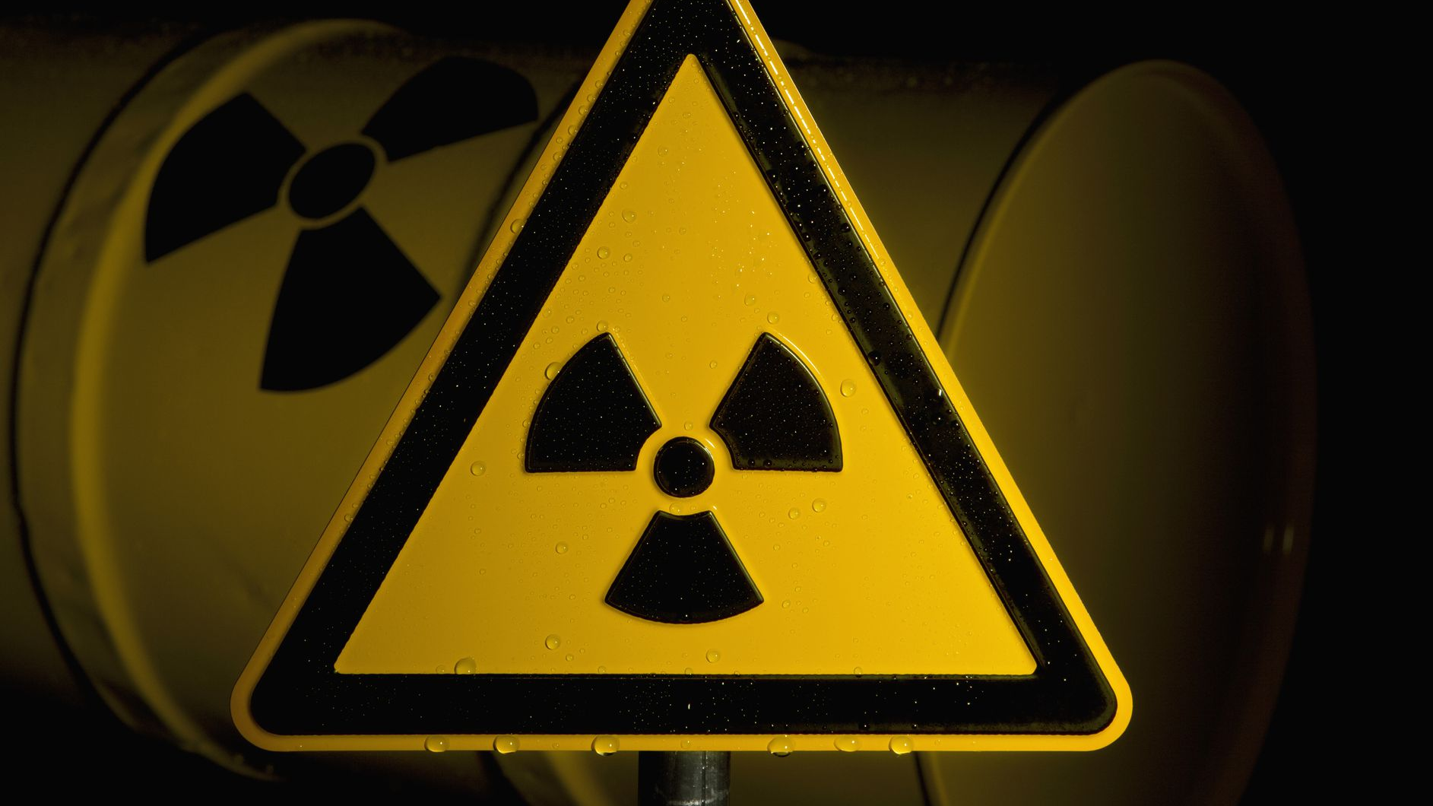
Alpha particles carry a positive charge, beta particles carry a negative charge and gamma rays are neutral.
Alpha denotes the largest particle and it penetrates the least. Beta particles are high energy electrons. Gamma rays are waves of electromagnetic energy.

Slide 3
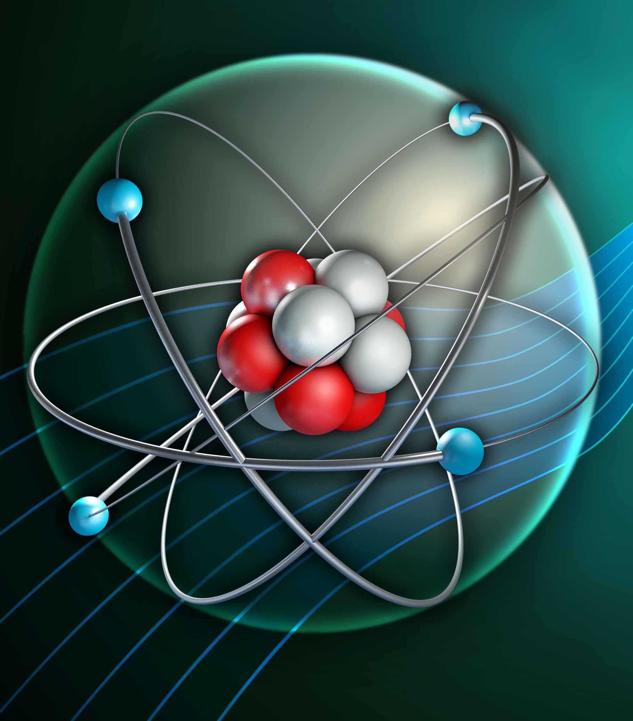
Properties of alpha, beta and gamma radiation
Describe the properties of alpha, beta, and gamma radiation. These include their range in air, their penetrating power, and their ionising power.
Explain the use of alpha, beta and gamma radiation in terms of the properties
Apply their knowledge to the uses of radiation and evaluate the best sources of radiation to use in a given situation

Slide 4

From cosmic rays
The air we breath
From the rocks and soil
From the food we eat and even our own bodies
From plants
Developing Experts All rights reserved © 2021

Slide 5
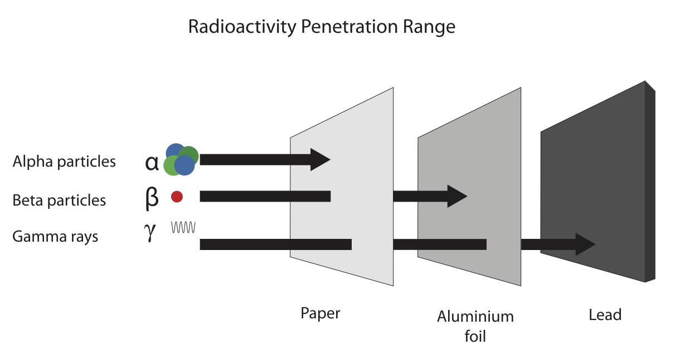

Slide 6
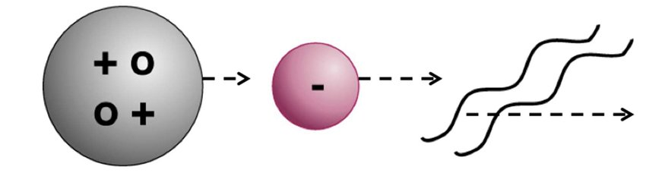
Alpha
Beta
Gamma

Slide 7
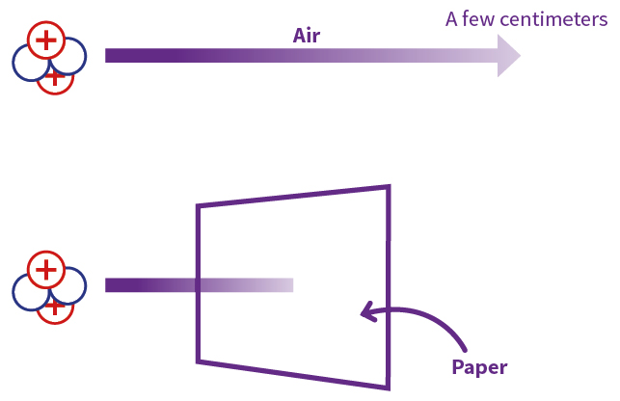
A few centimetres
Air
Paper
Developing Experts All rights reserved © 2021

Slide 8
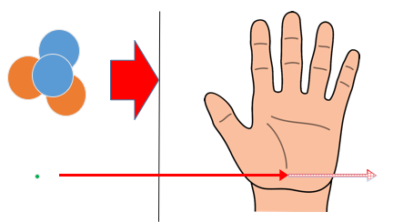
Alpha vs Beta ionising radiation
alpha
beta
Piece of paper
Human tissue

Slide 9
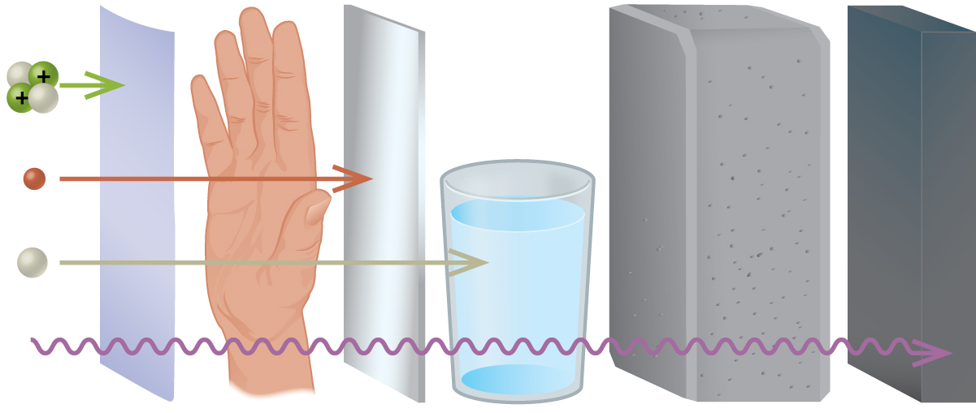
Alpha
Beta
Neutron
Gamma
Paper
Metal
Water
Concrete
Lead

Slide 10

The ability of radiation to damage molecules is analysed in terms of what is called ionising power. When a radiation particle interacts with atoms, the interaction can cause the atom to lose electrons and thus become ionised.

