Slide 1

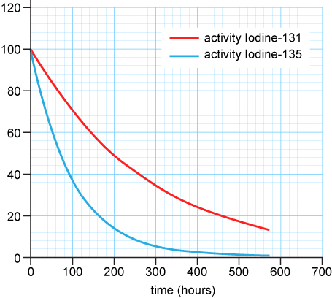
0001.01
Mission Assignment
Task | Use all of the problems that provide data on the handout to plot different graphs and practice plotting the data.
Developing skills | Use graph data to make comparison between the radioactivity of different isotopes. In the example here, which isotope has the shortest half life?
Think about… | The applications of different of isotopes for medical treatments – in the example here, why is Iodine 131 a better treatment for thyroid cancer?
KS4-21-06:
Explore the half-live of a radioactive isotope

