Slide 1

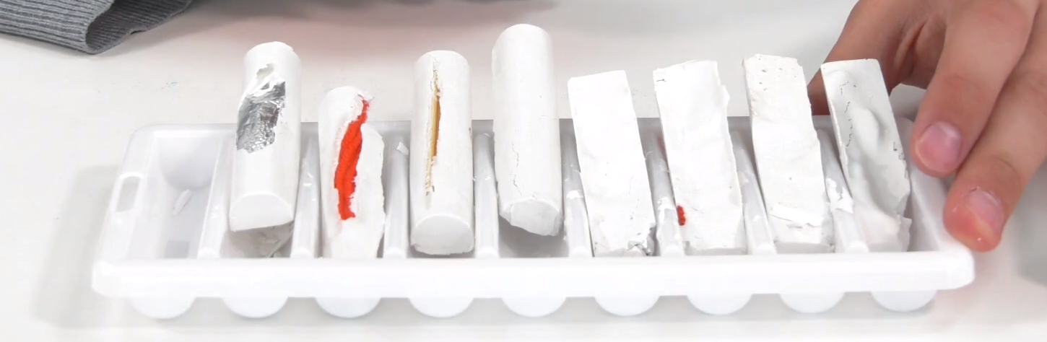
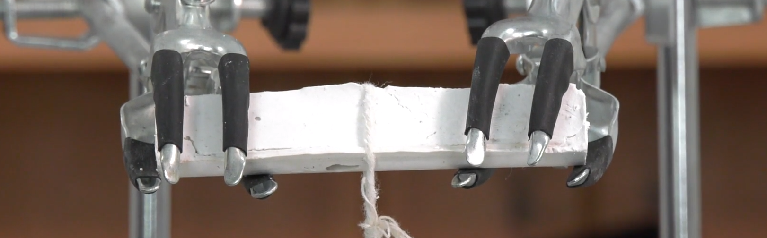
Mission Assignment: Describe the properties of composites
KS3-17-05
Testing Composites - In this experiment, you will be investigating how the addition of materials to plaster affects the strength of the overall composite material.
Method
Prepare the plaster as per the manufacturers
instructions. The plaster will likely set quickly so the
next steps must be done quickly.
In the ice stick tray or mould, pour a shallow layer of
the plaster. Then gently lay the material samples on
top of the layer of plaster.
Pour the remaining plaster on top of the material
samples, so that the material sample are roughly in
the centre of the plaster, leave this to set.
You should make multiple samples of your
composite materials to allow you multiple trials.
Once the plaster is set remove it from the mould and clamp the ends in two clamp stands. Tie a loop of string around the plaster and tie another loop in the other end of the string.
Hang masses of increasing size from the string until the plaster breaks. Record the force at which the plaster breaks and any other relevant observations
e.g. Breaks suddenly, two halves stick together etc.
NB: 100g ≈ 1N
Equipment
Ice stick tray or mould
Quick set plaster
Clamp stand
String
Masses
Wool, wooden sticks, plastic straw, foil, paper strips
Material | Force to break (N) Trial 1 | Force to break (N) Trial 2 | Other Observations
Developing Experts Copyright 2023 All Rights Reserved

Slide 2
Mission Assignment: Describe the properties of composites
KS3-17-05
Describe the term ‘composite material’.
___________________________________________________________________________________________________________________________________________________________________________________________________________________________________________________
Suggest three reasons why composite materials are produced.
___________________________________________________________________________________________________________________________________________________________________________________________________________________________________________________
Reinforced concrete is made from concrete and iron rebar. Complete the table below by describing the properties of concrete and iron.
Suggest how combining iron rebar and concrete helps create a stronger material.
______________________________________________________________________________________________________________________________________________________________________________________________________________________________________________________________________________________________________________________________________________________________________________________________________________________________________________________________________________________________________
 | List some of the physical properties of the material | Describe how easily the material can change shape. | Describe the appearance of the material
Iron
Concrete
Developing Experts Copyright 2023 All Rights Reserved

Slide 3

Mission Assignment: Describe the properties of composites
KS3-17-05
Challenge: Design your own imaginary composite material for a particular use. You need to consider the properties the item must have for its use and describe and explain the materials that will be mixed to create the composite material.
For example: A colourful raincoat must be waterproof, lightweight and able to be worn. A composite could be made from cotton and a polymer. Cotton and polymer can both be made colourful and are lightweight. Cotton is comfortable to wear and polymers are waterproof, so combining their properties you will get a waterproof, wearable raincoat.
_____________________________________________________________________________________________________________________________________________________________________________________________
________________________________________________________________________________________________________________________________________________________________________________________________________________________________________________________________________________________________________________________________________________________________________________________________________________________________________________________________________________________________________________________
Developing Experts Copyright 2023 All Rights Reserved

Slide 4
Mission Assignment: Describe the properties of composites
ANSWERS
KS3-17-05
Testing Composites - In this experiment, you will be investigating how the addition of materials to plaster affects the strength of the overall composite material.
Method
Prepare the plaster as per the manufacturers
instructions. The plaster will likely set quickly so the
next steps must be done quickly.
In the ice stick tray or mould, pour a shallow layer of
the plaster. Then gently lay the material samples on
top of the layer of plaster.
Pour the remaining plaster on top of the material
samples, so that the material sample are roughly in
the centre of the plaster, leave this to set.
You should make multiple samples of your
composite materials to allow you multiple trials.
Once the plaster is set remove it from the mould and clamp the ends in two clamp stands. Tie a loop of string around the plaster and tie another loop in the other end of the string.
Hang masses of increasing size from the string until the plaster breaks. Record the force at which the plaster breaks and any other relevant observations
e.g. Breaks suddenly, two halves stick together etc.
NB: 100g ≈ 1N
Equipment
Ice stick tray or mould
Quick set plaster
Clamp stand
String
Masses
Wool, wooden sticks, plastic straw, foil, paper strips
Material | Force to break (N) Trial 1 | Force to break (N) Trial 2 | Other Observations
Students’ own results
Developing Experts Copyright 2023 All Rights Reserved

Slide 5
Mission Assignment: Describe the properties of composites
ANSWERS
KS3-17-05
Describe the term ‘composite material’.
___________________________________________________________________________________________________________________________________________________________________________________________________________________________________________________
Suggest three reasons why composite materials are produced.
___________________________________________________________________________________________________________________________________________________________________________________________________________________________________________________
Reinforced concrete is made from concrete and iron rebar. Complete the table below by describing the properties of concrete and iron.
Suggest how combining iron rebar and concrete helps create a stronger material.
______________________________________________________________________________________________________________________________________________________________________________________________________________________________________________________________________________________________________________________________________________________________________________________________________________________________________________________________________________________________________
A material composed of two or more different types of materials, which have been combined to produce a material with superior properties compared to the individual materials
Improved performance: e.g. greater strength
Cost-effectiveness: using less expensive raw materials
Aesthetics: such as colour, texture, and surface finish
 | List some of the physical properties of the material | Describe how easily the material can change shape. | Describe the appearance of the material
Iron | Strong, ductile, malleable | Can be shaped with tools | Smooth, shiny appearance
Concrete | Hard, strong, durable | Difficult to change shape | Grey or off-white, rough texture
Concrete is a strong, durable material but can be brittle and prone to cracking under tension. Iron rebar is ductile and can absorb tensile forces, but it is not strong enough to withstand compression forces on its own. By embedding iron rebar into the concrete, the two materials work together to create a composite material that can resist both tension and compression forces, making it much stronger than either material on its own.
Developing Experts Copyright 2023 All Rights Reserved

Slide 6
Mission Assignment: Describe the properties of composites
ANSWERS
KS3-17-05
Challenge: Design your own imaginary composite material for a particular use. You need to consider the properties the item must have for its use and describe and explain the materials that will be mixed to create the composite material.
For example: A colourful raincoat must be waterproof, lightweight and able to be worn. A composite could be made from cotton and a polymer. Cotton and polymer can both be made colourful and are lightweight. Cotton is comfortable to wear and polymers are waterproof, so combining their properties you will get a waterproof, wearable raincoat.
_____________________________________________________________________________________________________________________________________________________________________________________________
________________________________________________________________________________________________________________________________________________________________________________________________________________________________________________________________________________________________________________________________________________________________________________________________________________________________________________________________________________________________________________________
Students’ own ideas
Developing Experts Copyright 2023 All Rights Reserved

