Slide 1
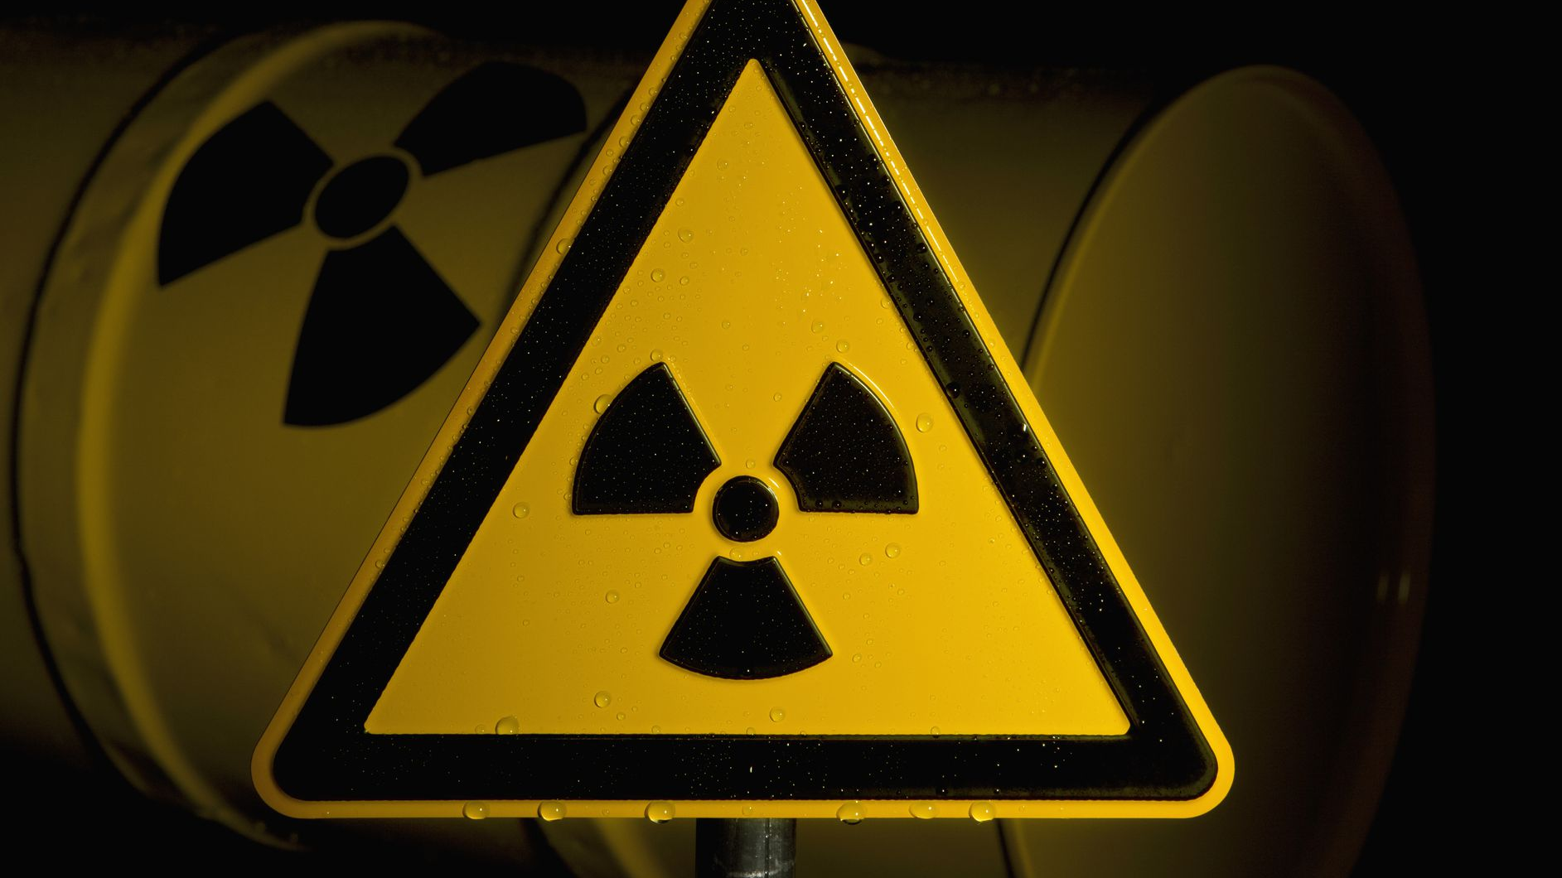

Slide 2
Radioactive decay is the process by which an unstable atomic nucleus loses energy by radiation. A material containing unstable nuclei is considered radioactive. Three of the most common types of decay are alpha decay, beta decay, and gamma decay.

Slide 3
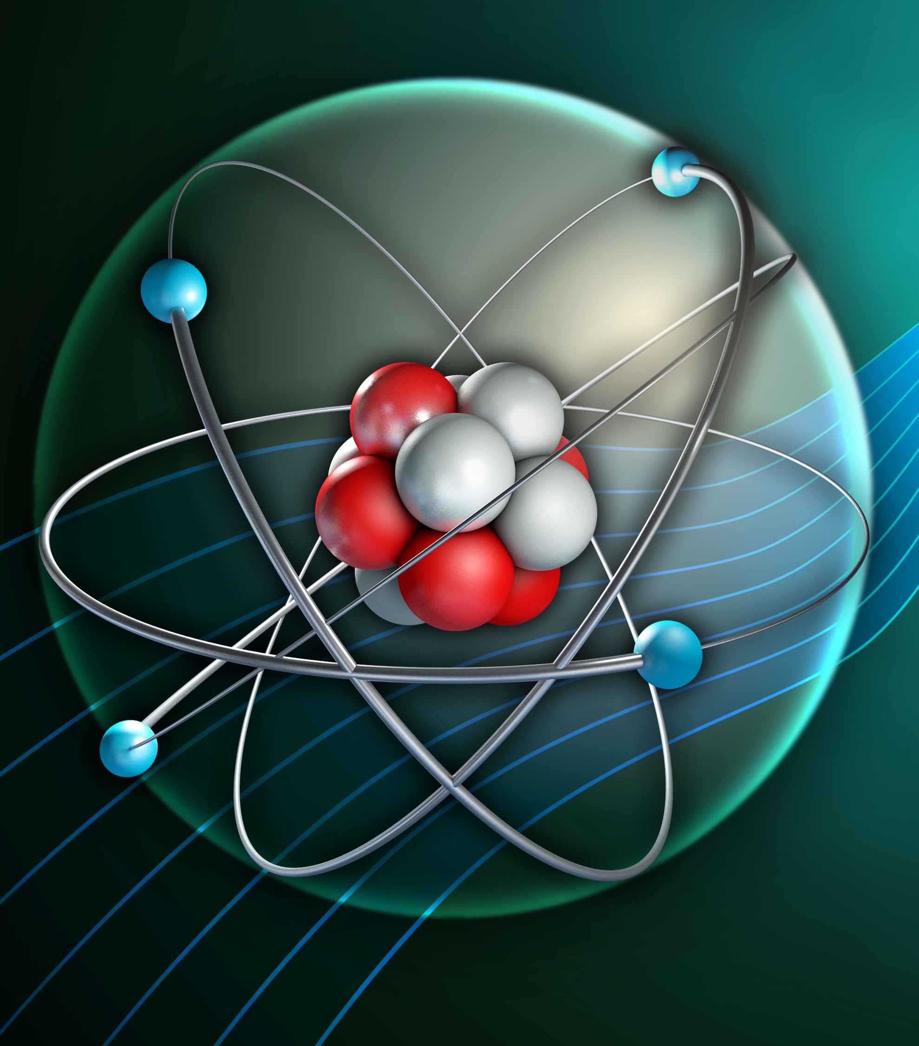
Radioactivity
You should be able to describe what's meant by radioactive decay.
You should be able to describe the four types of nuclear radiation.

Slide 4
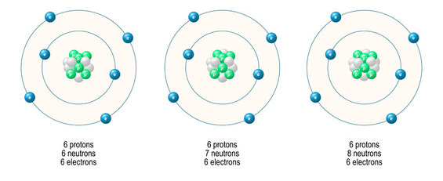
Carbon-12
Carbon-13
Carbon-14
6 protons + 6 neutrons = atomic mass 12 6 protons + 7 neutrons = atomic mass 13 6 protons + 8 neutrons = atomic mass 14

Slide 5
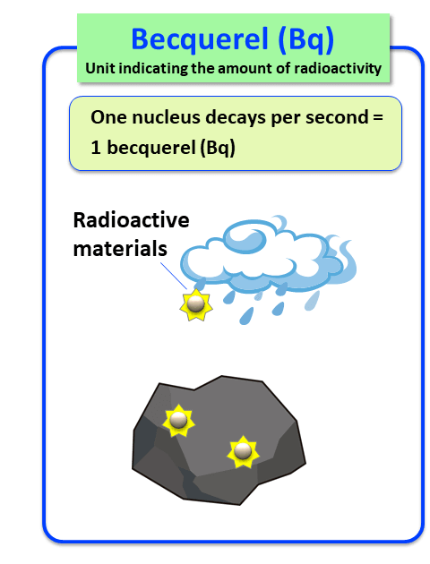

Slide 6
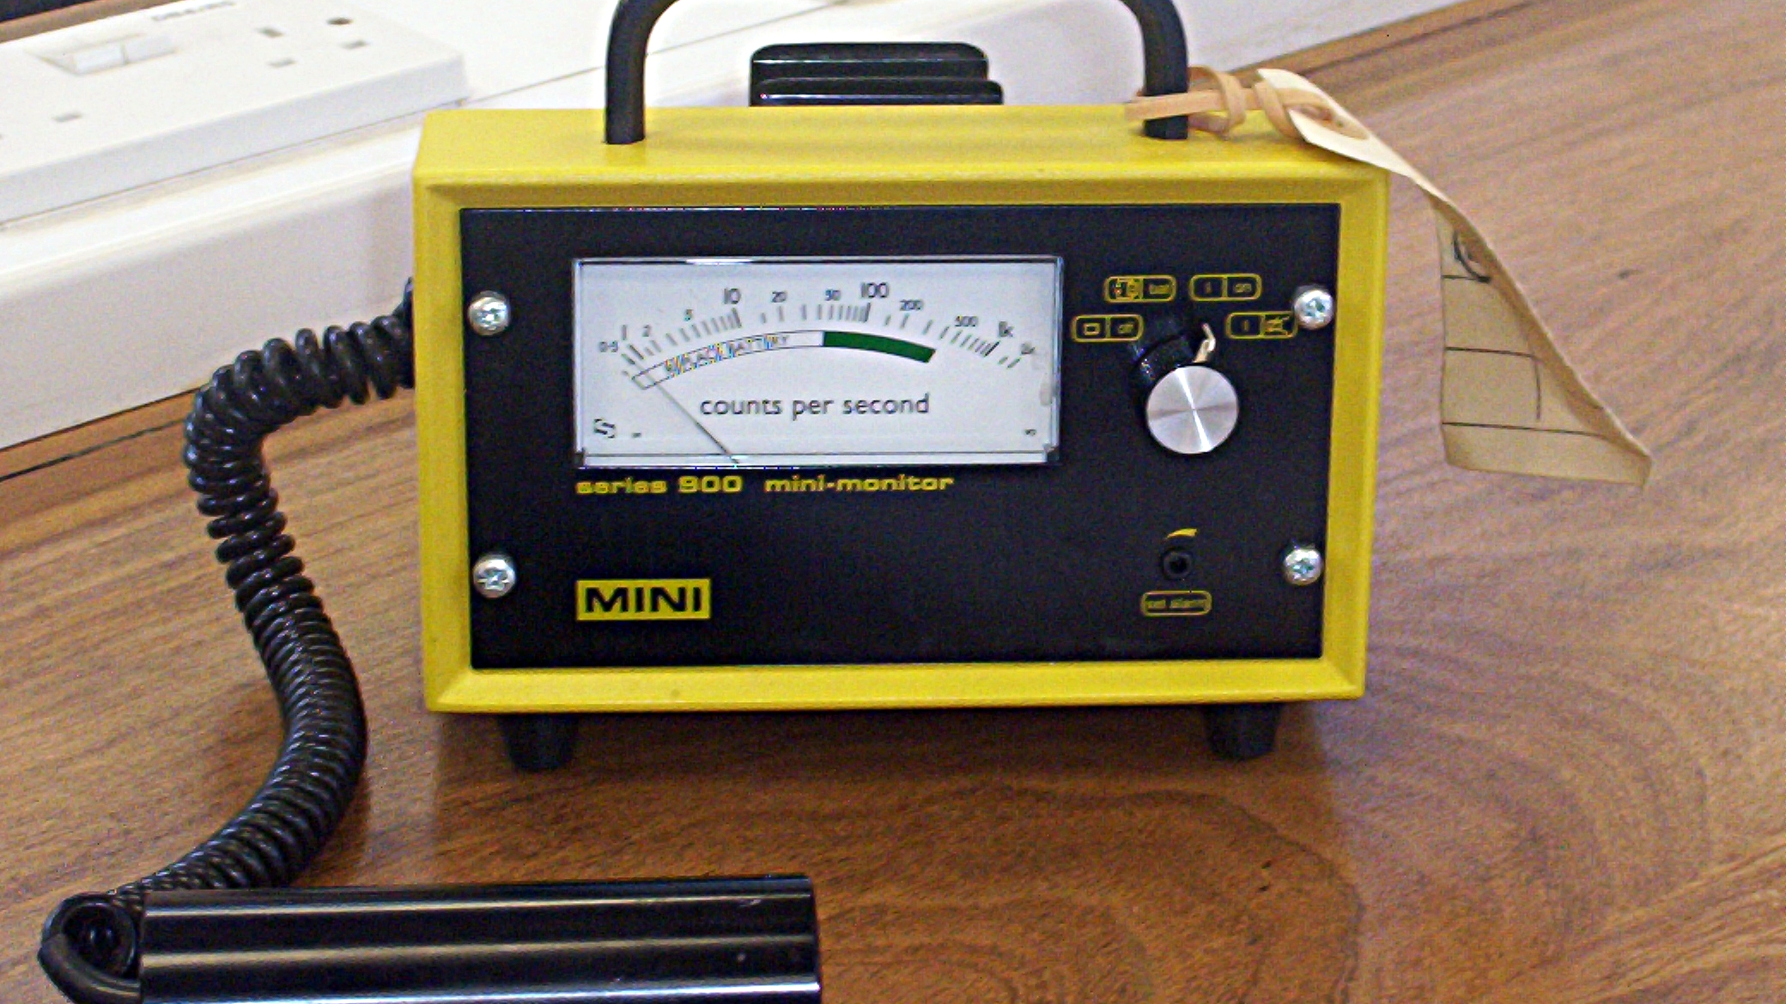
Developing Experts All rights reserved © 2021

Slide 7

From cosmic rays
The air we breath
From the rocks and soil
From the food we eat and even our own bodies
From plants
Developing Experts All rights reserved © 2021

Slide 8
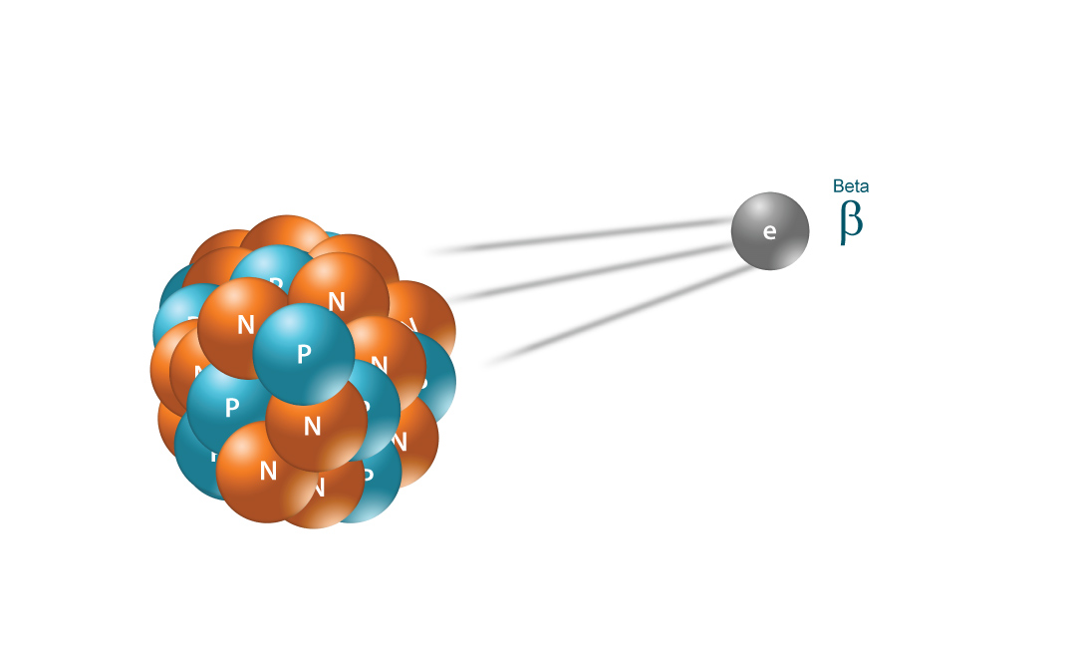

Slide 9
