Slide 1
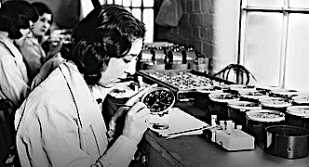
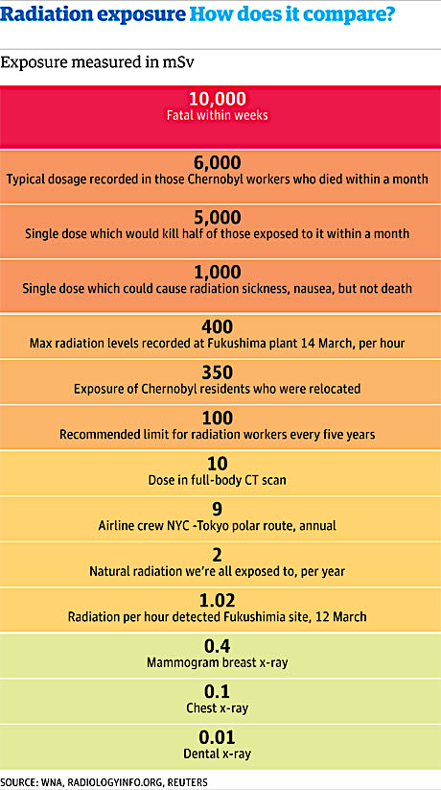
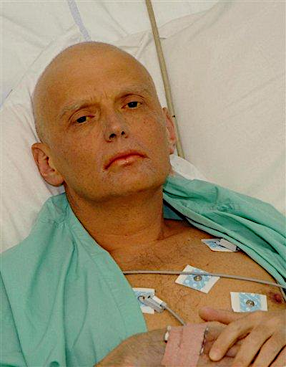
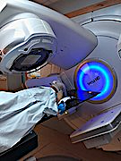

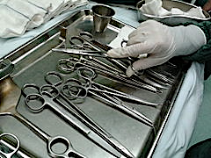
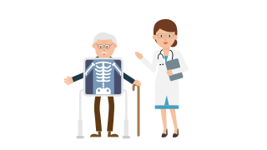
Irradiation or radioactive contamination?
The positive uses and the negative effects of radiation are often confused and make people fearful. In fact, if we actually list all of the positive ways we use irradiation, including medical treatment, sterilising surgical equipment, and increasing the shelf-life of fruit and vegetables, it would show that the negative effects of radioactive contamination are few and far between.
Irradiation is when something has been exposed to radiation. However, radioactive contamination is when an object has taken in some of an unwanted radioactive source. Levels of exposure and contamination are measured in mSv = millisieverts.
Radiation safety measures:-
Use; time, distance and shielding.
Wear a dosimeter.
Avoid contact with contamination.
Wear protective clothing.
Wash thoroughly after coming into any contact with any radioactivity.
OUTSIDE the body β and γ are more likely to cause harm as α radiation is blocked by the skin.
INSIDE the body an α source causes the most damage because it is the most ionising.
Radioactive contamination | Irradiation
Nuclear material on person. | Nuclear material not on person.
Longer term radiation exposure. | (Usually) short term exposure.
Safety precaution is to wear radiation suit and wash after exposure. | Safety precaution is to maintain distance and only expose to low dose.
Why do we irradiate food?
Irradiation of food has been used around the world since the 1950s and is safe. The reasons why food is irradiated are to:-
Kill bacteria
Extend shelf life
Remove insects
Irradiation of food as a method of preserving may lead to some loss of vitamins.
Gravitational
field strength
10N/kg

Slide 2

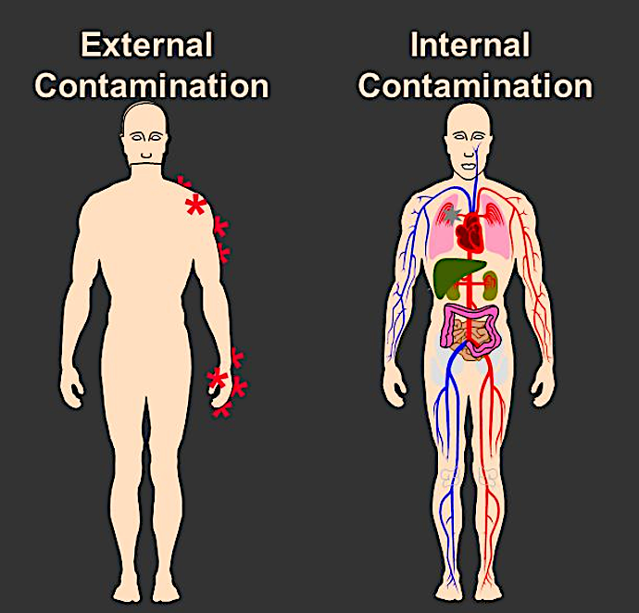
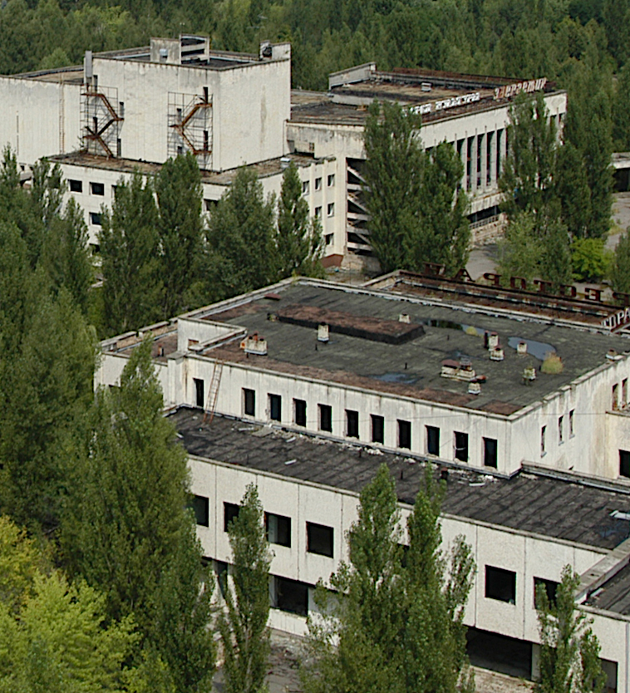
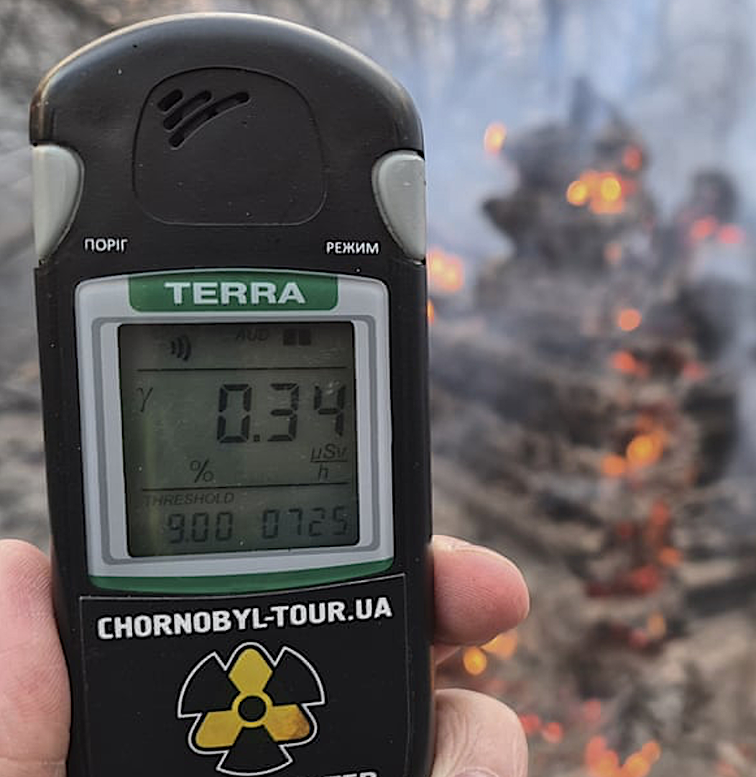
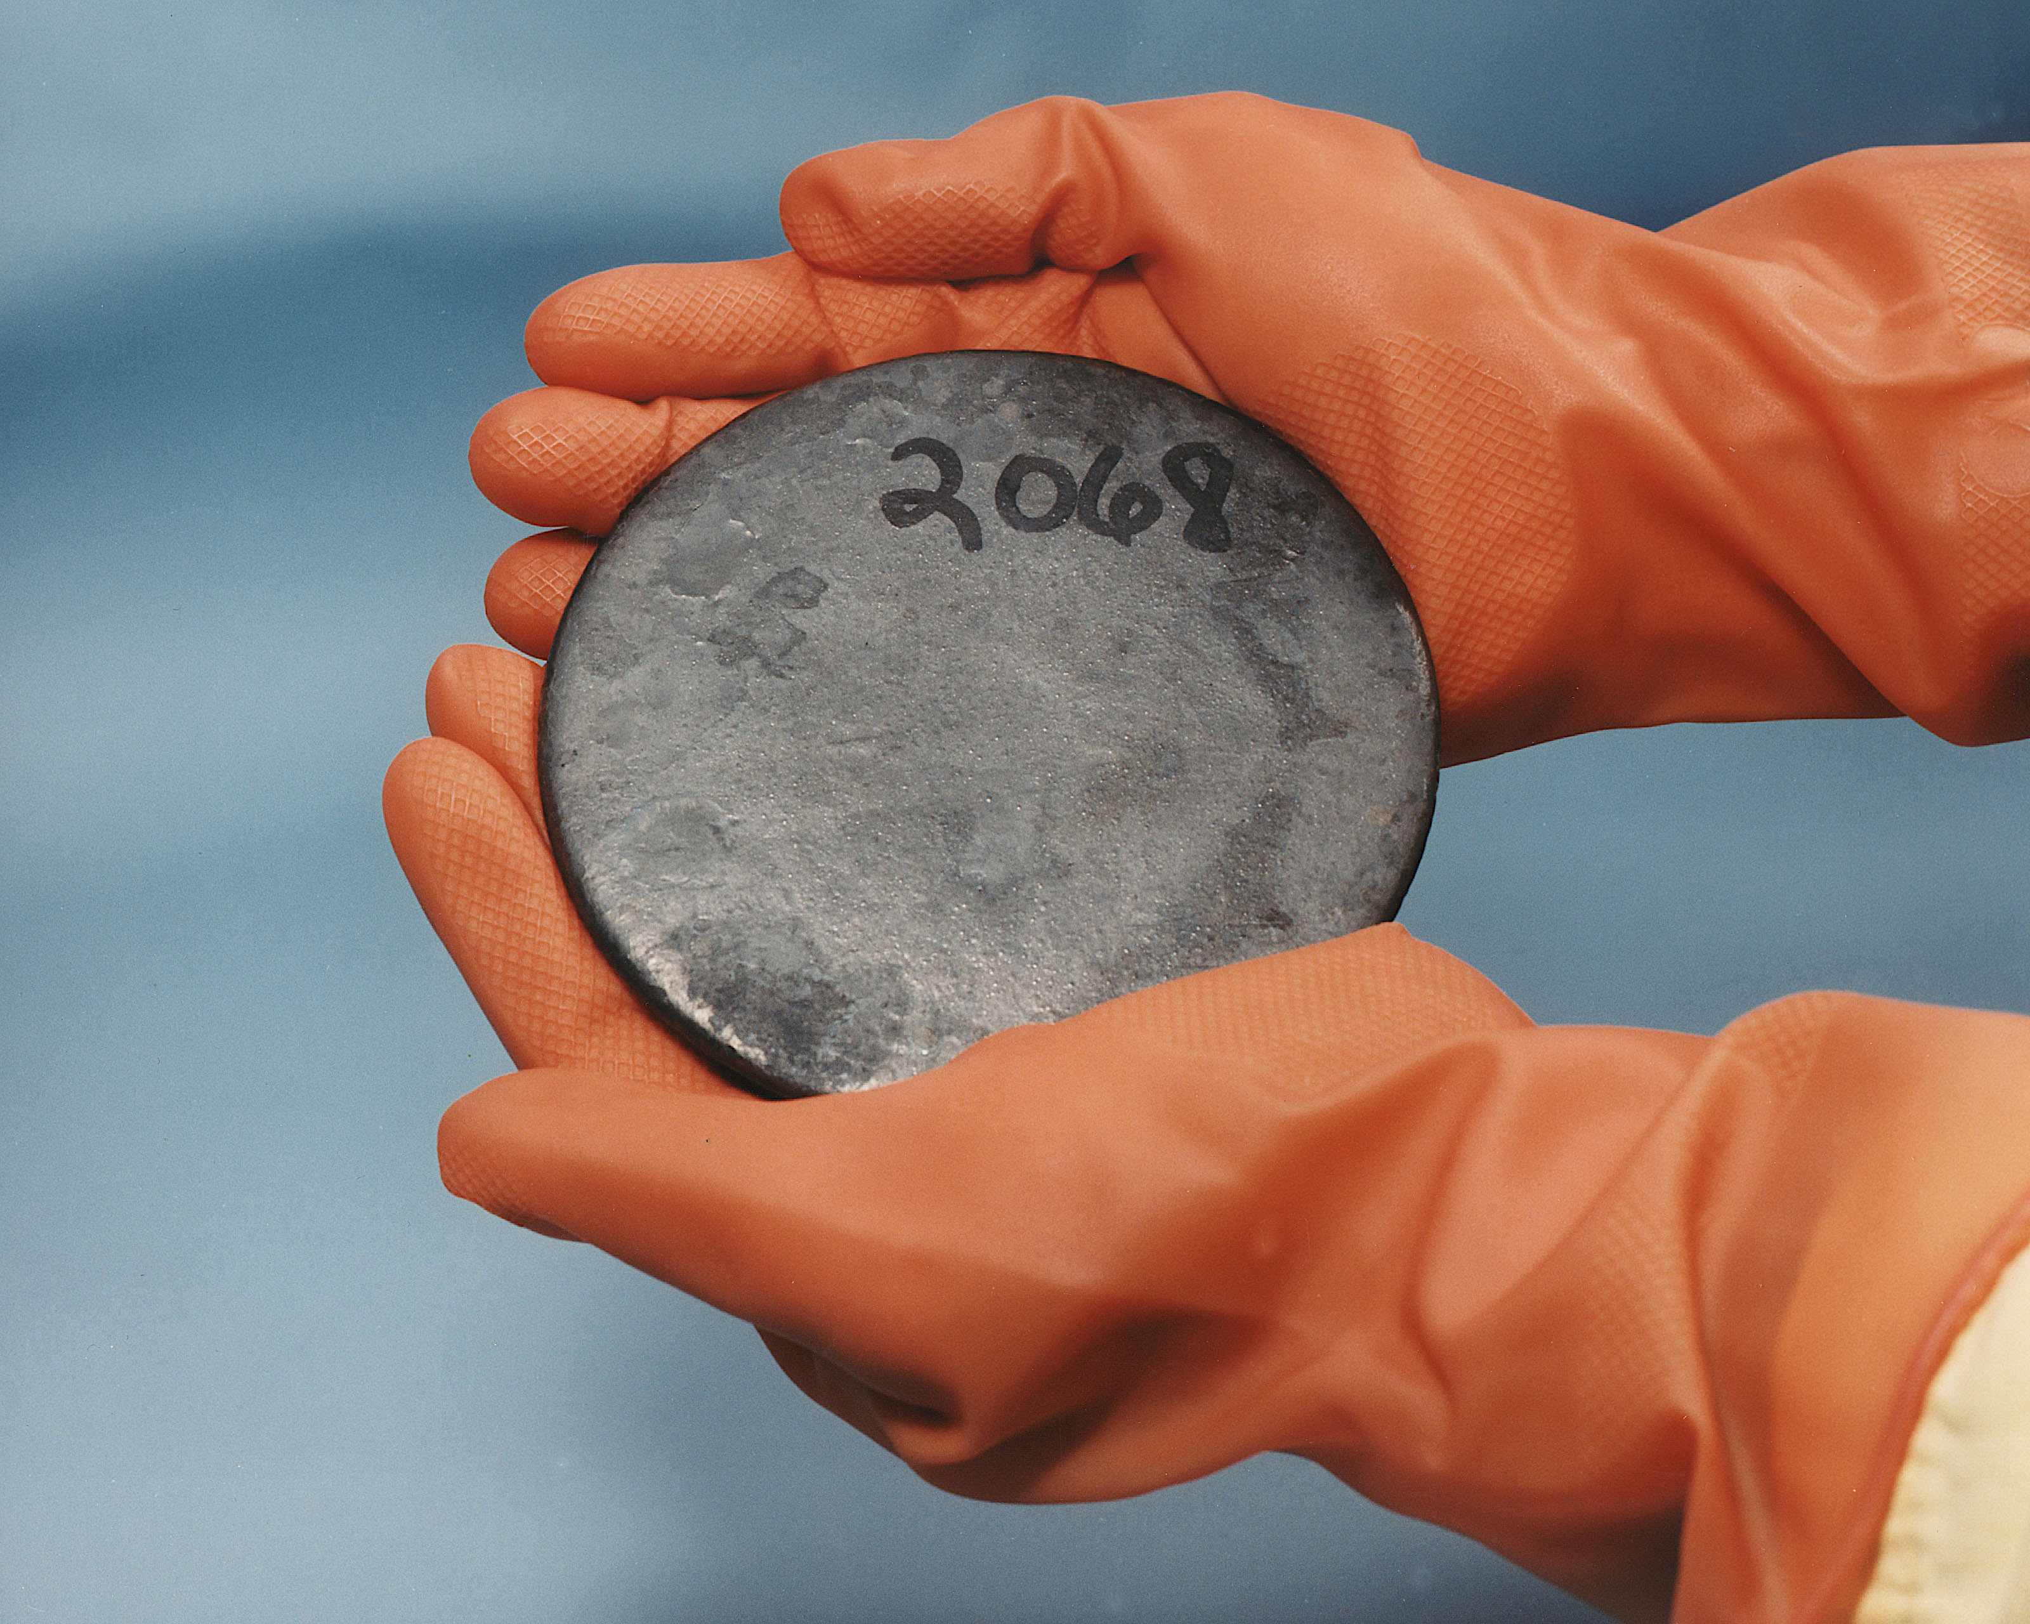
Radiation and contamination
What does direct damage by ionising radiation do to the body? ____________________________________________________________________________________________________________________________________________________________________________________
Explain the difference between irradiation and radioactive contamination. ____________________________________________________________________________________________________________________________________________________________________
Following the Chernobyl explosion, some milk supplies were found to be radioactive.
iodine-131 half-life = 8 days
If one litre of milk contaminated with iodine-131 – gives a count rate of 400 counts/second, how long will it take for the count rate to fall to 25 counts/second?
Show clearly how you work out your answer. ________________________________________________________________________________________________________________________________________________________________________
Why does a teacher wear polythene gloves when handling radioactive material? __________________________________________________________________________________ _____________________________________

Slide 3
Define & describe
Contamination will lead to __________ exposure to radiation compared to irradiation. This is because unlike irradiation, contamination means __________ sources are left on the skin or clothing and can remain unseen. That’s why it is important to ______ thoroughly if a person comes into contact with radioactive material. This also explain why we would use ___________ to sterilise fruit and vegetables, as exposure to radiation will not itself cause the food to become radioactive.
wash increased radioactive irradiation
Give a full description of the irradiation type and reason for doing it:-
Irradiation type | Description of irradiation process and explanation
Irradiating fruit and vegetables
Sterilising surgical instruments
Treating cancer

