Slide 1

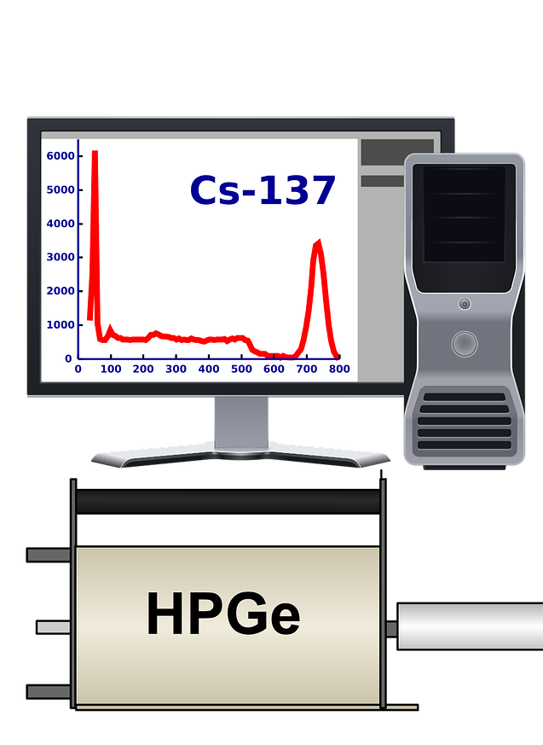
0001.01
Mission Assignment
Task | Visit the recommended link given by your teacher to the use of radiation in medicine. Make notes on internal and external use of radioactive isotopes
Developing skills | Taking notes from written text that list precise bullet points of information that can become flashcards that are easy to revise for exams
Think about… | Consider how radiation can be used in positive and life-changing applications
KS4-21-11:
Explore how Radiation is used in Medicine

