Slide 1
S06.10.06 Handout 2 – Renewable Energy Debate
Explore the benefits and problems of renewable energy sources
Get into groups of three. Pick one of six sets of people below. Think about what attitude your chosen group will have towards renewable and non-renewable energy. Choose a role each from the three shown on the next page then complete the following tasks:
Write a speech that argues for your group’s point of view
Create a poster featuring key points about your arguments
Create an information sheet to help back up those arguments in more depth
Take part in a debate using the information you have found
Villagers of a seaside resort overlooking a proposed offshore wind farm site.
Your little village has the great views all around it – out to open countryside one way, out over the vast stretches of sea the other way.
The proposal for an offshore wind farm that would interrupt that sea view not only would spoil it, but the villagers fear it may put people off coming to their village, staying in their holiday homes and buying from the local shops.
The leaders of a worldwide scientific research company.
Science, science, science. You live and breathe science. You conduct research across the globe into the human impact on the planet. You monitor everything from global temperatures to recycling figures.
You keep a track of worldwide fossil fuel usage and how much energy is used by humans every year. What you are most interested in is the clear facts about renewable energy.
The President of the USA and her/his advisors.
You are the leaders of a very wealthy country. You deal with a lot of global sales of fossil fuels (you produce a lot of oil) and have a lot of industry to support (you need a lot of power to keep your country going).
You are responsible for the wellbeing of tens of millions of people and you have to decide what is best for them – long-term and short-term.
A wildlife conservation group.
You run a huge national park that is a place to live for tens of thousands of different species of plants and animals.
You are responsible for ensuring that the habitats in your park remain in a state that supports the survival of the species living there. You are all animal lovers and care a lot about the survival of the creatures that you look after. The current fossil fuel usage worries you and you are anxious for things to change for the better.
The townspeople living next to a site proposed for a new nuclear power station
You are people living in a town very close to a proposed site for a new nuclear power station. You have heard what has happened to wildlife near other such power stations and are worried about health issues associated with them. Radioactive waste is a worry.
The power station would bring new jobs, but at what expense?
The board (leaders) of a large oil company.
Money makes the world go round! That’s what you care about. You got where you are as a result of your own hard work and you aren’t about to lose it all because some people are worrying about some sea life in the Atlantic Ocean or not enough people are driving electric cars.
People have done what you have been doing for centuries and it’s just jealousy that is leading people to try to get your wealth for themselves.
Stretch:
make direct references to key aspects of your group’s needs. Identify persuasive features and use them in your own presentation.
Challenge:
create a presentation that gives a persuasive argument for your group’s point of view.
Developing Experts Ltd. Copyright 2018 All rights reserved.

Slide 2
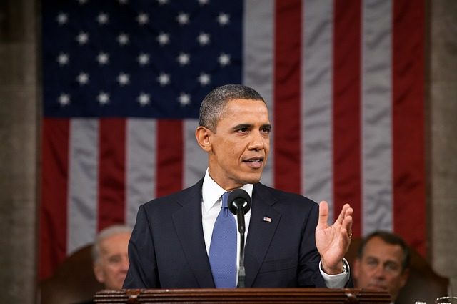
S06.10.06 Handout 2 – Renewable Energy Debate
Explore the benefits and problems of renewable energy sources
Each member of your group will have a specific role to play. Remember, teamwork is very important when you are trying to achieve something. Select your group roles carefully.
Creative Director
responsibilities:
design and produce the information poster
ensure all relevant information is included, properly researched and presented persuasively
meet and communicate with the Literary Director and Spokesperson to agree key points
ensure that the images and text on the poster reflect the group’s key messages
Literary Director
responsibilities:
design and produce the information leaflet
ensure all relevant information is included, researched and written persuasively in the leaflet
meet and communicate with the Literary Director and Spokesperson to agree key points
ensure that the images and text on the poster reflect the group’s key messages
Spokesperson
responsibilities:
write and deliver a persuasive speech to deliver to the class
ensure that all relevant information is included and accurate
meet and communicate with the Literary Director and Spokesperson to agree key points
ensure that speech is written persuasively and reflects the group’s key messages
Developing Experts Ltd. Copyright 2018 All rights reserved.

Slide 3
S06.10.06 Handout 2 – Renewable Energy Debate
Explore the benefits and problems of renewable energy sources
Persuasive Talk Tips
Think about how you are going to persuade the other groups that your argument is a good one.
Think carefully about how you can use images and language to do this.
Use the table below to help you use persuasive language effectively.
To persuade your audience, use FRAWPS!
FRAWPS | Technique | What does it mean?
F | Facts and Statistics | Using information that is true. You might include numbers or statistics, percentages or dates.
R | Rhetorical Questions | Asking questions that are meant to be thought about rather than answered.
A | Alliteration | Using the same sound often and close together in a sentence.
W | Word Choice | Think carefully about the vocabulary you use. What thoughts or emotions does each word make your reader/listener experience?
P | Paragraphing | Make sure that you divide your work into paragraphs – especially if you change topic or setting in your writing.
S | Sentence Length | Vary the length of your sentences. Short sentences might be used to point out important points or ideas, but longer sentences could be used to give more information to your reader.
Which of these two examples is better? Why? Which one uses FRAWPS better?
A | B
Don’t use fossil fuels because it’s bad for everyone because we’ll run out and then everyone will have to walk to work anyway. They’ll be sad about it because their legs will get tired and the wildlife will be bad and there’ll be no way to make it better. It’s better to use wind energy and stuff. | 2088. That is the year that scientists predict that Earth will completely run out of coal. Worrying, isn’t it? Why wait? Why wait to act when wind energy could save us all with clean, safe energy production in our lifetime. What are we waiting for?
Developing Experts Ltd. Copyright 2018 All rights reserved.

