Slide 1



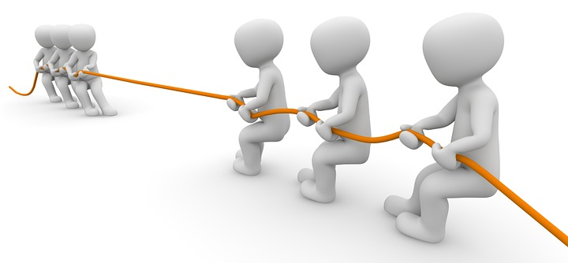


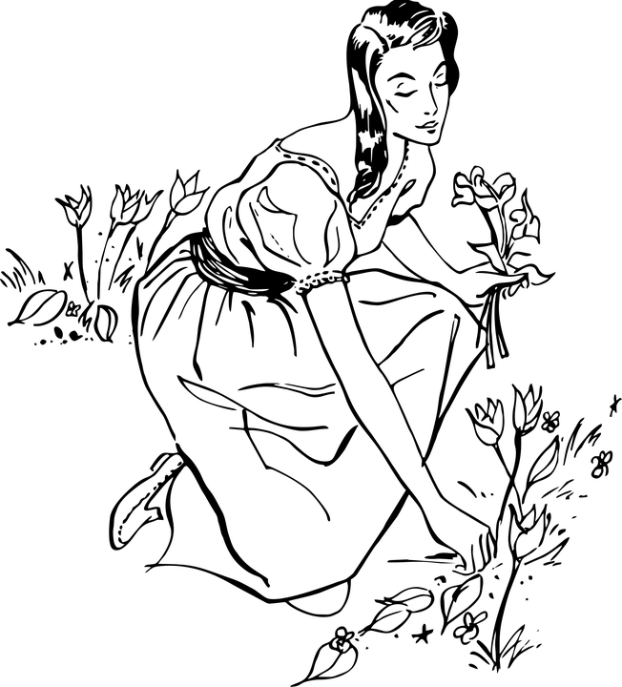
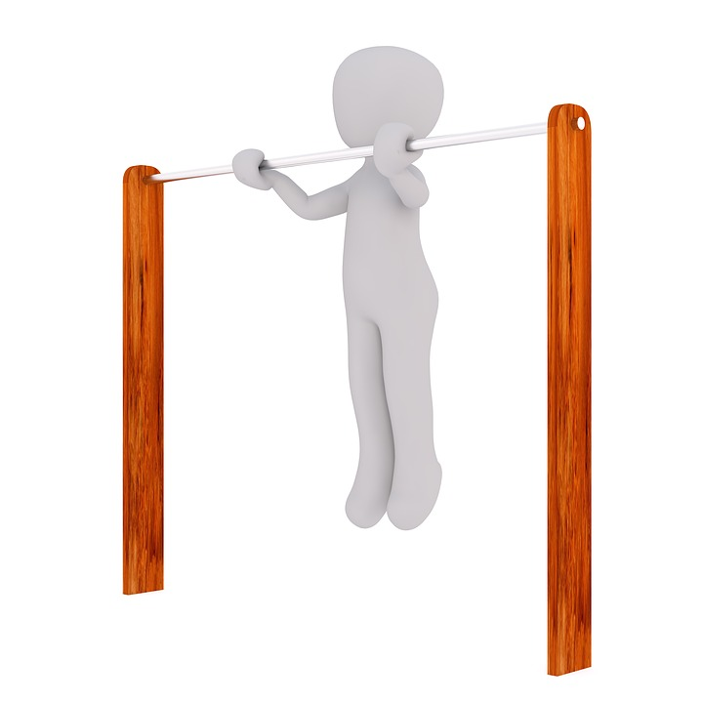

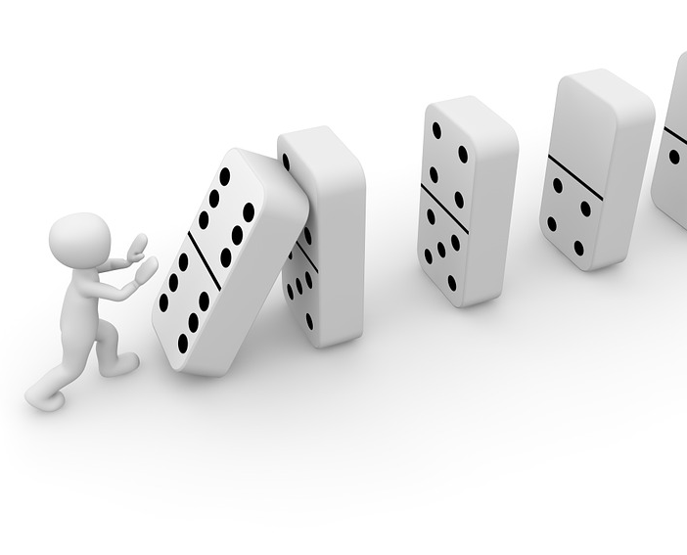
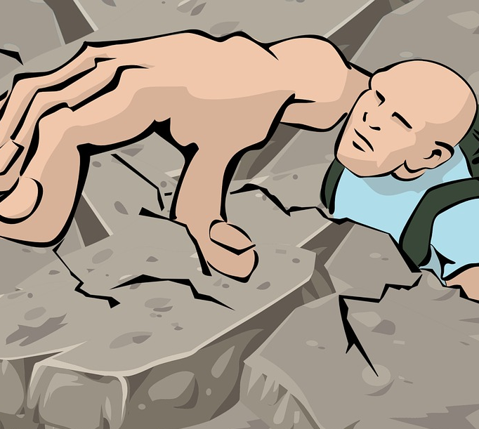
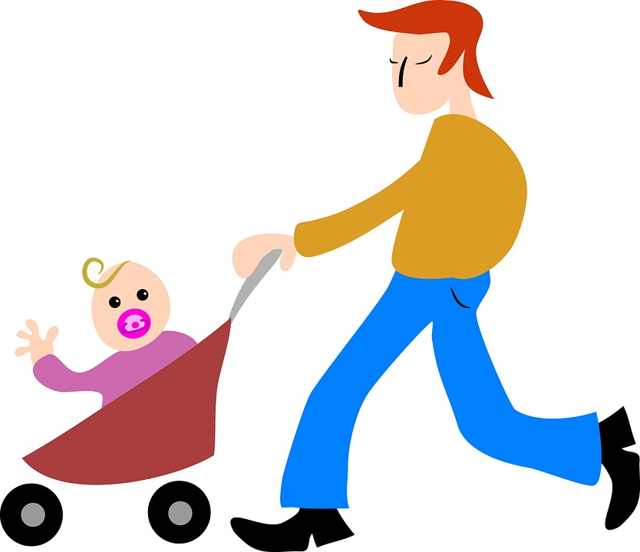


Mission Assignment: What happens when you push or pull something?
Code: EYFS-03-01
Cut out the cards and sort them into pushes and pulls.
2
Developing Experts Copyright 2024 All Rights Reserved

Slide 2
Mission Assignment: What happens when you push or pull something?
Code: EYFS-03-01
Draw the different pushes and pulls you can do in your classroom.
3
3
Developing Experts Copyright 2024 All Rights Reserved
Developing Experts Copyright 2023 All Rights Reserved

