Slide 1
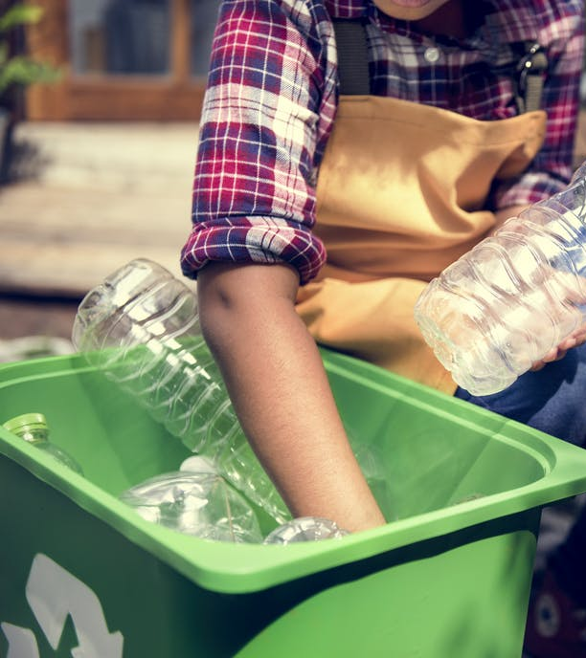

Explore the importance of recycling
Describe ways to reduce the use of resources.
Developing Experts All rights reserved © 2021

Slide 2
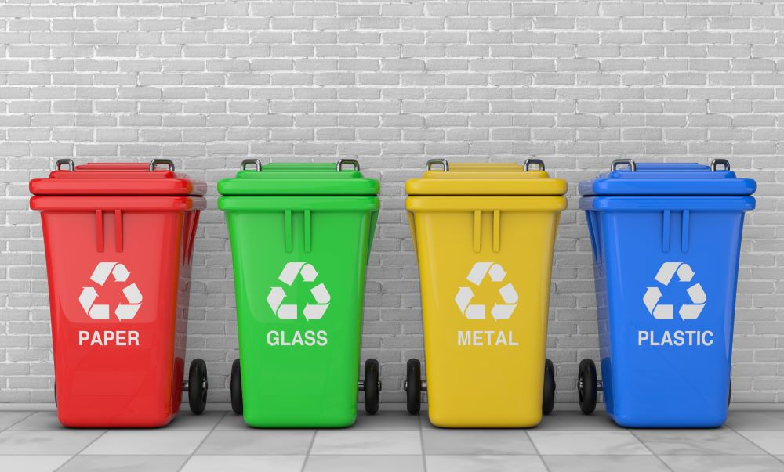
Developing Experts All rights reserved © 2021

Slide 3
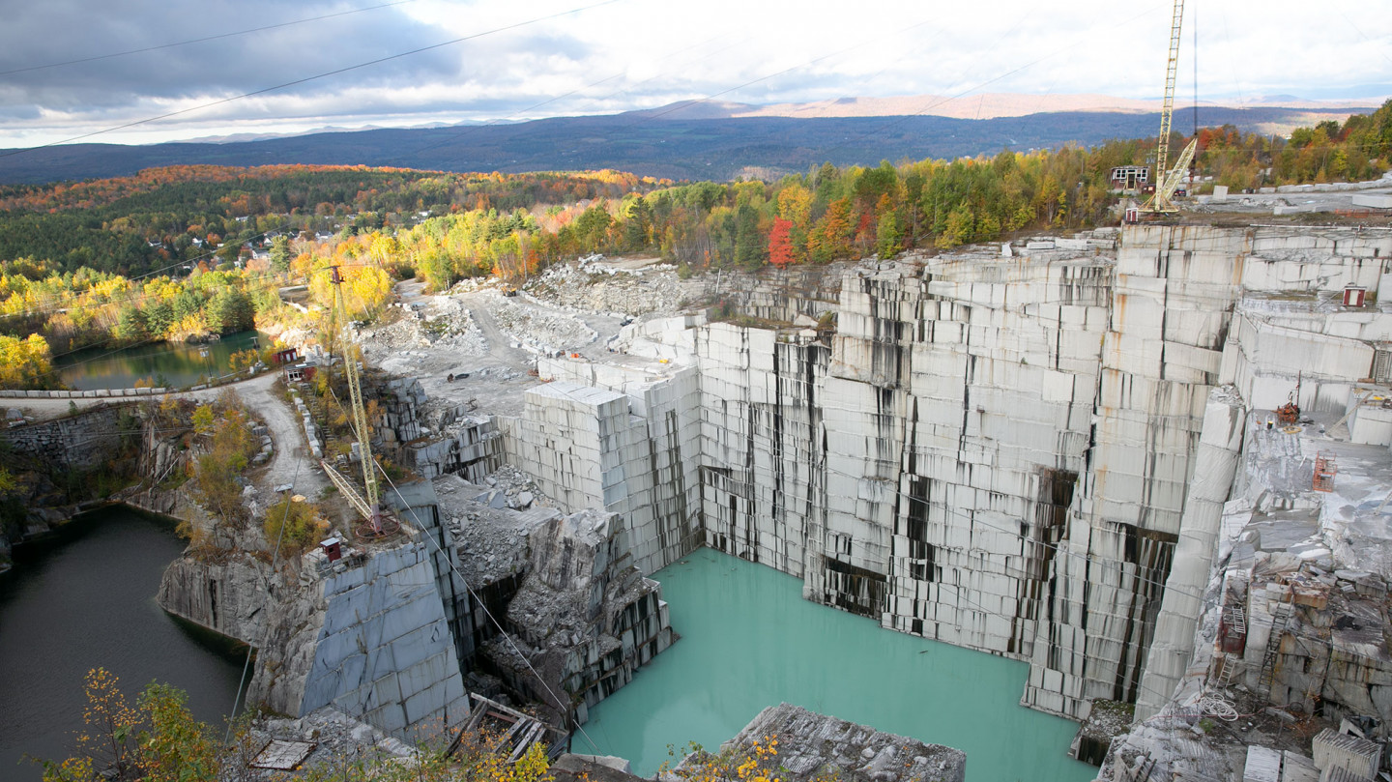
Developing Experts All rights reserved © 2021

Slide 4
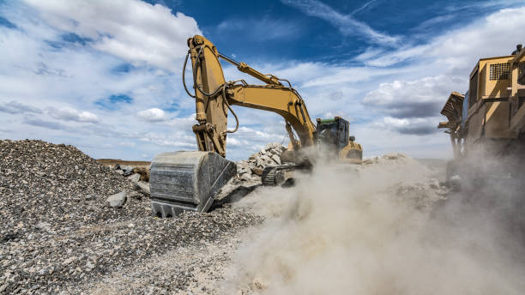
Developing Experts All rights reserved © 2021

Slide 5
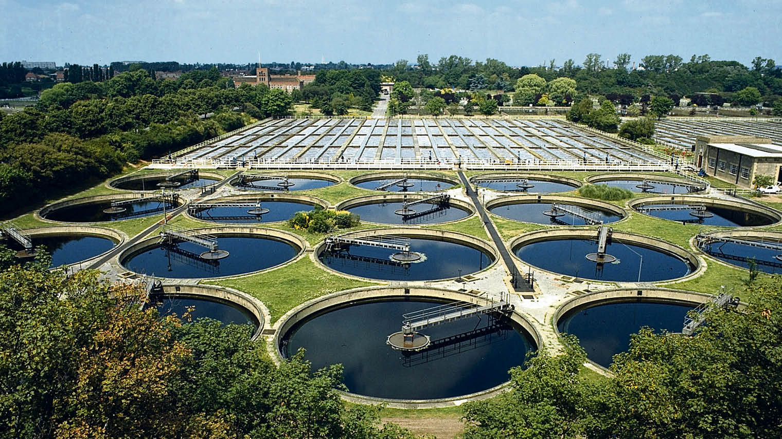
Developing Experts All rights reserved © 2021

Slide 6
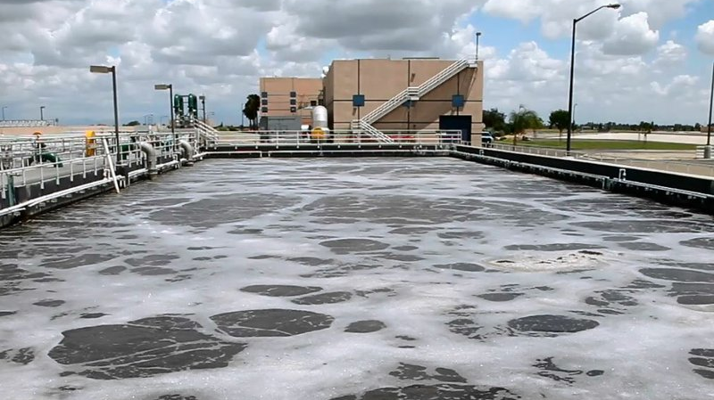
Developing Experts All rights reserved © 2021

Slide 7
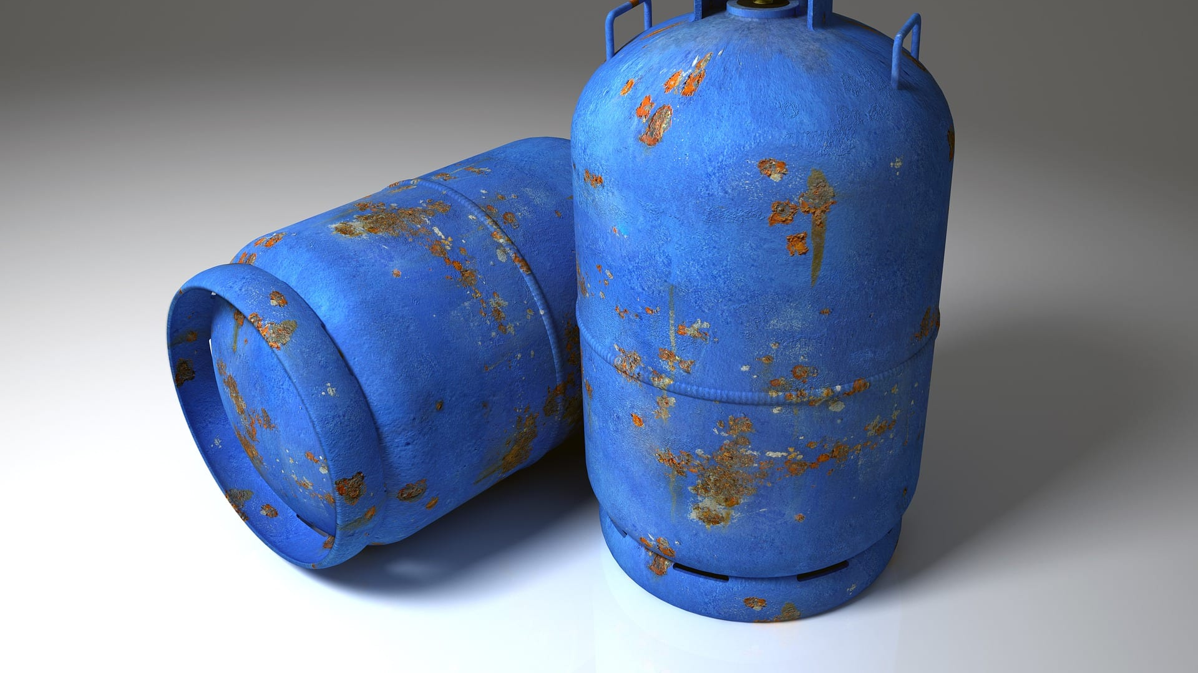
Developing Experts All rights reserved © 2021

Slide 8
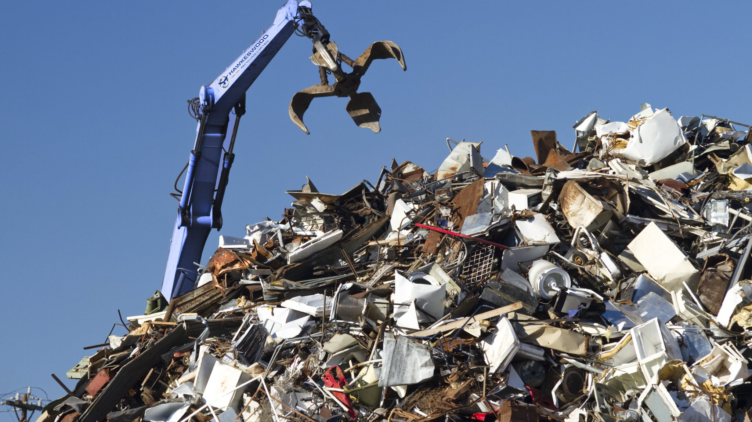
Developing Experts All rights reserved © 2021

Slide 9
Explore the importance of recycling
Describe ways to reduce the use of resources.
Developing Experts All rights reserved © 2021

