Slide 1


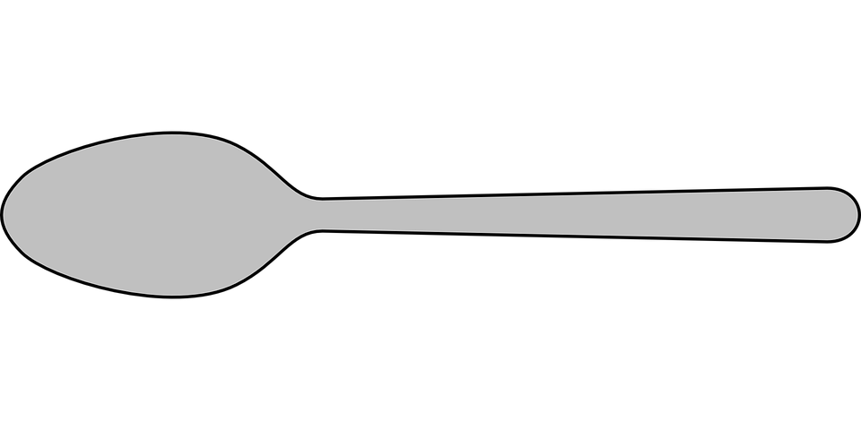
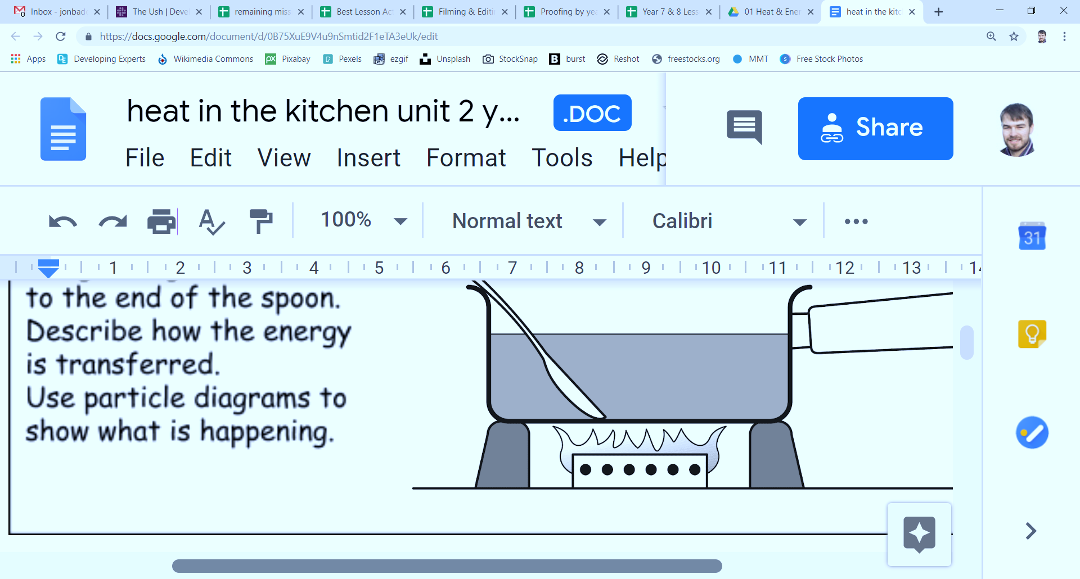
Mission Assignment: Describe how heat is transferred through solids
KS3-04-03
Metal conductivity
The picture below shows a metal saucepan with a plastic handle. Water is being boiled in the saucepan. A wooden spoon and a metal spoon have been left in the saucepan.
Which spoon is likely to feel hotter? Explain your idea.
_______________________________________________________________________________________________________________________________________________________________________________________________________________
Add arrows to your diagram to show how the heat moves from its source to a spoon.
Label two thermal conductors and two thermal insulators on the diagram.
Explain how heat is conducted through a metal. Include a particle diagram in your answer.
____________________________________________________________________________________________________________________________________________________________________________________________________________________________________________________________________________________
Explain why the handle is made of plastic.
_______________________________________________________________________________________________________________________________________________________________________________________________________________
Developing Experts Copyright 2023 All Rights Reserved

Slide 2
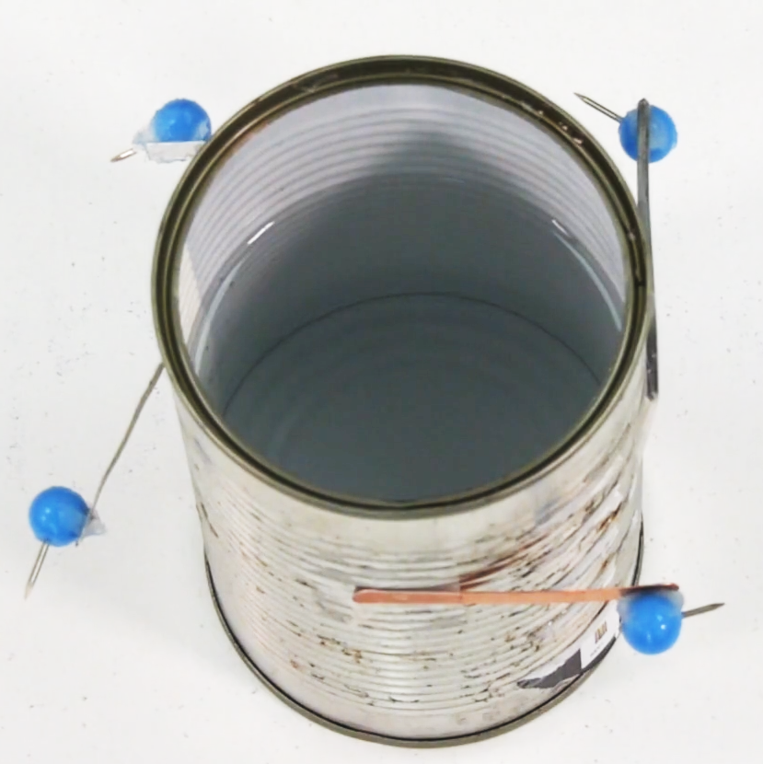
Mission Assignment: Describe how heat is transferred through solids
KS3-04-03
Metal conductivity
Method:
Tape metal samples to the outside of the tin can, ensuring that they are in direct contact with the can but not each other.
Stick drawing pins onto the ends of the metal strips using petroleum jelly. Try to use the same amount of jelly on each pin.
Pour hot water from the kettle into the can so that it comes up to the same level as the metal samples. Start your stopwatch.
Record the time taken for the pin to drop from its metal strip.
Equipment
Sticky tape
Drawing pins
Petroleum jelly
Tin can
Kettle
Stopwatch
Metal sample cut into strips of the same thickness and length.
Metal | Time taken for pin to drop (s)
Which metal in your experiment was the best thermal conductor?
____________________________________________________________________________________
Explain how you know.
________________________________________________________________________________________________________________________________________________
Suggest how this experiment could be improved to give more accurate results.
________________________________________________________________________________________________________________________________________________
How would changing the material of the can affect your results?
________________________________________________________________________________________________________________________________________________
Developing Experts Copyright 2023 All Rights Reserved

Slide 3
Mission Assignment: Describe how heat is transferred through solids ANSWERS
KS3-04-03
Metal conductivity
The picture below shows a metal saucepan with a plastic handle. Water is being boiled in the saucepan. A wooden spoon and a metal spoon have been left in the saucepan.
conductor
insulator
Which spoon is likely to feel hotter? Explain your idea.
___________________________________________________________________________________________________________________________________________________________________________________________________________________________________________________
Add arrows to your diagram to show how the heat moves from its source to a spoon.
Label two thermal conductors and two thermal insulators on the diagram.
Explain how heat is conducted through a metal. Include a particle diagram in your answer.
_____________________________________________________________________________________________________________________________________________________________________________________________________________________________________________________________________________________________________________________________________________________________________________________________________________________
Explain why the handle is made of plastic.
___________________________________________________________________________________________________________________________________________________________________________________________________________________________________________________
The metal spoon is a better conductor of heat than the wooden spoon because metal conducts heat and wood does not.
The particles closest to the heat source gain thermal energy. This causes the particles to vibrate. This increase in kinetic energy passes the energy down the spoon as heat.
Plastic is an insulator. It is a poor conductor of heat. This stops a person getting hurt when they use the pan.
Developing Experts Copyright 2023 All Rights Reserved

Slide 4
Mission Assignment: Describe how heat is transferred through solids ANSWERS
KS3-04-03
Metal conductivity
Method:
Tape metal samples to the outside of the tin can, ensuring that they are in direct contact with the can but not each other.
Stick drawing pins onto the ends of the metal strips using petroleum jelly. Try to use the same amount of jelly on each pin.
Pour hot water from the kettle into the can so that it comes up to the same level as the metal samples. Start your stopwatch.
Record the time taken for the pin to drop from its metal strip.
Equipment
Sticky tape
Drawing pins
Petroleum jelly
Tin can
Kettle
Stopwatch
Metal sample cut into strips of the same thickness and length.
Metal | Time taken for pin to drop (s)
Which metal in your experiment was the best thermal conductor?
____________________________________________________________________________________
Explain how you know.
________________________________________________________________________________________________________________________________________________
Suggest how this experiment could be improved to give more accurate results.
________________________________________________________________________________________________________________________________________________
How would changing the material of the can affect your results?
________________________________________________________________________________________________________________________________________________
Repeat the practical and calculate a mean/average.
If the material is better at conducting heat, then the time will decrease. If the material was an insulator, the pin will take longer to drop or not drop at all.
Developing Experts Copyright 2023 All Rights Reserved

