Slide 1

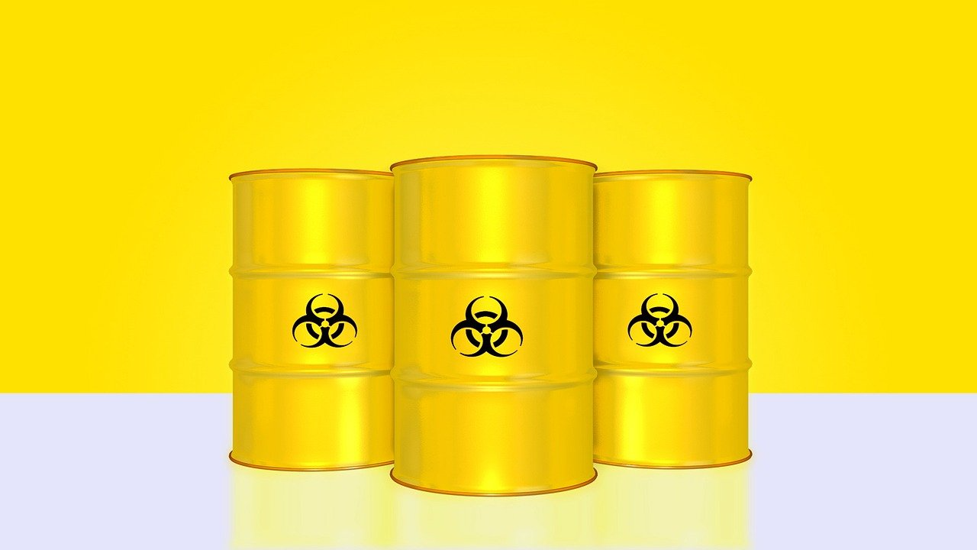
0001.01
Mission Assignment
Task | Make a risk assessment of the protections and measures that must be followed when using sources of radiation in a school laboratory.
Developing skills | Health and safety in the practical science environment is an essential requirement – keep a journal of safety guidance you have followed.
Think about… | The comparison between proactive and safe use of radioactive materials and incidents of radioactive contamination – what have we learnt?
KS4-21-08:
Explore the Hazards of Radiation

