Slide 1


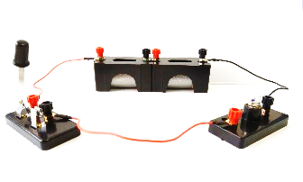
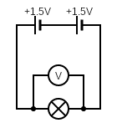
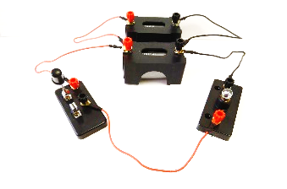
Mission Assignment: Describe the role of voltage
KS3-22-03
Investigate the effect of cells arranged in series and parallel circuits.
Build the circuits as shown below. Describe the brightness of the bulbs and measure the voltage across the bulb.
Circuit | Brightness of bulb | Bulb voltage (V)
Series Cells
Parallel Cells
Equipment
2 cells 1.5V
1.5V Bulb
6 wires
Voltmeter
What can you conclude from this experiment about how the arrangement of batteries affects the brightness of the bulb?
____________________________________________________________________________________________________________________________________________________________________________________________________________________________________________________________
What can you conclude from this experiment about how the arrangement of batteries affects the voltage across a bulb?
____________________________________________________________________________________________________________________________________________________________________________________________________________________________________________________________
Adding batteries in series or parallel will affect how long the power can be supplied for. Which arrangement will power devices for longer? Explain your idea.
____________________________________________________________________________________________________________________________________________________________________________________________________________________________________________________________
Developing Experts Copyright 2023 All Rights Reserved

Slide 2
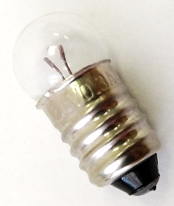

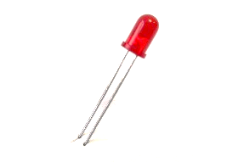
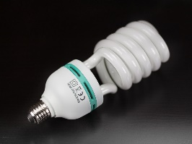
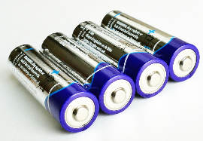
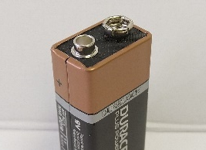
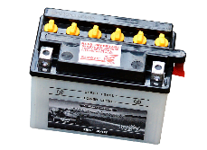

Mission Assignment: Describe the role of voltage
KS3-22-03
For each of the following bulbs, give operating voltage, power rating, a description of its brightness and what it is used for.
Bulb | Voltage (V) | Power (W) | Brightness | Use
Small Filament
Neon Sign
LED
Energy Saving
For each of the following batteries, give the voltage, an example of their usage and how long they last.
Battery | Voltage (V) | Use | Lifetime
AA Battery
9V Battery
Car Battery
Cell Phone Battery
Developing Experts Copyright 2023 All Rights Reserved

Slide 3
Mission Assignment: Describe the role of voltage
KS3-22-03
Batteries and bulbs information sheet
Bulb Information
Small Filament Bulbs These are typically used in simple electrical circuits in education and novelty lighting. They normally operate between 1.5V - 12V and have a power output of between 0.45W -3.6W. These are not very efficient as a lot of energy is wasted as heat. | Neon Sign A neon sign works by using electrical energy to excite the gases inside to the point that they glow. These are typically used in displays to promote shops, restaurants etc. They will operate on a supply between 110-230V but, despite the high voltage, they have a relatively low current (~0.8A) and consume between 90-180W.
LEDs LEDs are commonly found in electronics as they consume very little power and only need a small current to light up. They operate on a voltage between 1.5-4.0V but, because they only require a small current, have a power output of 0.03-1.40W. | Energy Saving An energy-saving bulb is an alternative to the incandescent filament bulb. As the name suggests, they are a lot more energy efficient. Despite the relatively high voltage needed to operate (between 110-230V), they consume a low level of power (9-15W). The little power that is consumed is used efficiently with little waste.
Battery Information
Car Battery As the name suggests, a car battery is used in vehicles. This is used for all the electrical processes in the car i.e. lights, radio etc. It operates between 12-14V and is charged by the motion of the vehicle. Because they are continually recharged, they can last the lifetime of the vehicle. | AA Battery The AA battery is the most common battery in the world. Their size and versatility make them excellent for powering a broad range of devices (e.g. torches, radios, remote controls). Their popularity can be a problem as more than 3 billion are thrown away in the USA alone every year. Their 1.5V output means they can be easily combined with other batteries to create a range of voltages.
Cell Phone Battery A cell phone is actually named after its battery! The battery is essential for all the phone’s operations. Most smartphone batteries require charging every day. However, some simpler phones can have batteries that last for weeks.! They operate between 3.7-4.2 volts. | 9V Battery A 9V battery has quite a large power capacity and is therefore used in devices that need to be left unattended for long periods of time (e.g. smoke detectors, alarm clocks, walkie-talkies).
Developing Experts Copyright 2023 All Rights Reserved

Slide 4
Mission Assignment: Describe the role of voltage
ANSWERS
KS3-22-03
Investigate the effect of cells arranged in series and parallel circuits.
Build the circuits as shown below. Describe the brightness of the bulbs and measure the voltage across the bulb.
Circuit | Brightness of bulb | Bulb voltage (V)
Series Cells
Parallel Cells
Equipment
2 cells 1.5V
1.5V Bulb
6 wires
Voltmeter
What can you conclude from this experiment about how the arrangement of batteries affects the brightness of the bulb?
____________________________________________________________________________________________________________________________________________________________________________________________________________________________________________________________
What can you conclude from this experiment about how the arrangement of batteries affects the voltage across a bulb?
____________________________________________________________________________________________________________________________________________________________________________________________________________________________________________________________
Adding batteries in series or parallel will affect how long the power can be supplied for. Which arrangement will power devices for longer? Explain your idea.
____________________________________________________________________________________________________________________________________________________________________________________________________________________________________________________________
Bulbs should be dimmer in the series circuit than the parallel circuit.
Voltage is the same across all components in a parallel circuit and shared across the components in a series circuit.
Batteries last longer in parallel because the voltage remains the same across all the components.
Developing Experts Copyright 2023 All Rights Reserved

