Slide 1

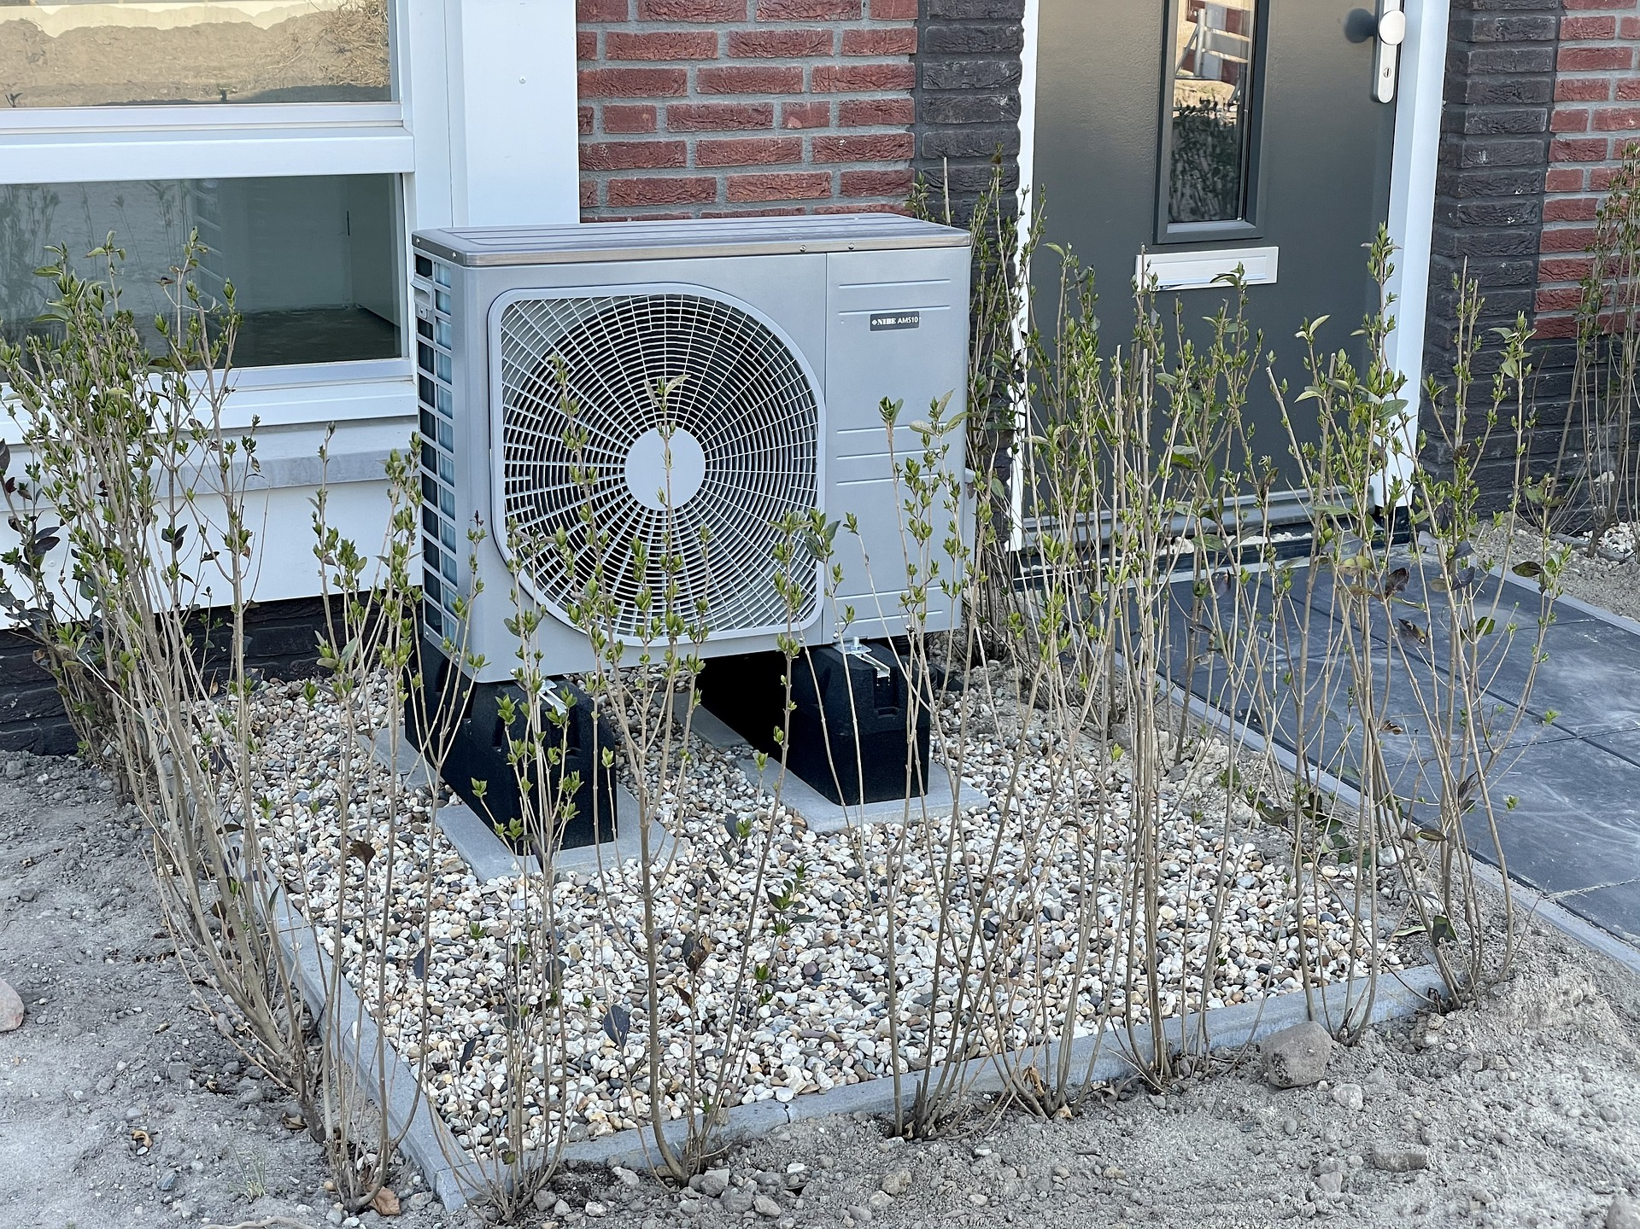
0001.01
Mission Assignment
Task | Explore the connections between James Joule and his peers, such as Lord Kelvin. Explain how their discoveries in thermal energy experiments and calculations were made by collaboration between scientists and engineers. Work through the mathematical problems and practise rearranging equations.
Developing skills | Go online and find specific heat capacity problems to practise
Think about… | Reflect on how collaborative scientific thinking over a period of time and through a group of unconnected scientists adds to the body of knowledge.
KS4-18-07:
Explore specific heat capacity

