Slide 1


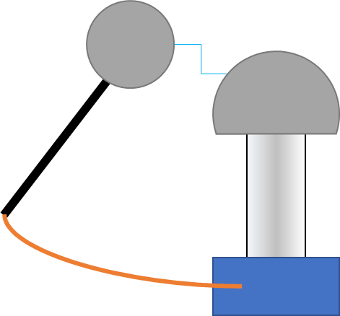
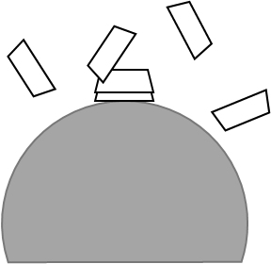
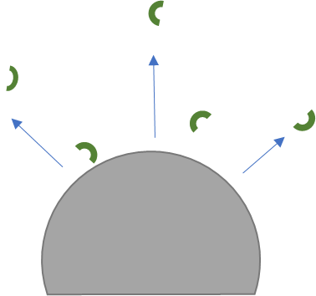
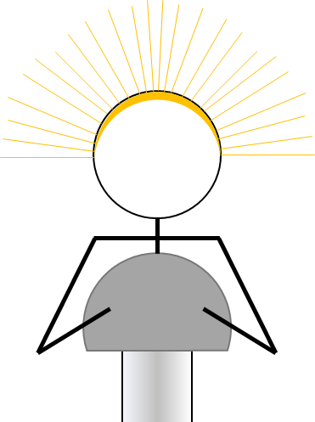

Mission Assignment: Describe how objects become charged
KS3-23-01
Explain how each phenomenon occurs in terms of electron flow. You can use the diagrams to help your explanation.
Static wand
________________________________________________________________________________________________________________________________________________________________________________________________________________________________________
Cupcake cases
________________________________________________________________________________________________________________________________________________________________________________________________________________________________________
Polystyrene chips
________________________________________________________________________________________________________________________________________________________________________________________________________________________________________
Hair standing on end
________________________________________________________________________________________________________________________________________________________________________________________________________________________________________
Balloon sticking to wall
________________________________________________________________________________________________________________________________________________________________________________________________________________________________________
Lightning is an example of static electricity on a very large scale. Explain how lightning occurs. ____________________________________________________________________________________________________________________________________________________________________________________________________________________________________________________________________________________________________________________________________________________________________________________________________________________________________________________________________________________________________________
Developing Experts Copyright 2023 All Rights Reserved

Slide 2
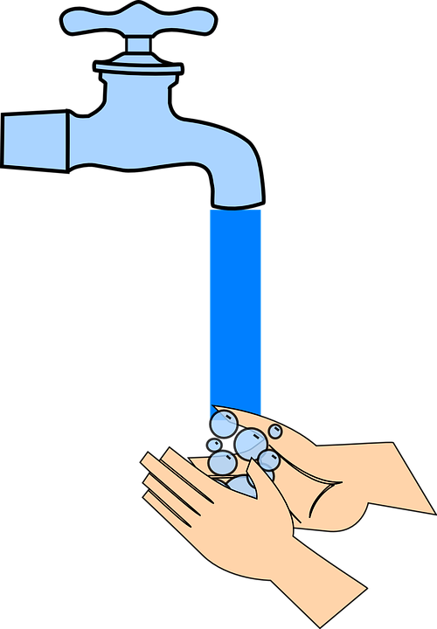

Mission Assignment: Describe how objects become charged
KS3-23-01
Explain how each phenomenon occurs in terms of electron flow. You can use the diagrams to help your explanation.
Water is a polarised molecule; that means it has a positively charged side and a negatively charged side.
Water molecules will rotate and spin when placed near a charged object.
If you charge up a balloon on a piece of wool and hold it near a tap with water gently flowing, what do you think will happen to the stream of water?
Write your prediction below.
____________________________________________________________________________________________________________________________________________________________________________________________________________________________________________________________
Now try it for yourself and write what you observe below.
____________________________________________________________________________________________________________________________________________________________________________________________________________________________________________________________
Explain why your observation occurred.
________________________________________________________________________________________________________________________________________________________________________
____________________________________________________________________________________
Static electricity is less likely to be observed in humid
conditions. Suggest why higher humidity decreases the
effects of static electricity.
________________________________________________________________________________________________________________________________________________________________________________________________________________________________________________________________________________________
Developing Experts Copyright 2023 All Rights Reserved

