Slide 1


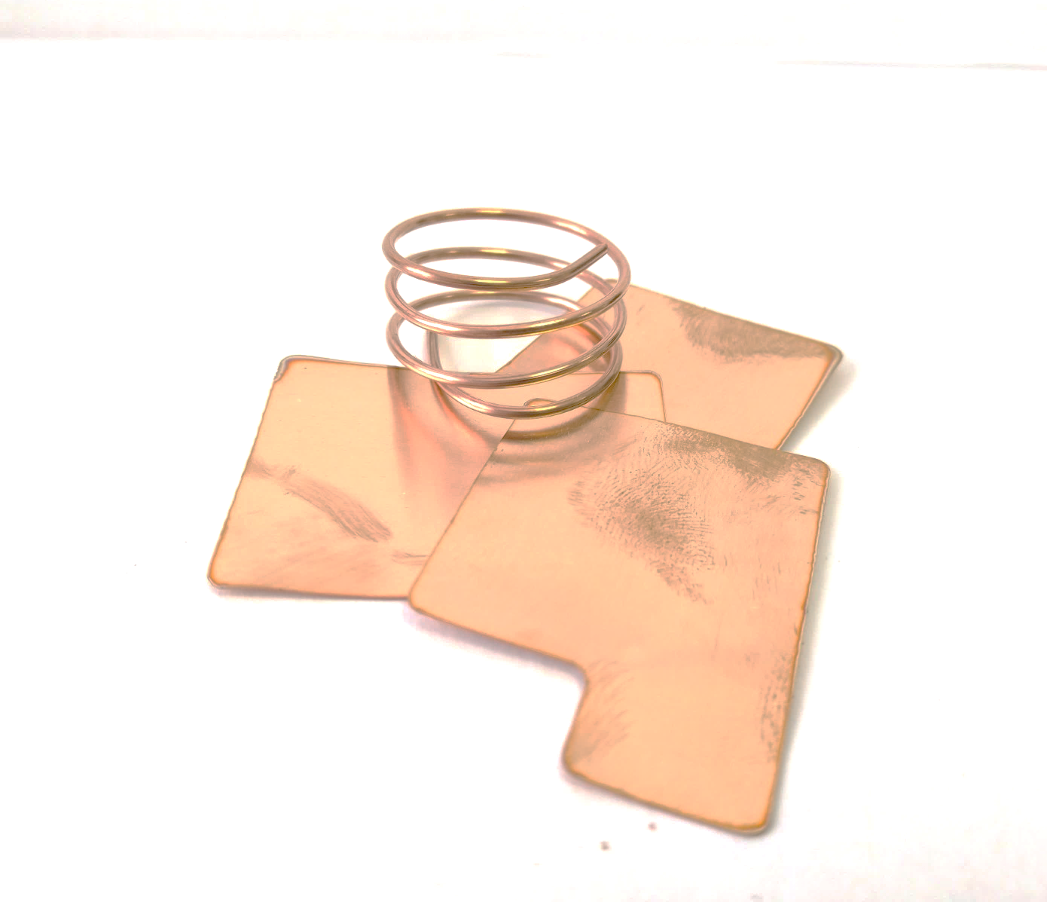
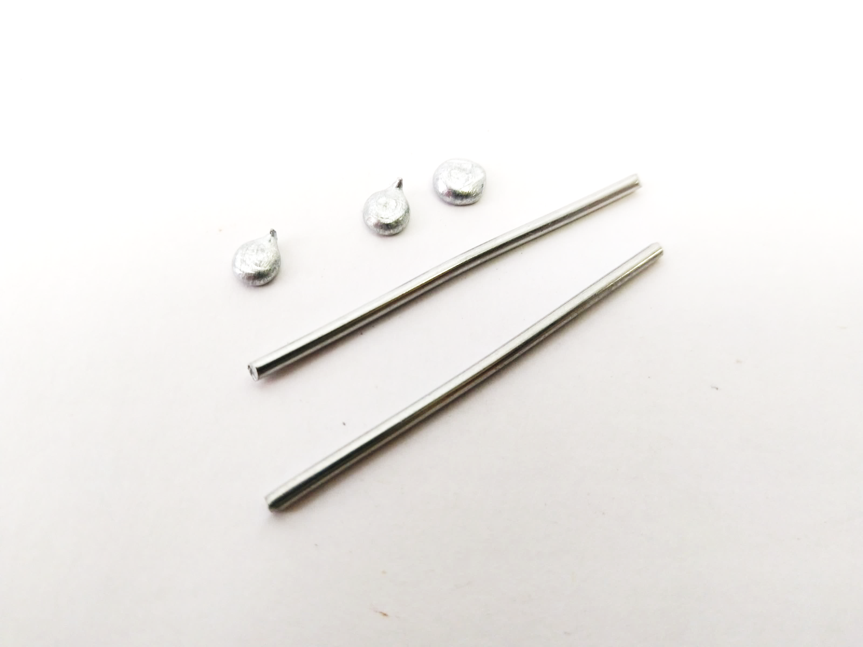
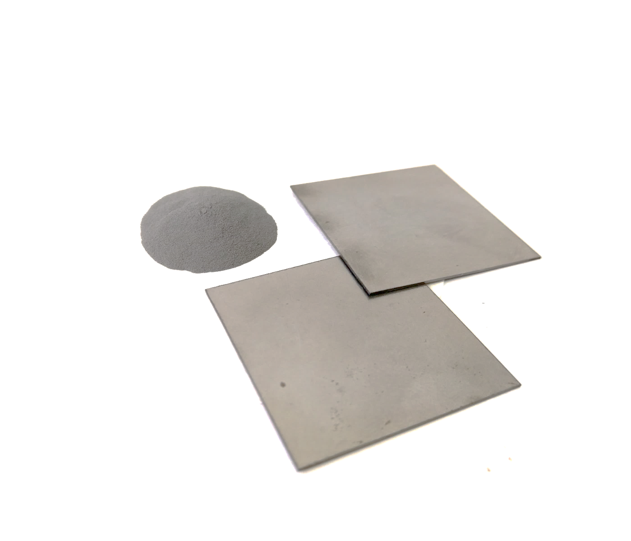
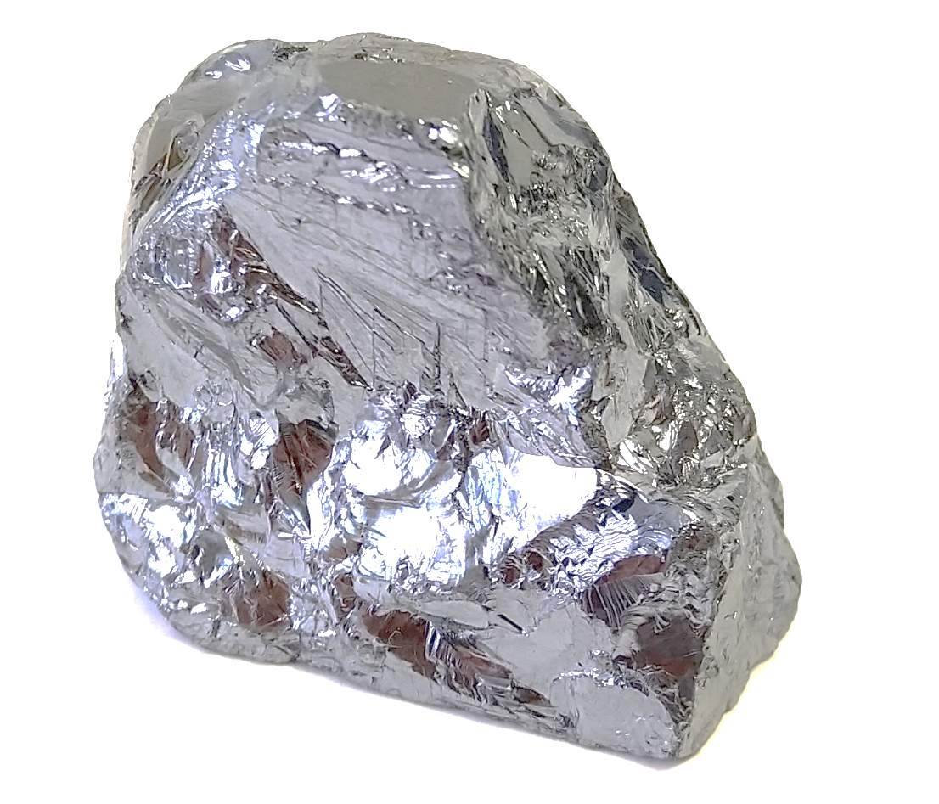
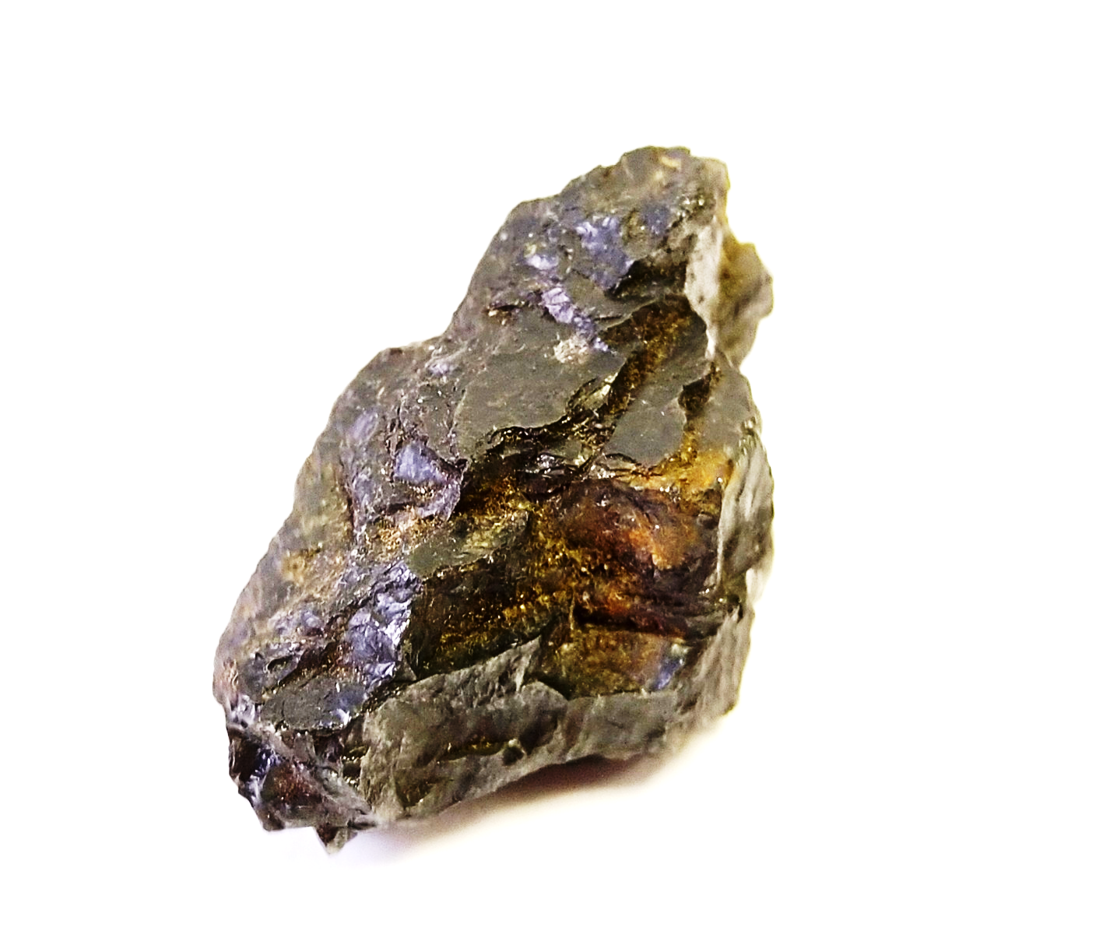
Mission Assignment: Compare electrical conductors, insulators and semiconductors
KS3-22-05
Look at the table below. Use the information to answer the following questions.
Element | Copper | Zinc | Iron | Silicon | Carbon
Resistance (Ω) | 0.6 | 0.5 | 1.5 | 28.0 | 450,000
Copper
Cu
Zinc
Zn
Iron
Fe
Silicon
Si
Carbon
C
1. Answer the questions below.
  The material with the highest resistance is ____________________.
  The material with the lowest resistance is ___________________.
  A material that is a conductor is ________________.
  A material that is a good semi-conductor is _______________.
2. Which element would allow the most current to flow? Justify your answer.
________________________________________________________________________________________________________________________________________________________________________________________________________________________
3. Carbon is used in the chemical industry to make thick electrodes. Why does carbon need to be thick to allow current to flow?
________________________________________________________________________________________________________________________________________________________________________________________________________________________
4. Current can flow through an object of high resistance when a high voltage is put across it. What is the hazard of putting a high voltage across carbon?
________________________________________________________________________________________________________________________________________________________________________________________________________________________
Developing Experts Copyright 2023 All Rights Reserved

Slide 2
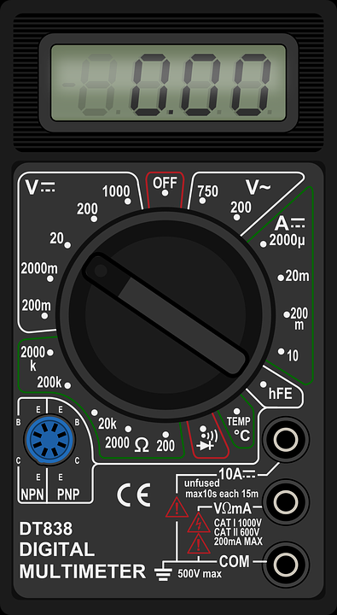
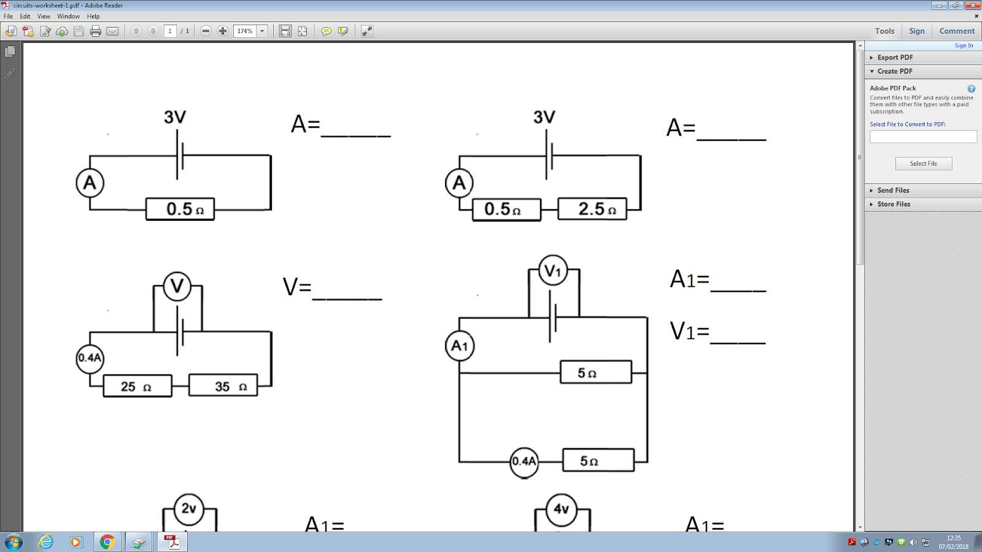
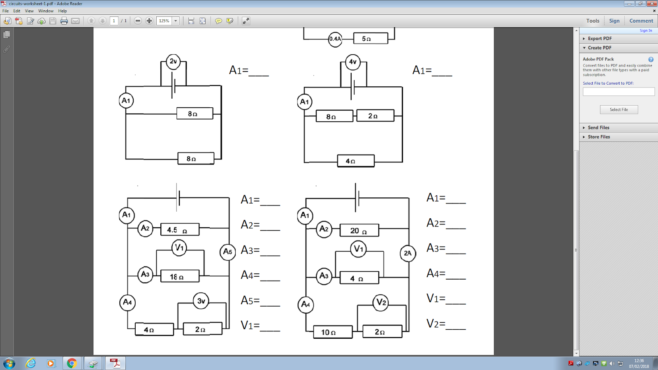
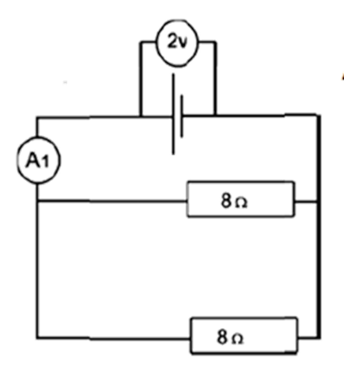
Mission Assignment: Compare electrical conductors, insulators and semiconductors
KS3-22-05
The multimeter is a very useful piece of electrical equipment as it can measure voltage, current and resistance. The multimeter can measure a large range of values from very small currents to very large resistances. Read the information below and answer the questions.
This section measures DC voltage from 0.001-1,000V. On this setting, the multimeter should be placed in parallel.
This is the dial - it is rotated to change what the multimeter is measuring.
This section measures current (from 0.000001-10A). On this setting, the multimeter should be placed in series in the circuit.
This section measures resistance from 0.1-1,000,000Ω. On this setting, the multimeter should be placed in series and the circuit does not need to be on.
Input the wires here.
1. Why does the multimeter setting need changing when measuring the resistance of
a range of materials?
____________________________________________________________________________________________________________________________________________________________________________________________________________
2. What is the advantage of using the multimeter in a circuit instead of other measuring devices?
____________________________________________________________________________________________________________________________________________________________________
3. In the circuits below, multimeters are being used in different places as either a voltmeter or an ammeter. Add either an A or a V into the blank circles to show if it is being used as an ammeter or voltmeter.
Developing Experts Copyright 2023 All Rights Reserved

Slide 3
Mission Assignment: Compare electrical conductors, insulators and semiconductors ANSWERS
KS3-22-05
Look at the table below. Use the information to answer the following questions.
Element | Copper | Zinc | Iron | Silicon | Carbon
Resistance (Ω) | 0.6 | 0.5 | 1.5 | 28.0 | 450,000
Copper
Cu
Zinc
Zn
Iron
Fe
Silicon
Si
Carbon
C
1. Answer the questions below.
  The material with the highest resistance is ____________________.
  The material with the lowest resistance is ___________________.
  A material that is a conductor is ________________.
  A material that is a good semi-conductor is _______________.
2. Which element would allow the most current to flow? Justify your answer.
________________________________________________________________________________________________________________________________________________________________________________________________________________________
3. Carbon is used in the chemical industry to make thick electrodes. Why does carbon need to be thick to allow current to flow?
________________________________________________________________________________________________________________________________________________________________________________________________________________________
4. Current can flow through an object of high resistance when a high voltage is put across it. What is the hazard of putting a high voltage across carbon?
________________________________________________________________________________________________________________________________________________________________________________________________________________________
carbon
zinc
copper or zinc
silicon
Copper would allow the most current to flow as it has the lowest resistance.
Carbon needs to be thick to help lower the resistance enough so it is not hazardous to use.
There is the risk of an electrical shock.
Developing Experts Copyright 2023 All Rights Reserved

Slide 4
Mission Assignment: Compare electrical conductors, insulators and semiconductors ANSWERS
KS3-22-05
The multimeter is a very useful piece of electrical equipment as it can measure voltage, current and resistance. The multimeter can measure a large range of values from very small currents to very large resistances. Read the information below and answer the questions.
This section measures DC voltage from 0.001-1,000V. On this setting, the multimeter should be placed in parallel.
This is the dial - it is rotated to change what the multimeter is measuring.
This section measures current (from 0.000001-10A). On this setting, the multimeter should be placed in series in the circuit.
This section measures resistance from 0.1-1,000,000Ω. On this setting, the multimeter should be placed in series and the circuit does not need to be on.
Input the wires here.
1. Why does the multimeter setting need changing when measuring the resistance of
a range of materials?
____________________________________________________________________________________________________________________________________________________________________________________________________________
2. What is the advantage of using the multimeter in a circuit instead of other measuring devices?
____________________________________________________________________________________________________________________________________________________________________
3. In the circuits below, multimeters are being used in different places as either a voltmeter or an ammeter. Add either an A or a V into the blank circles to show if it is being used as an ammeter or voltmeter.
The order of magnitude will change, so you need to use a different unit of measure.
You do not need to calculate resistance, so answers will be more precise.
V
V
A
A
Developing Experts Copyright 2023 All Rights Reserved

Slide 5
Mission Assignment: Compare electrical conductors, insulators and semiconductors ANSWERS
KS3-22-05
The multi-meter is a very useful piece of electrical equipment as it is able to measure voltage, current and resistance. The multi-meter is able to measure a large range of values from very small currents to very large resistances. Read the information below and answer the questions.
This section measures DC voltage from 0.001-1,000V. On this setting the multi-meter should be placed in parallel.
This is the dial; it is rotated to change what the multi-meter is measuring.
This section measures current. From 0.000001-10A. On this setting the multi-meter should be placed in series in the circuit.
This section measures resistance. From 0.1-1,000,000Ω. On this setting the multi-meter should be placed in series, the circuit does not need to be on.
These are where you input the wires.
1. Why does the multi-meter setting need changing when measuring the resistance of
a range of materials?
____________________________________________________________________________________________________________________________________________________________________
2. What is the advantage of using the multi-meter in a circuit instead of other measuring devices?
____________________________________________________________________________________________________________________________________________________________________
3. In the circuits below, multi-meters are being used in different places as either a voltmeter or an ammeter. Add either an A or a V into the blank circles to show if it is being used as an ammeter or voltmeter.
Because the order of magnitude will change so you need to use a different unit of measure
You do not need to calculate resistance. Answers will be more precise
v
v
A
A
Developing Experts Copyright 2023 All Rights Reserved

