Slide 1
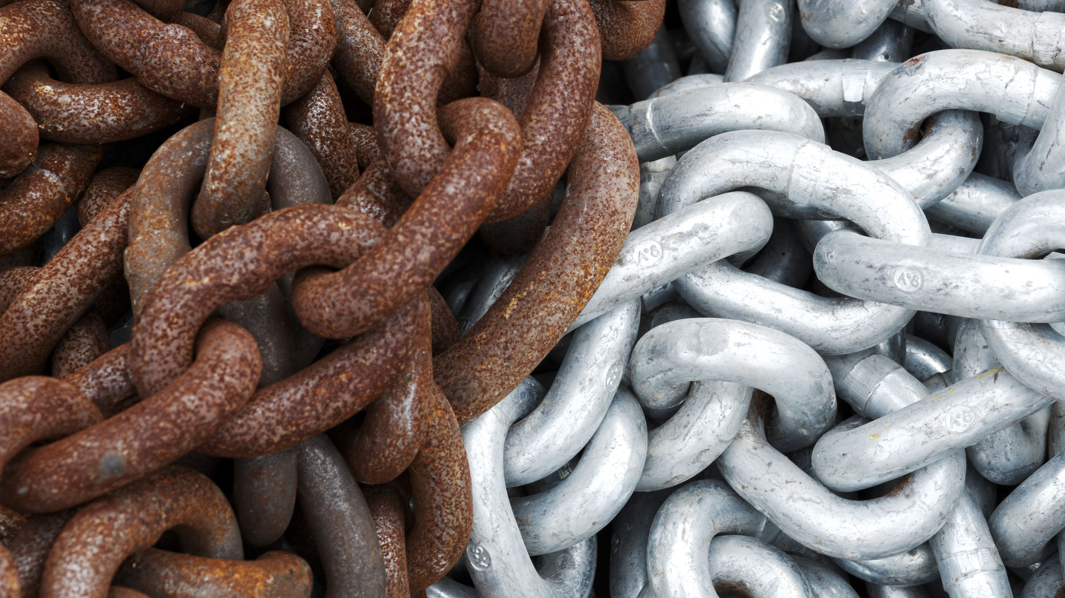
Developing Experts All rights reserved © 2021

Slide 2
Rust is the result of corroding steel after the iron (Fe) particles have been exposed to oxygen and moisture (e.g., humidity, vapour, immersion).
Developing Experts All rights reserved © 2021

Slide 3
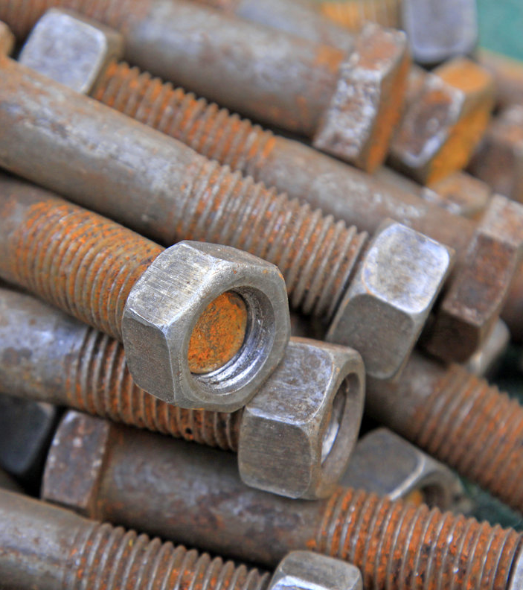
Explore rusting
Describe what's meant by the word corrosion.
Describe the conditions required for rusting.
Describe how to prevent corrosion, including sacrificial protection.
Developing Experts All rights reserved © 2021

Slide 4
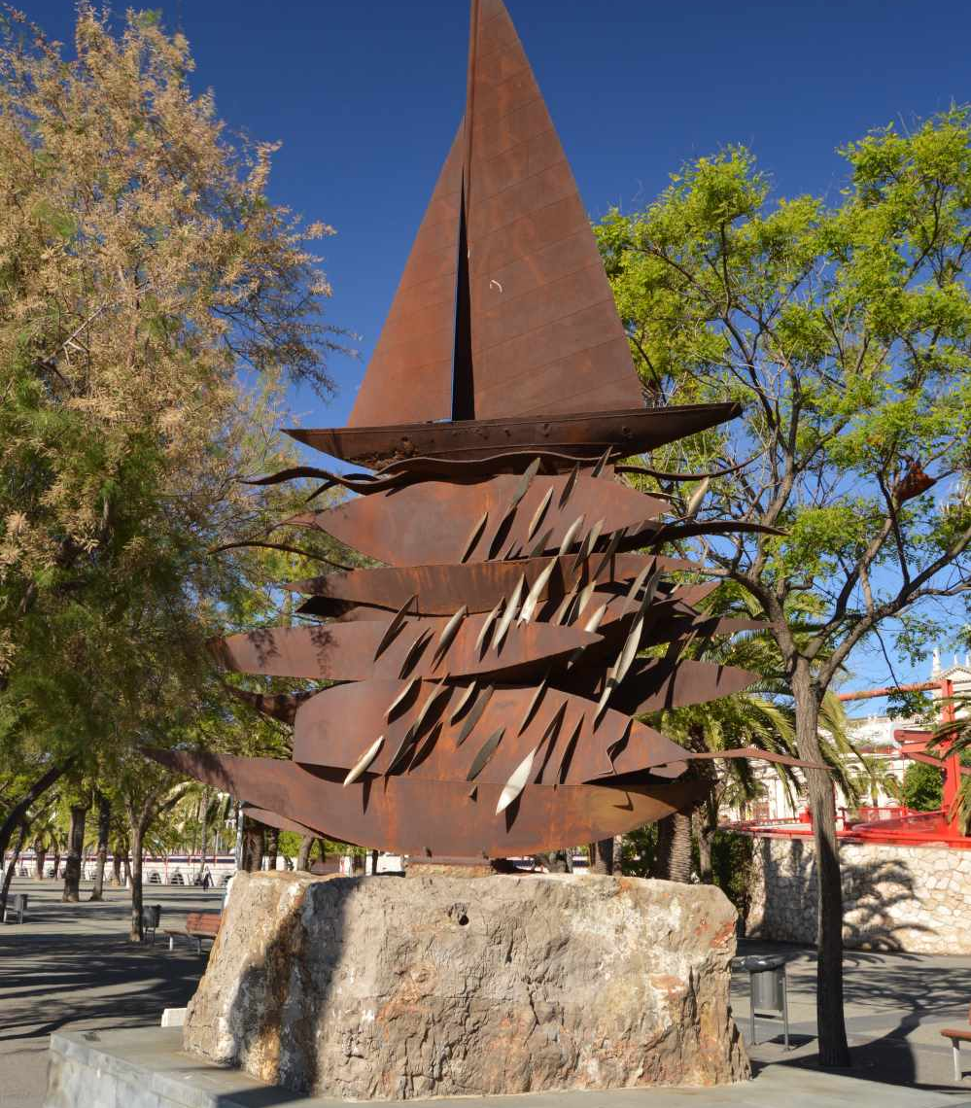
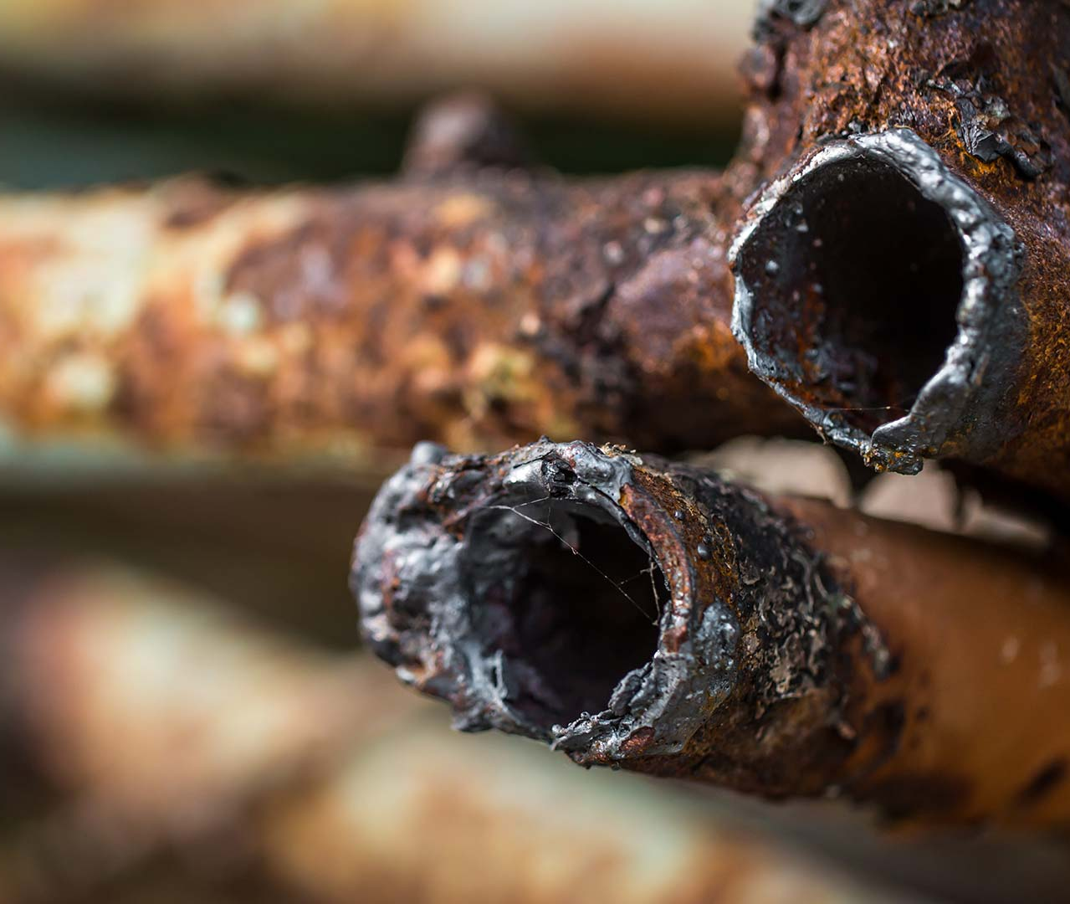
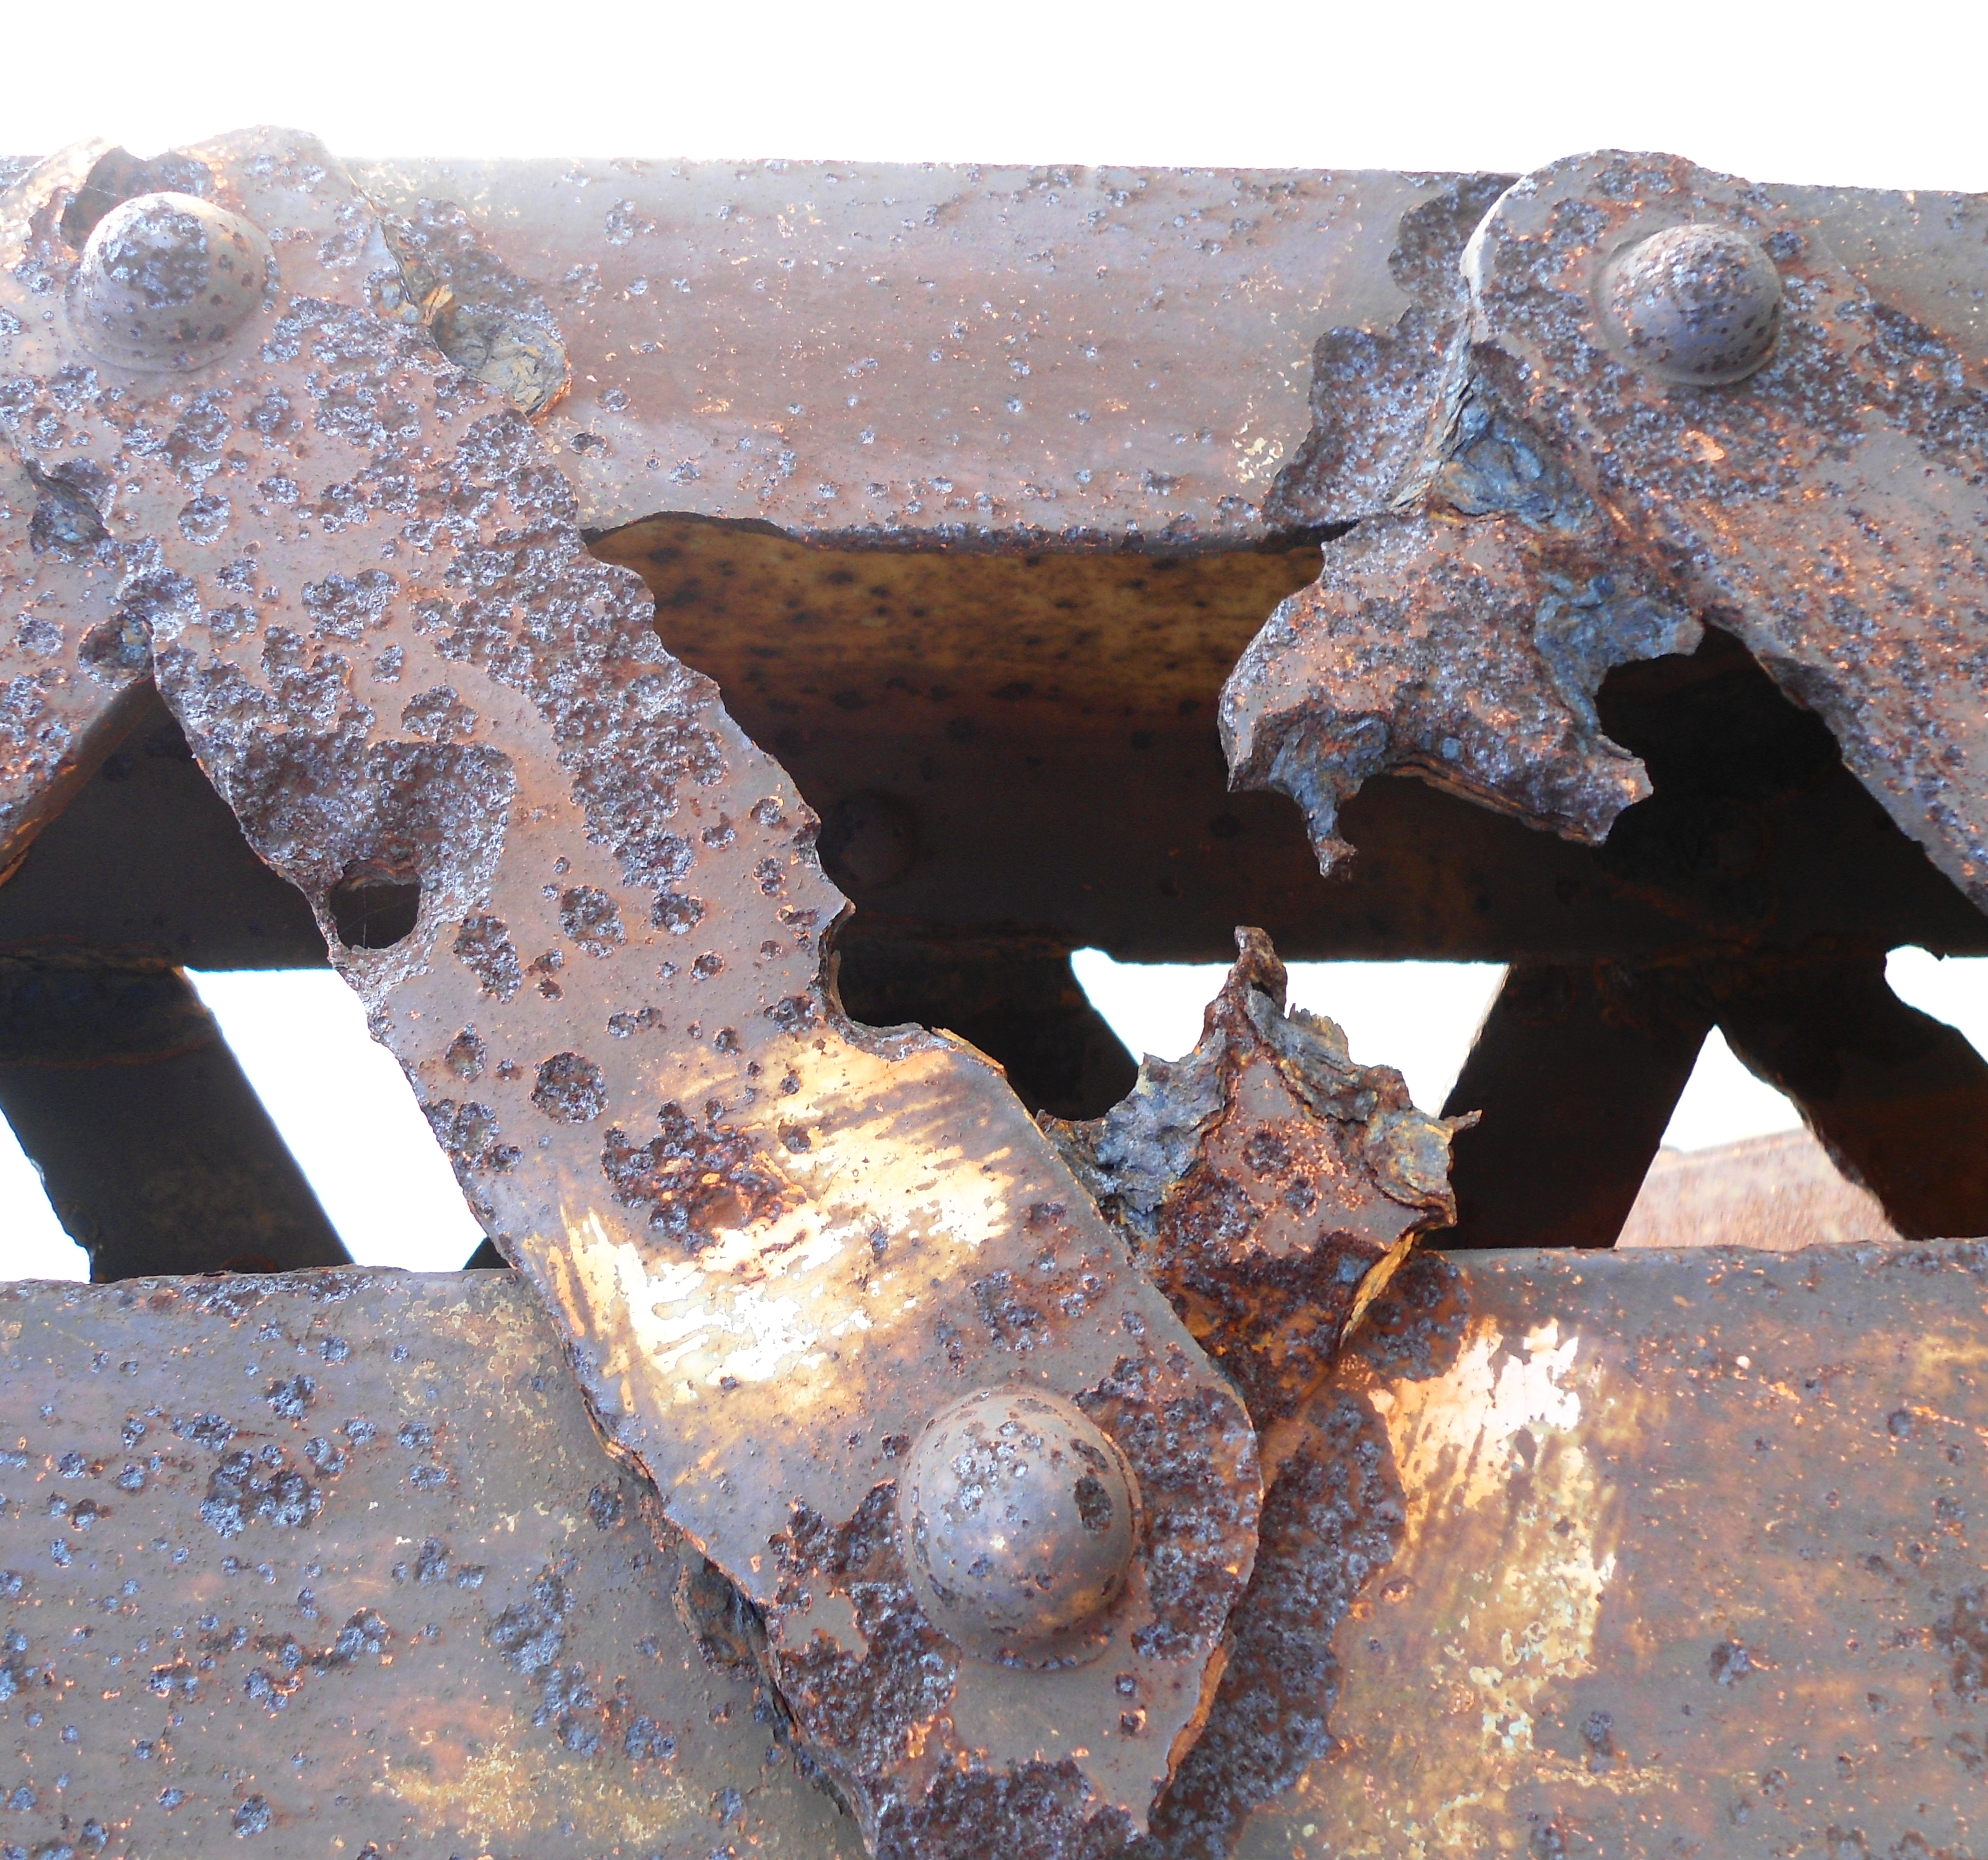
Developing Experts All rights reserved © 2021

Slide 5
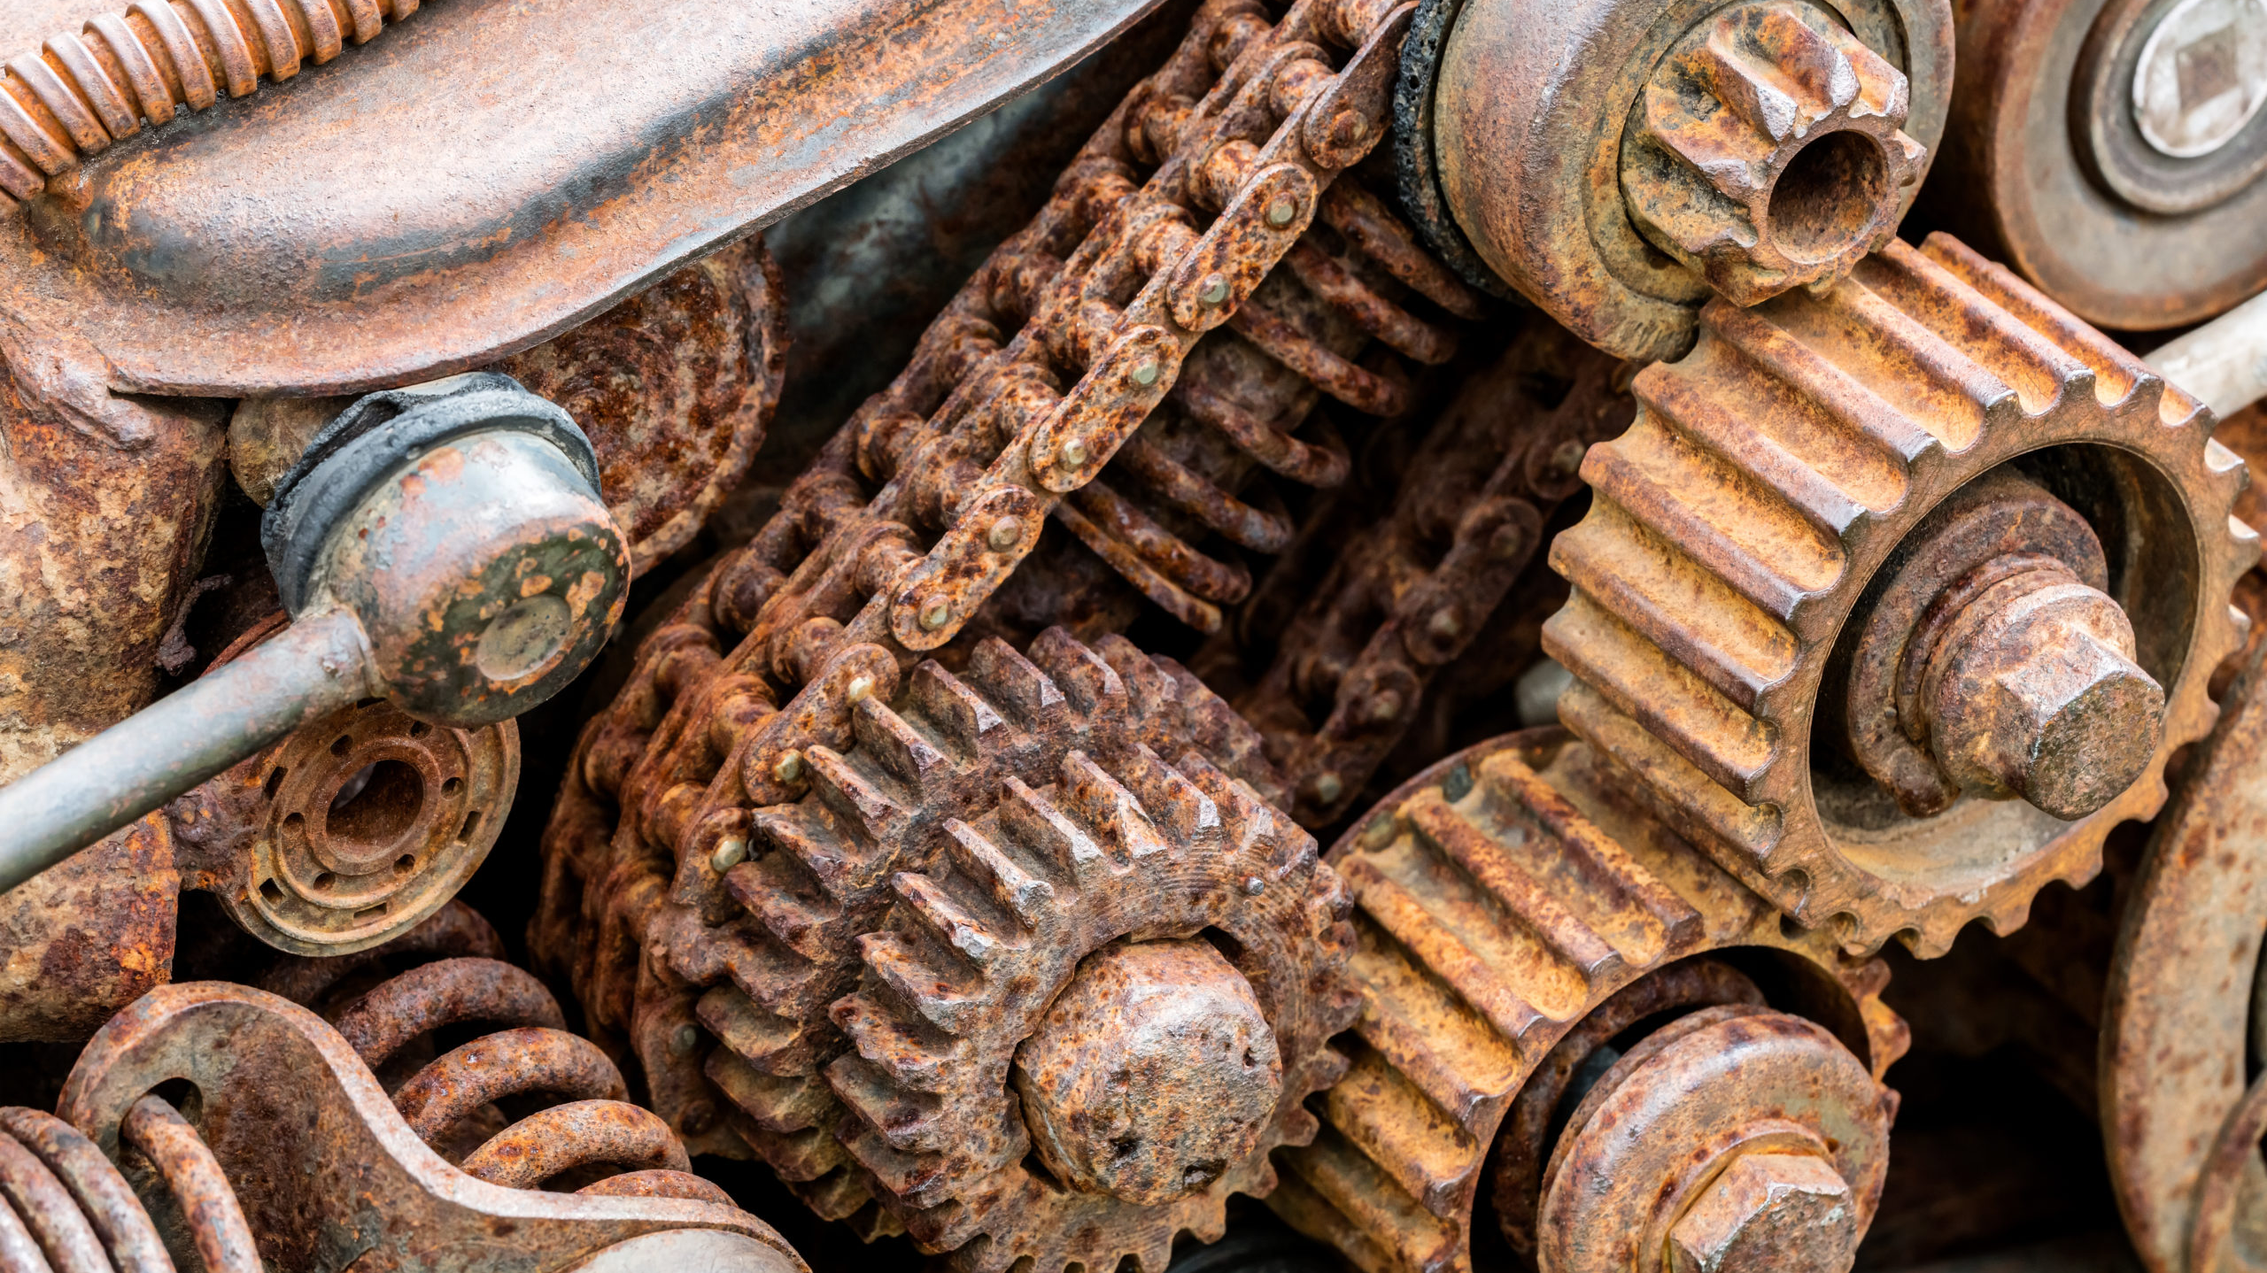
Developing Experts All rights reserved © 2021

Slide 6
Iron and steel rust when they come into contact with water and oxygen. They rust faster in salty water or acid rain. Aluminium, on the other hand, does not corrode easily, because its surface is protected by a layer of aluminium oxide.
The following experiment investigates the conditions necessary for rusting to occur.
Fill up test tubes as follows:
Test tube A is filled with boiled water and an oil layer so that there is no oxygen.
Test tube B has calcium chloride which will dry the air.
Test tube C has regular tap water that has oxygen.
Place an iron nail in each of the three test tubes.
Cover each test tube and let it stand for a couple of days.
Compare the conditions of the nails in each test tube.
observation: the iron nail of only test tube c rusts because it was exposed to oxygen and moisture
conclusion: oxygen and moisture cause rusting.
Exam Question:
Describe how to carry out an experiment on the conditions required for rusting.
Developing Experts All rights reserved © 2021

Slide 7
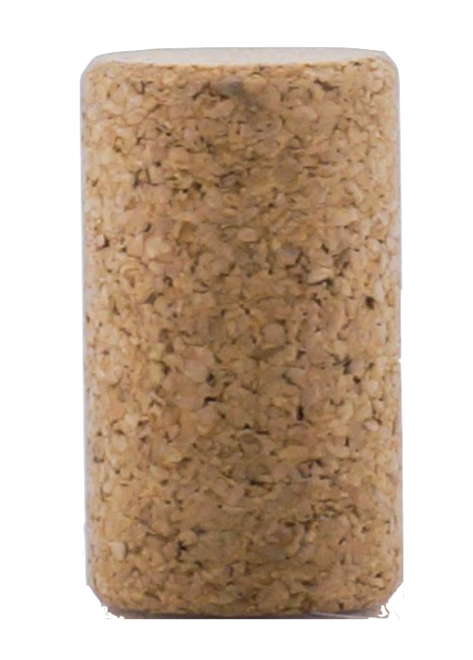
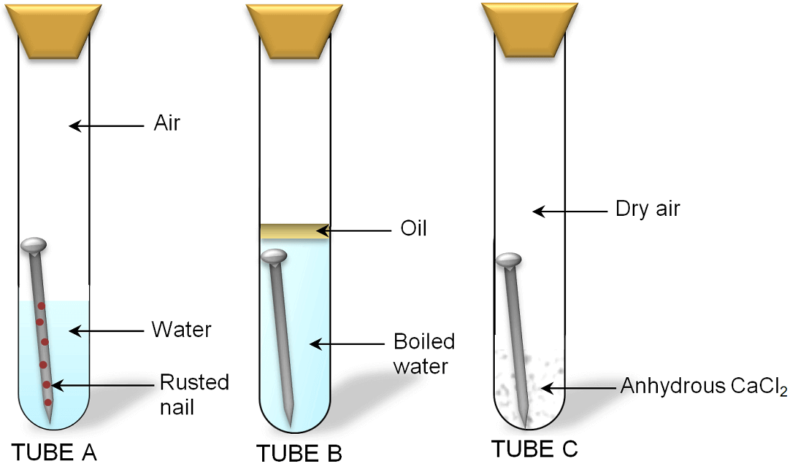
air
oil
distilled water
distilled water
nail
Developing Experts All rights reserved © 2021

Slide 8
air
dry air
oil
distilled water
distilled water
nail
Anhydrous CaCI2
Developing Experts All rights reserved © 2021

Slide 9
1
2
3
air
dry air
oil
distilled water
distilled water
nail
Anhydrous CaCI2
Developing Experts All rights reserved © 2021

Slide 10
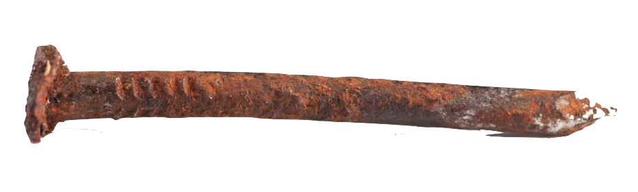
1
2
3
air
dry air
oil
distilled water
distilled water
rusty
nail
Anhydrous CaCI2
Developing Experts All rights reserved © 2021

Slide 11
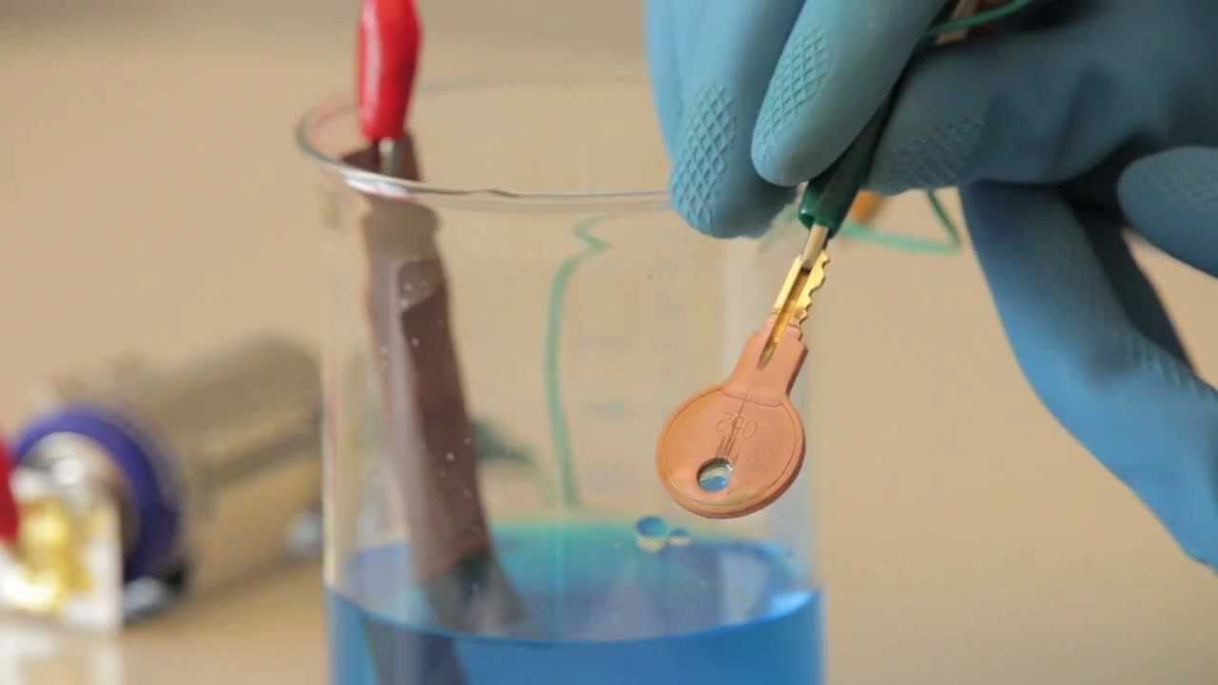
Developing Experts All rights reserved © 2021

Slide 12
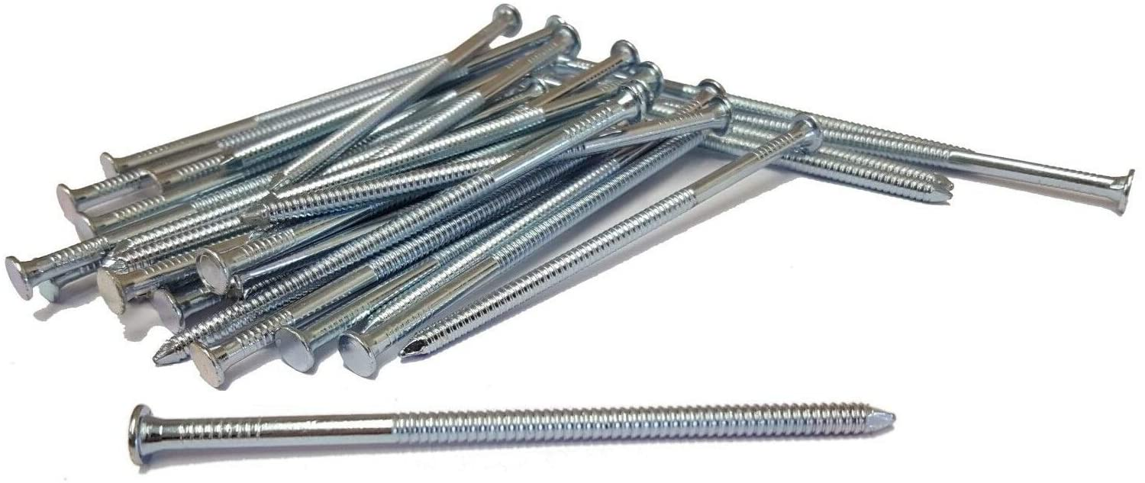
Developing Experts All rights reserved © 2021

Slide 13
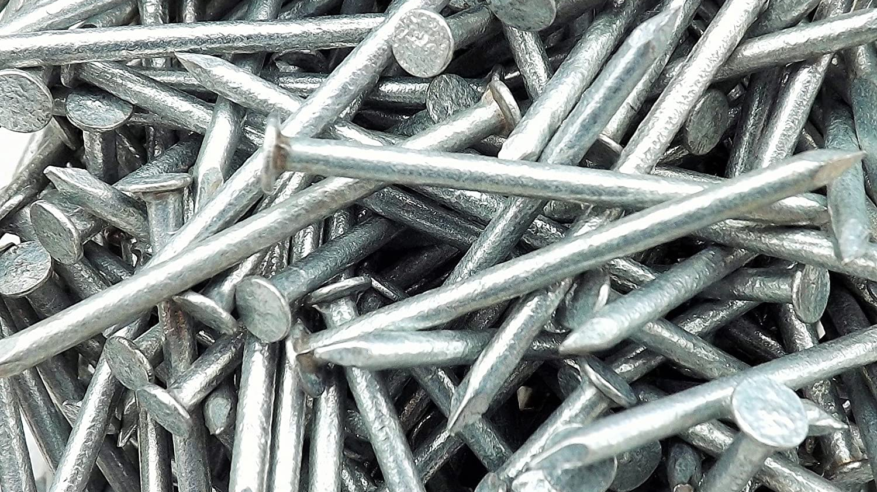
sacrificial protection
Developing Experts All rights reserved © 2021

Slide 14
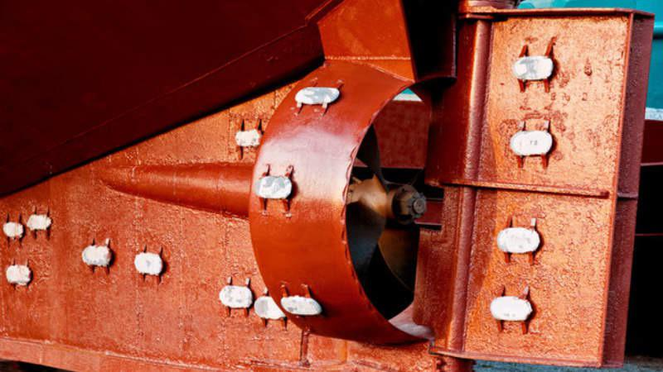
Developing Experts All rights reserved © 2021

Slide 15
Explore rusting
Describe what's meant by the word corrosion.
Describe the conditions required for rusting.
Describe how to prevent corrosion, including sacrificial protection.
Developing Experts All rights reserved © 2021

