Slide 1
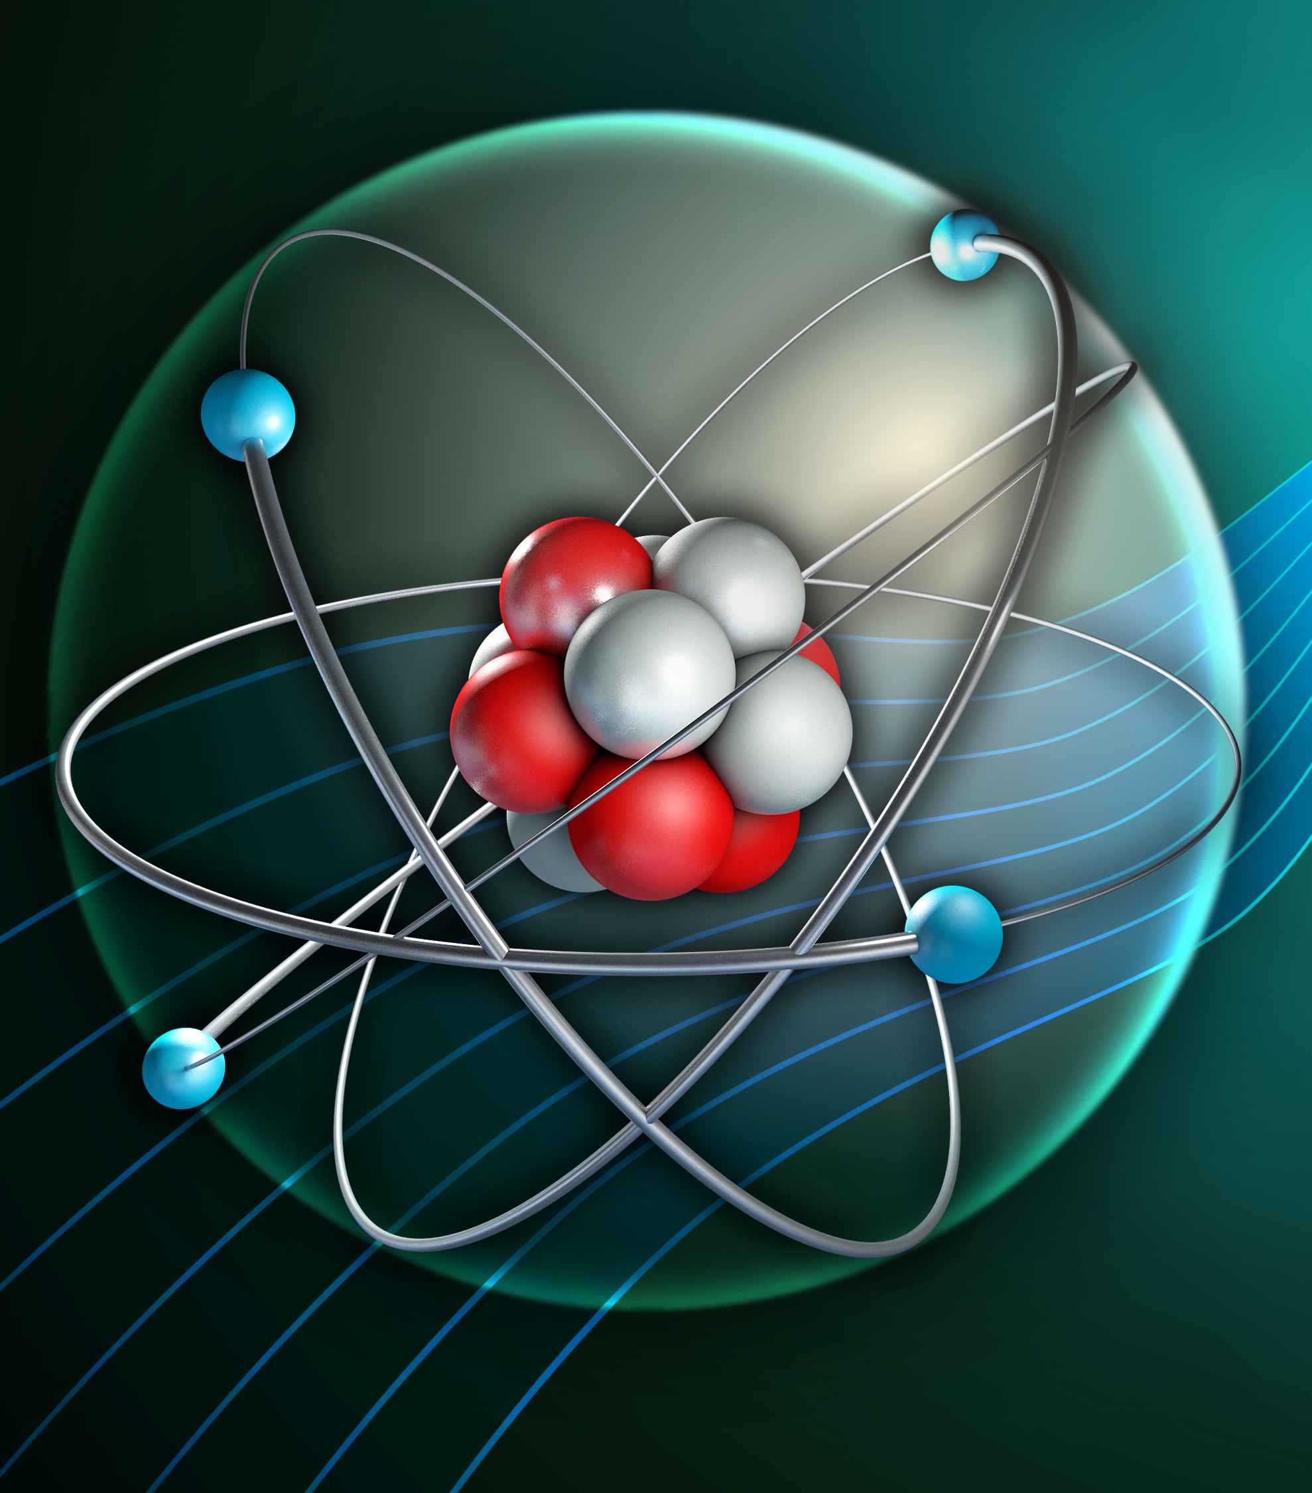
Fission and fusion
Define nuclear fission and fusion
Describe what happens in a chain reaction
Explain how a chain reaction can be controlled in a nuclear reactor
Describe why scientists are keen to develop fusion as a power source

Slide 2
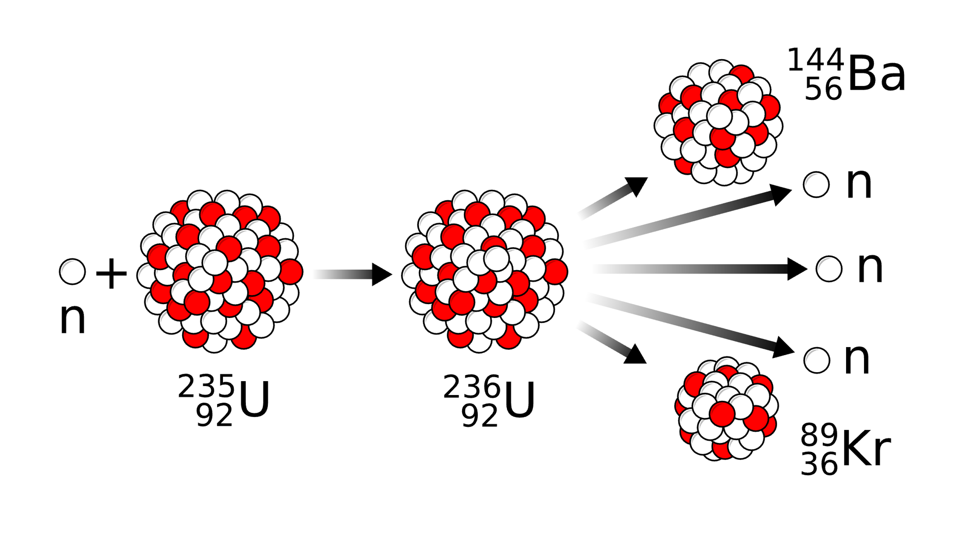

Slide 3
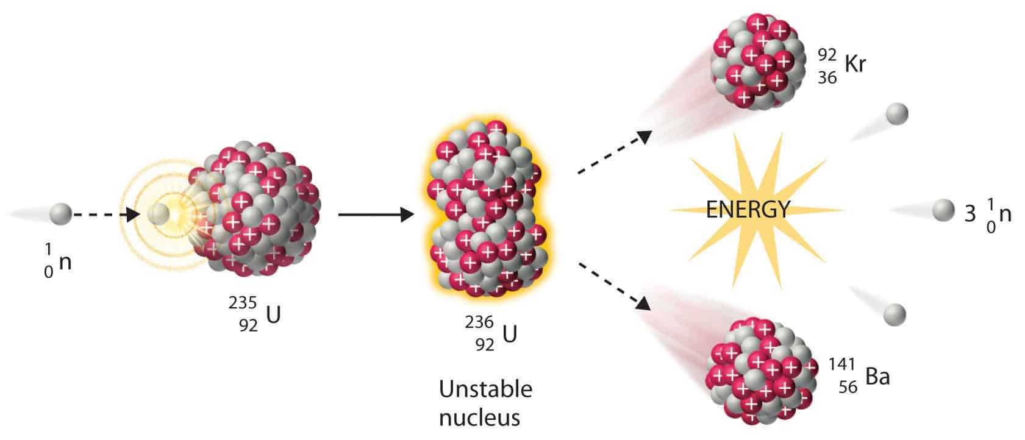

Slide 4
Hydrogen-2
(deuterium)
Helium
Hydrogen-3
(tritium)
Neutron

Slide 5
