Slide 1


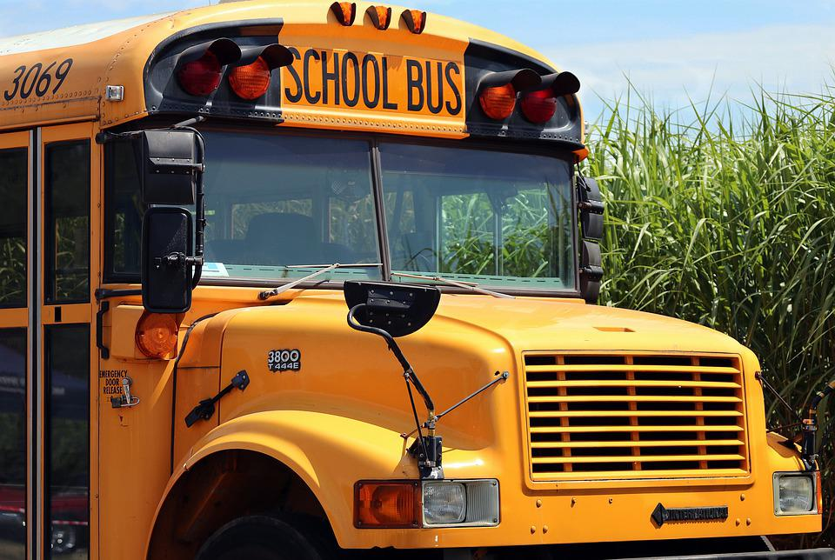
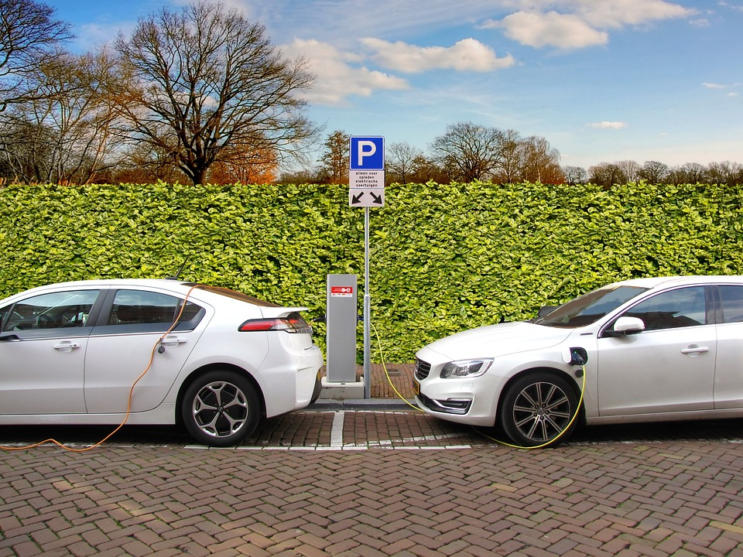
Mission Assignment: Explore how to speed up the switch to electric vehicles and renewables
Code: COP26_01_04
Create your own walking bus or walk to work campaign. Answer the following questions first.
How will you engage staff and pupils who cannot walk to work?
What other ways can we get around that are more sustainable than taking the car?
Use the table below to plan your campaign.
Campaign name
Targeted at:
What does the campaign involve?
Campaign slogan
2
Developing Experts Copyright 2022 All Rights Reserved

Slide 2
Mission Assignment: Explore how to speed up the switch to electric vehicles and renewables
Code: COP26_01_04
To support your campaign, conduct a survey of the whole class and find out how they usually get to school or work. Present your findings in the table below and use it to make suggestions for alternative methods of travel in you campaign.
Method of travel | Number of people that travel this way
Bus
Fuel car
Electric car
Hybrid car
Walk
Walking bus
Park and walk
Bike
Other
4
Developing Experts Copyright 2022 All Rights Reserved
Developing Experts Copyright 2022 All Rights Reserved
Developing Experts Copyright 2022 All Rights Reserved

