Slide 1



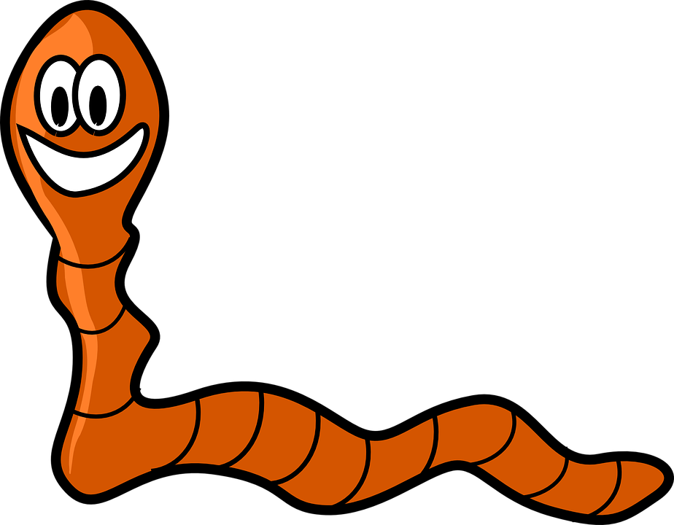
Mission Assignment: Explain how toxic material accumulates in ecosystems
KS3-20-04
Print this sheet single sided and cut out the tiles below. You may want to mount these tiles onto card.
 |  |  |  | William
 |  |  |  | Winston
 |  |  |  | Wilma
 |  |  |  | Walter
 |  |  |  | Warren
 |  |  |  | Wendy
 |  |  |  | Whitney
 |  |  |  | Winnie
Developing Experts Copyright 2023 All Rights Reserved

Slide 2
Mission Assignment: Explain how toxic material accumulates in ecosystems
KS3-20-04
Scenario
Each player represents a hungry bird living near a farmer’s field that is sprayed with DDT. The birds eat worms that may have eaten leaves covered in DDT. You don’t want to be the bird that accumulates DDT.
Objective
To survive, you must eat the worms containing the least amount of DDT. If you eat more that 4 doses of DDT, your bird is poisoned and dies.
Setup
1. You will need 2 worm cards, 4 green leaf cards and 4 orange leaf cards per player.
2. Lay all the worm cards out in a line on the table. Shuffle all the leaf cards into a deck and place these face down on the table.
Turn order
First round - Eating leaves.
1. Pick up a leaf card – Draw the top card from the deck of leaf cards. Keep the card face down at all times.
2. Choose a worm – Allocate that leaf card to a worm and place the card next to your chosen worm card. You can place the leaf card on any worm that has 3 leaf cards or less next to it.
3. When all the leaves have been “eaten”, the first round ends.
Second Round – Eating Worms
1. Choose your worm – Say the name of the worm you would like to “eat”. Move that worm card and its leaf cards into your hand.
2. Flip the leaf cards – Once the cards are in your hand, you may flip over the leaf cards to see how many orange and green leaf card you have.
When all the worms have been “eaten”, any player with 5 or more orange leaf cards is eliminated from the game.
Winning
The round ends when all worms have been collected.
If you have 5 or more orange leaf cards in your hand you are eliminated.
The winner is the final player remaining.
Rules
The maximum number of leaf cards any worm can have is 4.
Each player must choose 2 worms.
An orange leaf card represents 1 dose of DDT.
More than one player can be eliminated at the end of a round.
Developing Experts Copyright 2023 All Rights Reserved

Slide 3
Mission Assignment: Explain how toxic material accumulates in ecosystems
KS3-20-04
Define bioaccumulation.
______________________________________________________________________________________________________________________________________________________________________
Explain why the amount of toxins in an individual animal increases further up the food chain.
_________________________________________________________________________________________________________________________________________________________________________________________________________________________________________________________
Explain why farmers need to think carefully before using a pesticide.
_________________________________________________________________________________________________________________________________________________________________________________________________________________________________________________________
In the game, it is possible for more than one player to be eliminated at the same time. Explain how this is similar to what happens in nature.
_________________________________________________________________________________________________________________________________________________________________________________________________________________________________________________________
In the game, which leaves are toxic is kept secret. Explain how this is similar to what happens in nature.
_________________________________________________________________________________________________________________________________________________________________________________________________________________________________________________________
Describe what happened when you played the game. Include any strategy you tried.
_______________________________________________________________________________________________________________________________________________________________________________________________________________________________________________________________________________________________________________________________________________________________________________________________________________________________
Challenge question:
Why are pregnant mothers advised not to eat certain types of fish? Which fish are included and why? What damage could those toxins do? ____________________________________________________________________________________________________________________________________________________________________________________________________________________________________________________________________________________________________________________________________________
Developing Experts Copyright 2023 All Rights Reserved

Slide 4
Mission Assignment: Explain how toxic material accumulates in ecosystems ANSWERS
KS3-20-04
Define bioaccumulation.
______________________________________________________________________________________________________________________________________________________________________
Explain why the amount of toxins in an individual animal increases further up the food chain.
_________________________________________________________________________________________________________________________________________________________________________________________________________________________________________________________
Explain why farmers need to think carefully before using a pesticide.
_________________________________________________________________________________________________________________________________________________________________________________________________________________________________________________________
In the game, it is possible for more than one player to be eliminated at the same time. Explain how this is similar to what happens in nature.
_________________________________________________________________________________________________________________________________________________________________________________________________________________________________________________________
In the game, which leaves are toxic is kept secret. Explain how this is similar to what happens in nature.
_________________________________________________________________________________________________________________________________________________________________________________________________________________________________________________________
Describe what happened when you played the game. Include any strategy you tried.
_______________________________________________________________________________________________________________________________________________________________________________________________________________________________________________________________________________________________________________________________________________________________________________________________________________________________
Challenge question:
Why are pregnant mothers advised not to eat certain types of fish? Which fish are included and why? What damage could those toxins do? ____________________________________________________________________________________________________________________________________________________________________________________________________________________________________________________________________________________________________________________________________________
The build-up of toxic substances in food chains.
Animals in higher trophic levels eat many animals from lower trophic levels. If each animal that is consumed has a small amount of toxin, and the consumer eats 5 animals, it will get 5 times the amount of toxin.
Pesticides kill pests. Other animals can ingest pesticides, which will build up in the food chain and could contaminate animals that people eat
Players are eliminated when they have eaten too much of the toxin, so the animal dies. In nature, toxins can build up and kill many animals.
Predators eat prey without knowing if they have been exposed to toxins.
Any personal experience.
Oily fish and tuna should be limited because they can contain pollutants and mercury, which are harmful to an unborn baby. Raw shellfish should be avoided as it can contain bacteria which causes food poisoning.
Developing Experts Copyright 2023 All Rights Reserved

