Slide 1
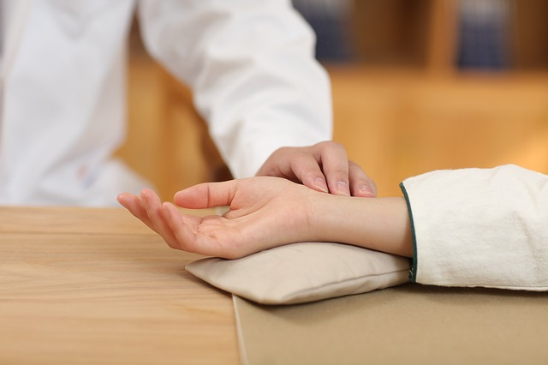
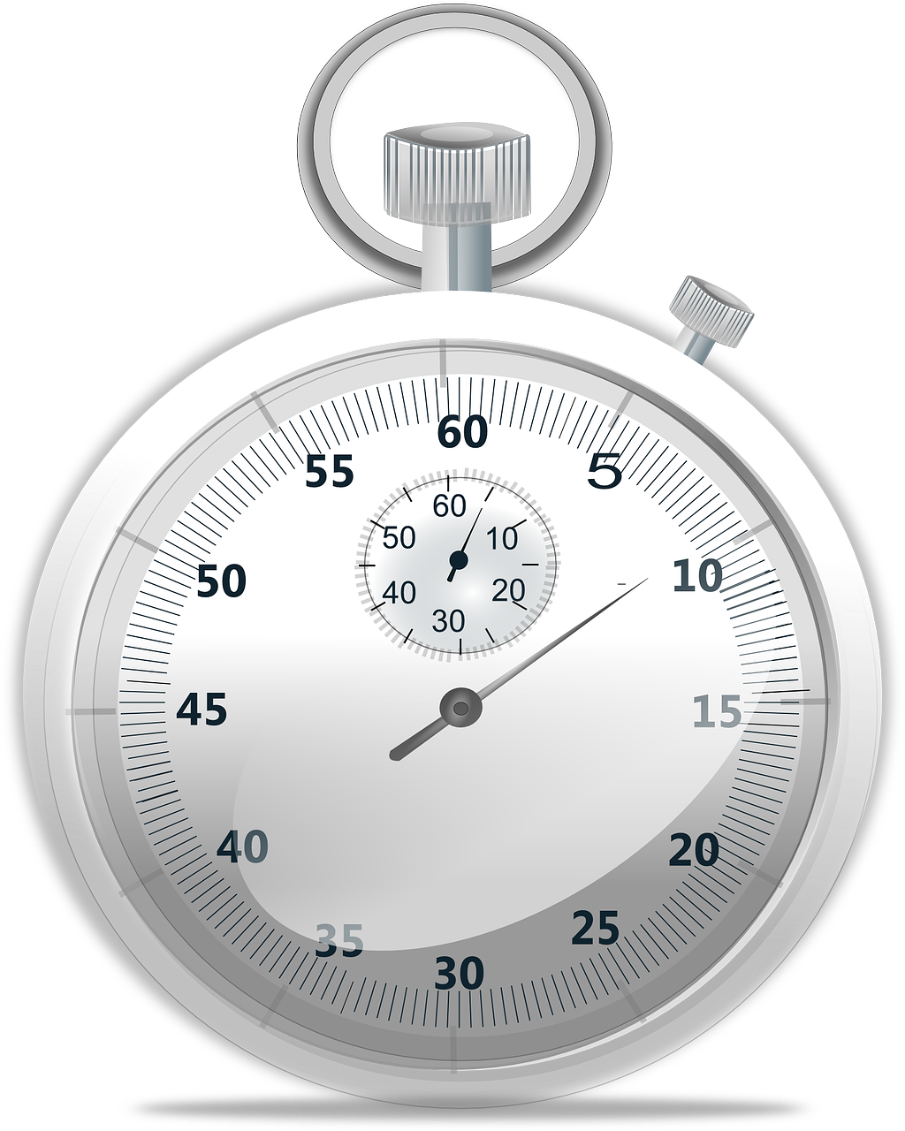
S06.04.05 Handout
Learn about blood pressure and pulse.
Measure your resting pulse then complete three types of exercise. After each type of exercise measure and record your pulse rate, add the information to the bar chart, then answer the questions.
Stretch:
Accurately take and record your resting and active pulse rate.
How to check your pulse You can check your pulse on your wrist or neck amongst other places. The easiest is usually on your wrist. Place two fingers between the bone and artery on the side of your wrist nearest the thumb. Once you can feel the pulse throbbing, count the amount of beats in 30 seconds, and multiply by 2.
Challenge:
Take and record your resting and active pulse rate.
activity | heartbeats in 30s | beats per minute
resting for 1 minute
walking for 1 minute
jogging for 1 minute
running for 1 minute
Developing Experts Ltd. © 2022

Slide 2
S06.04.05 Handout
Learn about blood pressure and pulse.
Complete the bar chart to show your heart rate for the different activities.
220
210
200
190
180
170
160
150
140
130
120
110
100
90
80
70
60
50
40
30
20
10
0
at rest | walking | jogging | running
heart rate (beats per minute)
Activity
Developing Experts Ltd. © 2022

Slide 3
S06.04.05 Handout
Learn about blood pressure and pulse.
Measure your resting pulse then complete three types of exercise. After each type of exercise measure and record your pulse rate then answer the questions.
Explain what high blood pressure is and how it can be caused?
________________________________________________________________________________________________________________________________________________________________________________________________________________________________________________________________________________________
________________________________________________________
What kind of habits or lifestyle choices might cause high blood pressure?
________________________________________________________________________________________________________________________________________________________________________________________________________________________________________________________________________________________
________________________________________________________
How can you calculate or measure your blood pressure?
________________________________________________________________________________________________________________________________________________________________________________________________________________________________________________________________________________________
________________________________________________________
In what ways can people control their blood pressure?
________________________________________________________________________________________________________________________________________________________________________________________________________________________________________________________________________________________
Stretch:
Accurately take and record your resting and active pulse rate.
Challenge:
Take and record your resting and active pulse rate.
Developing Experts Ltd. © 2022

