Slide 1
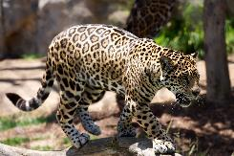
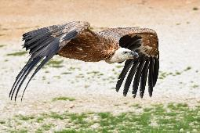
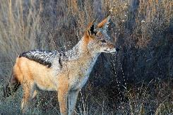
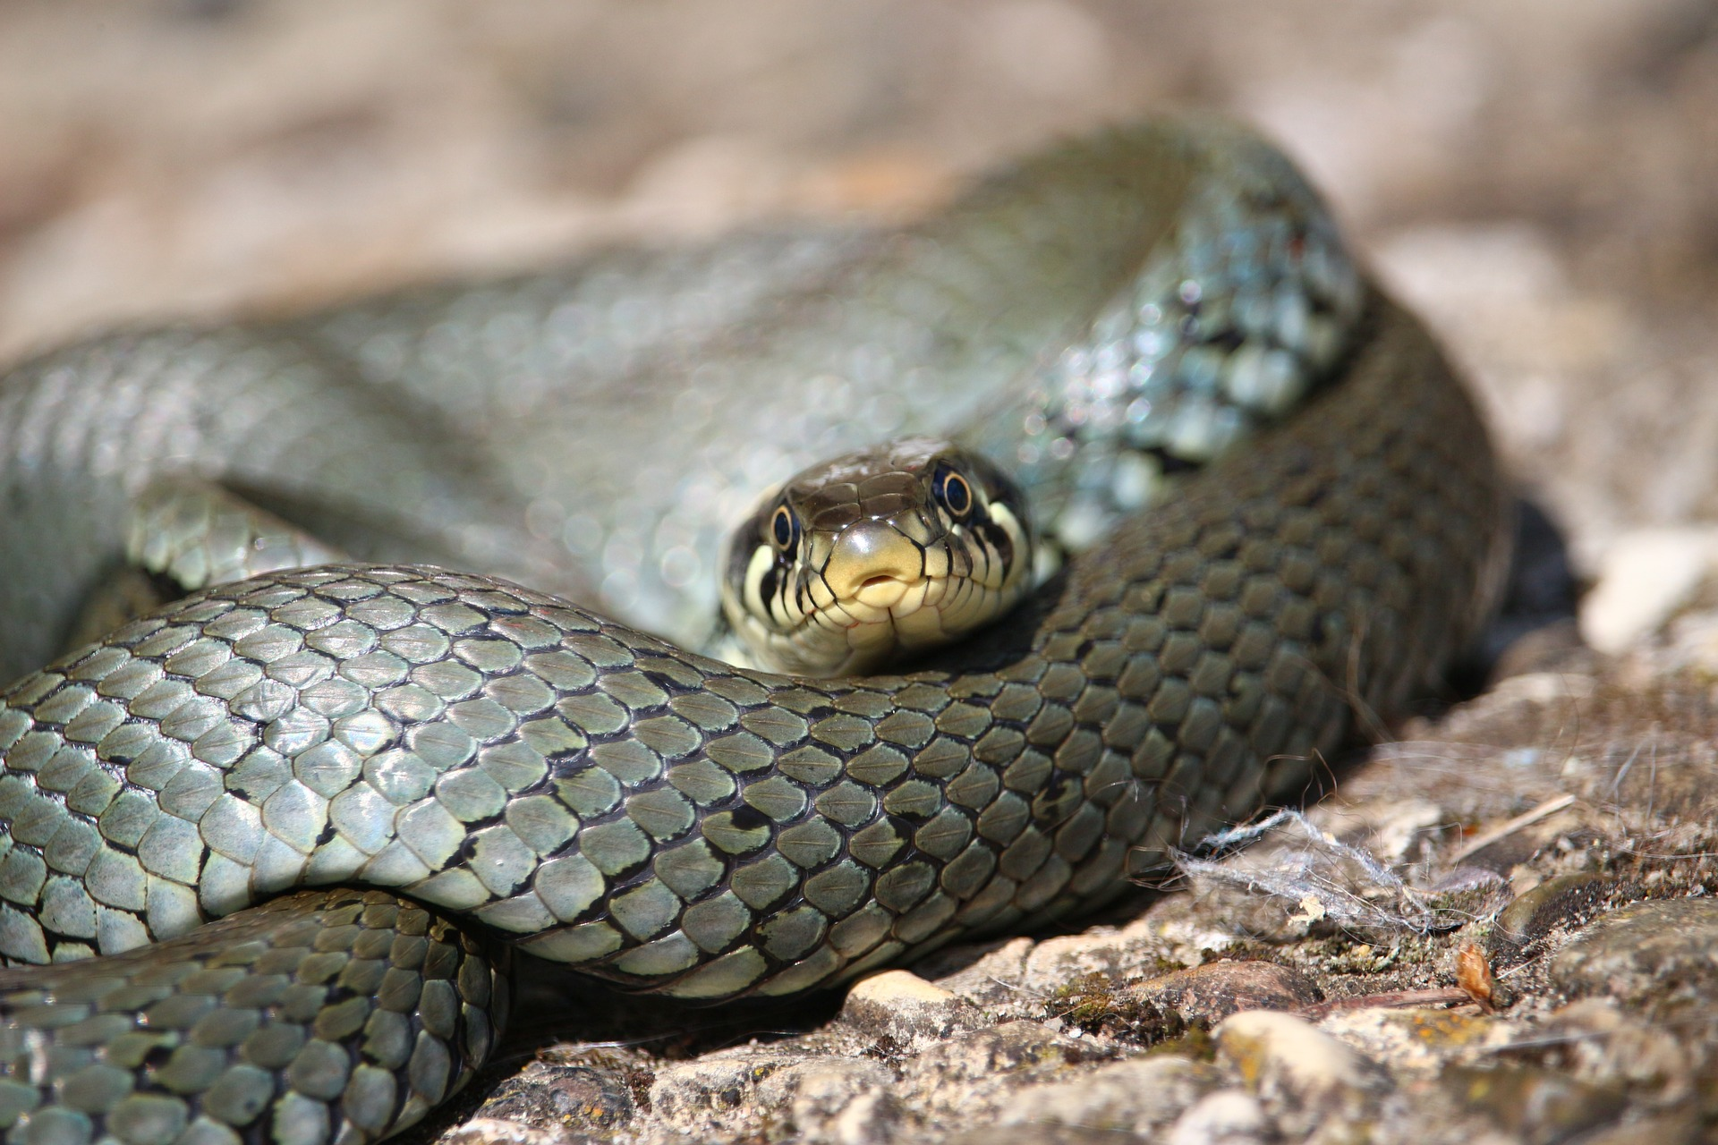
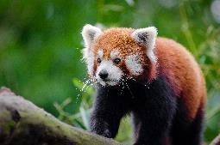
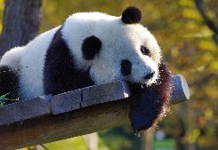
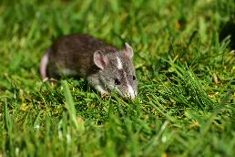
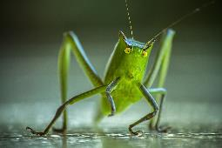
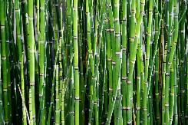
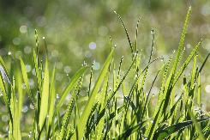
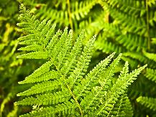
Study the food web below.
Leopard
Vulture
Jackal
Snake
Red panda
Giant panda
Rat
Grasshopper
Bamboo
Grass
Fern

Slide 2
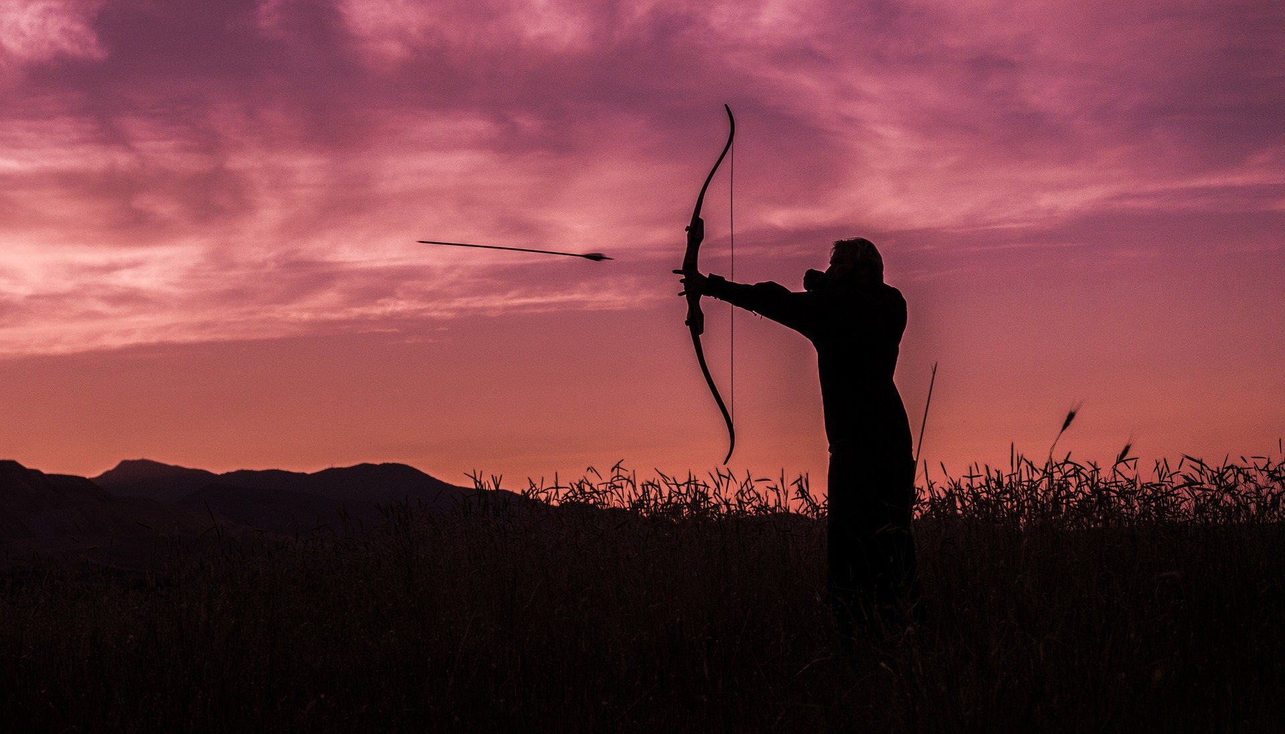
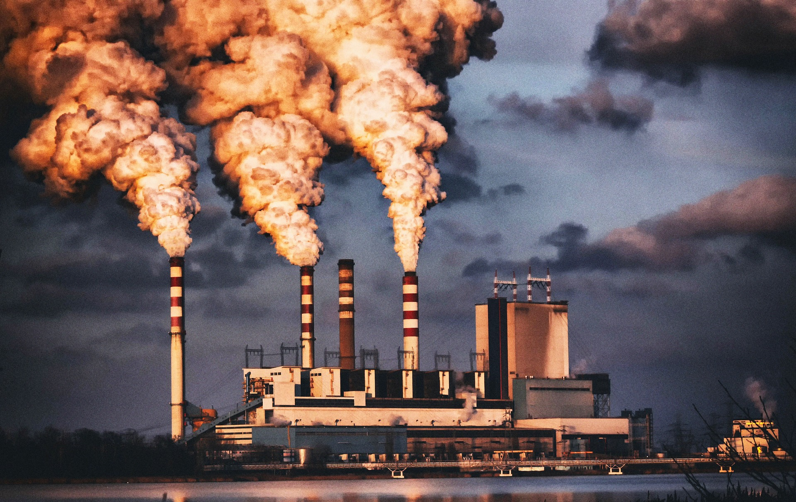
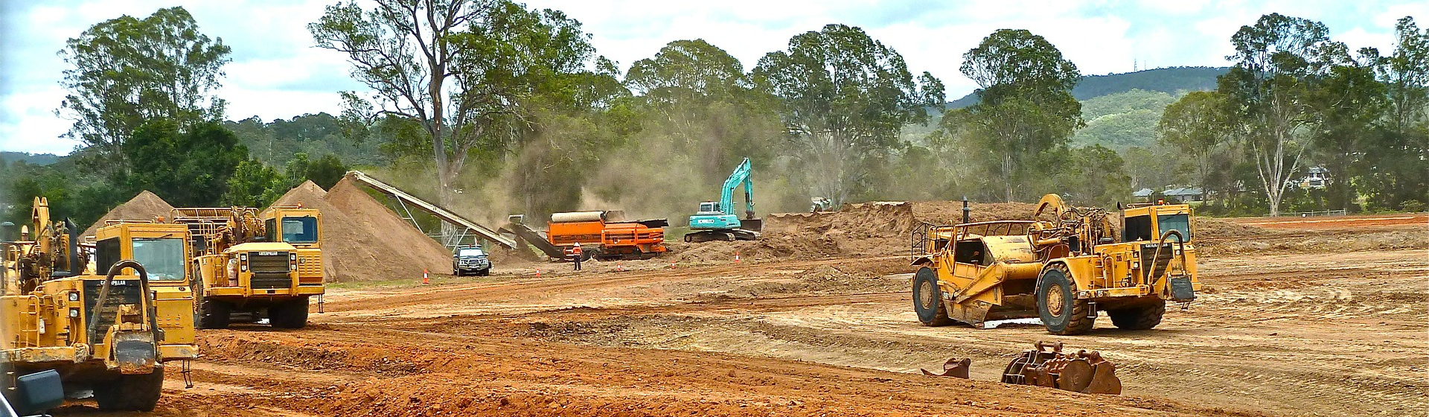
Explain what would happen to the population of each species if the following things happened to this ecosystem.
Draw ↑ to show that the population would increase. Draw ↓ to show that the population would decrease.
Leopards were hunted to extinction:
Climate change caused red pandas to migrate:
Deforestation of bamboo:
Jackal
Vulture
Snake
Red panda
Giant panda
Rat
Grasshopper
Bamboo
Grass
Fern
Leopard
Jackal
Vulture
Snake
Giant panda
Rat
Grasshopper
Bamboo
Grass
Fern
Leopard
Jackal
Vulture
Snake
Red panda
Giant panda
Rat
Grasshopper
Grass
Fern
Stretch:
What can you do to help protect ecosystems?
Challenge:
Create your own food web. How would it be affected if a species was removed?

