Slide 1


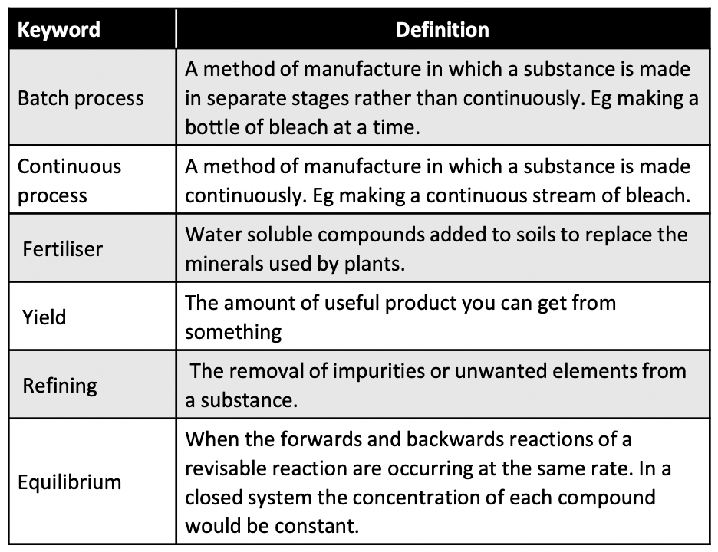
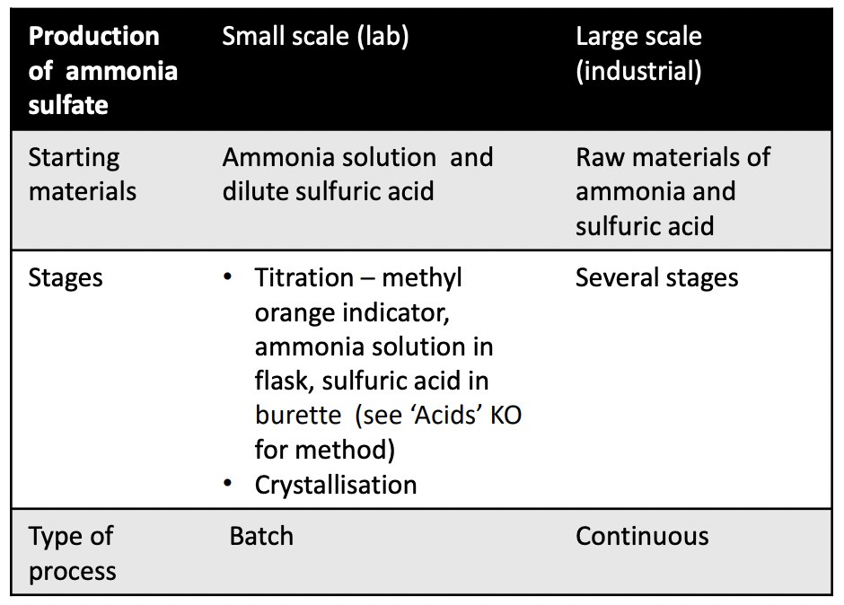
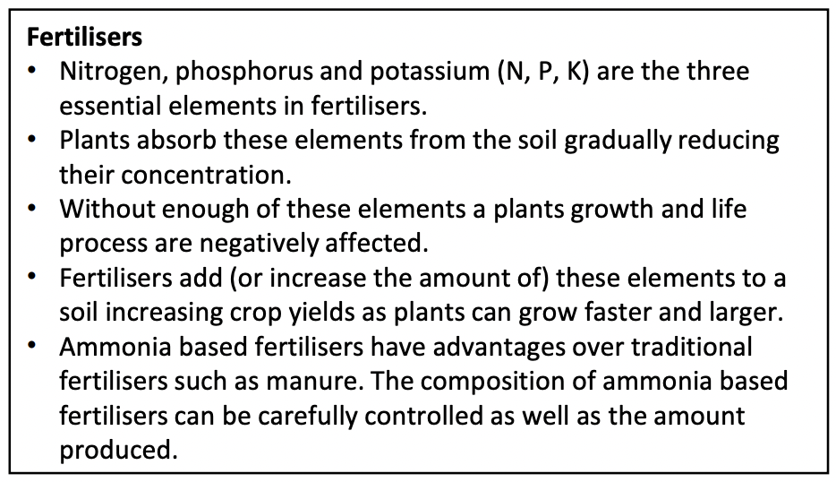
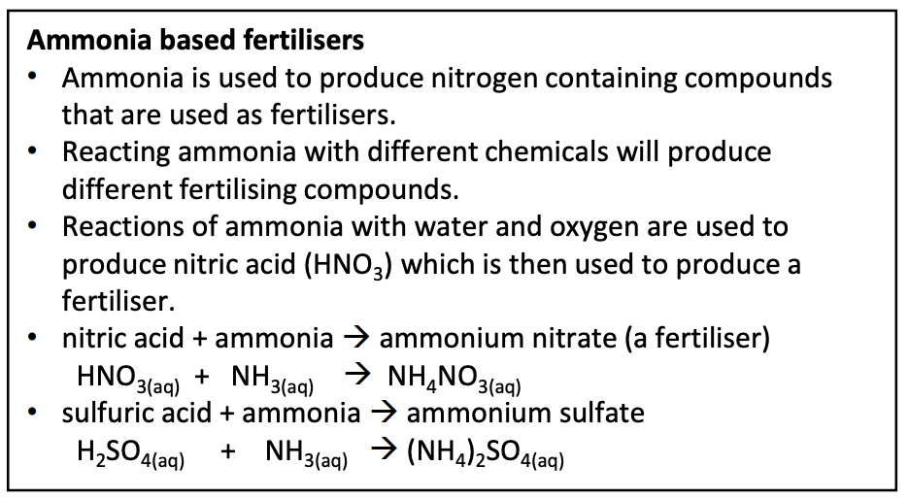
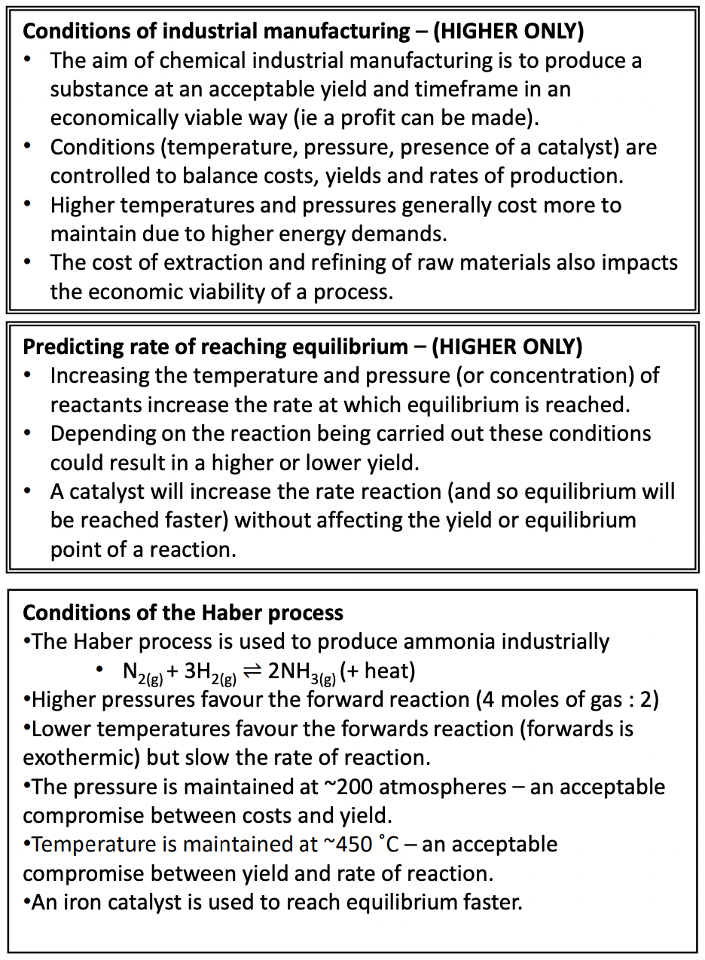
KS4-17-13: Using Resources - Explore making fertilisers in the lab and in industry
● State the elements in NPK fertilisers
● Describe how the compounds and NPK fertilisers are produced
● Compare the industrial production of fertilisers with their production in a lab
Which elements make up NPK fertilisers?
–––––––––––––––––––––––––––––––––––––––––––What is the chemical formula for ammonia?
–––––––––––––––––––––––––––––––––––––––––––
What is the fertiliser made from ammonia and phosphoric acid called?
–––––––––––––––––––––––––––––––––––––––––––
What is the fertiliser made from ammonia and sulphuric acid called?
––––––––––––––––––––––––––––––––––––––––––––––––––––––––––––––––––––––––––––––––––––––
Why do plants need nitrogen?
–––––––––––––––––––––––––––––––––––––––––––––––––––––––––––––––––––––––––––––––––––––––––––––––––––––––––––––––––––––––––––––––––Why can potassium salts be used directly instead of being converted into another product?
–––––––––––––––––––––––––––––––––––––––––––––––––––––––––––––––––––––––––––––––––––––––––––––––––––––––––––––––––––––––––––––––––––––––––––––––––––––––––––––––––––––––––––––––––––––––––––––––––––––––––––––––––––––––
Developing Experts All rights reserved © 2021

Slide 2
KS4-17-13: Using Resources - Explore making fertilisers in the lab and in industry
● State the elements in NPK fertilisers
● Describe how the compounds and NPK fertilisers are produced
● Compare the industrial production of fertilisers with their production in a lab
Extended writing: compare how fertilisers are produced in industry and in the laboratory.
––––––––––––––––––––––––––––––––––––––––––––––––––––––––––––––––––––––––––––––––––––––––––––––––––––––––––––––––––––––––––––––––––––––––––––––––––––––––––––––––––––––––––––––––––––––––––––––––––––––––––––––––––––––––––––––––––––––––––––––––––––––––––––––––––––––––––––––––––––––––––––––––––––––––––––––––––––––––––––––––––––––––––––––––––––
––––––––––––––––––––––––––––––––––––––––––––––––––––––––––––––––––––––––––––––––––––––––––––––––––––––––––––––––––––––––––––––––––––––––––––––––––––––––––––––––––––––––––––––––––––––––––––––––––––––––––––––––––––––––––––––––––––––––––––––––––––––––––––––––––––––––––––––––––––––––––––––––––––––––––––––––––––––––––––––––––––––––––––––––––––
––––––––––––––––––––––––––––––––––––––––––––––––––––––––––––––––––––––––––––––––––––––––––––––––––––––––––––––––––––––––––––––––––––––––––––––––––––––––––––––––––––––––––––––––––––––––––––––––––––––––––––––––––––––––––––––––––––––––––––––––––––––––––––––––––––––––––––––––––––––––––––––––––––––––––––––––––––––––––––––––––––––––––––––––––––
Investigate what was used as fertiliser before the industrial preparation of fertilisers was invented.
––––––––––––––––––––––––––––––––––––––––––––––––––––––––––––––––––––––––––––––––––––––––––––––––––––––––––––––––––––––––––––––––––––––––––––––––––––––––––––––––––––––––––––––––––––––––––––––––––––––––––––––––––––––––––––––––––––––––––––––––––––––––––––––––––––––––––––––––––––––––––––––––––––––––––––––––––––––––––––––––––––––––––––––––––––
––––––––––––––––––––––––––––––––––––––––––––––––––––––––––––––––––––––––––––––––––––––––––––––––––––––––––––––––––––––––––––––––––––––––––––––––––––––––––––––––––––––––––––––––––––––––––––––––––––––––––––––––––––––––––––––––––––––––––––––––––––––––––––––––––––––––––––––––––––––––––––––––––––––––––––––––––––––––––––––––––––––––––––––––––––
––––––––––––––––––––––––––––––––––––––––––––––––––––––––––––––––––––––––––––––––––––––––––––––––––––––––––––––––––––––––––––––––––––––––––––––––––––––––––––––––––––––––––––––––––––––––––––––––––––––––––––––––––––––––––––––––––––––––––––––––––––––––––––––––––––––––––––––––––––––––––––––––––––––––––––––––––––––––––––––––––––––––––––––––––––
Haber’s ambiguous morality could be discussed in the context of his work with fertilisers compared to his work on poison gas in World War I.
––––––––––––––––––––––––––––––––––––––––––––––––––––––––––––––––––––––––––––––––––––––––––––––––––––––––––––––––––––––––––––––––––––––––––––––––––––––––––––––––––––––––––––––––––––––––––––––––––––––––––––––––––––––––––––––––––––––––––––––––––––––––––––––––––––––––––––––––––––––––––––––––––––––––––––––––––––––––––––––––––––––––––––––––––––
––––––––––––––––––––––––––––––––––––––––––––––––––––––––––––––––––––––––––––––––––––––––––––––––––––––––––––––––––––––––––––––––––––––––––––––––––––––––––––––––––––––––––––––––––––––––––––––––––––––––––––––––––––––––––––––––––––––––––––––––––––––––––––––––––––––––––––––––––––––––––––––––––––––––––––––––––––––––––––––––––––––––––––––––––––
––––––––––––––––––––––––––––––––––––––––––––––––––––––––––––––––––––––––––––––––––––––––––––––––––––––––––––––––––––––––––––––––––––––––––––––––––––––––––––––––––––––––––––––––––––––––––––––––––––––––––––––––––––––––––––––––––––––––––––––––––––––––––––––––––––––––––––––––––––––––––––––––––––––––––––––––––––––––––––––––––––––––––––––––––––
Developing Experts All rights reserved © 2021

