Slide 1


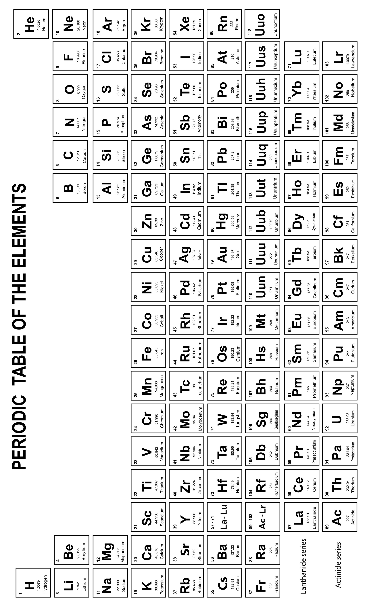
Mission Assignment: Represent chemicals with symbols and formulae
KS3-02-05
Elementary! What’s on the Periodic Table
Developing Experts Copyright 2023 All Rights Reserved

Slide 2
Mission Assignment: Represent chemicals with symbols and formulae
KS3-02-05
Elementary! What’s on the Periodic Table
Questions
1. What is the chemical symbol for hydrogen? ___________________
2. What is the chemical symbol for potassium? ___________________
3. What is the chemical symbol for magnesium? ___________________
4. What is the chemical symbol for iron? ___________________
5. What is the chemical symbol for sulfur? ___________________
6. What is the chemical symbol for radon? ___________________
7. Which element is represented by Pt? ___________________
8. Which element is represented by Bi? ___________________
9. Which element is represented by W? ___________________
10. Which element is represented by Pb? ___________________
11. Which element is represented by Hg? ___________________
12. Which element is represented by Ra? ___________________
13. Which element is represented by Sb? ___________________
14. Which element is represented by Po? ___________________
For the following compounds, identify which elements, and how many atoms of each element, are in the compound.
1. CO _________________________________________________
2. H₂SO₄ _________________________________________________
3. CH₄ _________________________________________________
4. NaOH _________________________________________________
5. Al₂Cl₃ _________________________________________________
6. H₃PO₄ _________________________________________________
7. Mg(OH)₂ _________________________________________________
Challenge
Can you write the formula of carbon dioxide, sulfur trioxide and nitrogen monoxide using only the names?
Developing Experts Copyright 2023 All Rights Reserved

Slide 3

Mission Assignment: Represent chemicals with symbols and formulae
KS3-02-05
Elementary! What’s on the Periodic Table
You can use element symbols to make words e.g.
The symbols from Helium, Lithium, Cobalt, Platinum and Erbium spell out HeLiCoPtEr
Write out the elements and their symbols to create a word. Remember the first letter should always be a capital letter and the second (if there is one) lower case.
___________________________________________________________________________________________________________________________________________________________________________________________________________________________________________________________________________________________________________________________________________________________________________________________________________________________________________________________________________________________________________________________________________________________________________________________________________________________________________________________________________________________________________________________________________________________________________________________________________________________________________________________________________________________________________________________________________________________________________________________________________________________________________________________________________________________________________________________________________________________________________________________________________________________________________________________________________________________
Challenge
What is the longest word that you can make?
Developing Experts Copyright 2023 All Rights Reserved

Slide 4
Mission Assignment: Represent chemicals with symbols and formulae
KS3-02-05
Elementary! What’s on the Periodic Table
Alphabetical list of element symbols
Ac | Actinium | Cd | Cadmium | Fe | Iron | Kr | Krypton
Ag | Silver | Ce | Cerium | Fl | Flerovium | La | Lanthanum
Al | Aluminium | Cf | Californium | Fm | Fermium | Li | Lithium
Am | Americium | Cl | Chlorine | Fr | Francium | Lr | Lawrencium
Ar | Argon | Cm | Curium | Ga | Gallium | Lu | Lutetium
As | Arsenic | Cn | Copernicium | Gd | Gadolinium | Lv | Livermorium
At | Astatine | Co | Cobalt | Ge | Germanium | Mc | Moscovium
Au | Gold | Cr | Chromium | H | Hydrogen | Md | Mendelevium
B | Boron | Cs | Caesium | He | Helium | Mg | Magnesium
Ba | Barium | Cu | Copper | Hf | Hafnium | Mn | Manganese
Be | Beryllium | Db | Dubnium | Hg | Mercury | Mo | Molybdenum
Bh | Bohrium | Ds | Darmstadtium | Ho | Holmium | Mt | Meitnerium
Bi | Bismuth | Dy | Dysprosium | Hs | Hassium | N | Nitrogen
Bk | Berkelium | Er | Erbium | I | Iodine | Na | Sodium
Br | Bromine | Es | Einsteinium | In | Indium | Nb | Niobium
C | Carbon | Eu | Europium | Ir | Iridium | Nd | Neodymium
Ca | Calcium | F | Fluorine | K | Potassium | Ne | Neon
Developing Experts Copyright 2023 All Rights Reserved

Slide 5
Mission Assignment: Represent chemicals with symbols and formulae
KS3-02-05
Elementary! What’s on the Periodic Table
Alphabetical list of element symbols
Nh | Nihonium | Rb | Rubidium | Tb | Terbium
Ni | Nickel | Re | Rhenium | Tc | Technetium
No | Nobelium | Rf | Rutherfordium | Te | Tellurium
Np | Neptunium | Rg | Roentgenium | Th | Thorium
O | Oxygen | Rh | Rhodium | Ti | Titanium
Og | Oganesson | Rn | Radon | Tl | Thallium
Os | Osmium | Ru | Ruthenium | Tm | Thulium
P | Phosphorus | S | Sulfur | Ts | Tennessine
Pa | Protactinium | Sb | Antimony | U | Uranium
Pb | Lead | Sc | Scandium | V | Vanadium
Pd | Palladium | Se | Selenium | W | Tungsten
Pm | Palladium | Sg | Seaborgium | Xe | Xenon
Po | Polonium | Si | Silicon | Y | Yttrium
Pr | Praseodymium | Sm | Samarium | Yb | Ytterbium
Pt | Platinum | Sn | Tin | Zn | Zinc
Pu | Plutonium | Sr | Strontium | Zr | Zirconium
Ra | Radium | Ta | Tantalum
Developing Experts Copyright 2023 All Rights Reserved

Slide 6
Mission Assignment: Represent chemicals with symbols and formulae ANSWERS
KS3-02-05
Elementary! What’s on the Periodic Table
Questions
1. What is the chemical symbol for hydrogen? ___________________
2. What is the chemical symbol for potassium? ___________________
3. What is the chemical symbol for magnesium? ___________________
4. What is the chemical symbol for iron? ___________________
5. What is the chemical symbol for sulfur? ___________________
6. What is the chemical symbol for radon? ___________________
7. Which element is represented by Pt? ___________________
8. Which element is represented by Bi? ___________________
9. Which element is represented by W? ___________________
10. Which element is represented by Pb? ___________________
11. Which element is represented by Hg? ___________________
12. Which element is represented by Ra? ___________________
13. Which element is represented by Sb? ___________________
14. Which element is represented by Po? ___________________
For the following compounds, identify which elements, and how many atoms of each element, are in the compound.
1. CO _________________________________________________
2. H₂SO₄ _________________________________________________
3. CH₄ _________________________________________________
4. NaOH _________________________________________________
5. Al₂Cl₃ _________________________________________________
6. H₃PO₄ _________________________________________________
7. Mg(OH)₂ _________________________________________________
H
K
Mg
Fe
S
Rn
Platinum
Bismuth
Tungsten
Lead
Mercury
Radium
Antimony
polonium
1 x carbon and 1 x oxygen
2 x hydrogen, 1 x sulfur and 4 x oxygen
1 x carbon and 4 x hydrogen
1 x sodium, 1 x oxygen and 1 x hydrogen
2 x aluminium and 3 x chlorine
3 x hydrogen, 1 x phosphorus and 4 x oxygen
1 x magnesium, 2 x oxygen and 2 x hydrogen
Challenge
Can you write the formula of carbon dioxide, sulfur trioxide and nitrogen monoxide using only the names?
Developing Experts Copyright 2023 All Rights Reserved

Slide 7
Mission Assignment: Represent chemicals with symbols and formulae ANSWERS
KS3-02-05
Elementary! What’s on the Periodic Table
You can use element symbols to make words e.g.
The symbols from Helium, Lithium, Cobalt, Platinum and Erbium spell out HeLiCoPtEr
Write out the elements and their symbols to create a word. Remember the first letter should always be a capital letter and the second (if there is one) lower case.
___________________________________________________________________________________________________________________________________________________________________________________________________________________________________________________________________________________________________________________________________________________________________________________________________________________________________________________________________________________________________________________________________________________________________________________________________________________________________________________________________________________________________________________________________________________________________________________________________________________________________________________________________________________________________________________________________________________________________________________________________________________________________________________________________________________________________________________________________________________________________________________________________________________________________________________________________________________________
Student’s own answer – website https://sciencenotes.org/list-words-made-periodic-table-element-symbols/
Challenge
What is the longest word that you can make?
Developing Experts Copyright 2023 All Rights Reserved

