Slide 1

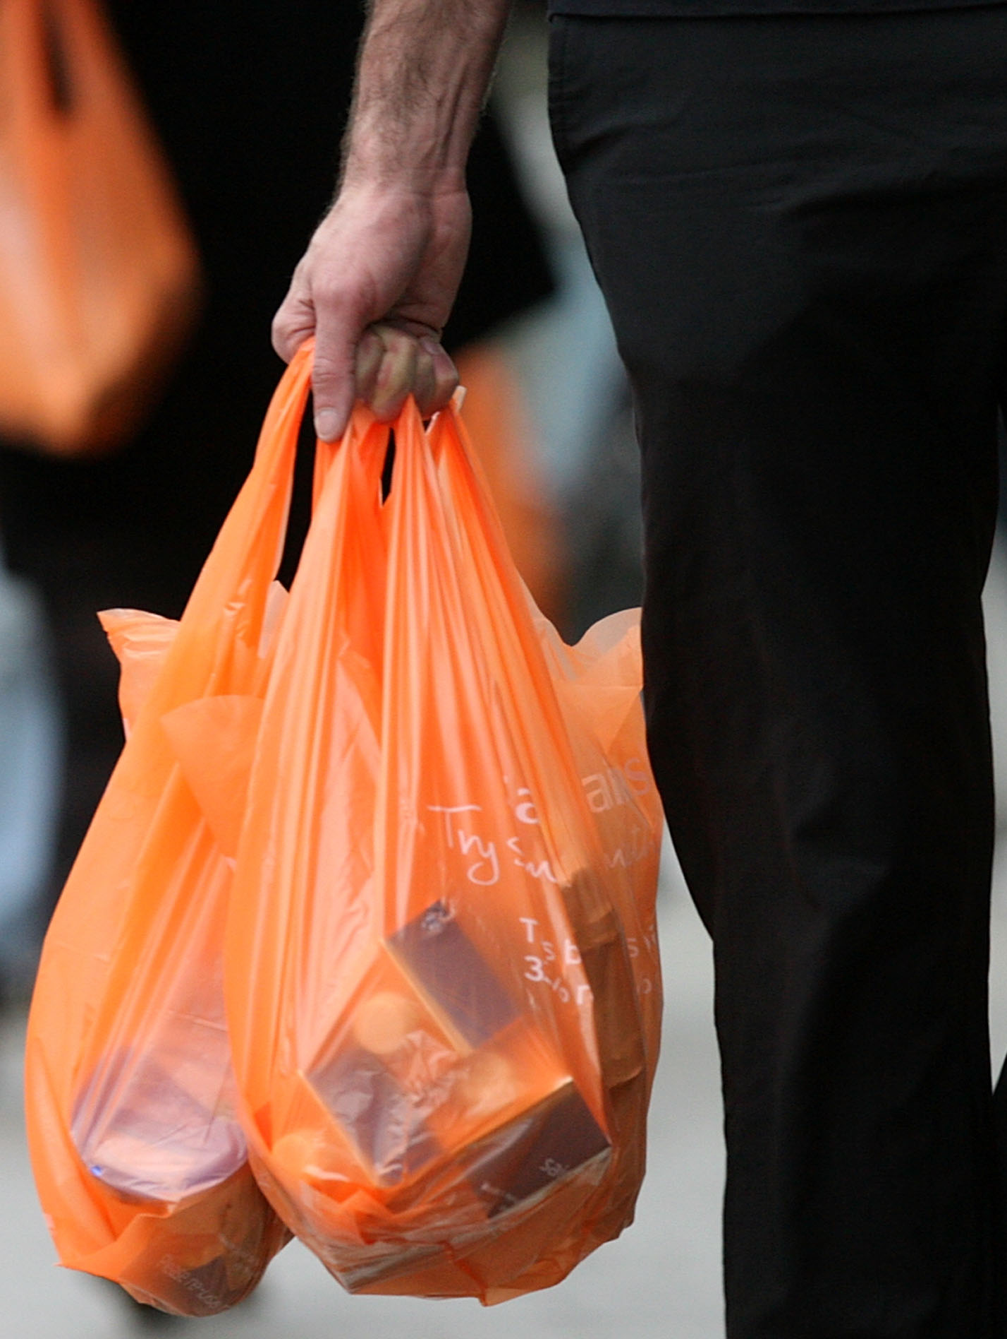
0001.01
Mission Assignment
Task
Developing skills
Think about…
Use the information in the table and your knowledge to give one advantage and one disadvantage for each of the methods used to deal with plastic bags in the table above.
Extract and interpret information about resources from charts, graphs and tables.
Describe the problems with life cycle assessments.
KS4-17-02:
Using Resources - Explore life Cycle Assessments

