Slide 1
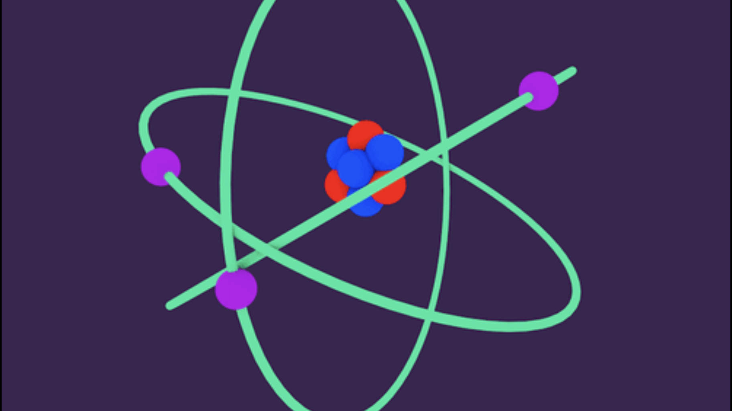
Atom definition:
The smallest particle of a chemical element that can exist.
What is the centre of an atom called?
A nucleus.
Developing Experts All rights reserved © 2021

Slide 2
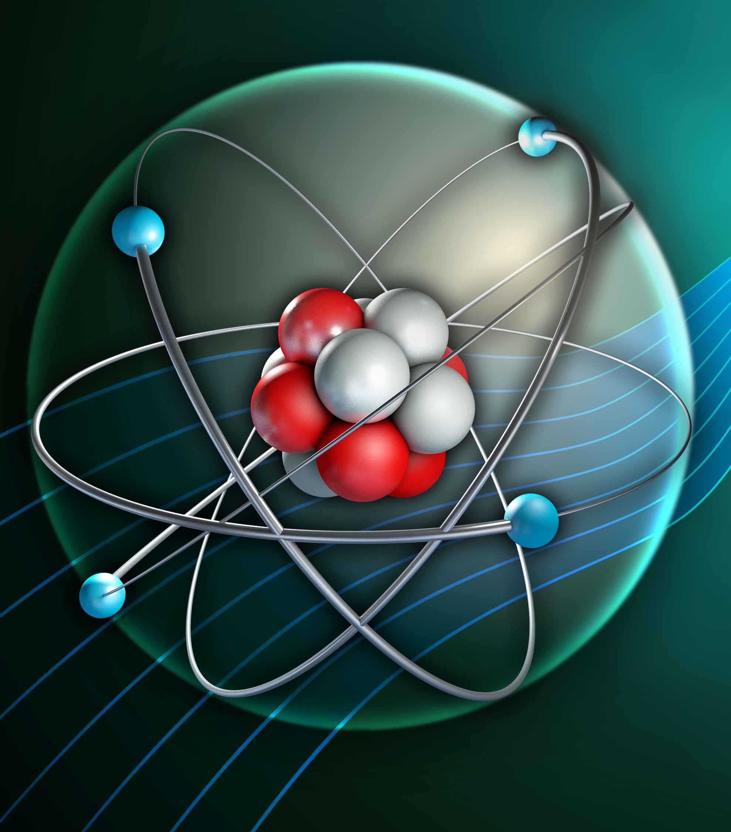
Inside atoms
You should be able to describe the basic structure of atoms.
You should be able to state the radius of an atom and the nucleus.
You should be able to describe how the electron arrangement may change when radiation is absorbed or emitted.

Slide 3
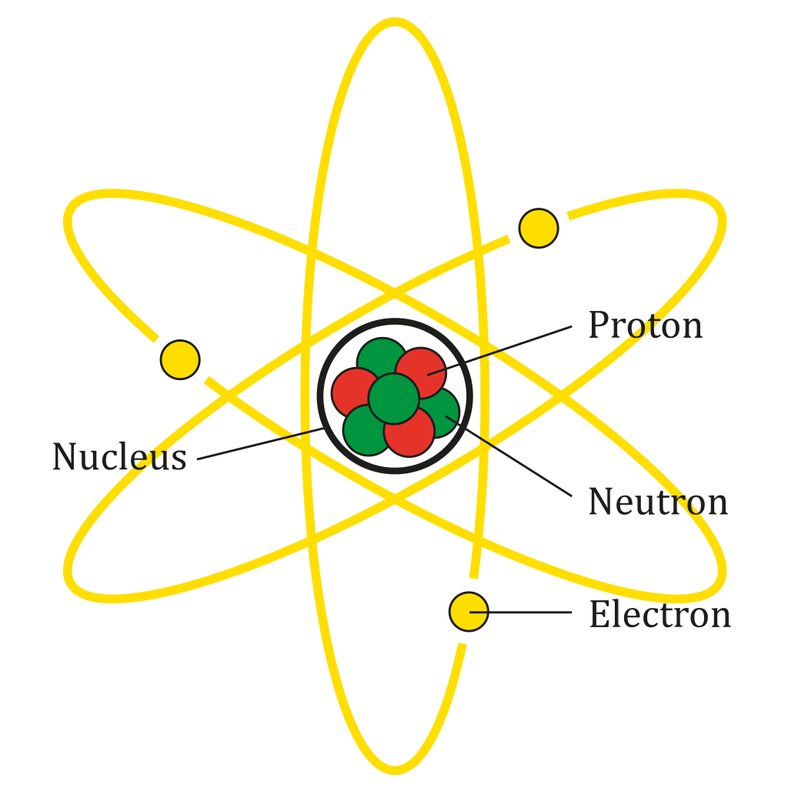

Slide 4
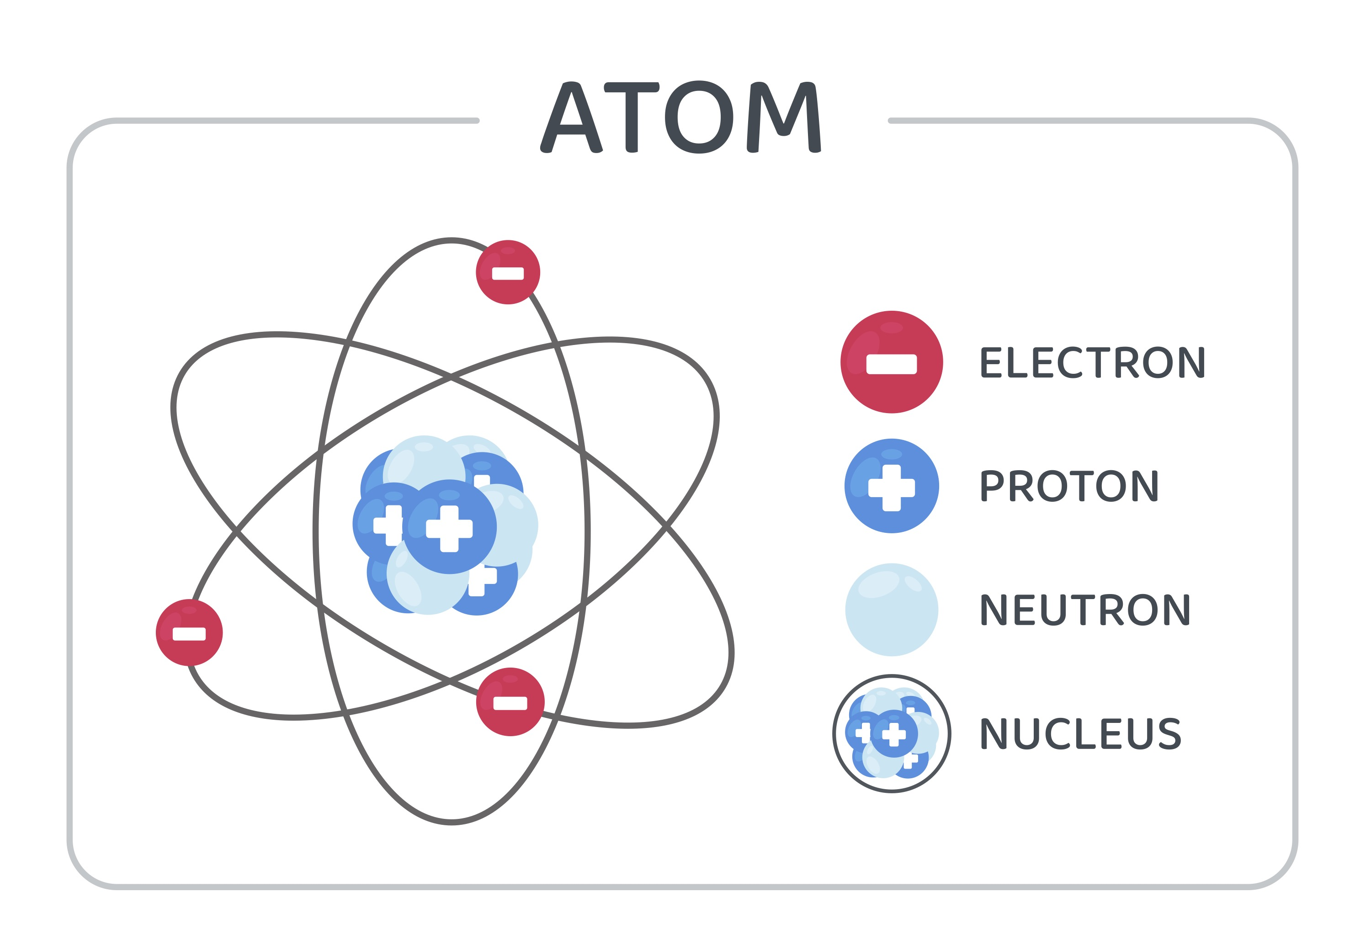
Developing Experts All rights reserved © 2021

Slide 5
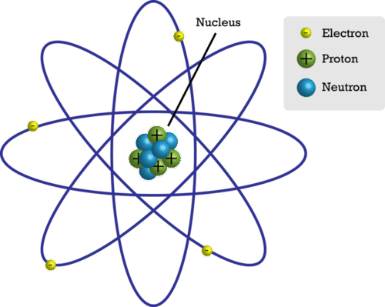

Slide 6
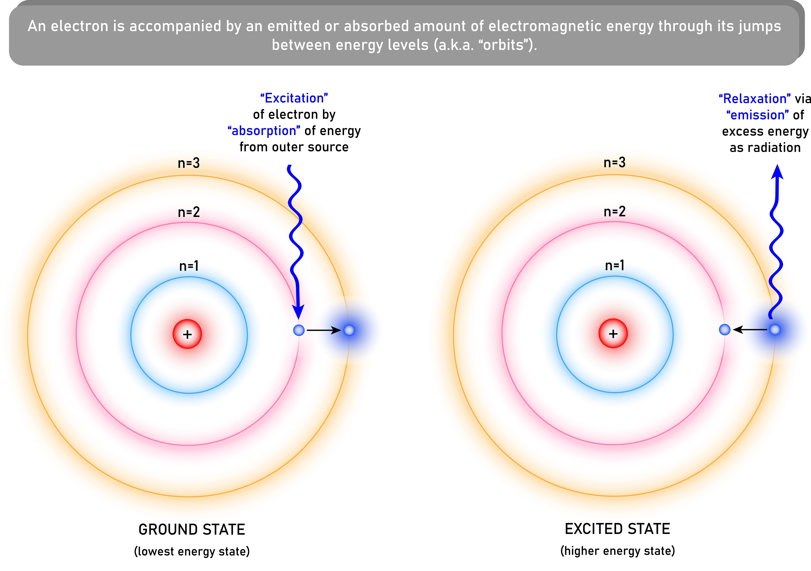
Excitation of electron by absorption of energy, moves it to higher energy level.
Relaxation to a lower energy level.
When the electron gets moved from its original energy level to a higher one, it then jumps back each level until it comes to the original level.

