Slide 1

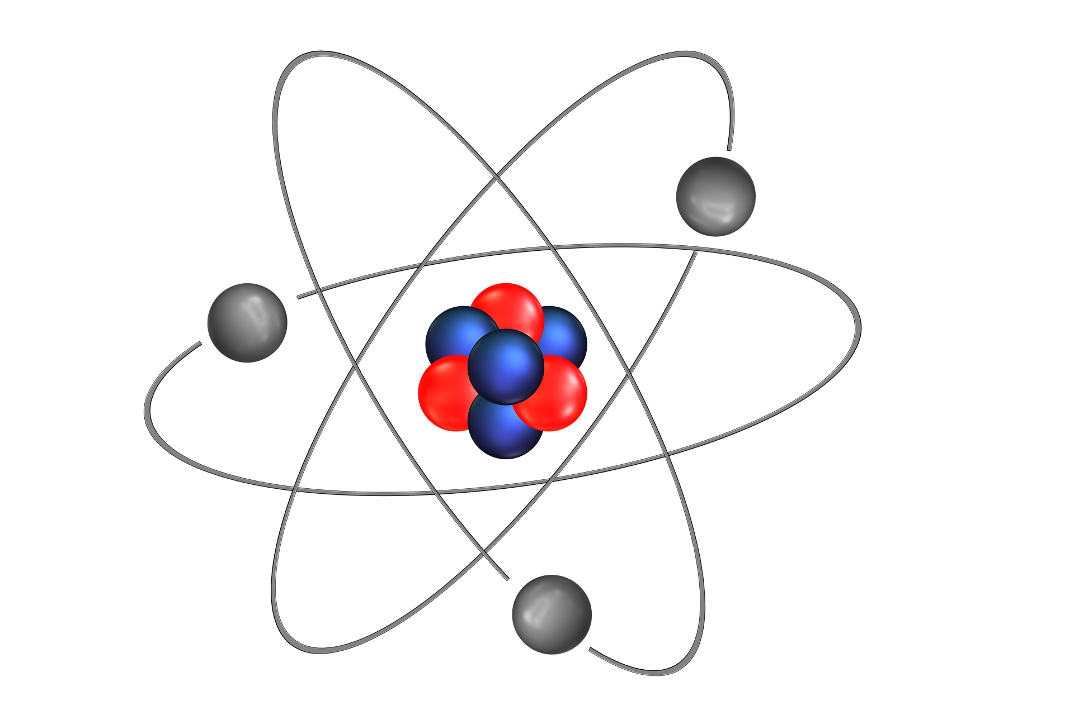
0001.01
Mission Assignment
Task | Make a model of a lithium atom. Model the atom so that you can remove or add neutrons to present the different isotopes: lithium 6 and lithium 8.
Developing skills | Using the periodic table, practise calculations for isotopes and for ions.
Think about… | The visibility or invisibility of women scientists in the history of science – what conclusions can you draw from this?
KS4-21-02:
Exploring isotopes and ionisation

