Slide 1

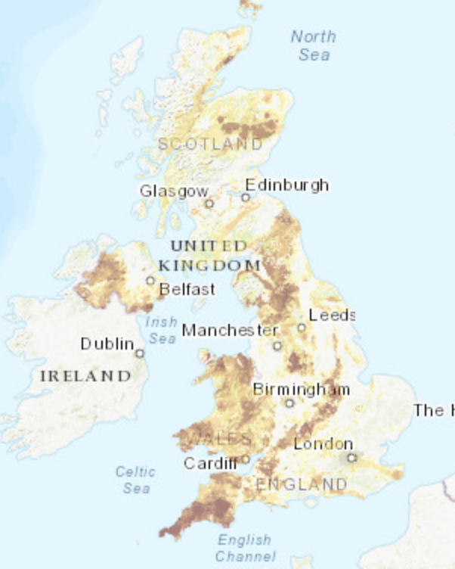
0001.01
Mission Assignment
Task | Go online to ukradon.org, explore the interactive radon map – write notes to explain why some areas of the country have higher levels of radon gas
Developing skills | Learn how to use a Geiger-Müller counter and find out what the normal levels are in the environment
Think about… | What other occupations may put people at elevated risk of exposure to higher levels of radiation?
KS4-21-09:
Explore uses of radiation

