Slide 1
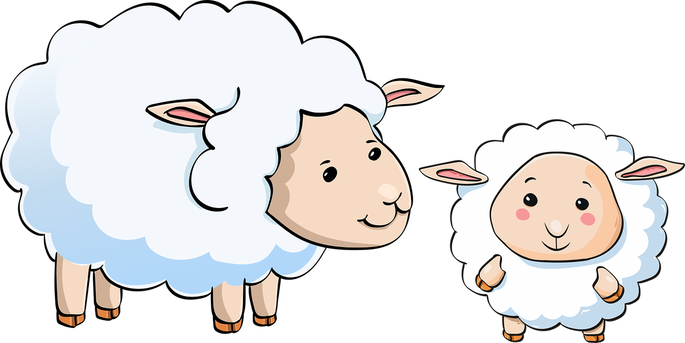
S02.05.09 Handout
Learn about reproduction and growth in animals.
Can you remember the key facts about reproduction and growth from today’s lesson?
FIVE FANTASTIC FACTS
Reproduction means to give birth to offspring which is the same or similar to its ______________.
Inside their mother, a baby ______________ until it is ready to be born.
Chicks are born when they ______________ out of an egg.
A baby sheep is called a _______________ and can be used for __________________.
A female human is pregnant for around _________ months, which is longer than a ______________ but shorter than an ____________________.
grows mouse parents
hatch nine
elephant lamb wool
Developing Experts Ltd. © 2022.

Slide 2
S02.05.09 Handout
Learn about reproduction and growth in animals.
Can you record each other’s height and foot length?
Then, draw a bar graph to show your results
Name | Height | Foot Length
e.g. Jon | 120cm | 20cm
Developing Experts Ltd. © 2022.

