Slide 1




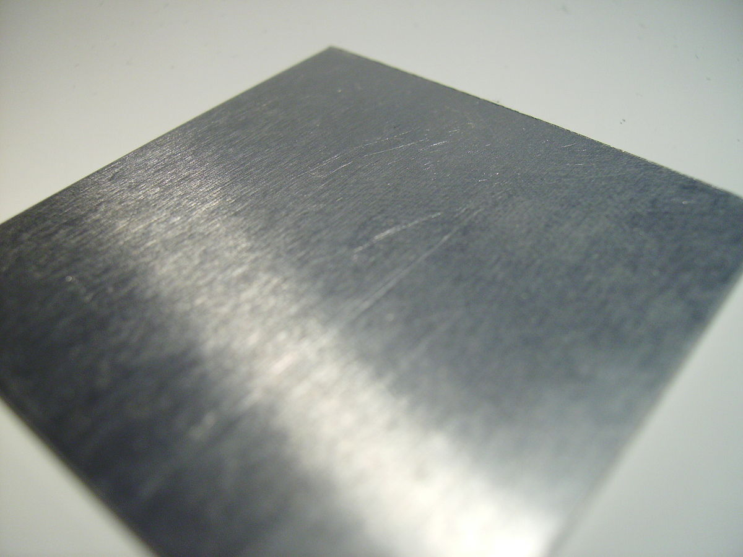


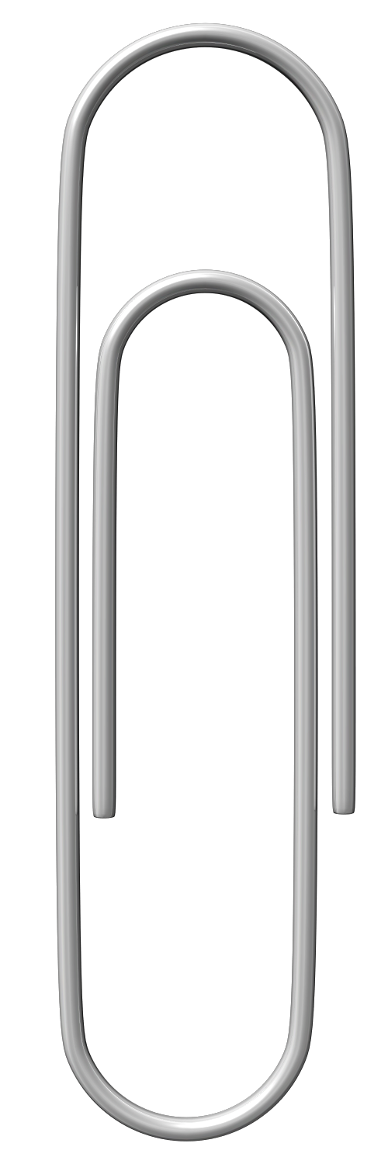
Mission Assignment: Demonstrate the shape of a magnetic field
KS3-23-04
Magnetic shielding
You are going to investigate which materials will disrupt a magnetic field.
Method
Tie the thread to the paperclip and fix it to the base of the stand.
Clamp the magnet so that the paper clip is suspended underneath it, while keeping a gap between paperclip and the magnet.
Raise the magnet to the highest point possible while still suspending the paperclip.
Slide different materials through the gap, without touching the paperclip.
Record if the paperclip stays in place or drops.
You may find some materials are attracted to the magnet. It doesn’t matter if the magnetic materials stick to the magnet.
Equipment
Thin thread
Bar magnet
Small metal paper clip
Sticky tack/ tape
Clamp, boss, and stand
Thin material samples – steel, iron, nickel, copper, paper, cloth, tin, aluminium, plastic
Material | Paperclip drop (✓/✗)
Steel
Iron
Nickel
Copper
Paper
Cloth
Tin
Aluminium
Plastic
What do the materials that cause the paper clip to drop have in common? ________________________________________________________________________________________________________________________________________________________________________________________________________________
Developing Experts Copyright 2023 All Rights Reserved

Slide 2
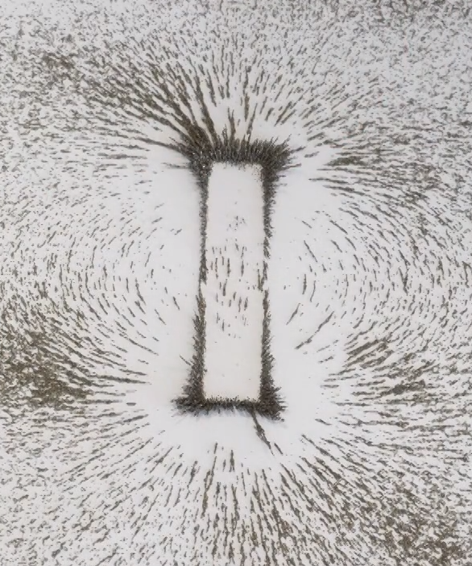

Mission Assignment: Demonstrate the shape of a magnetic field
KS3-23-04
Plotting magnetic fields
You are going to draw magnetic field lines for the following setups.
Method:
Arrange the magnets as shown in the illustrations below.
Place a piece of paper over the top, and sprinkle iron filings on the paper (you could also use plotting compasses).
Draw the lines that appear on the diagrams below.
Add the directional arrows to the field lines.
N
Single magnet with magnetic material attached.
Two magnets attracting (with a wooden block separating them).
N
N
N
N
Two magnets repelling.
Developing Experts Copyright 2023 All Rights Reserved

