Slide 1
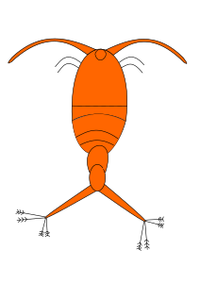
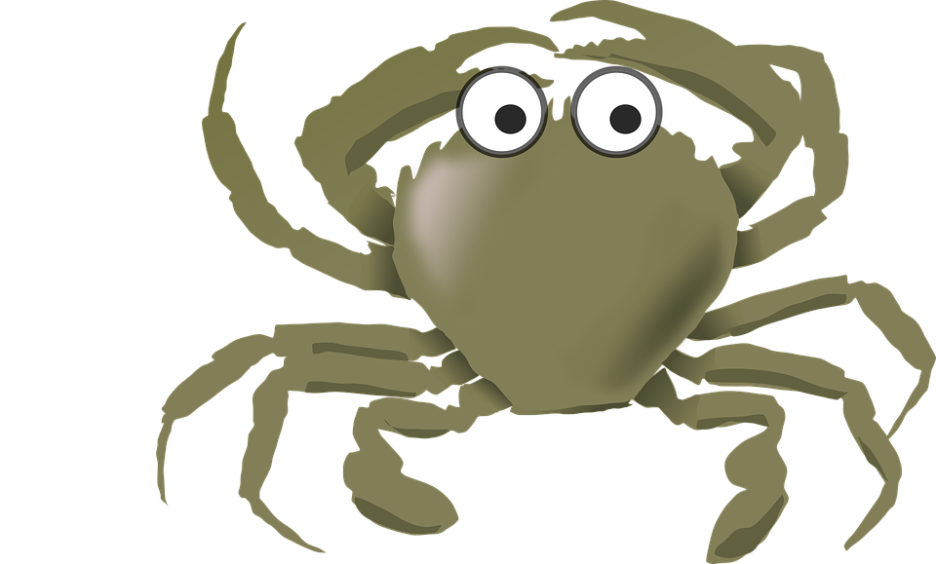
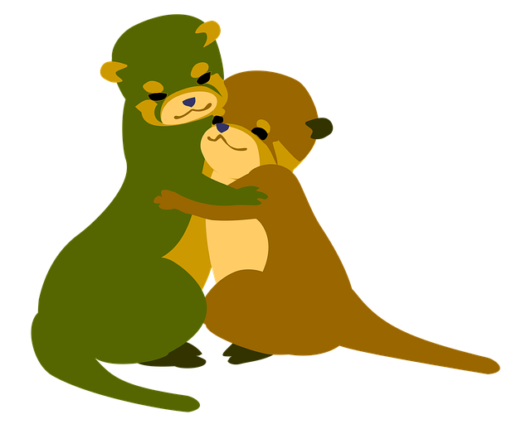
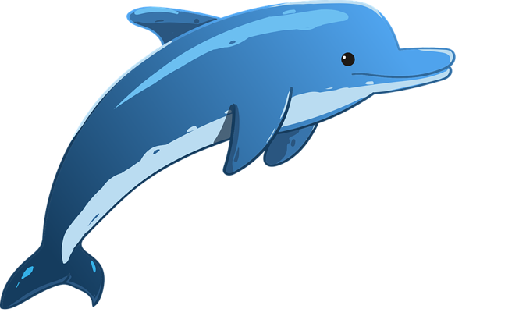
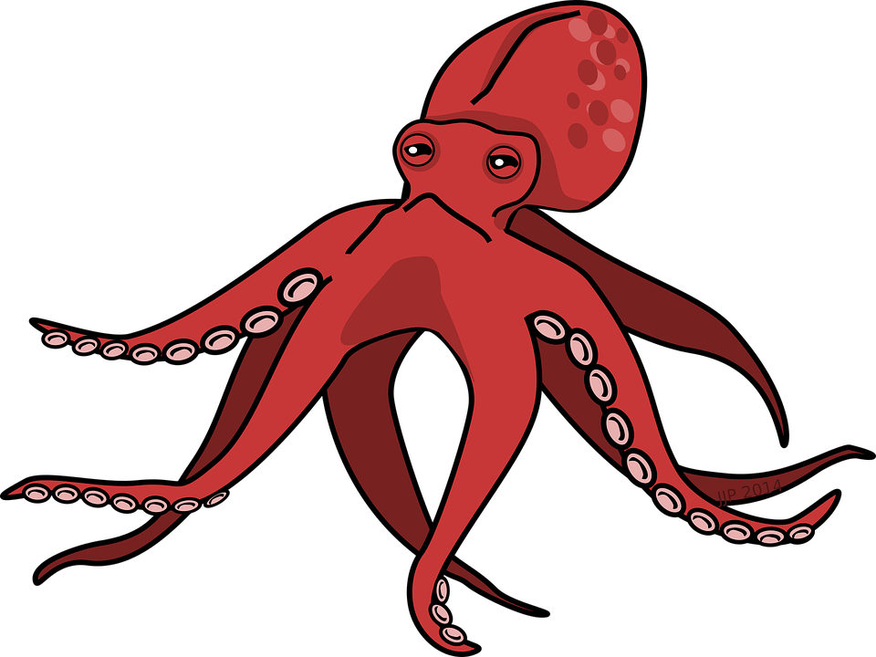
Read the information about the different ocean life.
Then cut out the pictures and stick them to show
how deep in the ocean they live.
plankton
Microscopic plants that float near the surface of the ocean to get sunlight.
Stretch:
How are animals that live near the surface different to those that live on the seafloor?
shore crab
Crustaceans that are commonly found in rock pools on the beach.
sea otter
Mammals that float on the surface of the ocean. They often hold hands to stick together.
Challenge:
Find out where in the ocean the blue whale lives. Add this to your work
dolphin
Mammals that need to breathe air, so they live near the surface.
word bank:
ocean
surface
deep
seafloor
mammal
squid
These have 8 arms with suckers on them. They live about 500m below the surface.

Slide 2
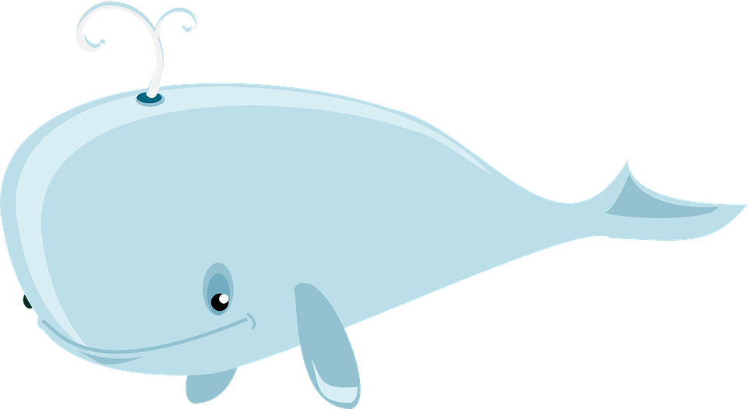
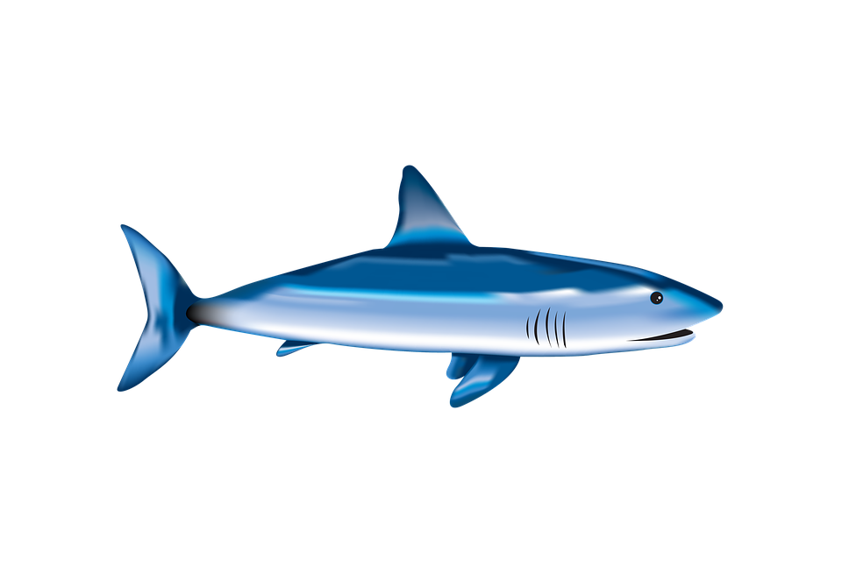
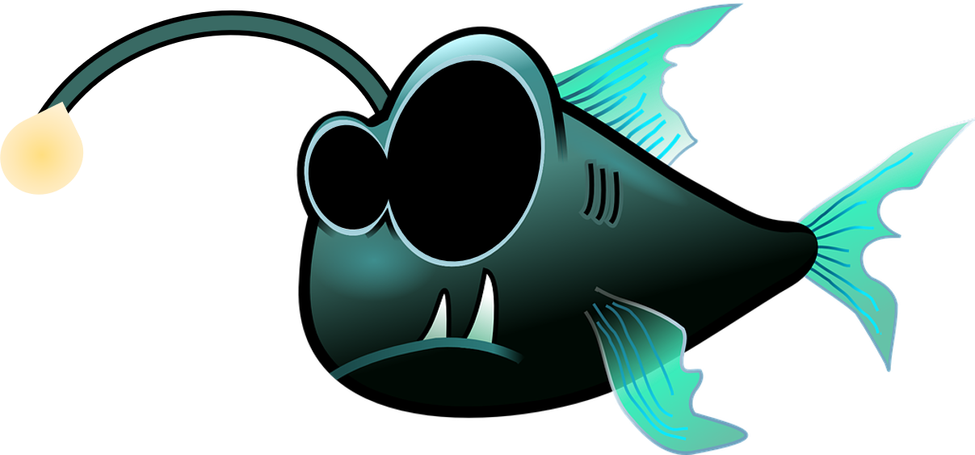
humpback whale
These are mammals so need to swim up to the surface to breathe but live at 500m below the surface.
blue shark
These are fish that are excellent predators. The hunt around 1000m below the surface
blob fish
These have a thick skin to help them survive the high-water pressure at 1500m below the surface.
angler fish
These live at the bottom of the ocean in the dark. They have a light on their head to help them see and hunt.
eel
These live on the seafloor and feed on the dead animals found there.

