Slide 1

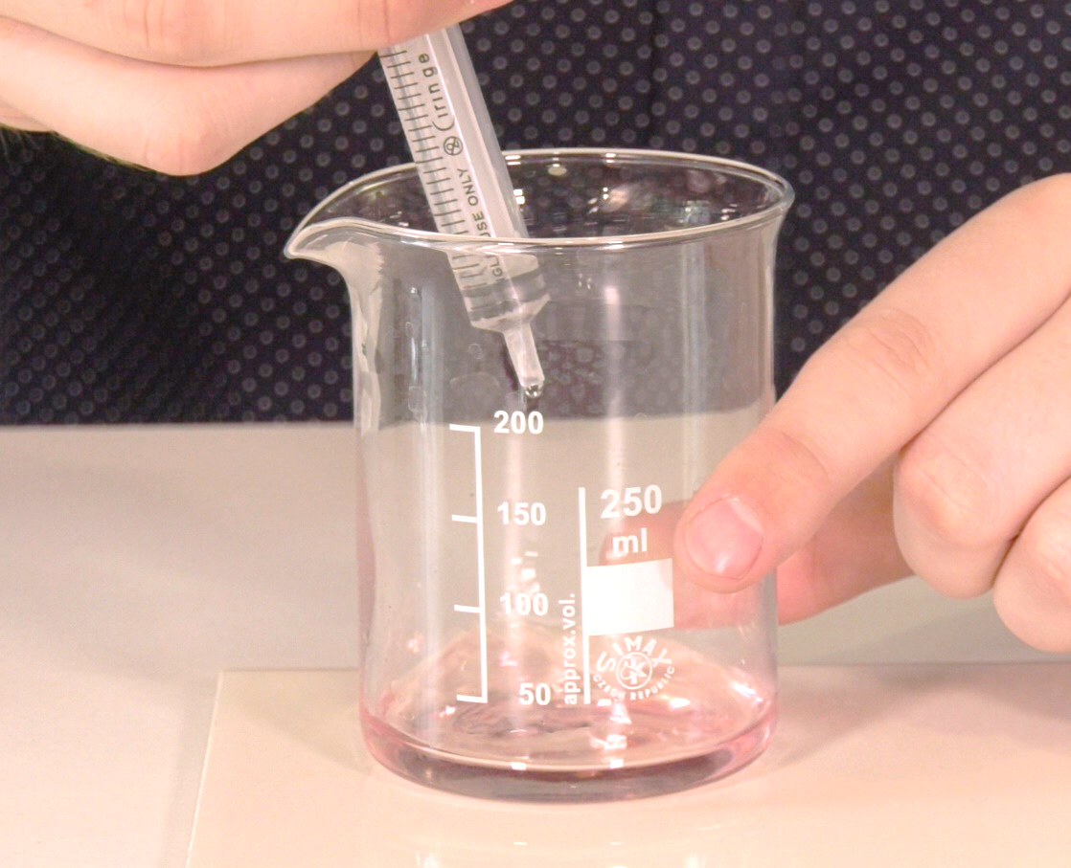
Mission Assignment: Outline the neutralisation reaction
KS3-15-03
Indigestion Remedies
Compare two unknown indigestion remedies to determine which is more effective in neutralising "stomach acid".
Method
Place 10ml of hydrochloric acid in a beaker
and add a few drops of universal indicator
solution (t should turn red). Place the beaker
on a white tile so that the colour can be
seen clearly.
Fill a syringe with remedy A. Slowly add this to
the beaker. While adding, gently swirl the
beaker to ensure the two solutions are mixed.
Continue slowly adding the solution until the
indicator so a neutral solution (green).
Record the amount of remedy that was
added to the solution to neutralise it.
Repeat this process for remedy B.
Questions
Which remedy is more effective at neutralising stomach acid? Explain your answer.
___________________________________________________________________________________________________________________________________________________________________________________________________________________________________________________
Calcium carbonate tablets are normally used as an indigestion remedy. This reactions produces calcium chloride, water and carbon dioxide. Write a word equation for this reaction.
_________________________________________________________________________________
Suggest why calcium carbonate may be a better than an alkali to neutralise excess stomach acid.
___________________________________________________________________________________________________________________________________________________________________________________________________________________________________________________
Equipment
"stomach acid"
(0.2M hydrochloric acid)
Remedy A
Remedy B
Graduated pipettes / syringes
250ml beaker
White tile
Universal indicator solution
Remedy | Volume added to neutralise (ml)
 | Trial 1 | Trail 2
A
B
Developing Experts Copyright 2023 All Rights Reserved

Slide 2
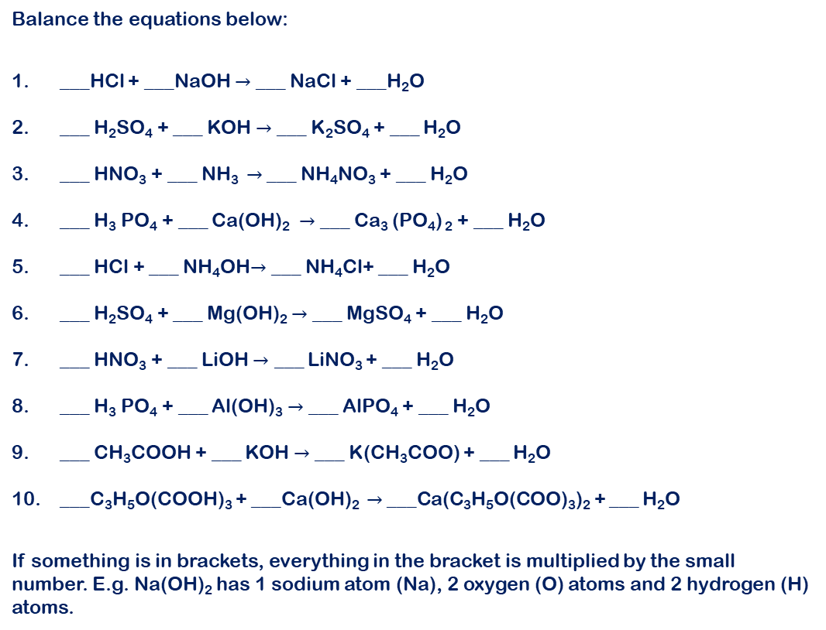
Mission Assignment: Outline the neutralisation reaction
KS3-15-03
Balancing Chemical Equations
Balance the equations below:
___HCl + ___NaOH $→$ ___ NaCl + ___H₂O
___ H₂SO₄ + ___ KOH $→$ ___ K₂SO₄ + ___ H₂O
___ HNO₃ + ___ NH₃ $→$ ___ NH₄NO₃ + ___ H₂O
___ H₃ PO₄ + ___ Ca(OH)₂ $→$ ___ Ca₃ (PO₄) ₂ + ___ H₂O
___ HCl + ___ NH₄OH$→$ ___ NH₄Cl+ ___ H₂O
___ H₂SO₄ + ___ Mg(OH)₂ $→$ ___ MgSO₄ + ___ H₂O
___ HNO₃ + ___ LiOH $→$ ___ LiNO₃ + ___ H₂O
___ H₃ PO₄ + ___ Al(OH)₃ $→$ ___ AlPO₄ + ___ H₂O
___ CH₃COOH + ___ KOH $→$ ___ K(CH₃COO) + ___ H₂O
___C₃H₅O(COOH)₃ + ___Ca(OH)₂ $→$ ___Ca(C₃H₅O(COO)₃)₂ + ___ H₂O
If something is in brackets, everything in the bracket is multiplied by the small number. E.g. Na(OH)₂ has 1 sodium atom (Na), 2 oxygen (O) atoms and 2 hydrogen (H) atoms.
Acids | Alkalis
HCl – Hydrochloric acid H₂SO₄ – sulphuric acid HNO₃ – nitric acid H₃ PO₄ – phosphoric acid CH₃OOH – ethanoic acid (vinegar) C₃H₅O(COOH)₃ - citric acid | LiOH – lithium hydroxide NaOH – Sodium hydroxide KOH – potassium hydroxide NH₃ – ammonia NH₄OH – ammonium hydroxide Ca(OH)₂ – calcium hydroxide Mg(OH)₂ – magnesium hydroxide Al(OH) ₃ – aluminium hydroxide
Developing Experts Copyright 2023 All Rights Reserved

Slide 3
Mission Assignment: Outline the neutralisation reaction
KS3-15-03
Balancing Chemical Equations - Top Tip #1
The elements are either written as a single upper-case letter or an upper-case letter followed by a lower-case letter.
C – carbon Na – sodium
Top Tip #2 | Top Tip #3
Two upper case letters next to each other indicate that there are two different elements present. | The subscript number after an element tells us how many atoms of that element are in the molecule. If there is no number, then there is just one atom of that element
Co – cobalt CO – carbon & oxygen (carbon monoxide) | P₂O₅ Here there are 2 phosphorus atoms and 5 oxygen atoms in 1 molecule.
Top Tip #4 | Top Tip #5
The large number in front shows how many molecules we have in total. If there is no number, then there is just one molecule. | The objective of balancing equations is to have the same number of atoms either side of the arrow.
2H₂O 2 molecules of water (H₂O). Which is 4 hydrogen (H) and 2 Oxygen (O) atoms in total. | 2Na + Cl₂ → 2NaCl On the left there are 2 sodium (Na) and 2 chlorine (Cl) atoms. On the right there are 2 sodium (Na) and 2 chlorine (Cl) atoms.
The GOLDEN rule
When we balance equations, we only change the number in front, never the small number as this changes the chemical.
To balance the equation H₂ + O₂ → H₂O Only add numbers in front 2H₂ + O₂ → 2H₂O Do not change or add subscript numbers H₂ + O₂ → H₂O₂* *Here water was changed into corrosive hydrogen peroxide!
Why do scientist use chemical equations?
What law of chemistry does a balanced equation demonstrate?
Developing Experts Copyright 2023 All Rights Reserved

Slide 4
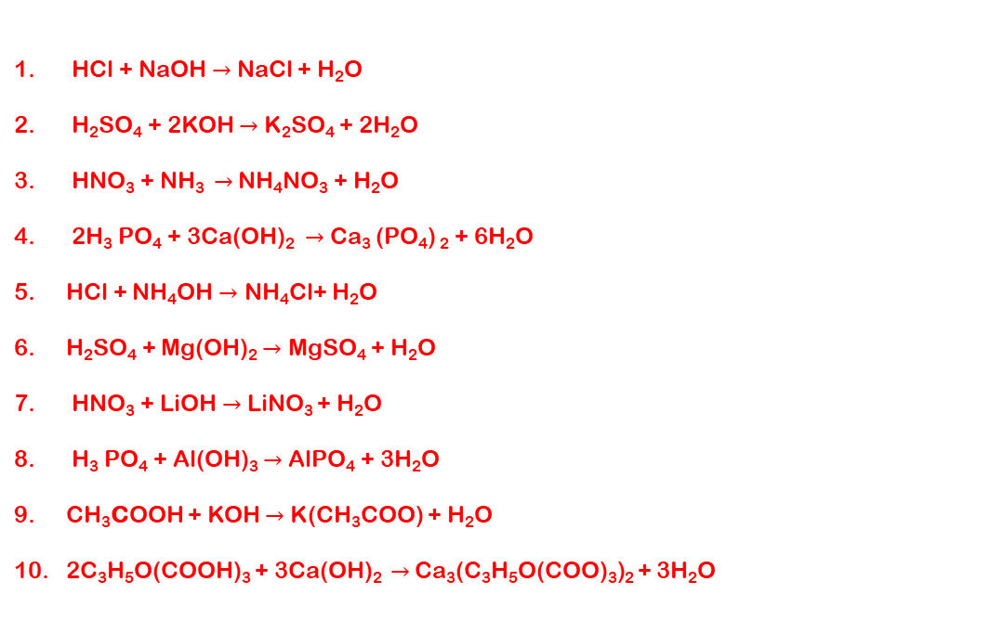
Mission Assignment: Outline the neutralisation reaction
ANSWERS
KS3-15-03
Balancing Chemical Equations
HCl + NaOH $→$ NaCl + H₂O
H₂SO₄ + 2KOH $→$ K₂SO₄ + 2H₂O
HNO₃ + NH₃ $→$ NH₄NO₃ + H₂O
2H₃ PO₄ + 3Ca(OH)₂ $→$ Ca₃ (PO₄) ₂ + 6H₂O
HCl + NH₄OH $→$ NH₄Cl+ H₂O
H₂SO₄ + Mg(OH)₂ $→$ MgSO₄ + H₂O
HNO₃ + LiOH $→$ LiNO₃ + H₂O
H₃ PO₄ + Al(OH)₃ $→$ AlPO₄ + 3H₂O
CH₃COOH + KOH $→$ K(CH₃COO) + H₂O
2C₃H₅O(COOH)₃ + 3Ca(OH)₂ $→$ Ca₃(C₃H₅O(COO)₃)₂ + 3H₂O
Developing Experts Copyright 2023 All Rights Reserved

