Slide 1
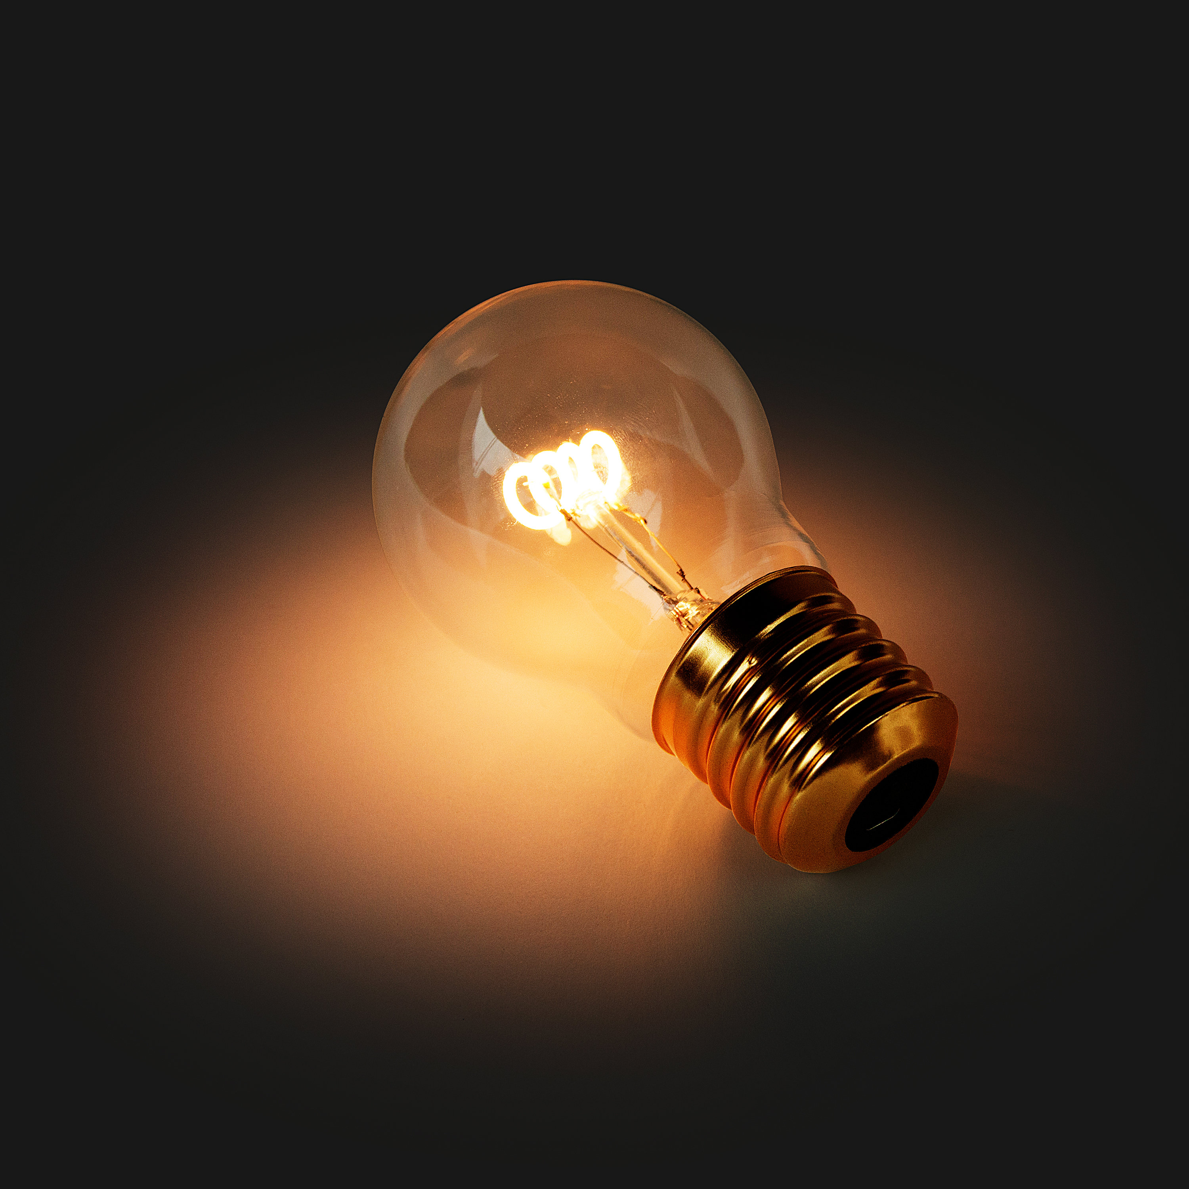
Explore efficiency and reducing unwanted energy transfers
Calculate the efficiency of energy transfer.
Describe ways to increase the efficiency of an energy transfer.
Developing Experts All rights reserved © 2021

Slide 2
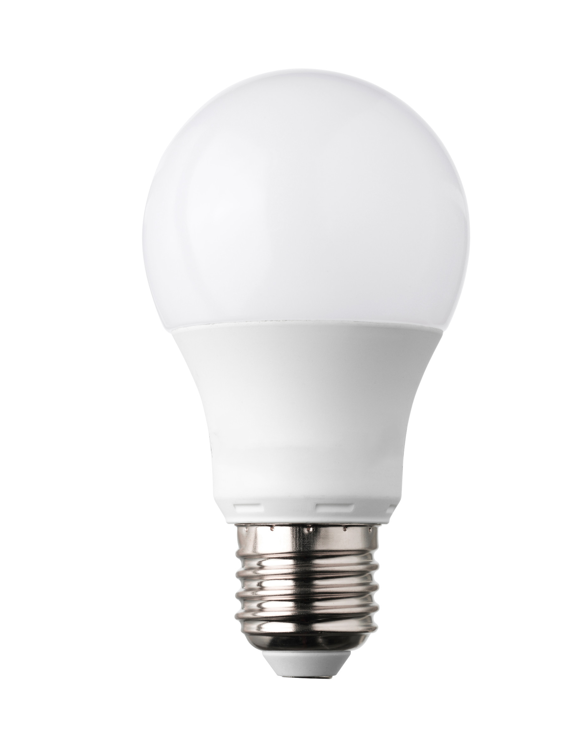
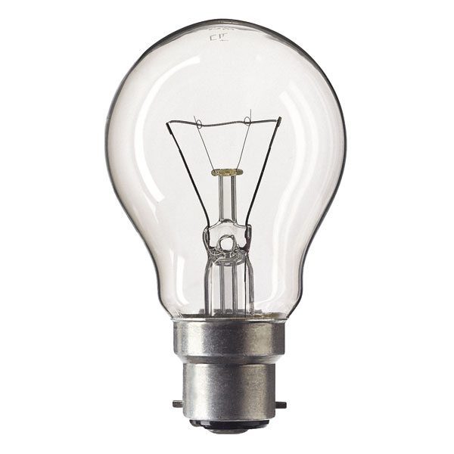
Developing Experts All rights reserved © 2021

Slide 3
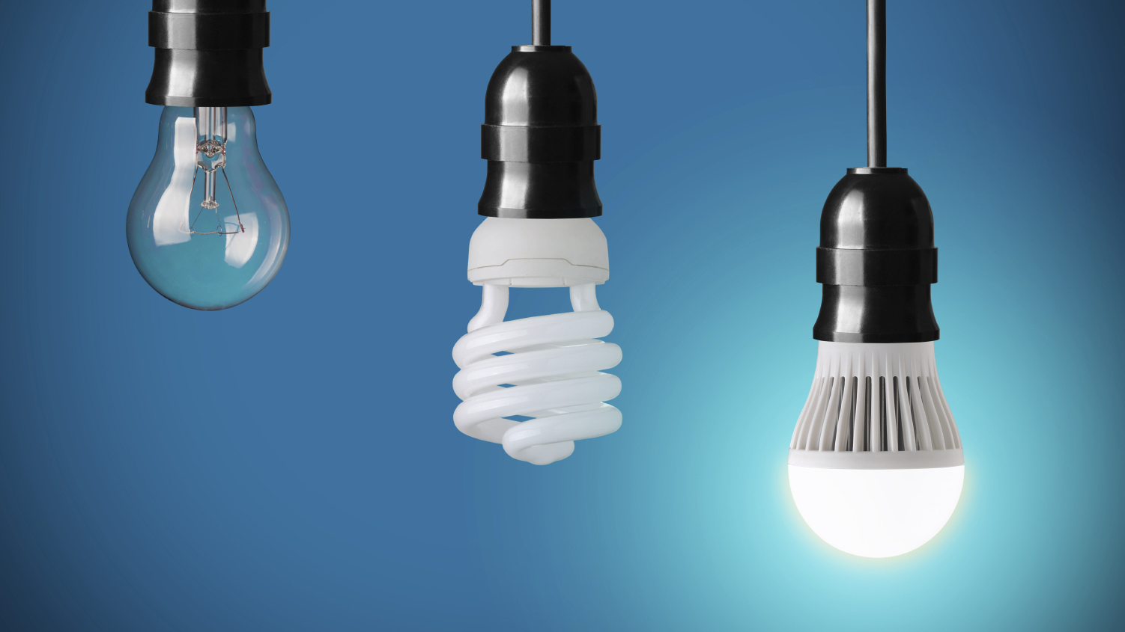
Developing Experts All rights reserved © 2021

Slide 4
Efficiency
Useful output energy transfer
Efficiency =
Total input energy transfer
Useful power output
Efficiency =
Total power input
Developing Experts All rights reserved © 2021

Slide 5
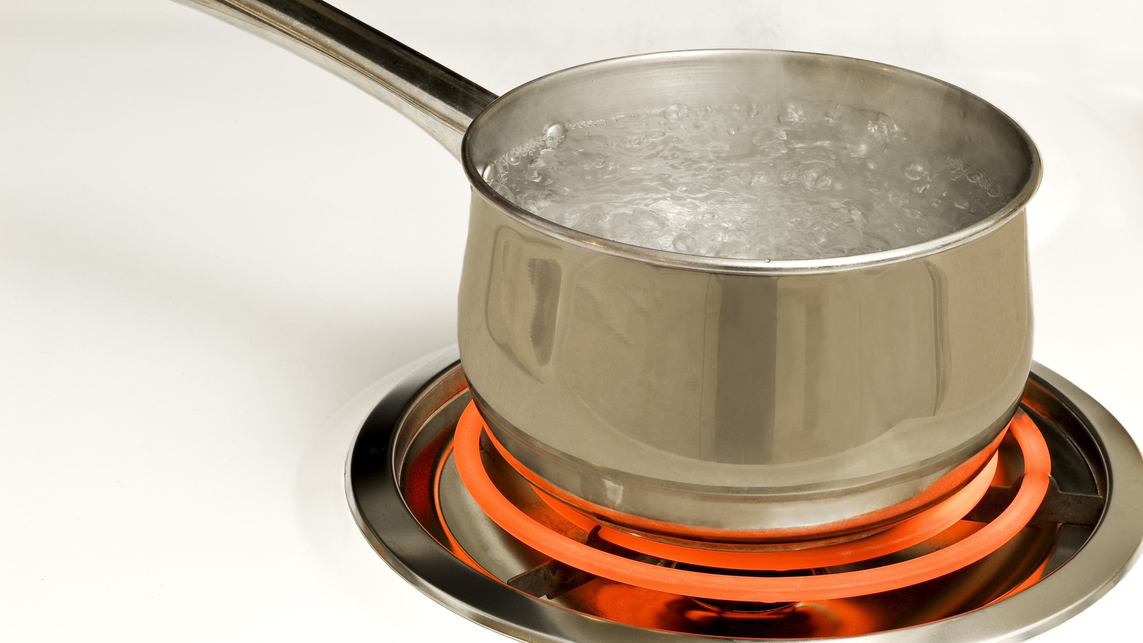
An electric hob is
used to heat water. 15,000 joules of thermal energy is transferred by the hob. 12,000 joules of thermal energy passes into the water. Calculate
the efficiency of
the energy
transfer.
Developing Experts All rights reserved © 2021

Slide 6
Useful output energy transfer
12,000 J
Efficiency =
=
= 0.8
Total input energy transfer
15,000 J
Developing Experts All rights reserved © 2021
Developing Experts All rights reserved © 2021

Slide 7
Useful output energy transfer
12,000 J
Efficiency =
=
= 0.8 x 100 = 80 %
Total input energy
transfer
15,000 J
Developing Experts All rights reserved © 2021
Developing Experts All rights reserved © 2021

Slide 8


Efficiency
Useful output energy transfer
Efficiency =
correct
Total input energy transfer
Total input energy transfer
Efficiency =
incorrect
Useful output energy transfer
Developing Experts All rights reserved © 2021

Slide 9
An electric current delivers the power of 60 watts to a light bulb. 3 watts of electrical energy are transferred to light energy. Calculate the efficiency of the bulb. Have a go at working out the answer.
Developing Experts All rights reserved © 2021

Slide 10
An electric current delivers the power of 60 watts to a light bulb. 3 watts of electrical energy are transferred to light energy. Calculate the efficiency of the bulb. Have a go at working out the answer.
Useful power output
Efficiency =
Total power input
3
Efficiency =
(5 %)
= 0.05
60
Developing Experts All rights reserved © 2021

Slide 11
Developing Experts All rights reserved © 2021

Slide 12
wasted energy
wasted energy
Developing Experts All rights reserved © 2021

Slide 13
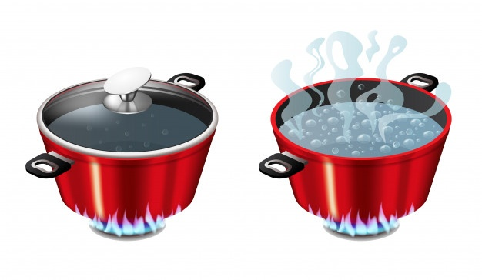
Developing Experts All rights reserved © 2021

Slide 14
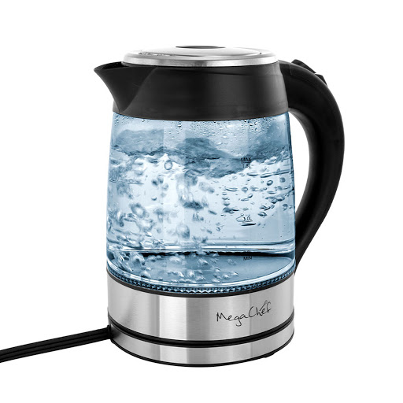
Metal is a good conductor of heat
Thermal energy will pass through the side on the lid of the pan into the air
Plastic conducts heat less well than metal (lower thermal conductivity)
This makes kettles a more efficient way of heating water than using a pan
Developing Experts All rights reserved © 2021

