Slide 1

Explore gravity and the life and work of Isaac Newton
Code: N22-56-01
Your question:
What do you want to know?
________________________________________________________________________
Fair test:
How will you ensure you conduct
a fair test?
________________________________________________________________________________________________________________________________________________________________________________________________________________________________________________________________________________________________
Your hypothesis:
What do you predict will happen?
____________________________________________________________________________________________________________________________________________________________________________________________________________________________________________________________________________________________________________________________________________________________________________________________________________
Control variables:
Which parts of your experiment will stay the same?
_______________________________________________________________________________________________________________
2

Slide 2
Explore gravity and the life and work of Isaac Newton
Code: N22-56-01
Your results:
Your analysis:
What did you find out?
________________________________________________________________________________________________________________________________________________________________________________________________________________________________________________________________________________________________
Ball | Mass (g) | Time taken to reach the ground (s)
Your conclusion:
Was your hypothesis correct? Explain
_________________________________________________________________________________________________________________________________________________________________________________________
2

Slide 3
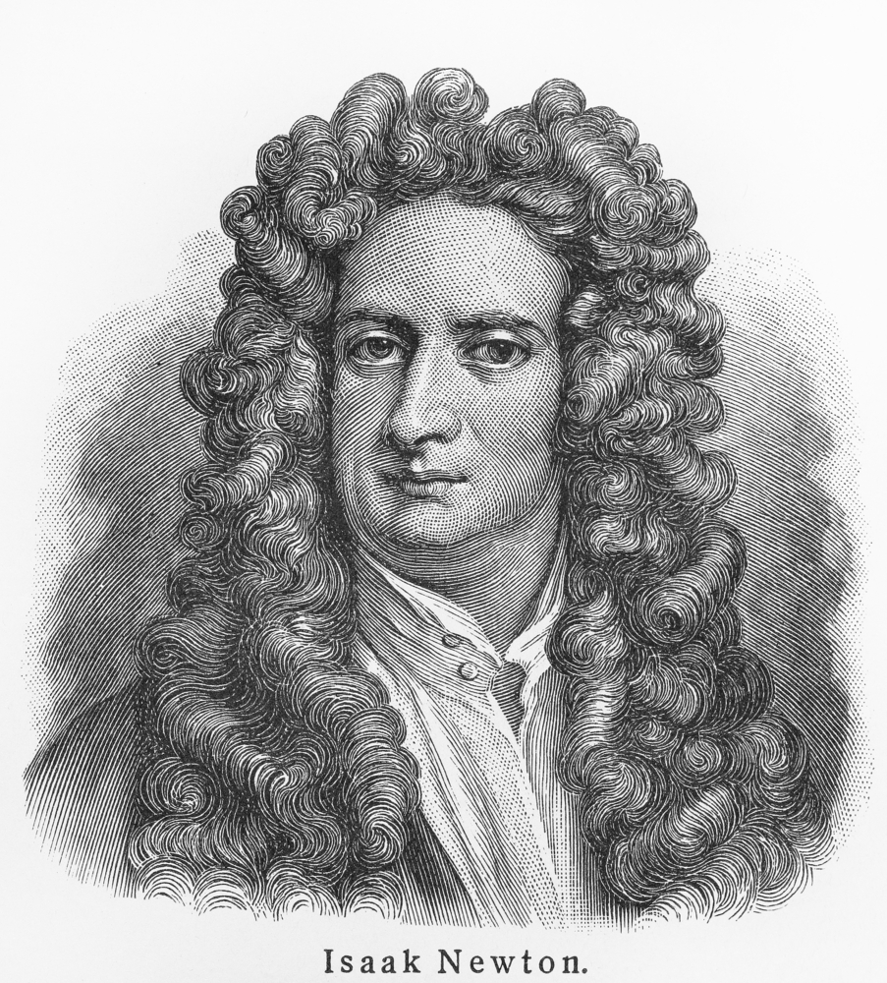
Explore gravity and the life and work of Isaac Newton
Code: N22-56-01
Write a paragraph about Sir Isaac Newton, discussing his life and work
________________________________________________________________________________________________________________________________________________________________________________________________________________________________________________________________________________________________________________________________________________________________________________________________________________________________________________________________________________________________________________________________________________________________________________________________________________________________________________________________________________________________________________________________________________________________________________
3

