Slide 1
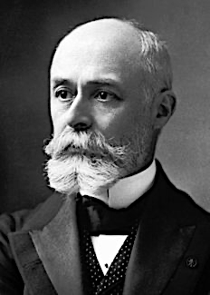
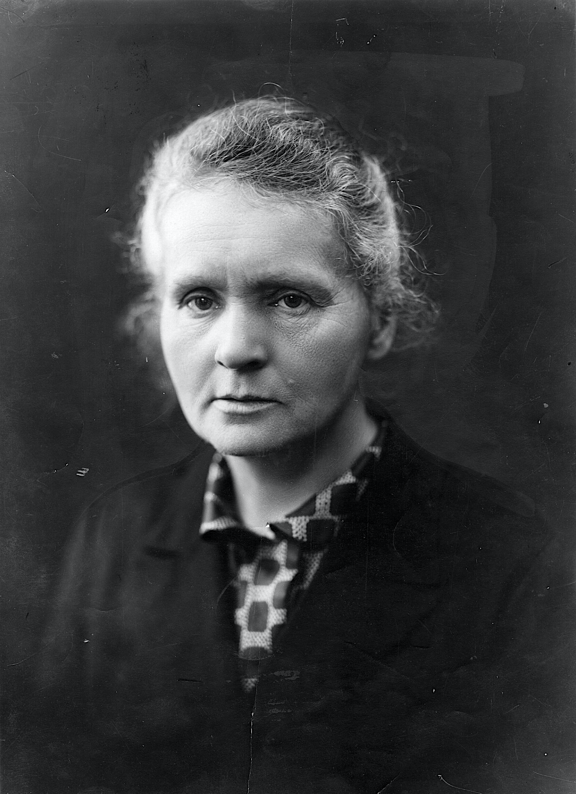
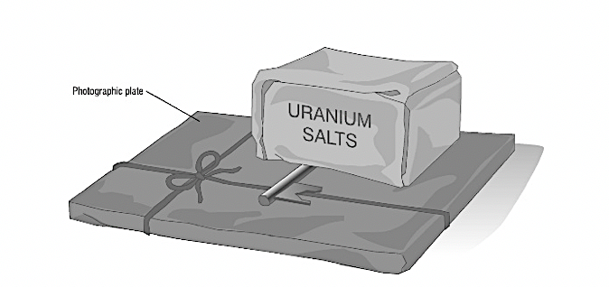
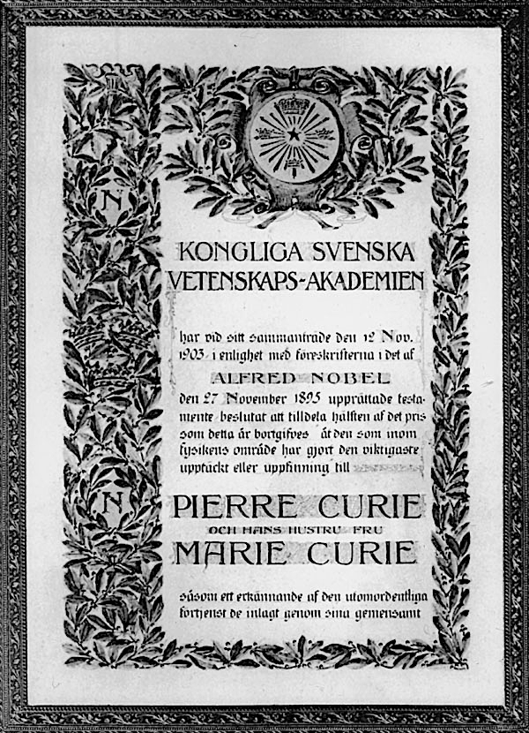
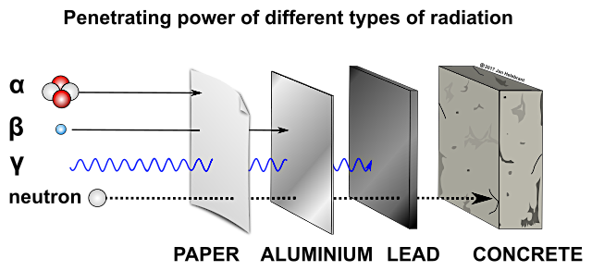
Marie Curie & Henri Becquerel
Marie Curie was not only the first woman to be awarded a Nobel Prize, but the only scientist to be awarded two Nobel Prizes for different areas of science. Her experiments and discoveries with radiation coincided with those of Henri Becquerel and his experiment with rays. Consequently, in 1903, they were co-awarded a Nobel Prize for physics for their groundbreaking discoveries. They made astounding progress with their findings that have revolutionised many areas of life, not least medicine and the generation of energy. Marie Curie brought forth the first theory that an atom was made up of parts in the form of energy, and the decay of atoms was the source of radiation, a phenomenon she named as radioactivity.
Becquerel and spontaneous radiation
In 1896, Becquerel was working with uranium salts. He observed that when this was left on a photographic plate that had a key placed on it, it left an image on that plate. There was a source of energy being emitted from the uranium spontaneously without any interaction or experimentation.
Marie Curie and radioactivity
When Becquerel made his discovery, Marie Curie became fascinated by the phenomena and set out to isolate and identify the source of the radioactivity as she named it. She was assisted by her husband Pierre, who was another astounding scientist. At first, she worked with a substance called pitch blend and then thorium. By 1898 she had identified polonium – which she named after her native country Poland – and later that year radium.
Gravitational
field strength
10N/kg
Types of radiation
Rutherford identified Alpha and Beta Radiation in 1899 and he went on to identify Gamma radiation in 1903. Alpha can be stopped by paper, beta by foil and gamma by lead. It was James Chadwick in 1932 who identified neutron radiation.

Slide 2
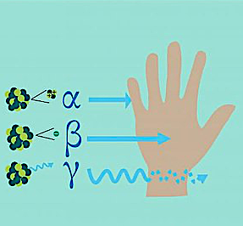
Practice
Source | %
Rocks
Cosmic
Air
Building Materials
Other sources
We have background radiation in our environment. Go online and research the following data. How much radiation is emitted from:-
  Rocks
  Cosmic
  Air
  Building Materials
Populate the table with your findings and draw a pie chart.
What are the three ways that background radiation can reach the air? ___________________________________________________________________________________________________________________________
Alpha
Electromagnetic wave
Paper
Beta
High-energy electron
Lead
Gamma
helium nuclei
Aluminum
Identify the correct symbol to radiation type and explain that type of radiation. ______________________________________________________________________________________________________________________________________________________________________________________________________________ _____________________________________

Slide 3
Types of radiation
Look on the first page at the diagram of Becquerel’s experiment. Which of the following materials stopped the radiation from the uranium?
air glass metal paper
  Complete the following sentences using words from the list.
around through under
  The radiation from the uranium salts affected the plate __________ the key.
  The radiation from the uranium salts did not affect the plate ___________ the key.
  The radiation from the uranium salts passed __________ the wrapper.
Radiation fact or fiction? | true/false
The word nuclear comes from the model of an atom
Radioactivity is measured in Becquerels
Nuclear radiation can damage your DNA
A Sievert is a measure of radioactive dose a that a person receives.
A banana gives off radiation
You can get radiation poisoning from a banana
Radioactive material glows in the dark
Nuclear waste cannot be disposed of safely
Radiation provides 2% of the world’s power
Radiation makes you into a superhero

