Slide 1

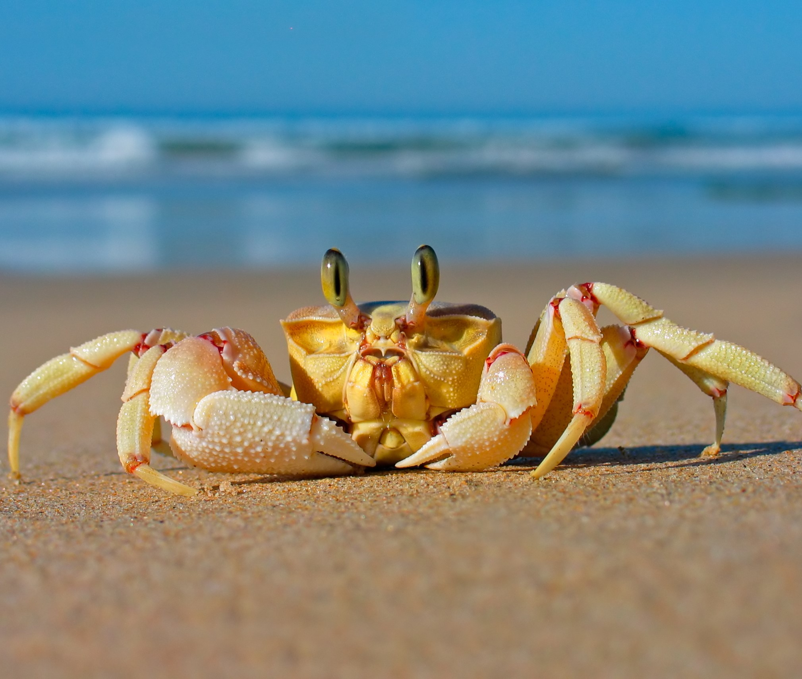
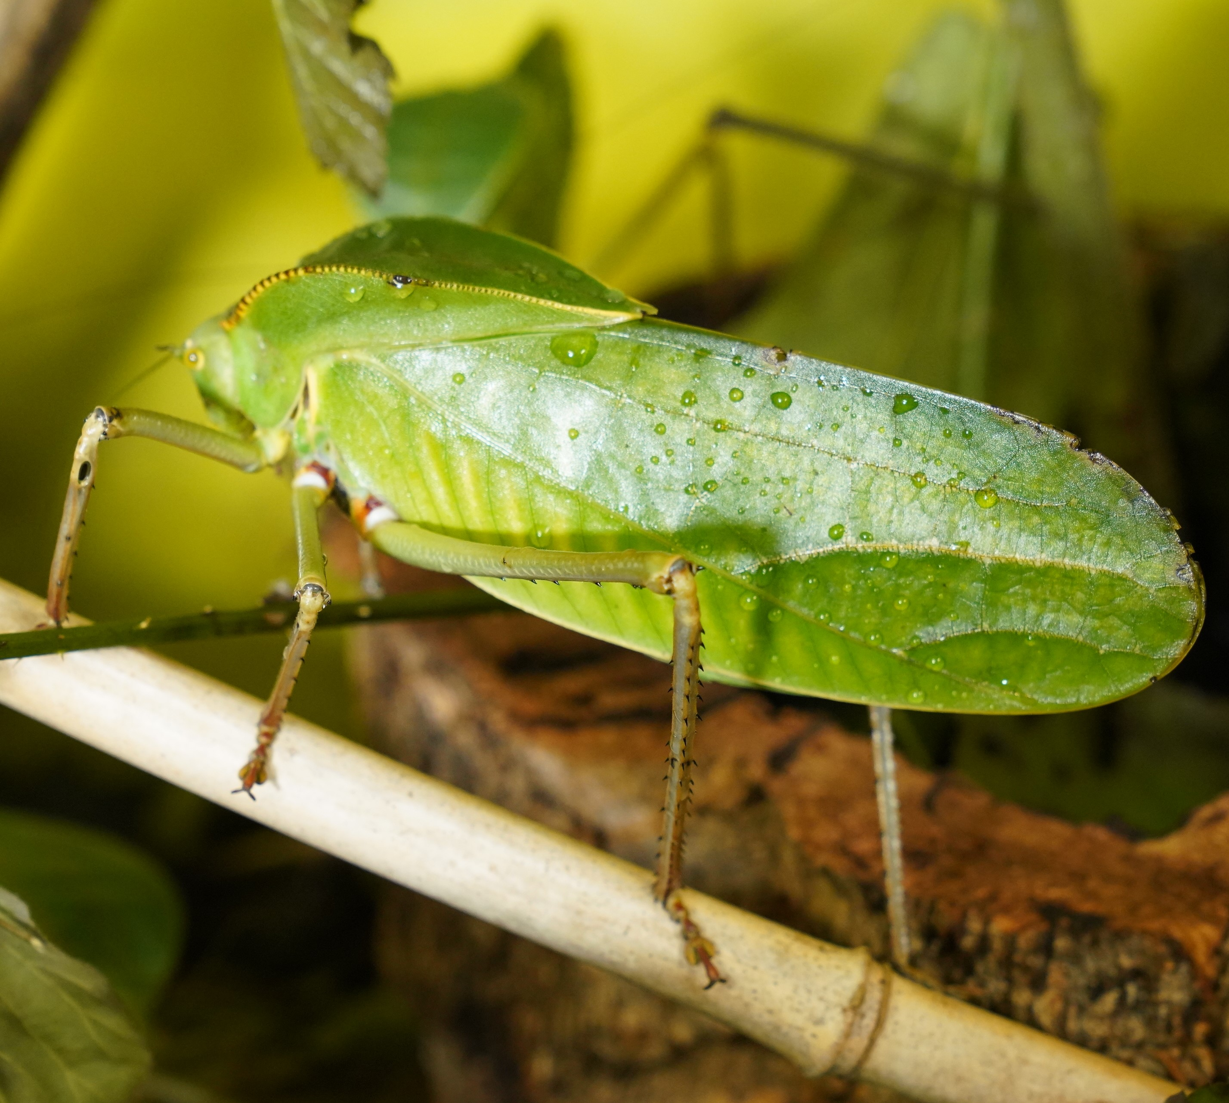
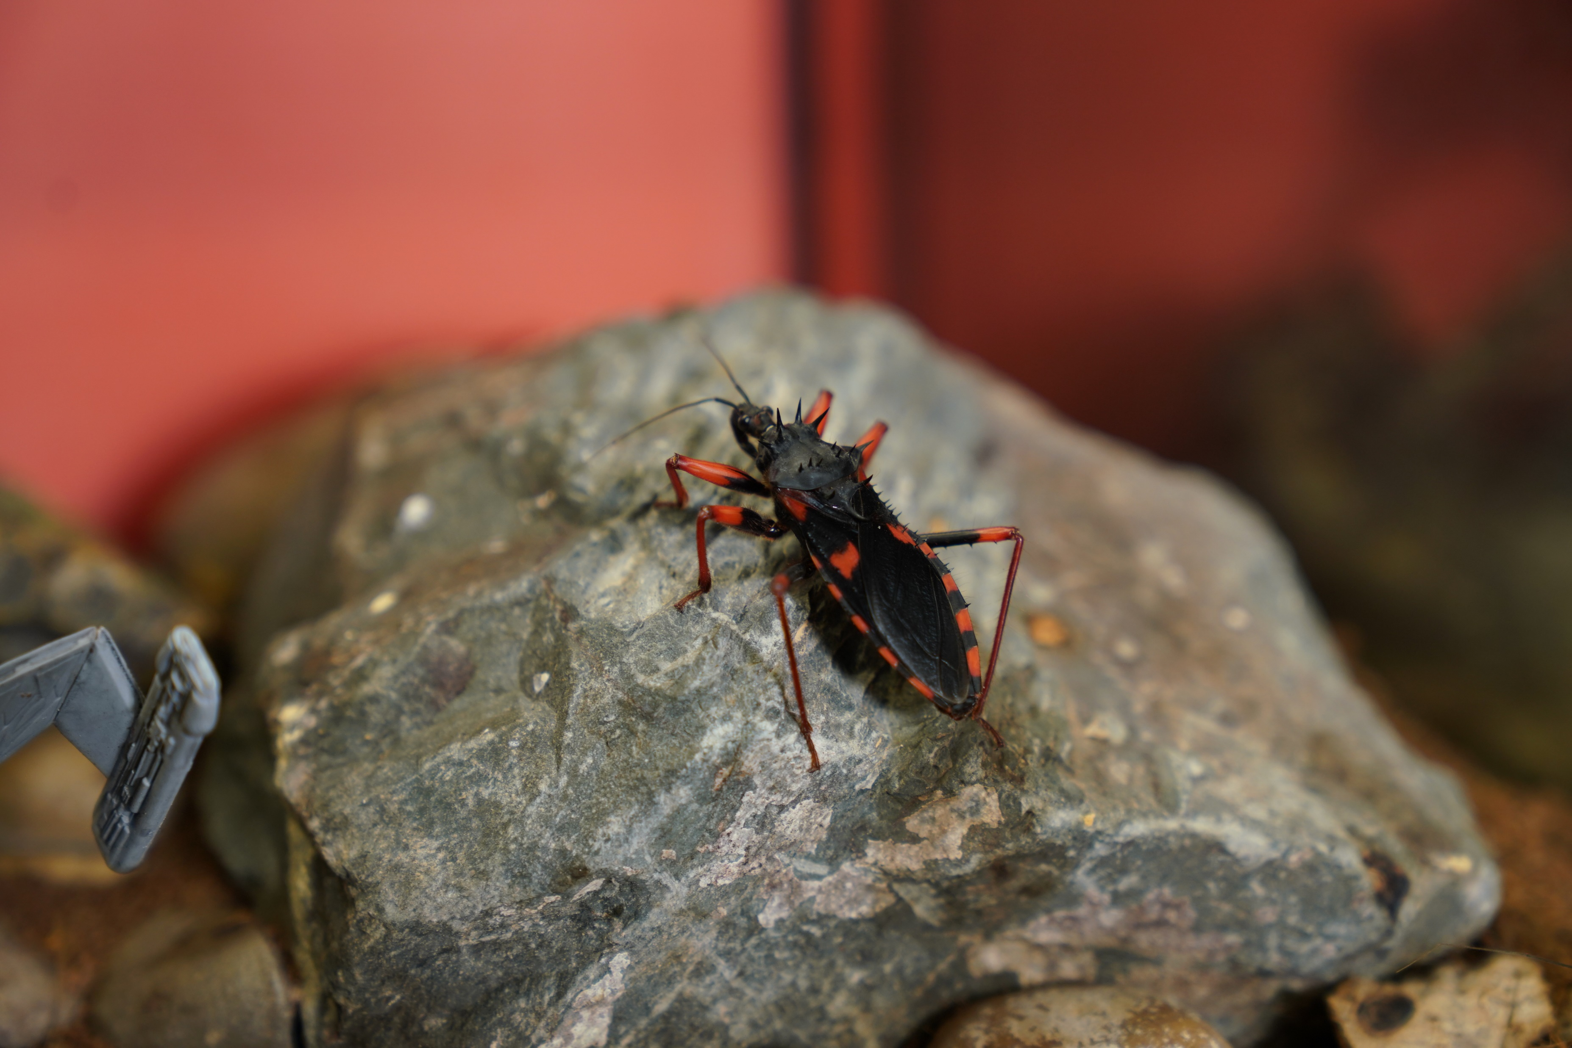
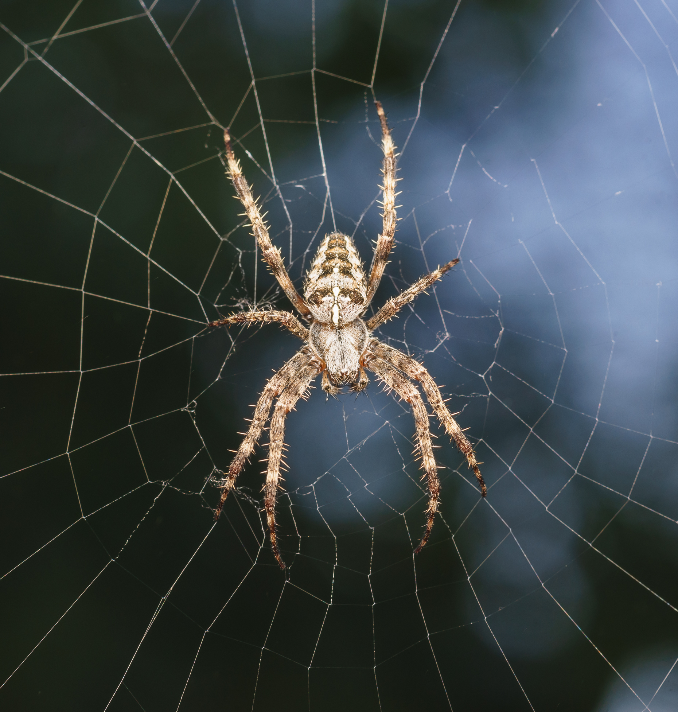
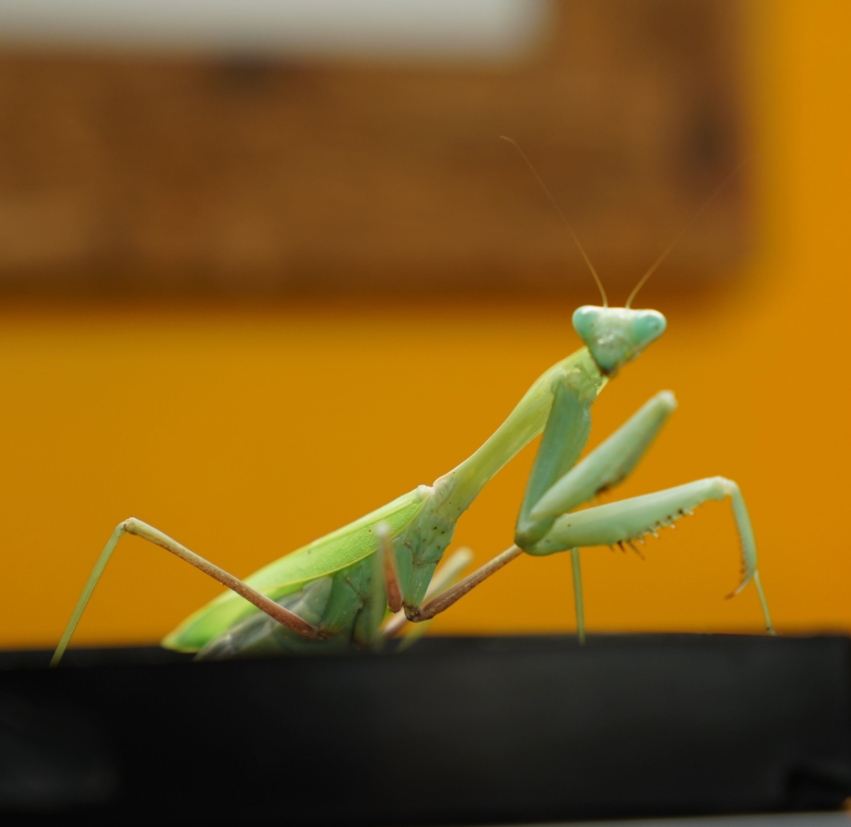
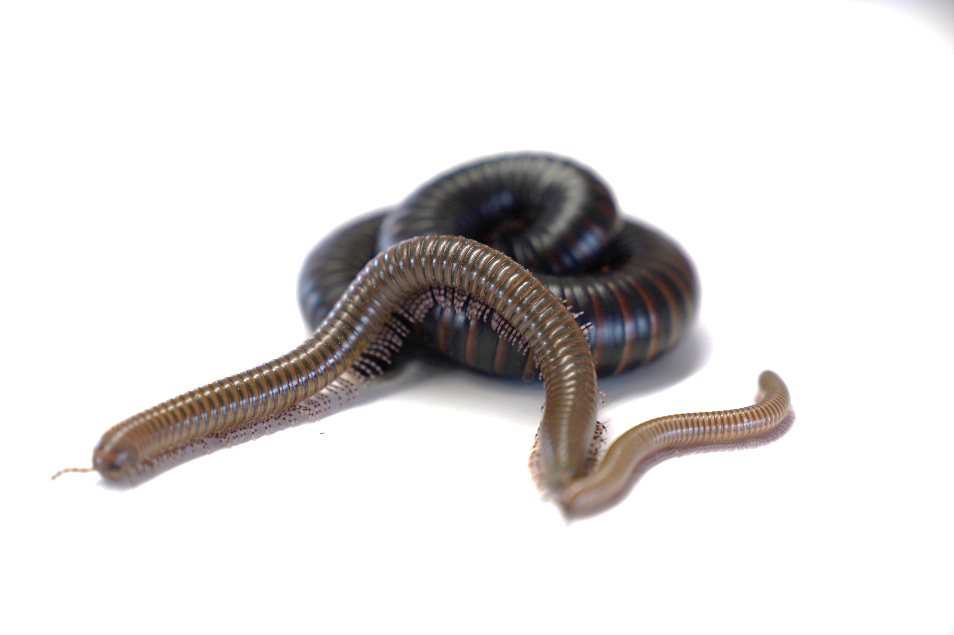
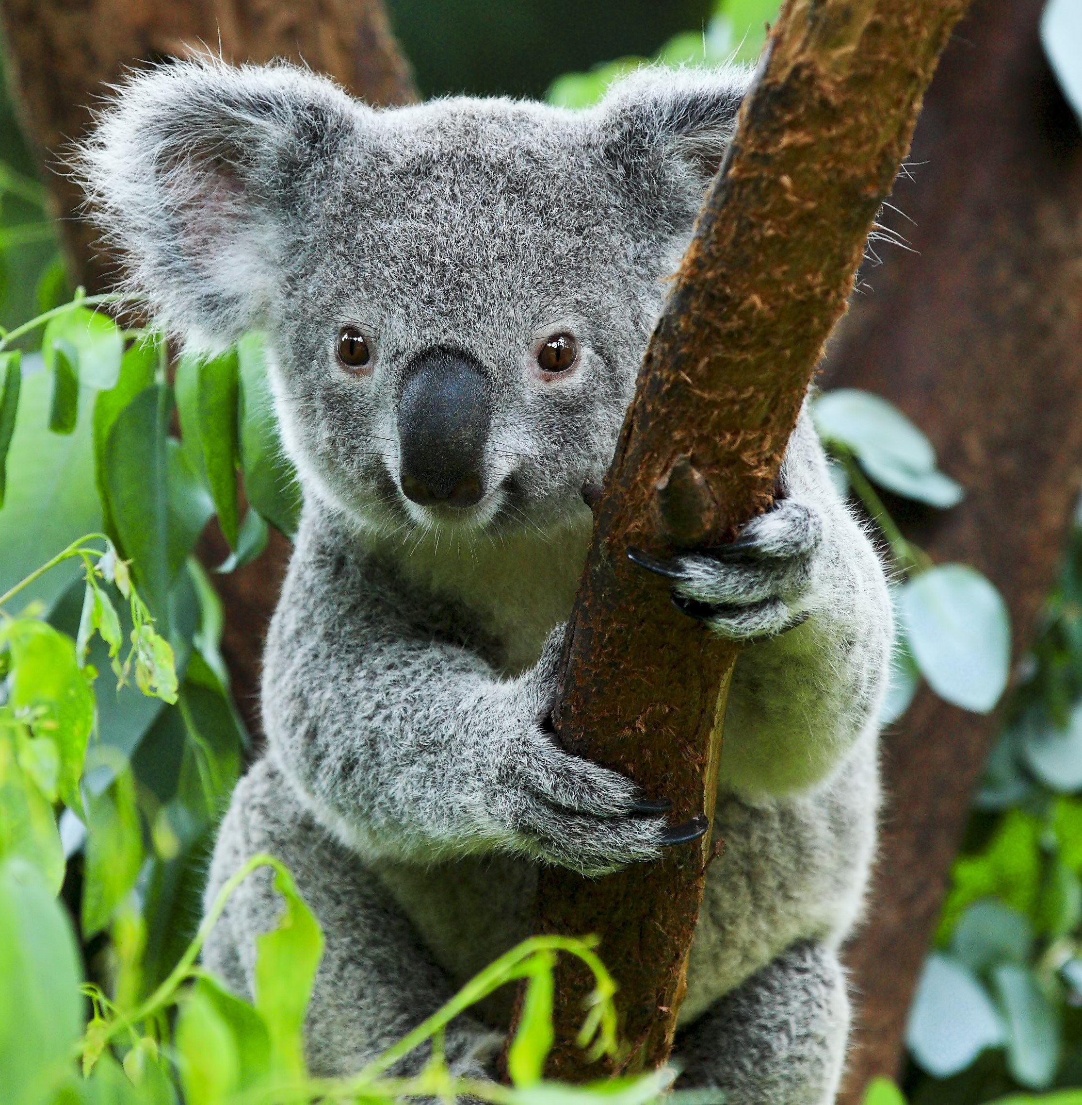
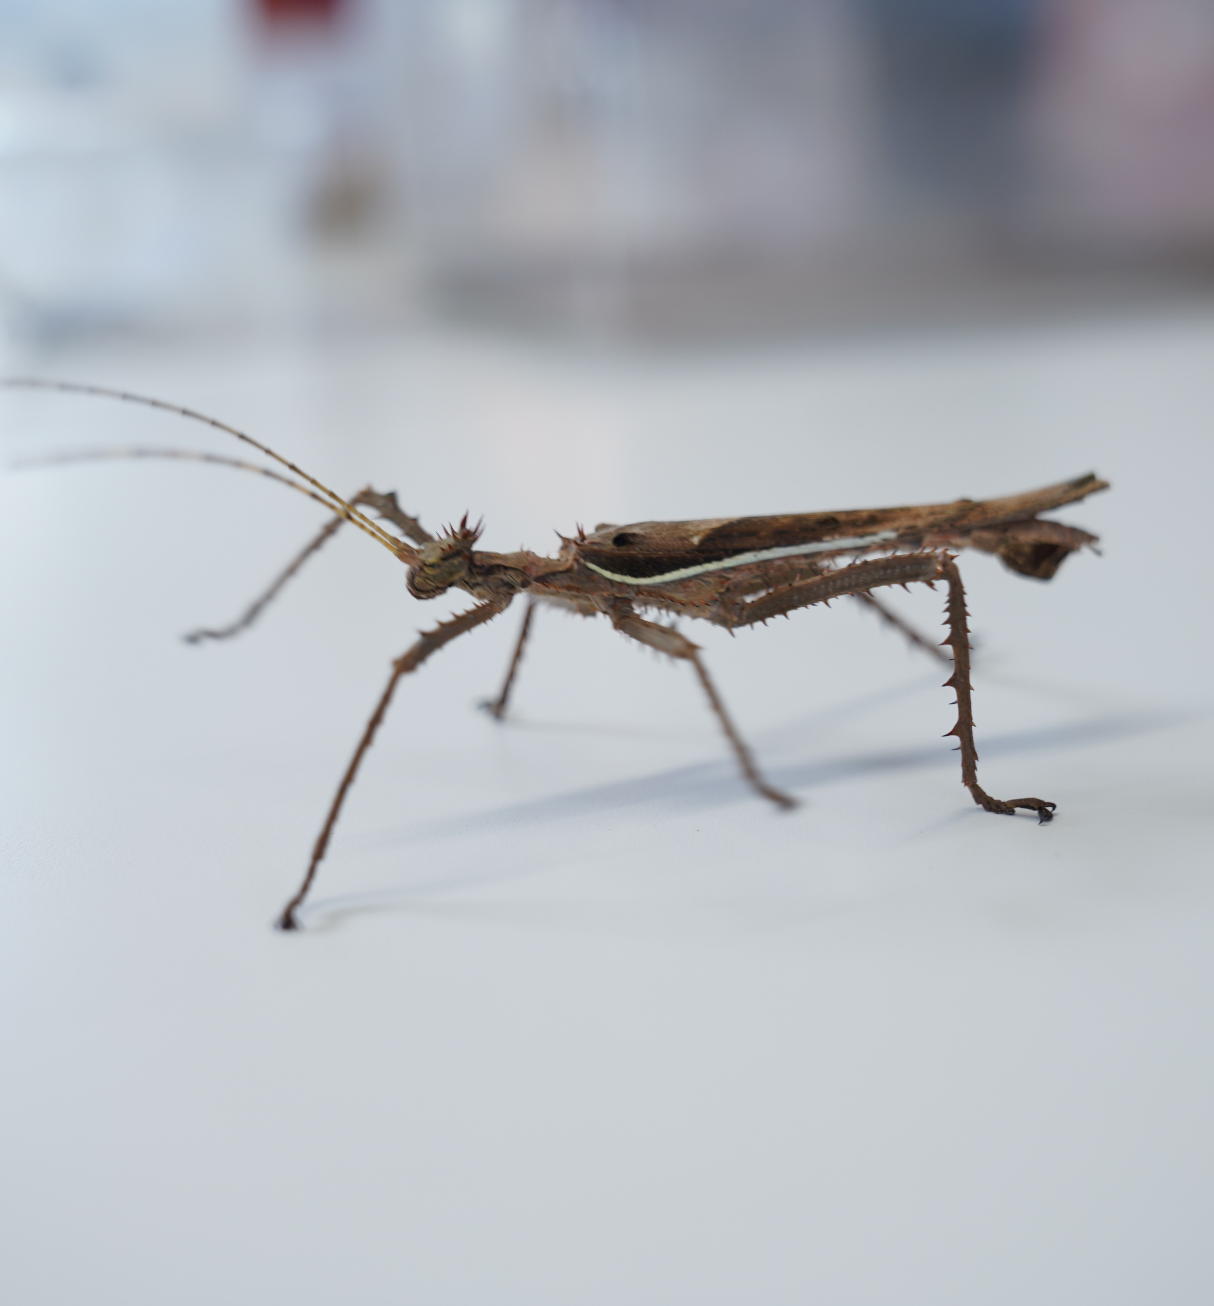
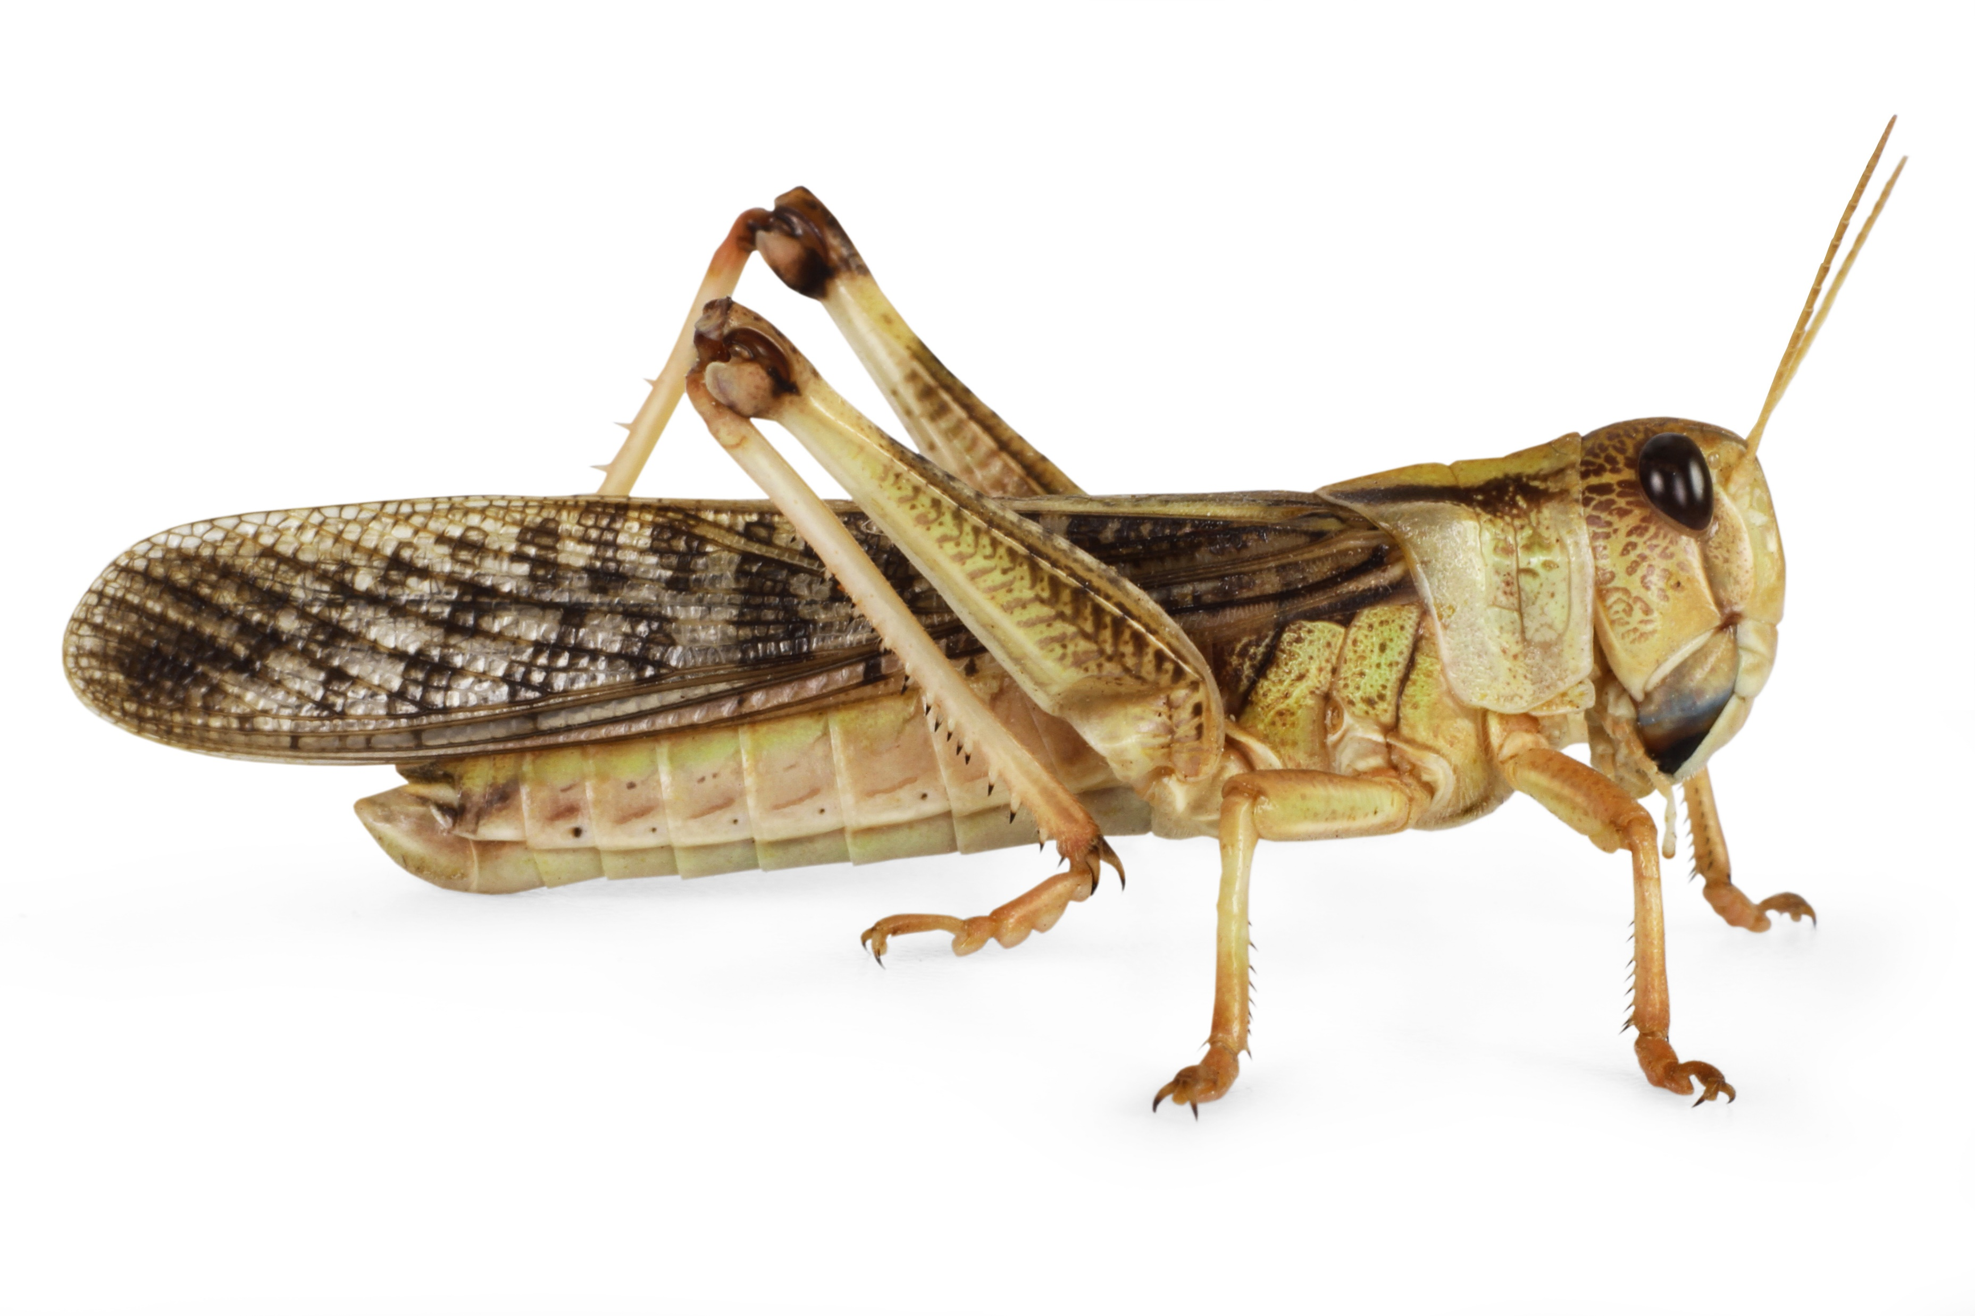
Mission Assignment: DE LIVE Lesson – Tick, tock, insects don’t stop
You’ll be told when to complete each activity.
Science Week 2024
Activity 1: Tick the insects
✓
Activity 2: Label the locust
abdomen
head
eye
wings
antenna
legs
thorax
How many…
legs? _____ antennae? _____ body parts? _____
Developing Experts Copyright 2024 All Rights Reserved

Slide 2
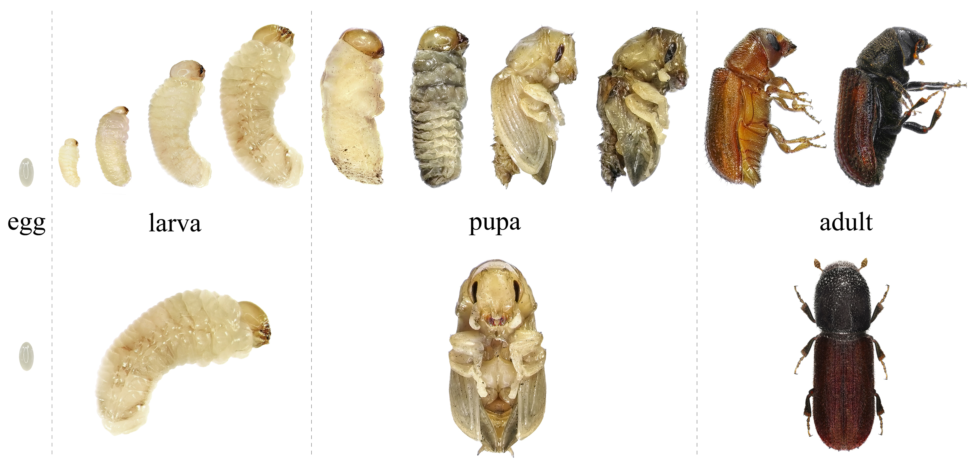
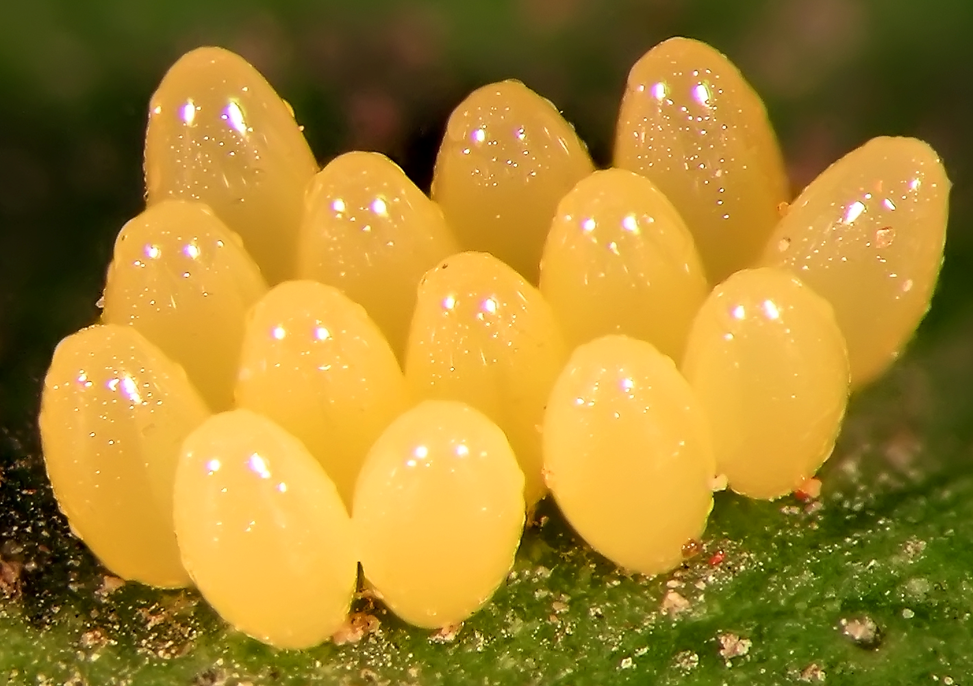
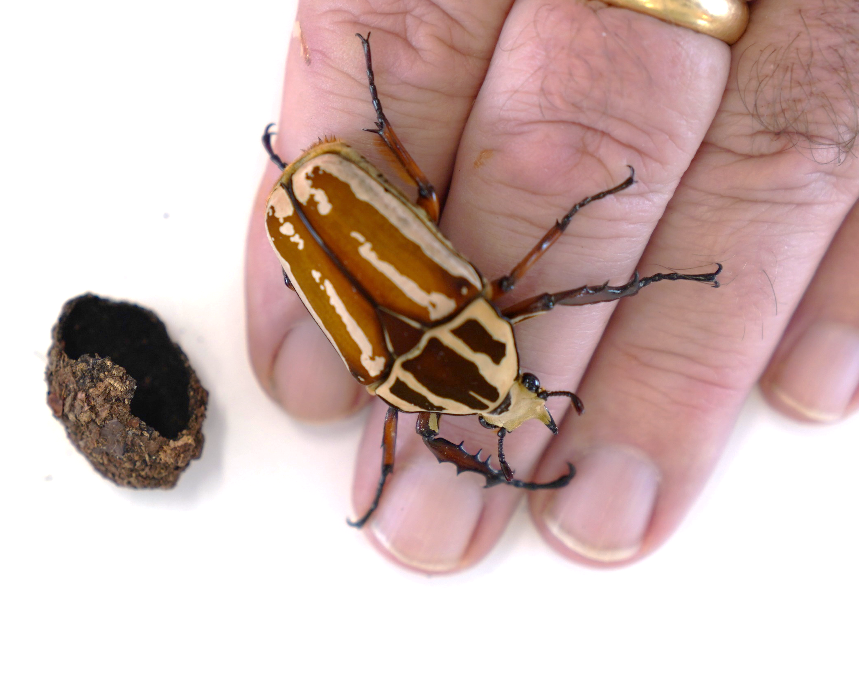

Mission Assignment: DE LIVE Lesson – Tick, tock, insects don’t stop
You’ll be told when to complete each activity.
Science Week 2024
Activity 3: Order the stages of a beetle’s life cycle
___________
___________
___________
___________
Word bank:
pupa adult egg larva
What is the larva stage of the flower beetle called? ____________
Activity 4: Spot the difference
What are some similarities and differences between an insect and a millipede?
insect
millipede
Developing Experts Copyright 2024 All Rights Reserved

