Slide 1


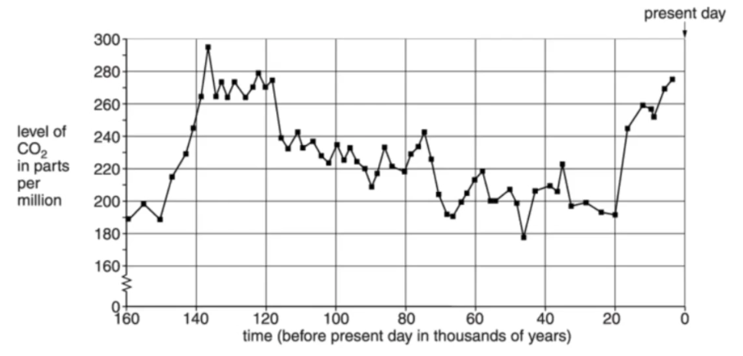
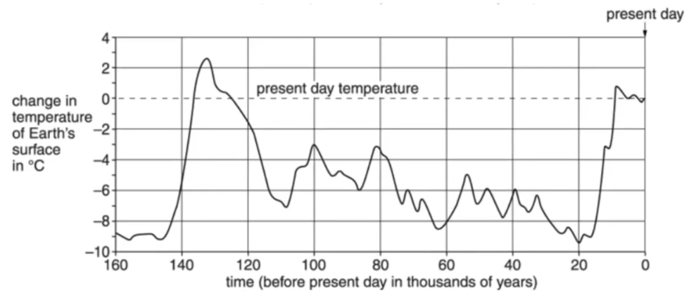
Mission Assignment: Explore global warming
Code: KS4_07_13
Examine temperature graphs and answer questions related to greenhouse effect and global warming
Task 1: Greenhouse effect and global warming
Some scientists say that an increase in global warming is part of a natural cycle.
Other scientists think that an increase in global warming will be disastrous for the world. They think that the surface temperature of the Earth is increasing and that this is because more fossil fuels are being burned.
Burning fossil fuels makes a lot of carbon dioxide.
Look at the graphs below. They show how the amount of carbon dioxide in the air and the temperature of the Earth have changed over the last 160 000 years.
Developing Experts Copyright 2022 All Rights Reserved

Slide 2
Mission Assignment: Explore global warming
Code: KS4_07_13
Task 1 (continued):
(A) What is the highest level of carbon dioxide in the air during the last 160 000 years?
__________________________________________________________________________________
(B) Describe what has happened to the surface temperature of the Earth in the last 160 000 years?
__________________________________________________________________________________ __________________________________________________________________________________ __________________________________________________________________________________
(C) Is there a link between the surface temperature of the Earth and the level of carbon dioxide in the air? Explain your answer. Use information from the graphs.
__________________________________________________________________________________ __________________________________________________________________________________ ____________________________________________________________________________________________________________________________________________________________________ __________________________________________________________________________________ __________________________________________________________________________________
Task 2: Some waste releases carbon dioxide and methane into the atmosphere. An increase in carbon dioxide and methane contributes to global warming. Global warming can cause sea levels to rise.
(A) Describe two other possible effects of global warming on our environment.
1.__________________________________________________________________________________________________________________________________________________________________2.__________________________________________________________________________________________________________________________________________________________________
(B) Storing the carbon dioxide helps to prevent more global warming. Carbon dioxide can be stored (sequestered) in trees when they photosynthesise.
Give one different way in which carbon dioxide is sequestered in our environment.
____________________________________________________________________________________________________________________________________________________________________
Developing Experts Copyright 2022 All Rights Reserved

