Slide 1

World Ocean Day: 8th June 2023
Create a cross section of the ocean. Label the seafloor at 2,000m and create another mark at 1,000m. Draw some ocean animals, cut them out and stick them on your collage in the appropriate location.

Slide 2
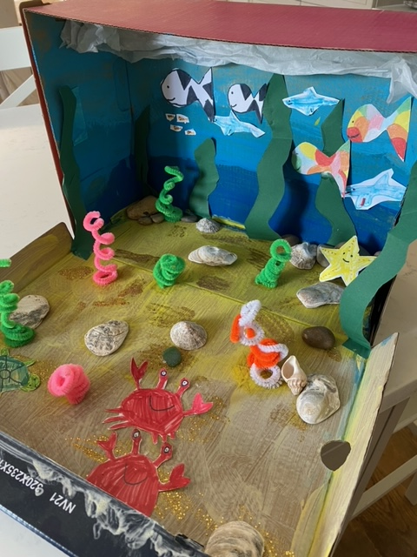
World Ocean Day: 8th June 2023
Create an ocean habitat in a shoe box
Plan your habitat here. What animals and plants do you need to include?

Slide 3
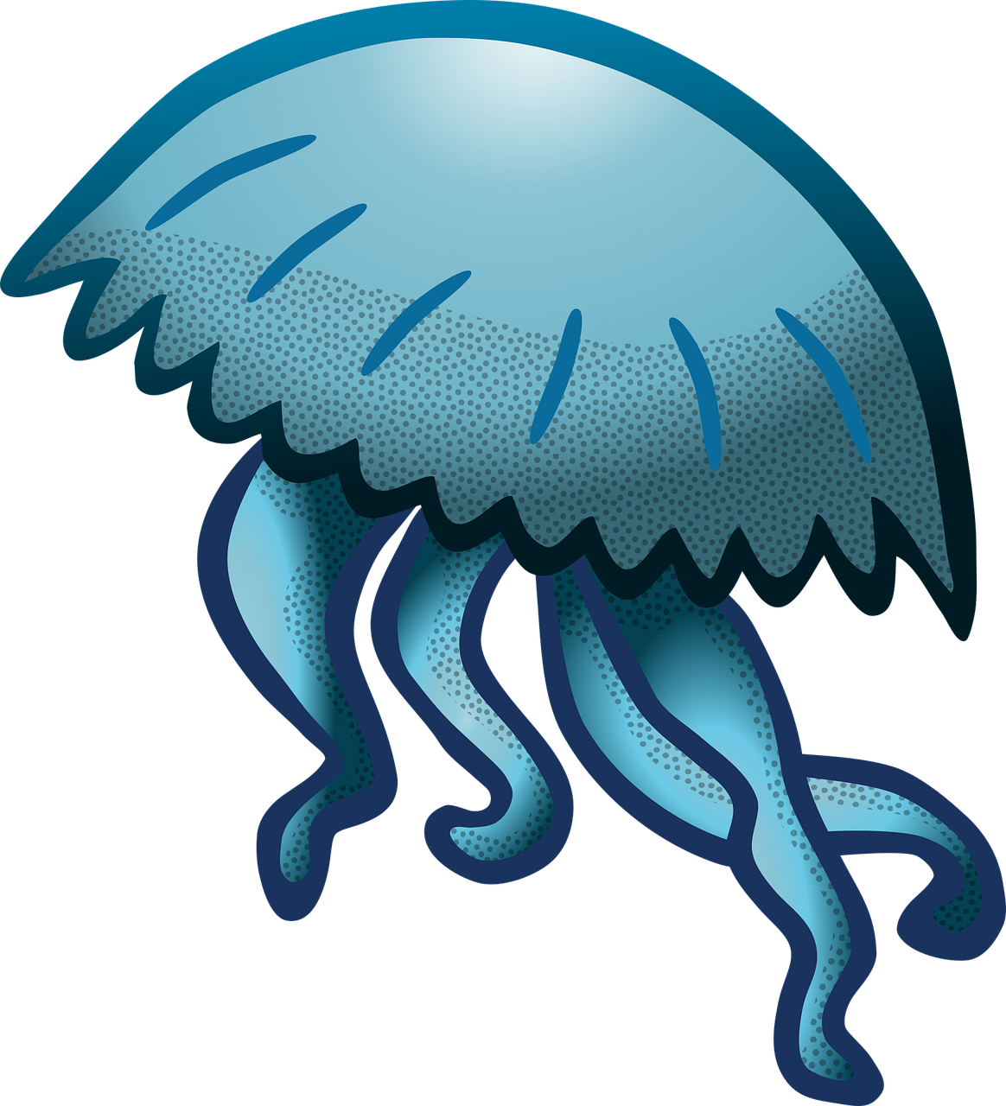
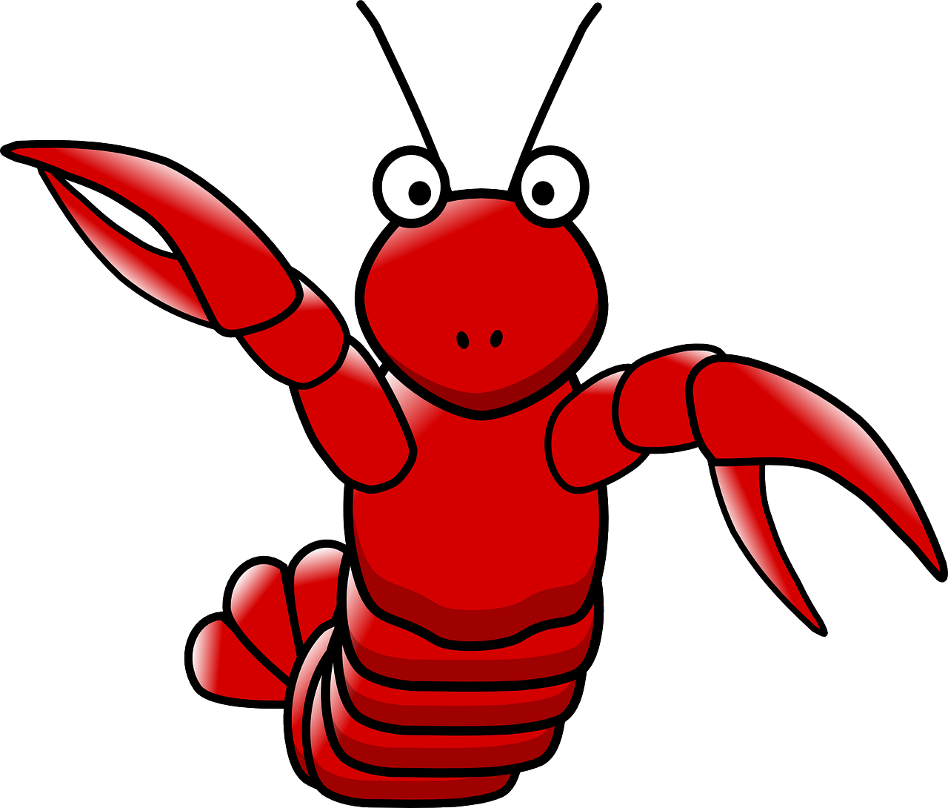
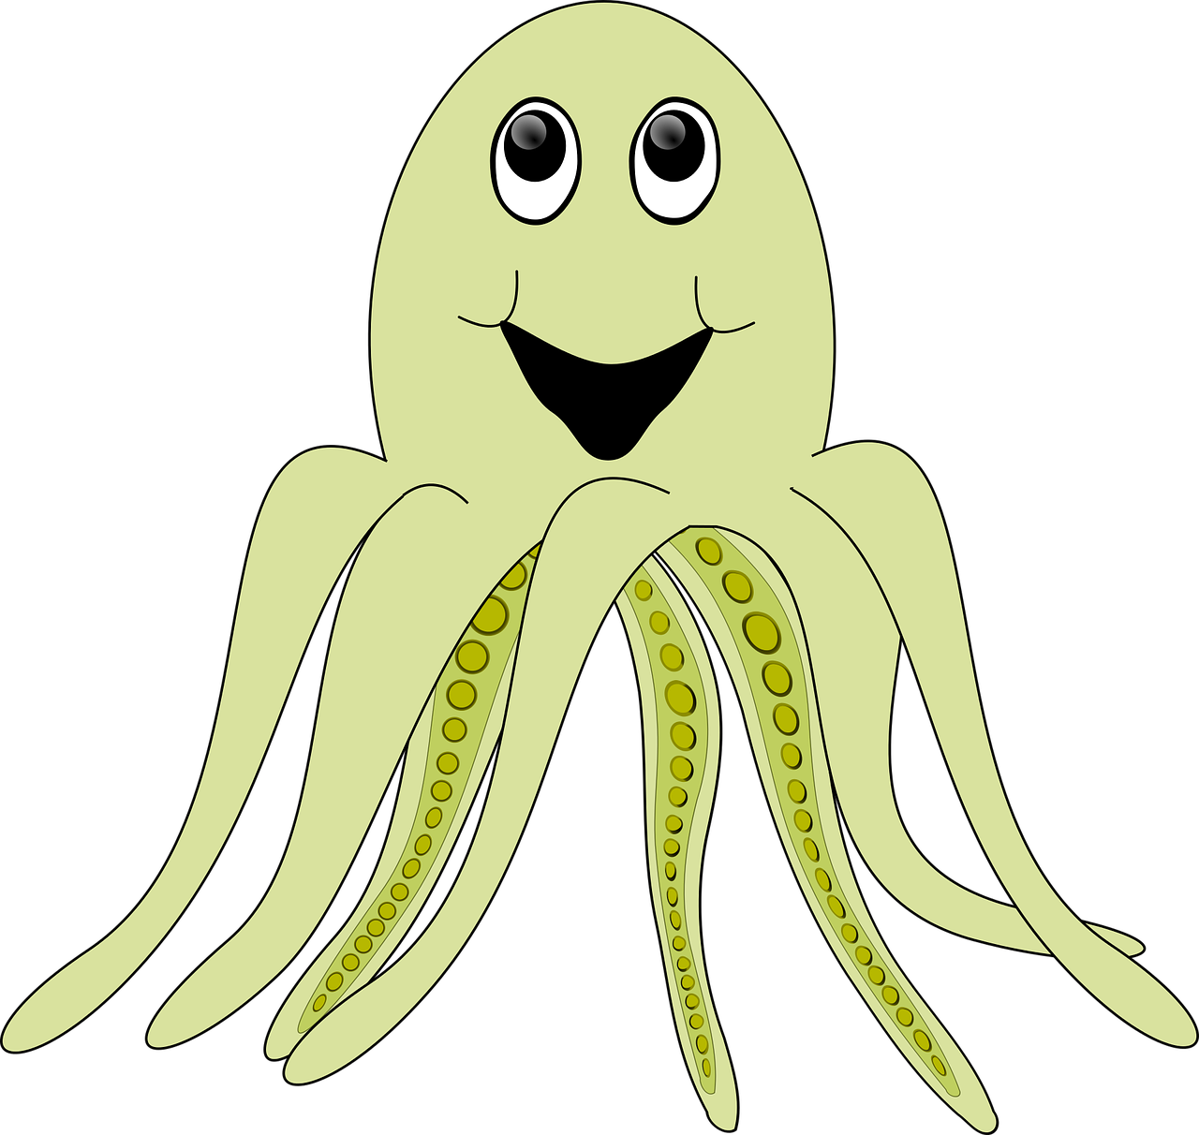
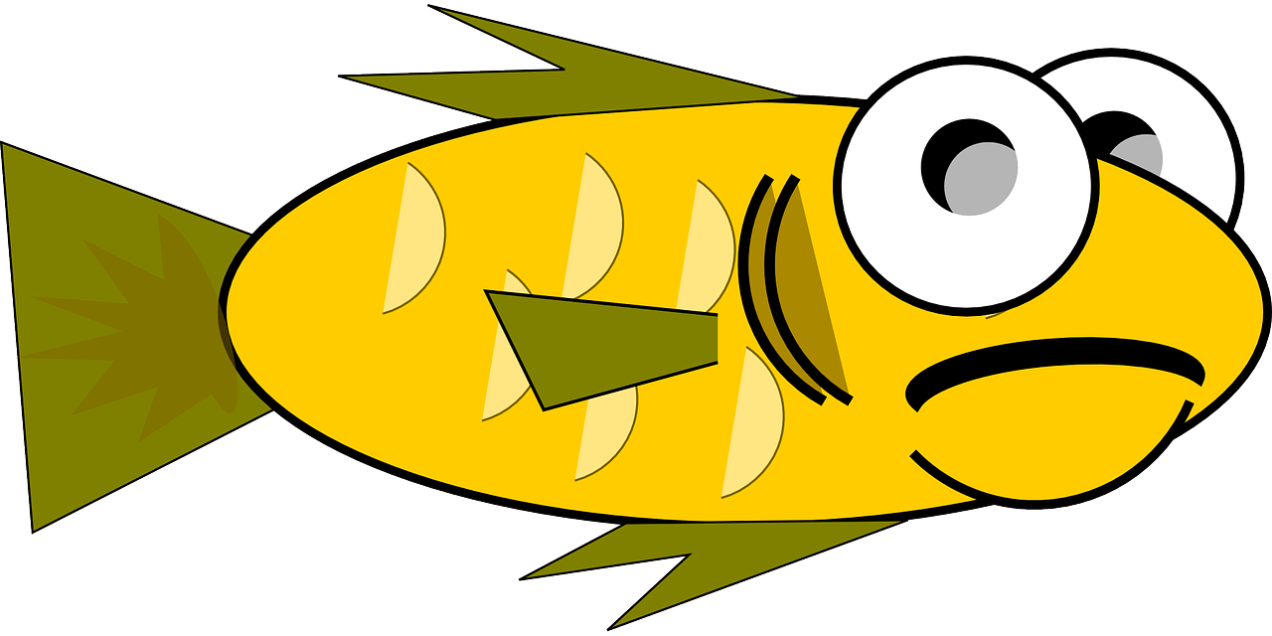
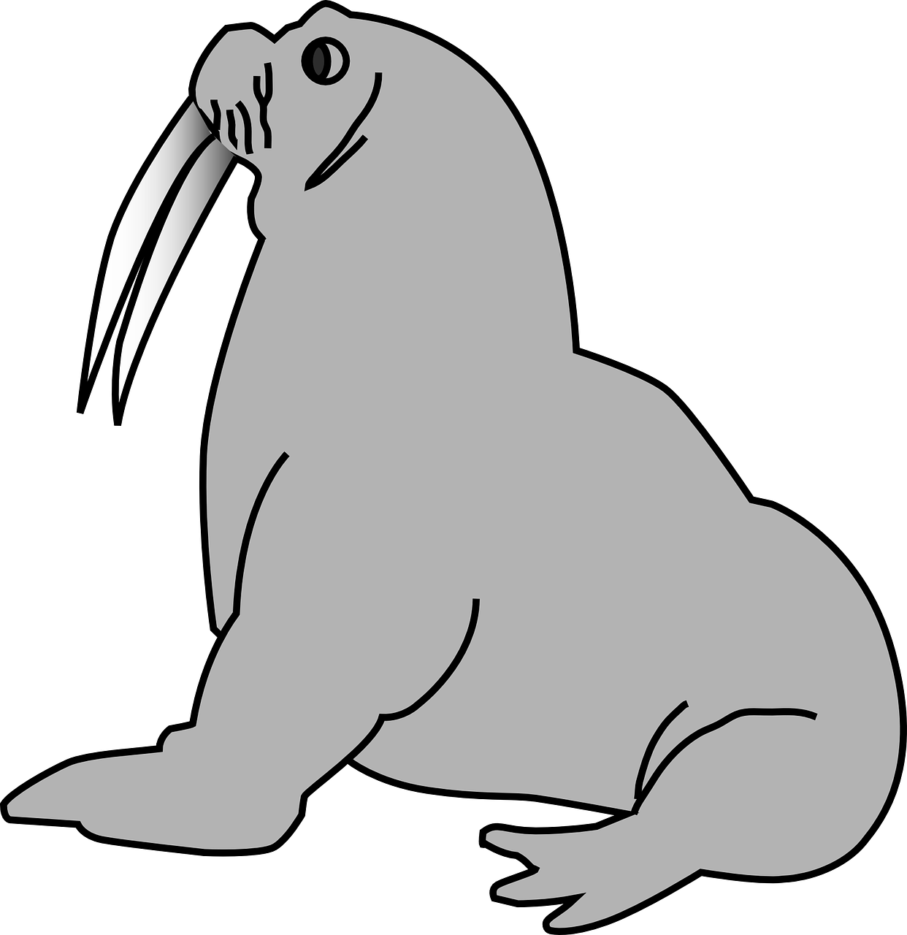
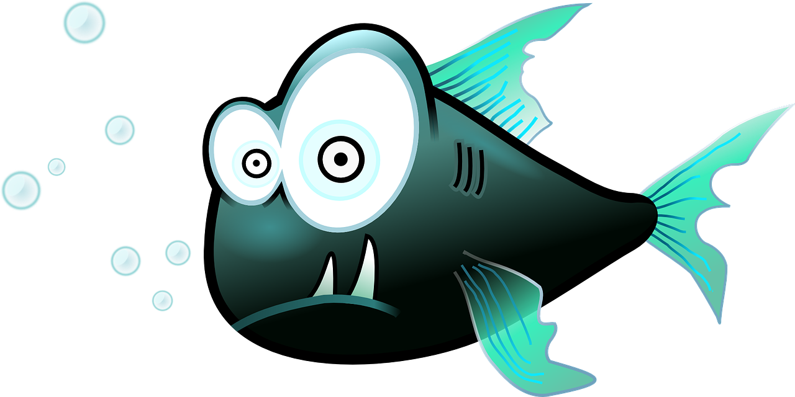
World Ocean Day: 8th June 2023
Create a fact file about your favourite ocean animal
My animal is a ______________________
It likes to eat ____________________________________________________________________________________________________________
Is your animal endangered? If yes, what do we need to do to help?
Endangered: Yes / No
What can we do? __________________________________________________________________________________________________________________________________________________________________________________________________________________________________________________________________________________________________________________________________________________________________________________________
Draw your animal in the space below.
How deep in the ocean does your animal live? Does it live in one specific area? Does it migrate? ____________________________________________________________________________________________________________________________________________________________________________________________________________________________________________________________________________________________________________________________________________________
Any other interesting facts: ____________________________________________________________________________________________________________________________________________________________________________________

Slide 4
World Ocean Day: 8th June 2023
Research tasks
Research an endangered ocean species. Outline the threats to its survival. _______________________________________________________________________________________________________________________________________________________________________________________________________________________________________________________________________________________________________________________________________________________________________________________________________________________________________________________________________________________________________________________________________________________________________________________________________
How can we preserve it? ____________________________________________________________________________________________________________________________________________________________________________________________________________________________________________________________________________________________________________________________
Research interesting areas of the ocean, such as the Great Blue Hole in Belize or the Seal Lion Caves in Oregon. What is the habitat like? _______________________________________________________________________________________________________________________________________________________________________________________________________________________________________________________________________________________________________________________________________________________________________________________________________________________________________________________________________________________________________________________________________________________________________________________________________
What sea creatures live there? _________________________________________________________________________________________________________________________________________________________________________________________________________________________________________________________________________

Slide 5
World Ocean Day: 8th June 2023
Research tasks
Research the different oceans on our planet. How are they different? What are the different species that live there? _______________________________________________________________________________________________________________________________________________________________________________________________________________________________________________________________________________________________________________________________________________________________________________________________________________________________________________________________________________________________________________________________________________________________________________________________________________________________________________________________________________________________________________________________________________________________________________________________________________________________________________________________________________________________________________________________________________________________________________________________________________________________________________
Why are coral reefs so important for our ecosystem? Research which countries you can find coral reefs, their importance to the environment and which species thrive there. __________________________________________________________________________________________________________________________________________________________________________________________________________________________________________________________________________________________________________________________________________________________________________________________________________________________________________________________________________________________________________________________________________________________________________________________________________________________________________________________________________________________________________________________________________________________________________________________________________________________________________________________________________________________________________________________________________________________________________________________

Slide 6
World Ocean Day: 8th June 2023
Research ocean craters
Research the impact craters that have been created on the ocean floor. Find out what lives in these craters. ____________________________________________________________________________________________________________________________________________________________________________________________________________________________________________________________________________________________________________________________________________________________________________________________________________________________________________________________________________________________________________________________________________________________________________________________________________________________________________________________________________________________________________________________________________________________________________________________________________________________________________________________________________________________________________________________________________________________________________________________________________________________________________________________________________________________________
Plot a graph to show the different depths.

Slide 7
World Ocean Day: 8th June 2023
Write a persuasive letter or article about the impact climate change, single use plastic and littering is having on our ocean habitats. What needs to be done to protect our oceans and its wildlife?
Letter
______________
______________
______________
______________
______________
______________
______________
________________________________________________________________________________________________________________________________________________________________________________________________________________________________________________________________________________________________________________________________________________________________________________________________________________________________________________________________________________________________________________________________________________________________________________________________________________________________________________________________________________________________________________________________
____________________
Article
____________________________________________________________________________________________________________________________________________________________________________________________________________________________________________________________________________________________________________________________________________________________________________________________________________________________________________________________________________________________________________________________________________________________________________________________________________________________________________________________________________________________________________________________________________________________________________________________________________________________________________________________________________________________________________________________________________________________________________________________________________________________________________________________________________________________________________________________________________________________________________________________________________________________________________________________________________________________________________________________________________________________________________________________________________________

Slide 8
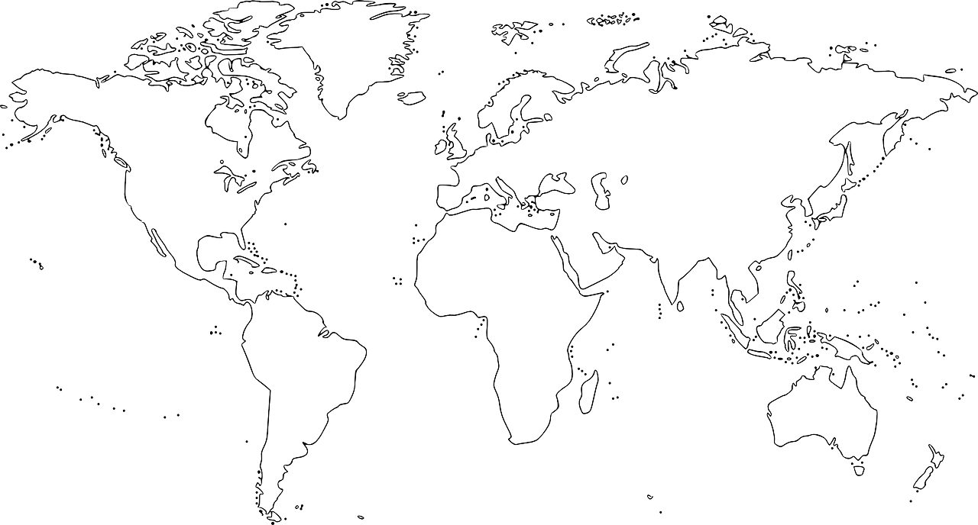
World Ocean Day: 8th June 2023
Plot a route for a cargo ship to travel from one side of the Earth to another
Can you work out the distance the ship would travel?
My ship would be able to dock at these main cities:
1. ________________ 2. ________________ 3. _________________ 4. _____________

Slide 9
World Ocean Day: 8th June 2023
Investigate the effect of salt water on different materials
Resources and materials needed: ______________________________________________________________________________________________________________________________________________________________________________________________________
A diagram of my investigation:
Investigation steps:
______________________________________________________________________________________
______________________________________________________________________________________
______________________________________________________________________________________
______________________________________________________________________________________
______________________________________________________________________________________
______________________________________________________________________________________
______________________________________________________________________________________
My hypothesis: _______________________________________________________________________________________________________________________________________________________________________________________________________________________________________________________________________________________
The variable I am testing is: _______________________________
My results: _____________________________________________________________________________________________________________________________________________________________________________________________

Slide 10
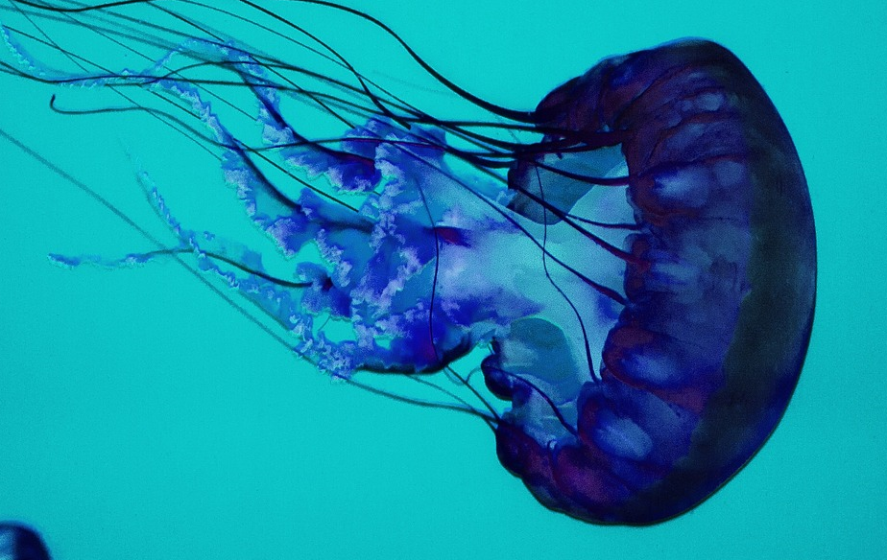
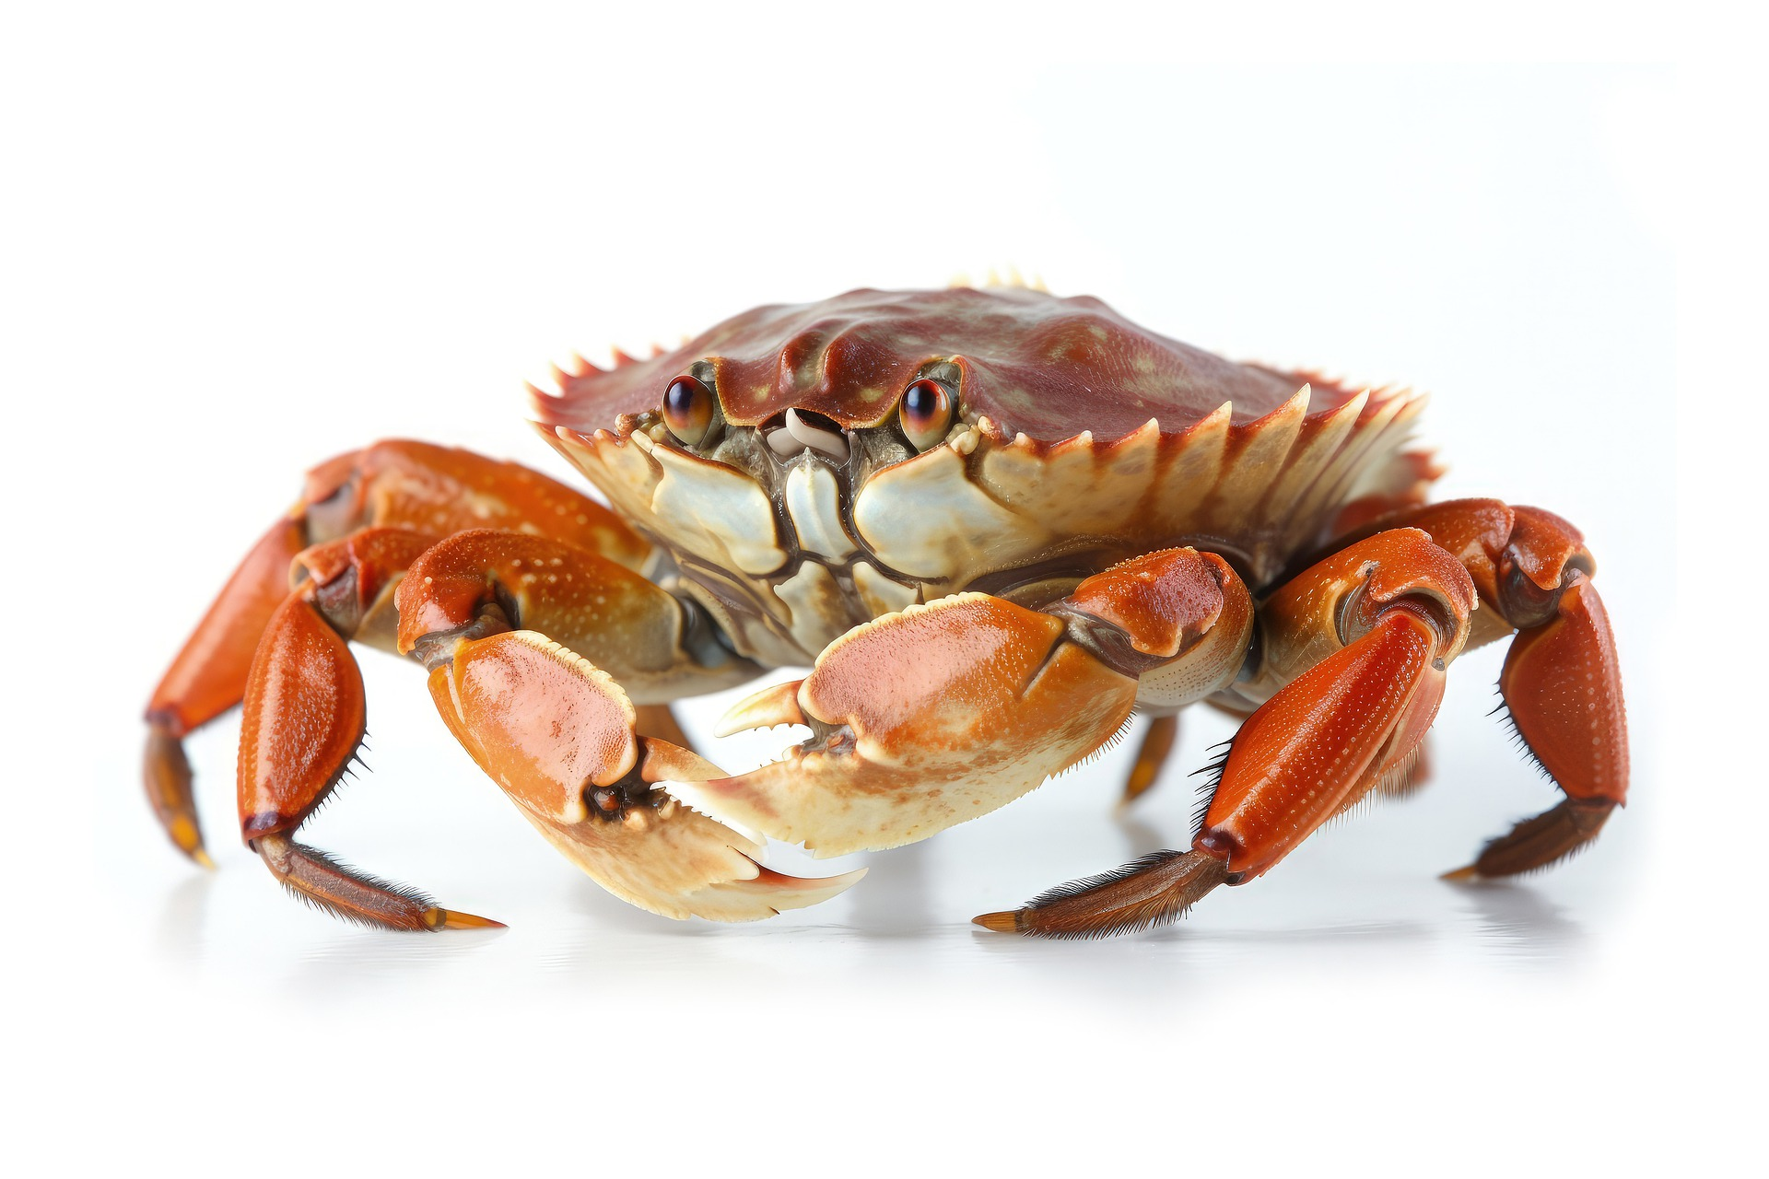
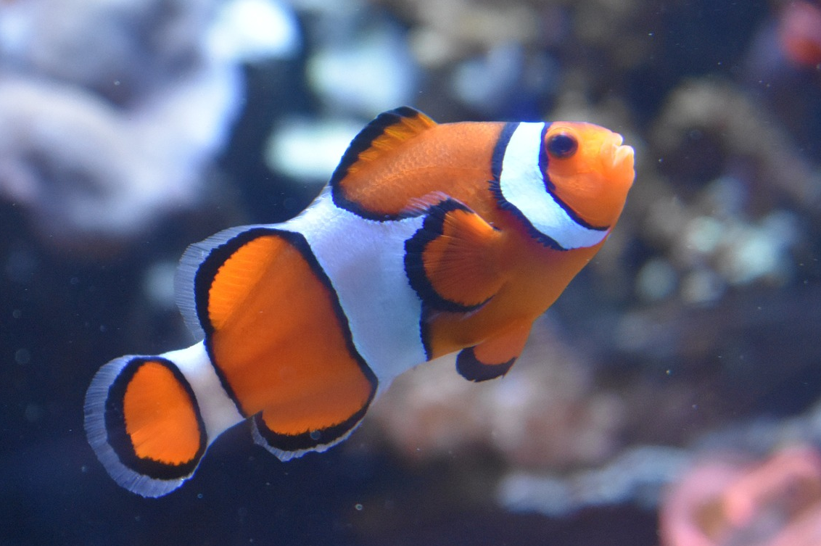
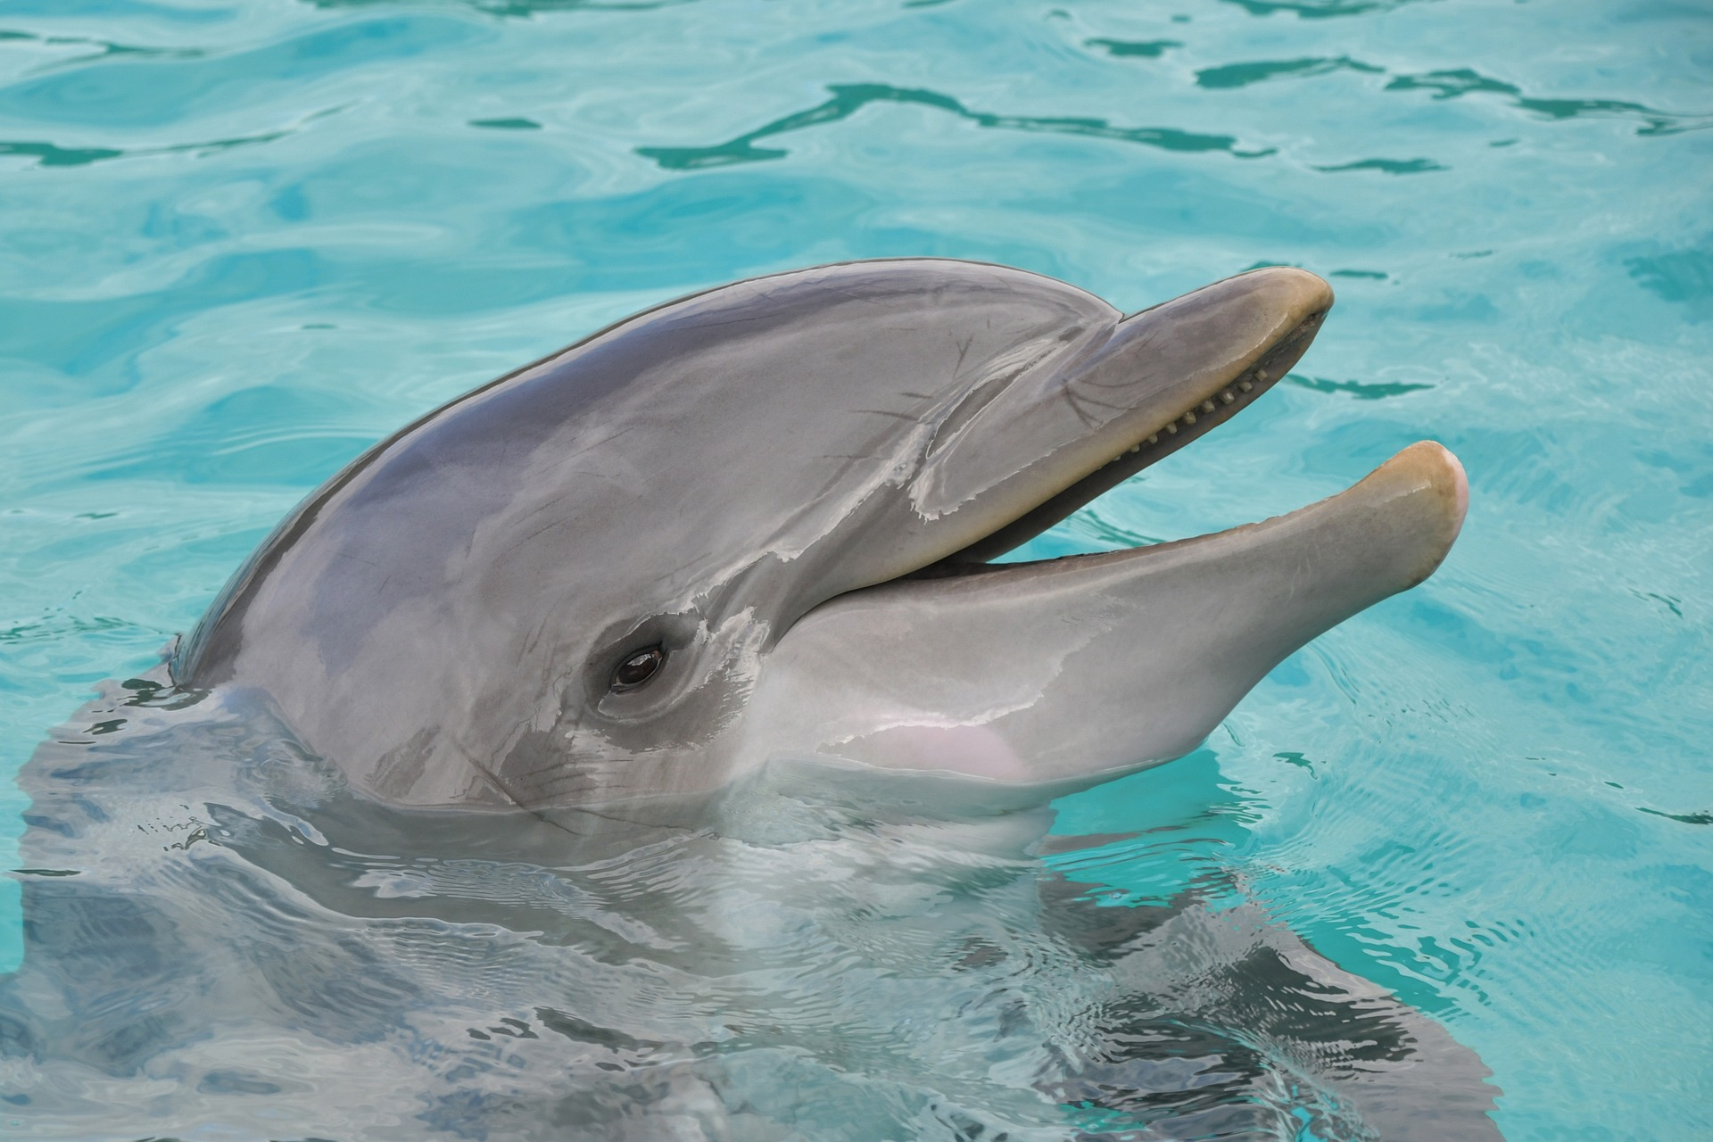
World Ocean Day: 8th June 2023
Your teacher has asked you to complete a scuba diving mission in the ocean. Complete the steps below to find out about ocean life and complete your mission.
1. Firstly, you need to wear the right gear! Draw a wetsuit, googles and flippers below.
2. Next, you need to make sure you know what you’re looking for! Match the pictures with the correct description.
A sea animal with a hard shell on its body, eight legs, and two big pincers. It likes to walk sideways and lives near the ocean or beaches.
A smart and playful marine animal that lives in the ocean. It has a sleek body, fins and a dorsal fin on its back.
A sea creature which looks like a transparent umbrella or a floating blob with long tentacles.
A small, colourful fish that lives in the ocean. It has bright orange and white stripes on its body, which make it look like it's wearing a clown costume.

Slide 11
World Ocean Day: 8th June 2023
Next, make sure you know how to complete your mission safely. Read the text below to be prepared.
The ocean, covering more than 70% of our planet, is a mysterious and fascinating realm filled with awe-inspiring creatures and breath-taking depths. Let's dive into the depths of knowledge about the wonders of the sea! As you descend deeper, the pressure increases quickly. At 100 meters below the surface, the pressure is equivalent to having an elephant standing on your thumb! The Mariana Trench, the deepest part of the ocean, plunges a staggering 11 kilometres below sea level, reaching pressures over 1,000 times greater than at the surface. While the ocean provides habitats for a diverse range of marine life, it also faces various threats. Pollution poses a significant challenge, with plastics and chemicals endangering the health of marine species. Every year, an estimated 8 million tons of plastic waste enter the ocean, harming countless creatures. Additionally, oil spills and chemical runoff from land contribute to water pollution, disrupting delicate marine ecosystems. Invasive species are another concern for our oceans. These are species that enter new environments and outcompete native species, upsetting the natural balance. One example is the lionfish, originally from the Indo-Pacific region but now an invader in the Atlantic. Lionfish reproduce rapidly, consuming native fish and damaging coral reefs. To address this issue, experts encourage responsible fishing practices and the development of early detection systems to prevent further harm.
Did you know that the blue whale, the largest animal on Earth, can reach lengths of up to 30 meters and weigh as much as 200 tons? It has a heart the size of a car and its tongue alone weighs as much as an elephant! Another astonishing creature is the humpback whale, famous for its beautiful songs that can travel hundreds of kilometres through the water. Speaking of impressive statistics, coral reefs are among the most biodiverse ecosystems on the planet, providing a home for an estimated 25% of marine species. Sadly, these invaluable habitats are under threat due to rising ocean temperatures, leading to coral bleaching events. Efforts to reduce carbon emissions and protect coral reefs are vital to preserving this fragile ecosystem.

Slide 12
World Ocean Day: 8th June 2023
Now, you’re ready to dive! Answer the questions below to guide yourself through your mission.
You descend downwards slowly. What increases as you dive deeper?
The saltiness of the water.
The pressure of the water.
The number of sea creatures.
The temperature of the water.
2. You can see a small trench in front of you. You know the ocean contains lots of trenches. What is the name of the deepest one?
The Tonga trench.
The Java trench.
The Mariana trench.
The American trench.
3. You spot some plastic floating in the water. How much plastic waste enters the ocean each year?
4 million tons.
6 million tons.
8 million tons.
4. As you dive deeper, you notice a striped fish with long, flowing fins. You know that this is a lionfish. Since you are diving in the Atlantic, it doesn’t belong here. What is the name given to this kind of species?
Intrepid species.
Invasive species.
Irritable species.
5. What do you do next?
Remember to let your teacher know so that they can record the sighting of the lionfish.
Ignore it – it’ll swim away eventually.
6. As you swim along, you notice lots of different fish and sea life. What is the biggest animal on Earth?
The saltwater crocodile.
The whale shark.
The southern elephant seal.
The blue whale.
7. You swim by a beautiful coral reef. What percentage of marine species live in coral reefs?
10%.
22%.
25% .
30%.
8. Why are coral reefs under threat?
Rising ocean temperatures.
Growing populations of clownfish.
Falling ocean temperatures.
Answer key:
1 – b, 2 – c, 3 – c, 4 – b, 5 – a, 6 – d, 7 – c, 8 - a. Give 2 points for each correct answer.
0-6 points: Keep practicing your diving!
7-11 points: You’re doing well!
12-16 points: You’re a diving enthusiast!

