Slide 1
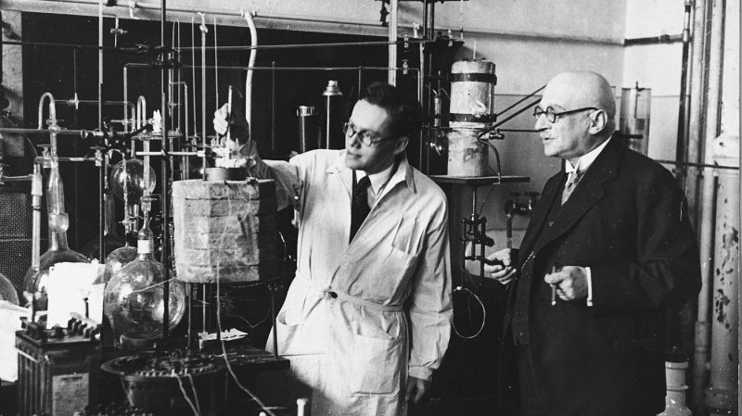
Why do you think Haber won the Nobel Prize in Chemistry in 1931?
Developing Experts All rights reserved © 2021

Slide 2
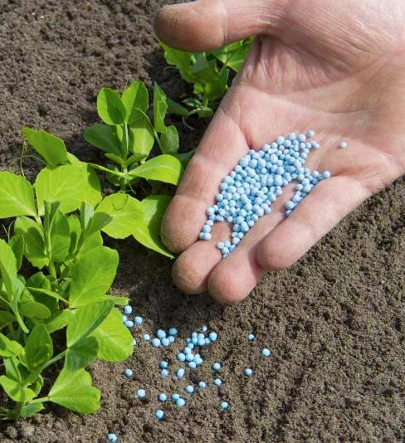

Explore making ammonia and the Haber process
Describe the Haber process for the manufacture of ammonia.
Explain how the conditions for the Haber process are selected to maximize the yield of ammonia. (Higher tier)
Developing Experts All rights reserved © 2021

Slide 3
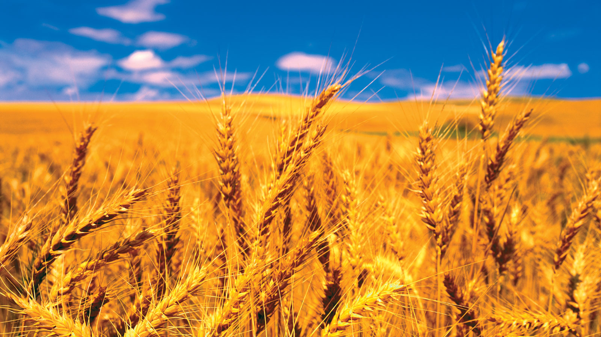

nitrogen
hydrogen
iron catalyst
ammonia
N2
+
3H2
2NH3
(g)
(g)
(g)
Developing Experts All rights reserved © 2021

Slide 4
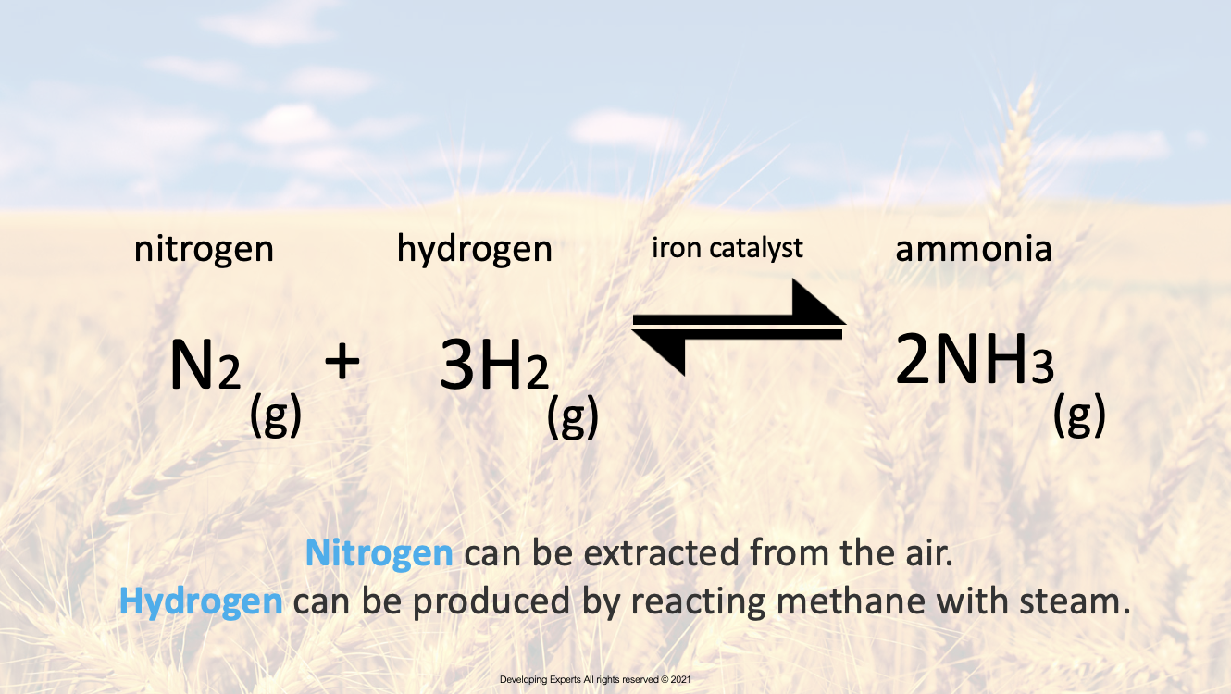

Slide 5
nitrogen
hydrogen
iron catalyst
ammonia
N2
+
3H2
2NH3
(g)
(g)
(g)
This causes some of the nitrogen and hydrogen molecules to react, and that forms ammonia. This is a reversible reaction, some of the ammonia breaks back down into nitrogen and hydrogen. To increase the yield, we now cool the ammonia and that turns into a liquid which is removed.
Developing Experts All rights reserved © 2021

Slide 6
nitrogen
hydrogen
iron catalyst
ammonia
N2
+
3H2
2NH3
(g)
(g)
(g)
We can then recycle the unreacted nitrogen and hydrogen back over the catalyst.
Higher tier students: You’ll need to be able to explain how the conditions for the Haber process are chosen to increase the yield.
Developing Experts All rights reserved © 2021

Slide 7
nitrogen
hydrogen
iron catalyst
ammonia
N2
+
3H2
2NH3
(g)
(g)
(g)
If a system is at equilibrium and a change is made to any of the conditions, then the system responds to counteract the change.
We can adjust the temperature and pressure to shift the position of the equilibrium towards the right-hand side, in the words, to produce more ammonia.
Developing Experts All rights reserved © 2021

Slide 8
nitrogen
hydrogen
iron catalyst
ammonia
N2
+
3H2
2NH3
(g)
(g)
(g)
In the case of the Haber process, the forward reaction is exothermic. This means that a relatively cool temperature will shift the equilibrium to the right-hand side. The problem is that a cool temperature makes a reaction slow. We've got a trade-off between the rate of reaction and the position of the equilibrium.
Developing Experts All rights reserved © 2021

Slide 9
nitrogen
hydrogen
iron catalyst
ammonia
N2
+
3H2
2NH3
(g)
(g)
(g)
That means that 450 degrees Celsius is a compromised temperature. We get a relatively fast rate and a relatively high yield of ammonia. The iron catalyst also increases the rate of the reaction. Pressure also affects the equilibrium. In the case of the Haber process, a high pressure will push equilibrium to the right-hand side.
Developing Experts All rights reserved © 2021

Slide 10

0
80
350 C
60
0
450 C
40
Percentage ammonia at equilibrium (%)
0
550 C
20
100
200
300
400
Pressure (atmosphere)
Developing Experts All rights reserved © 2021

